Slide 1
Geography and the Ancient Greeks

Slide 2
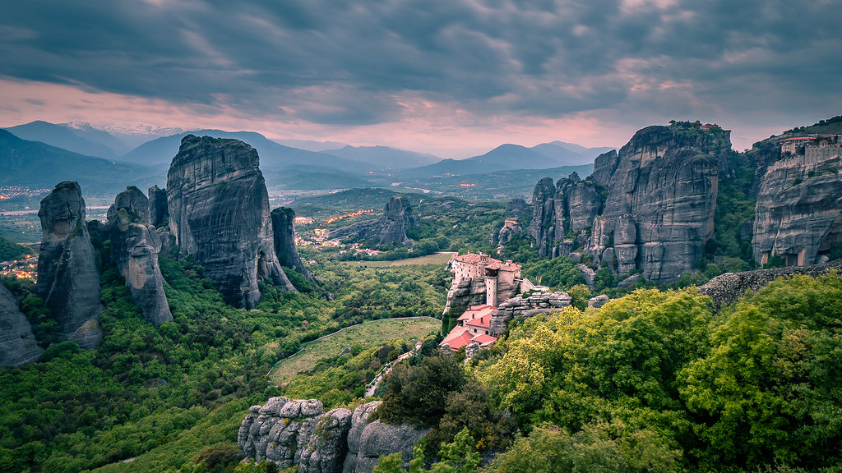
What do the physical features of this image tell you about Greece's land?
"Meteora - Greece - Landscape photography" by Giuseppe Milo (www.pixael.com) is licensed under CC BY 2.0

Slide 3
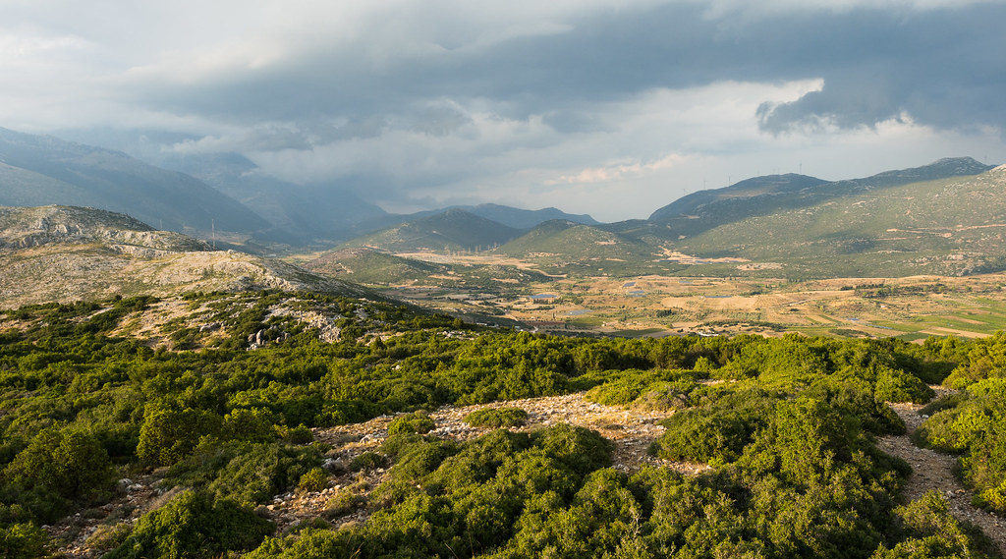
How could such an environment affect human life?
"1-79 - 2014_09_14 - 03134 q3 Greece Boetia boetia, greece, landscape" by John Van Atta is licensed under CC BY-NC-SA 2.0

Slide 4
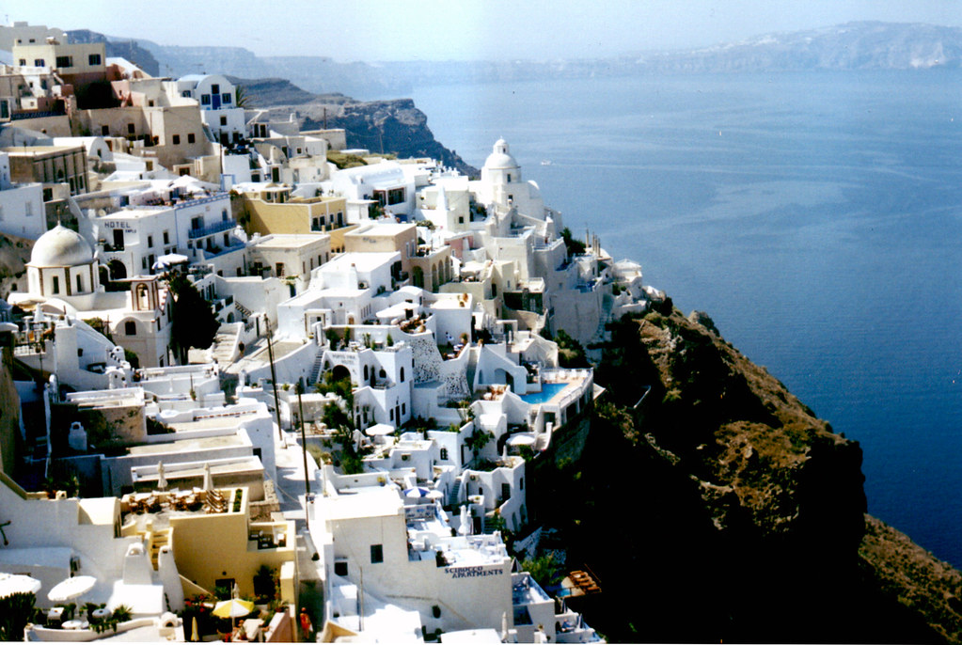
What things would the Greeks need to survive (meet their basic needs)?
"Santorini_02" by ancasta1901 is licensed under CC BY 2.0

Slide 5
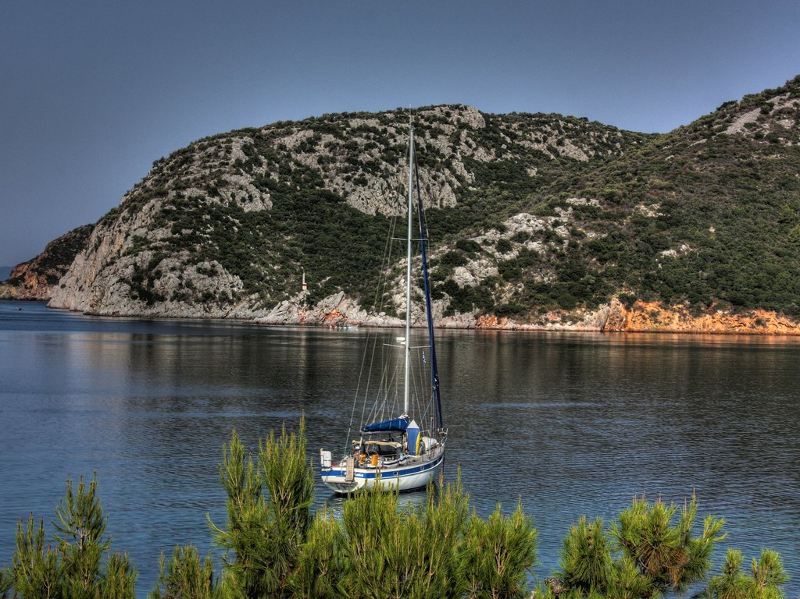
What natural resources did they have?
"Sailboat at Porto Koufo" by Klearchos Kapoutsis is licensed under CC BY 2.0

