Slide 1
Arizona Dams

Slide 2
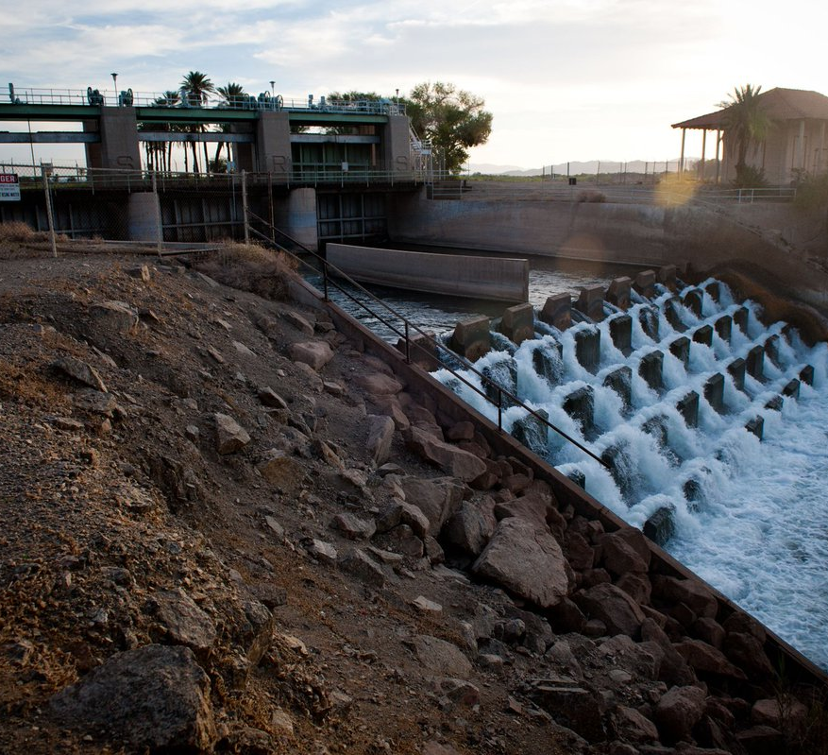
Laguna Dam 1909
https://twitter.com/usbr/status/859178620723445760

Slide 3
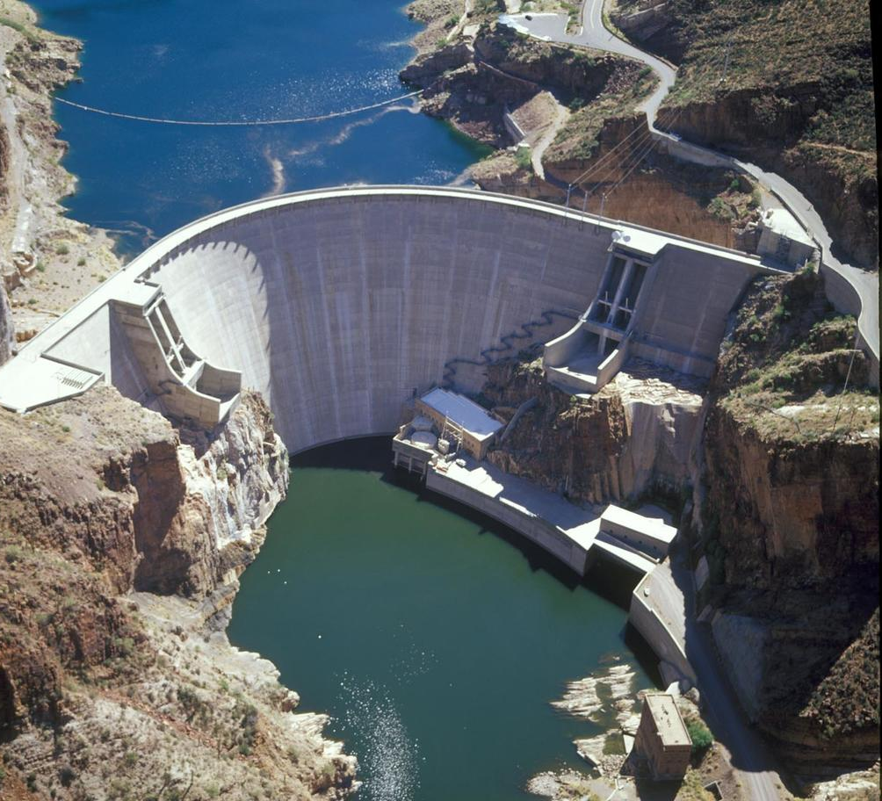
Roosevelt Dam 1912
https://www.usgs.gov/media/images/roosevelt-dam

Slide 4
Hoover Dam 1936
https://www.britannica.com/topic/Hoover-Dam

Slide 5
Parker Dam 1939
https://www.usbr.gov/projects/index.php?id=207

Slide 6
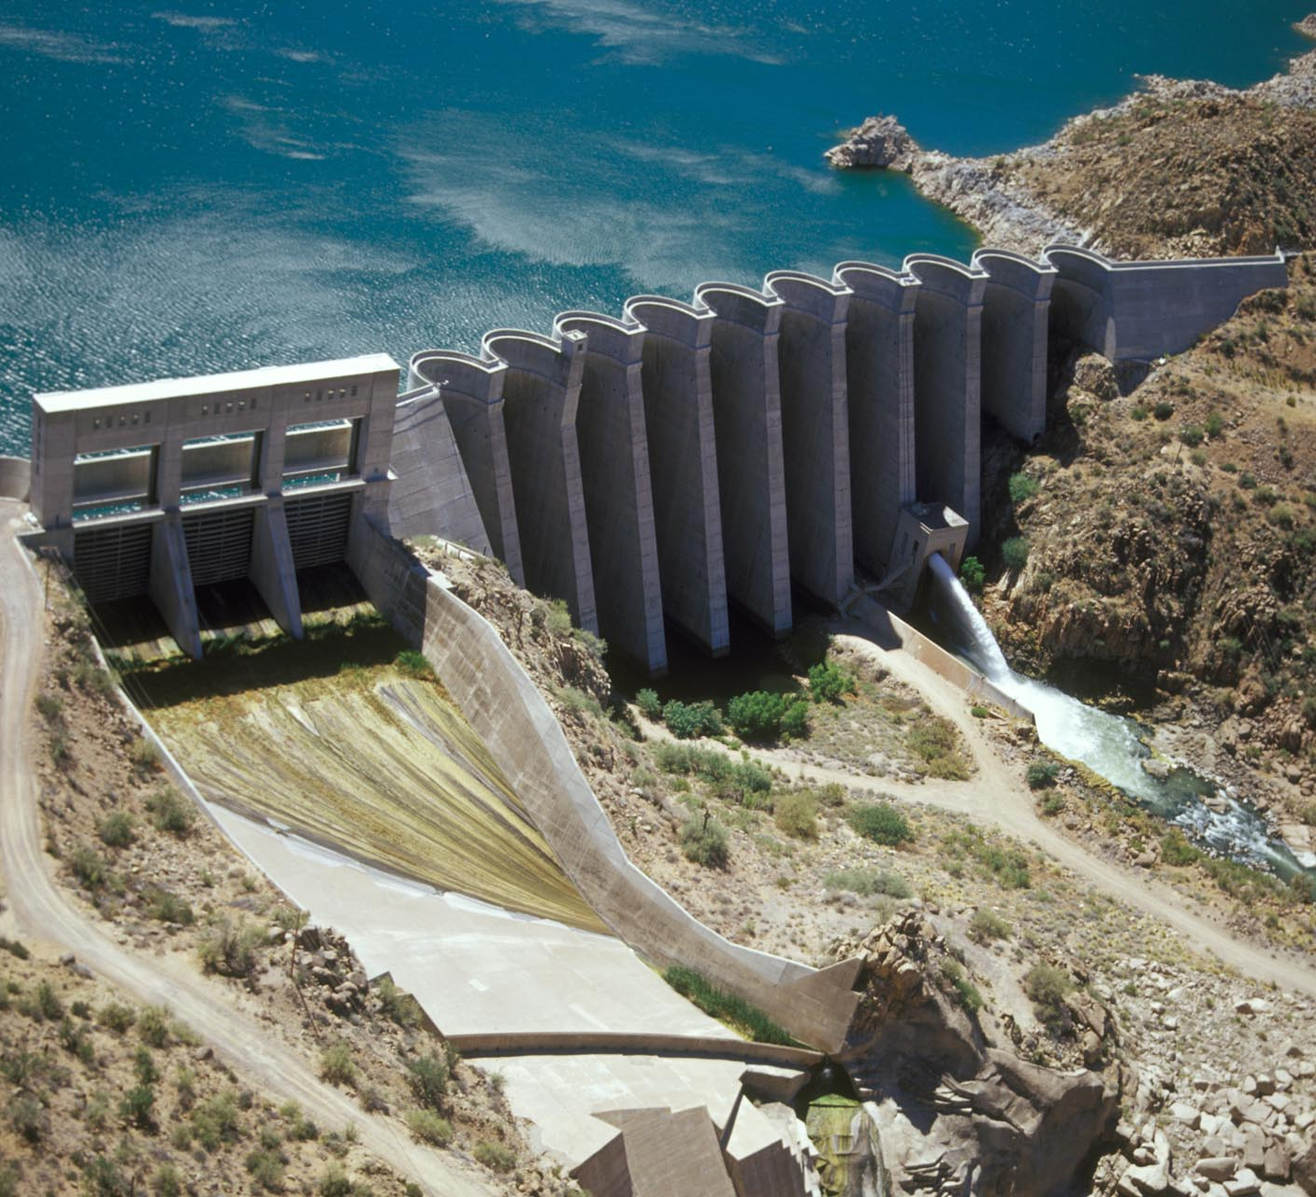
Bartlett Dam 1939
https://en.wikipedia.org/wiki/Bartlett_Dam

Slide 7
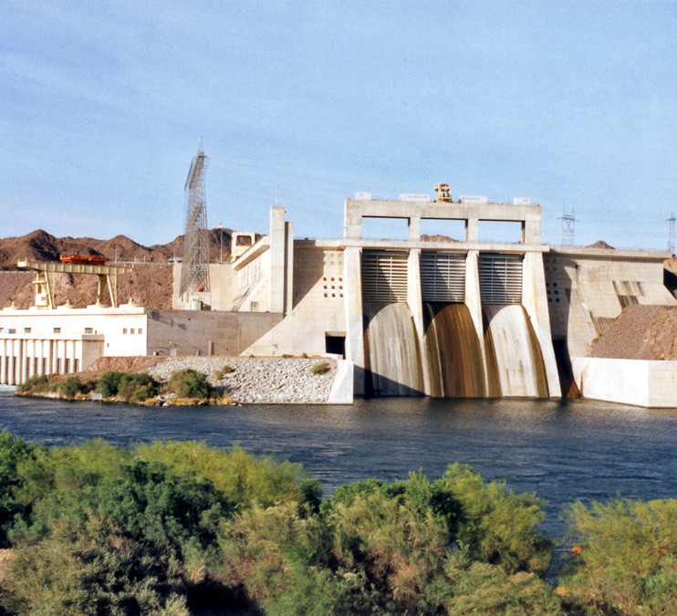
Davis Dam 1949
https://www.americansouthwest.net/arizona/lake_mead/davisdam_l.html

Slide 8
Glen Canyon Dam 1964
https://www.usbr.gov/uc/rm/crsp/gc/

