Slide 1
Runaway Rocks
What happens when rocks roll?

Slide 2
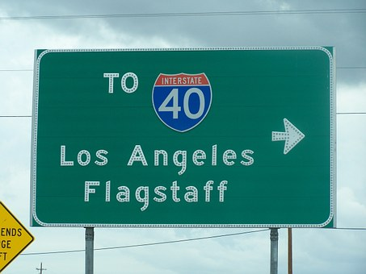
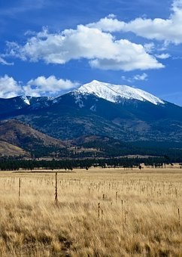
Flagstaff, Arizona

Slide 3
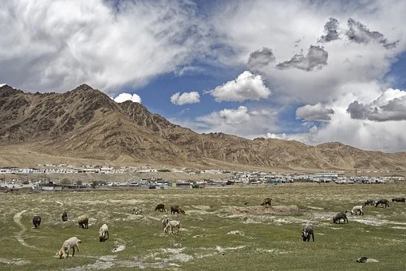
Village in Tajikistan

Slide 4
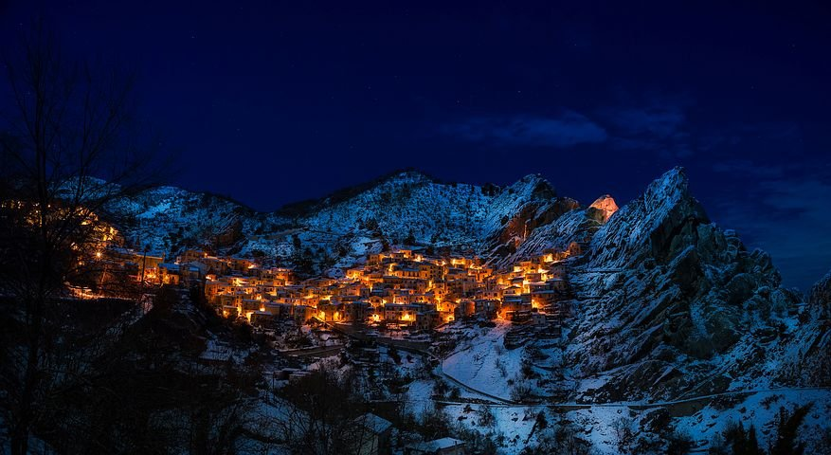
Castelmezzano, Italy

Slide 5
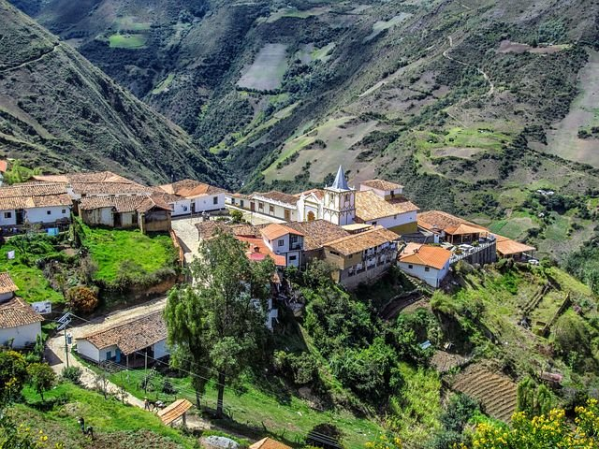
Merida, Venezuela

Slide 6
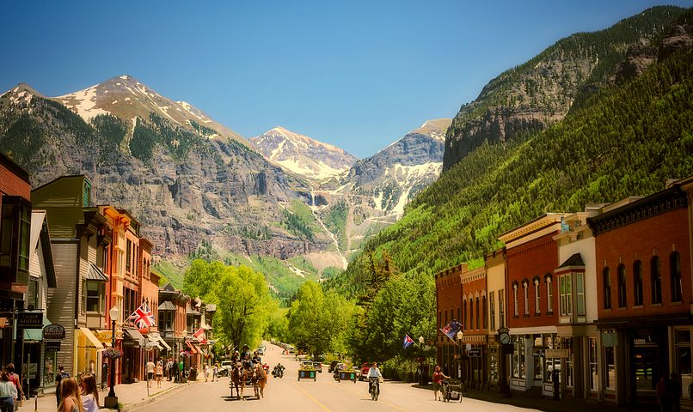
Telluride, Colorado

Slide 7
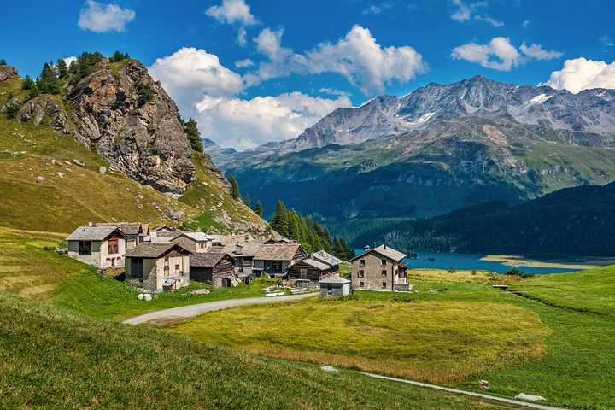
Swiss Alps

Slide 8
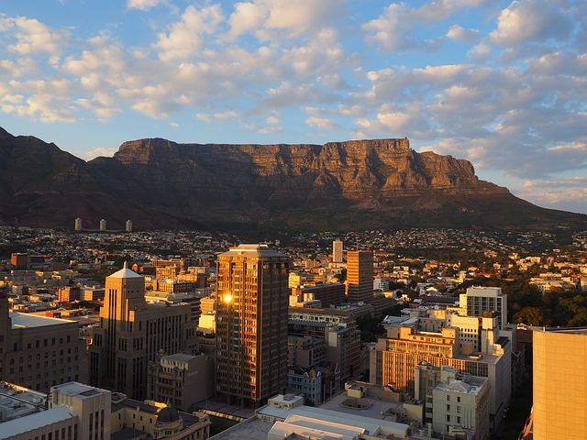
Capetown, South Africa

Slide 9
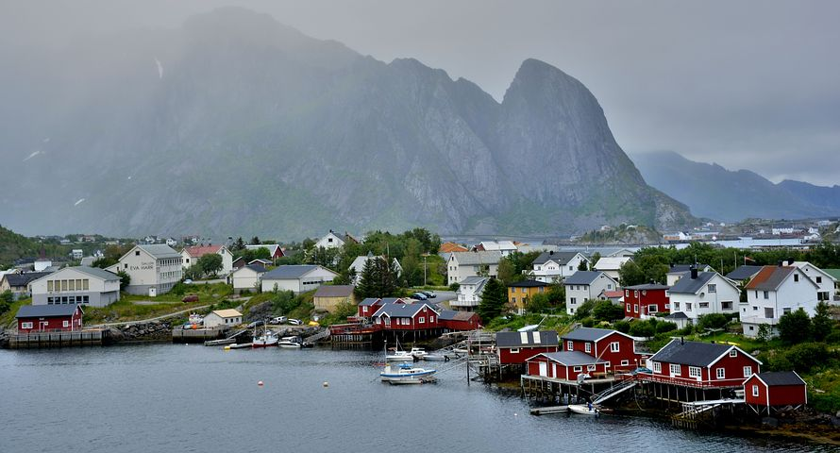
Lofoten Islands, Norway

Slide 11
What are the pros and cons of living in the mountains?
Pros: Good things
Cons: Not good things
Notes:
https://jamboard.google.com/d/1o9POBhLT70UYnPBxJr3fzbgyCs0HrdY_wLxPSGNh4lQ/edit?usp=sharing

Slide 12
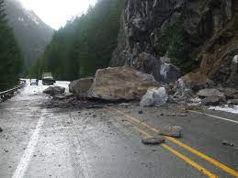

Slide 13
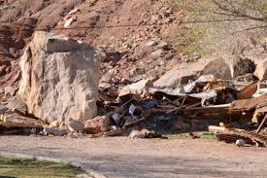

Slide 14
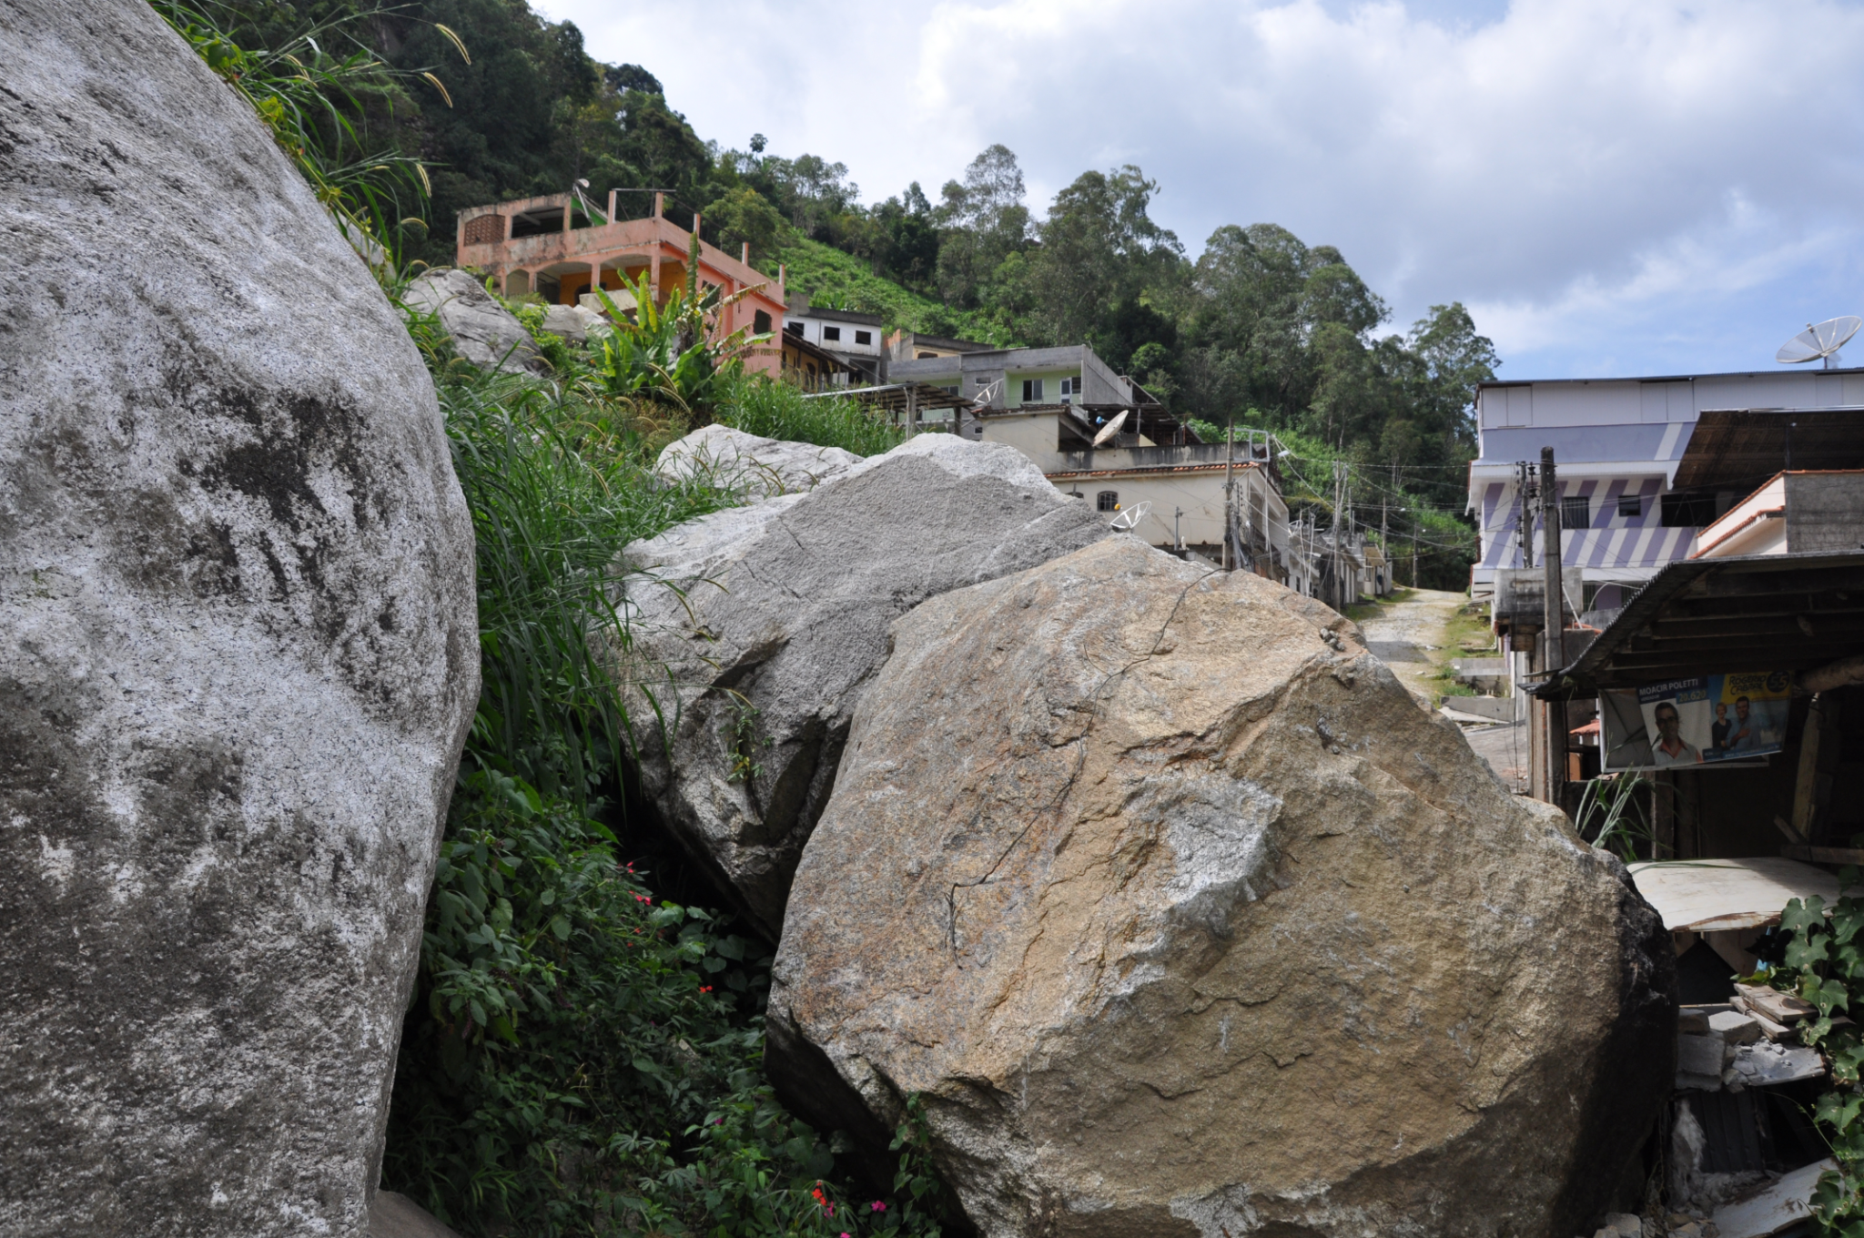

Slide 15
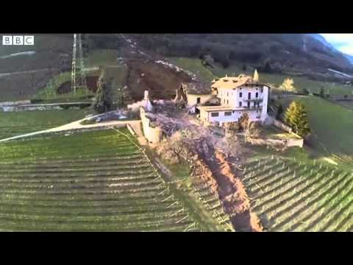
Video clip (.27 min)
https://youtu.be/hoTFpHd1LnE

