Slide 1
Physical
Features
Vocabulary

Slide 2
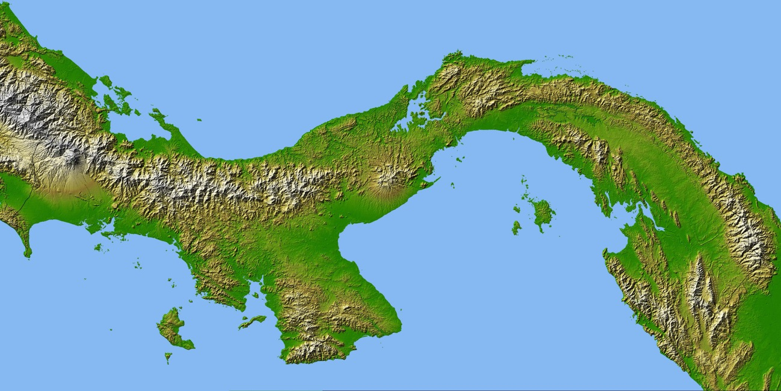
Isthmus
a narrow piece of land that connects two larger pieces of land
Nasa.gov

Slide 3
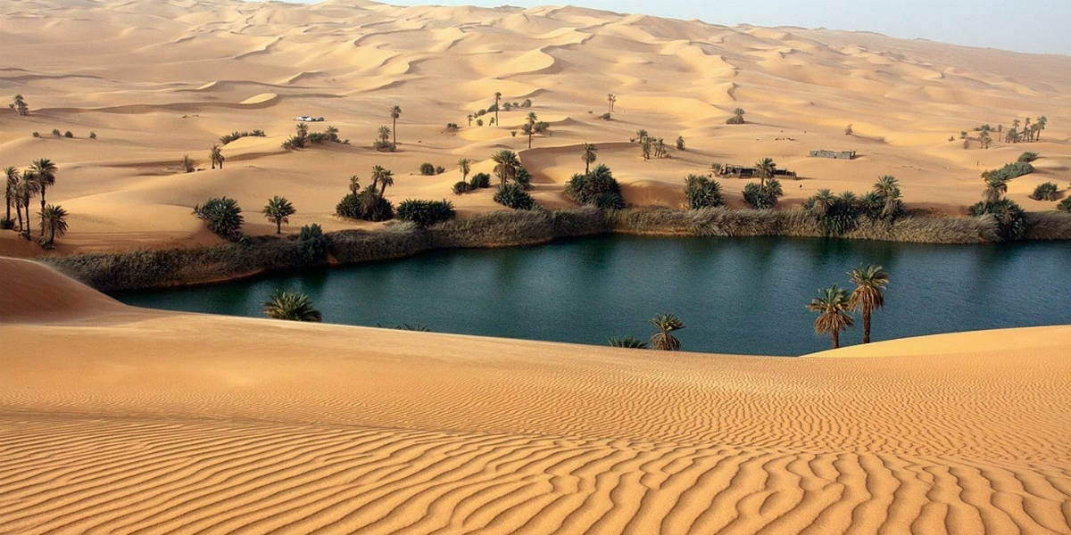
Oasis
a fertile desert water hole
https://www.crossroadsinitiative.com

Slide 4
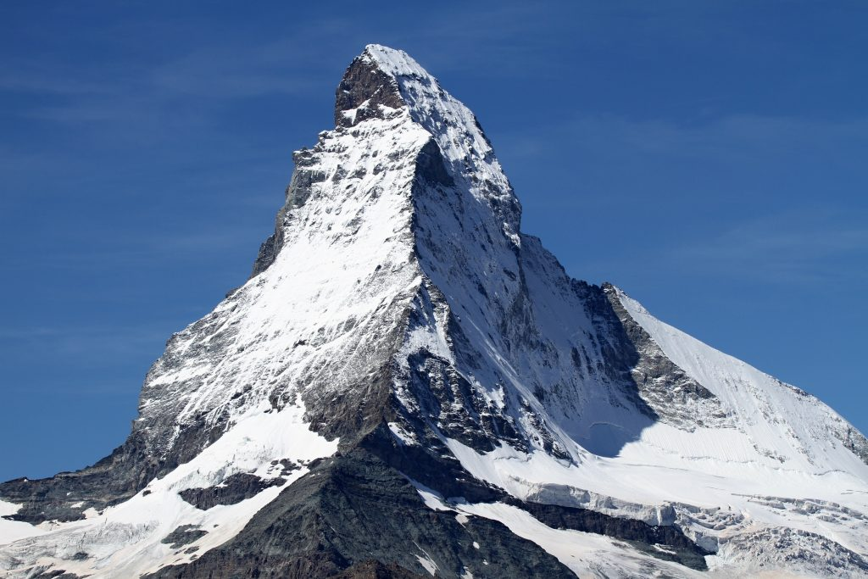
Peak
pointed mountain top
https://thenewstack.io

Slide 5
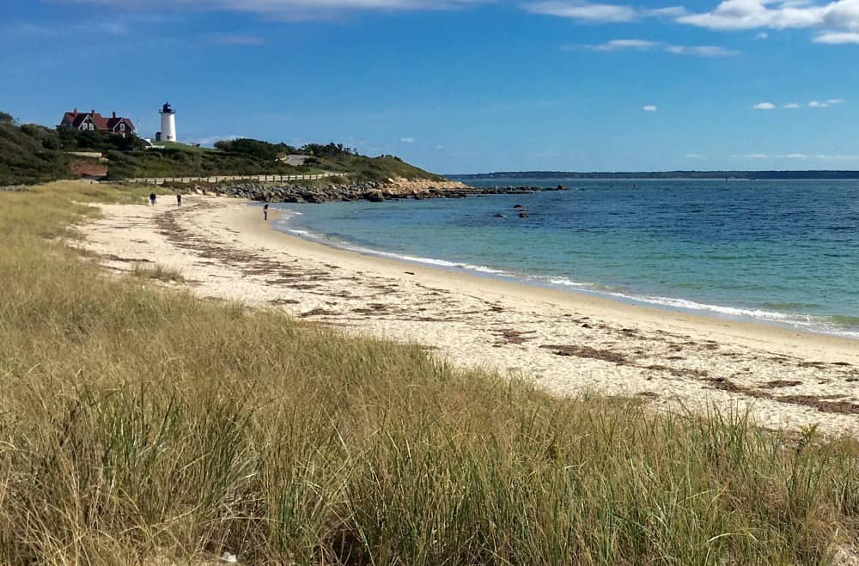
Cape
a piece of land extending into a lake or sea
https://www.platinumpebble.com/cape-cod-lighthouses/cape-cod-lighthouses/

Slide 6
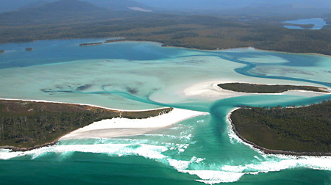
Lagoon
enclosed shallow body of water

Slide 7
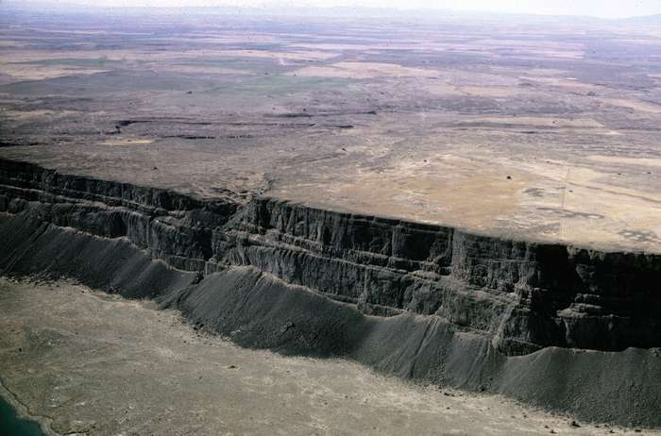
Plateau
a flat elevated landform
https://www.britannica.com/science/plateau-landform

Slide 8
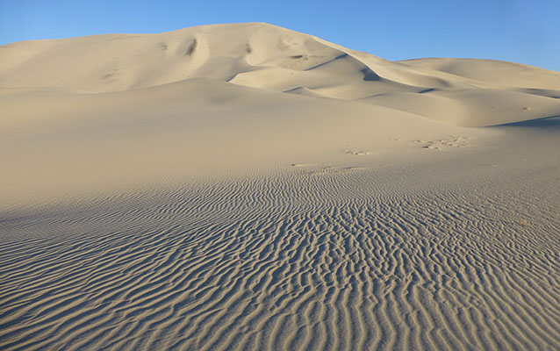
Dune
sand drifts
https://www.nps.gov/places/eureka-dunes.htm

Slide 9
Beach
sandy shore

Slide 10
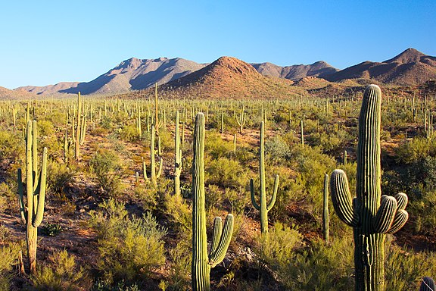
Desert
a region that receives less than 10" of rain per year
https://en.wikipedia.org/wiki/Sonoran_Desert

Slide 11
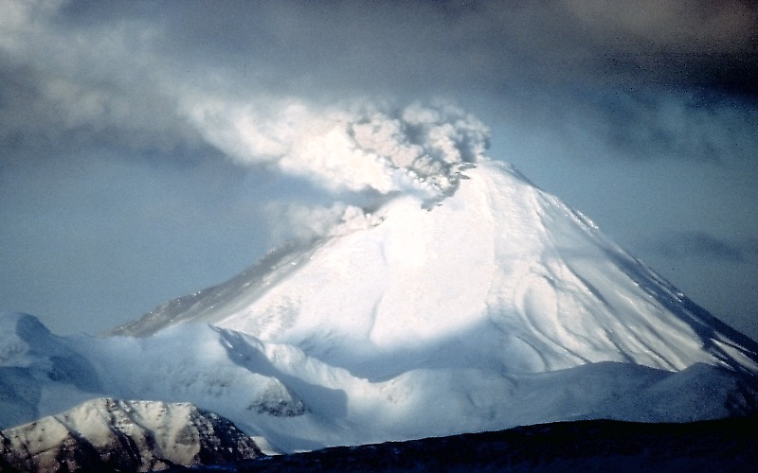
Volcano
opening (usually a hill or mountain) in the earth’s crust where gases, and molten (melted) rock pour out

Slide 12
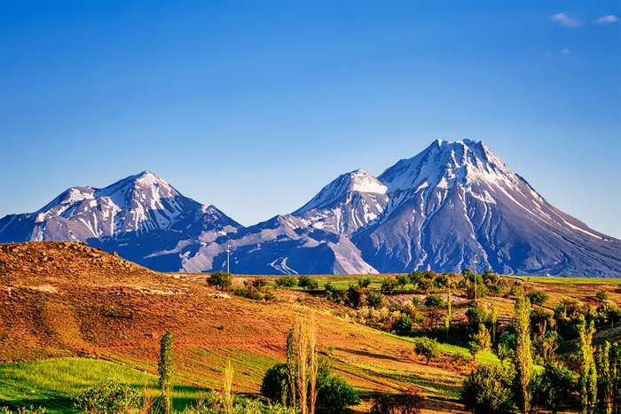
Mountain
A high, rounded or pointed elevated landform
https://www.britannica.com/place/Taurus-Mountains

Slide 13
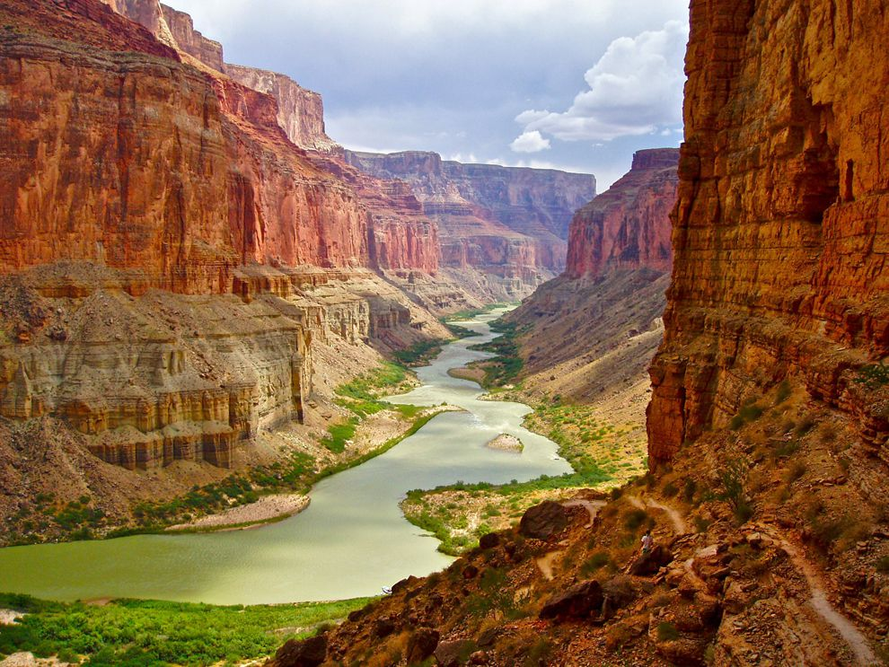
Canyon
deep narrow valley with high cliffs
https://www.nationalgeographic.org/encyclopedia/canyon/

Slide 14
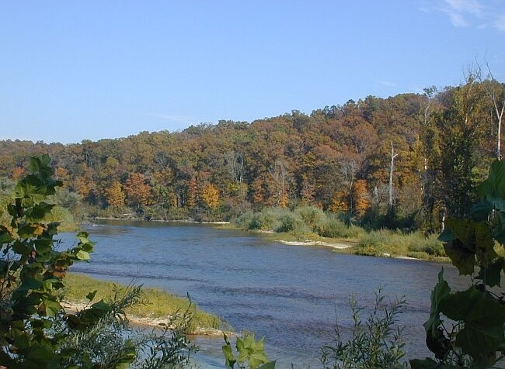
River
a large natural stream of water emptying into a larger body

Slide 15
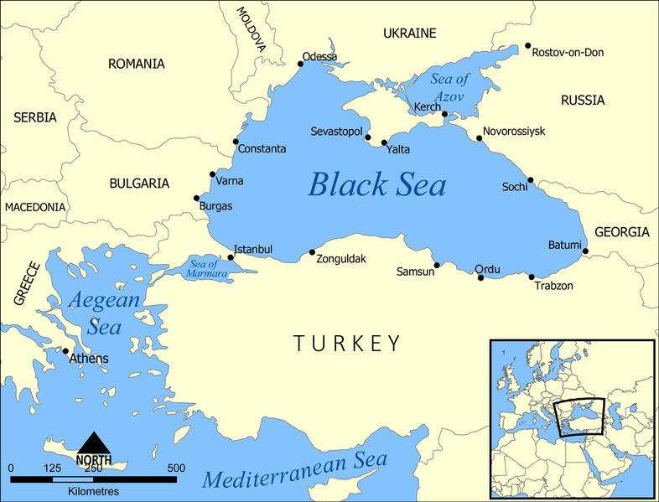
Sea
part of an ocean located close to land
https://www.fpri.org

Slide 16
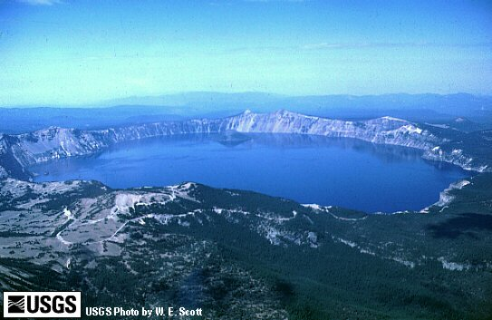
Lake
a body of fresh water surrounded by land

Slide 17
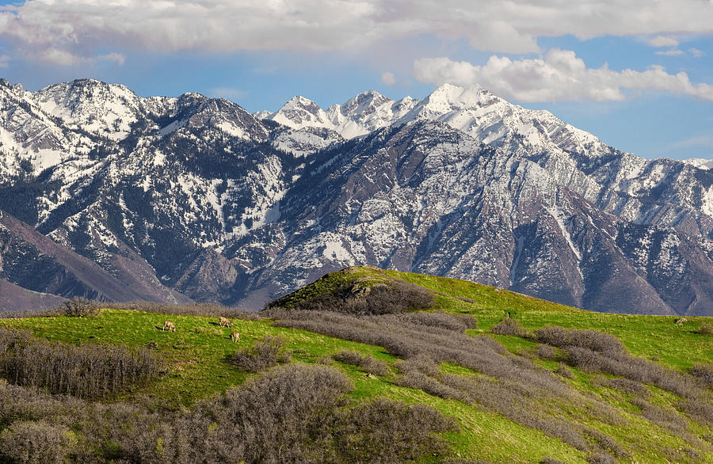
Foothills
small hills at the foot of mountains
https://fineartamerica.com

Slide 18
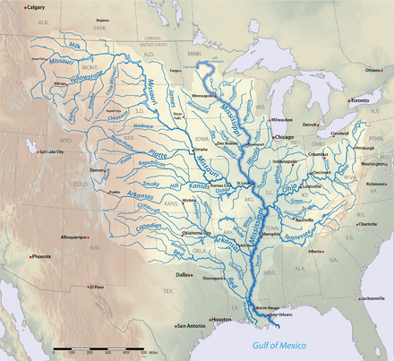
Tributary
smaller stream that flows into a bigger stream
https://en.wikipedia.org/wiki/Mississippi_River_System

Slide 19
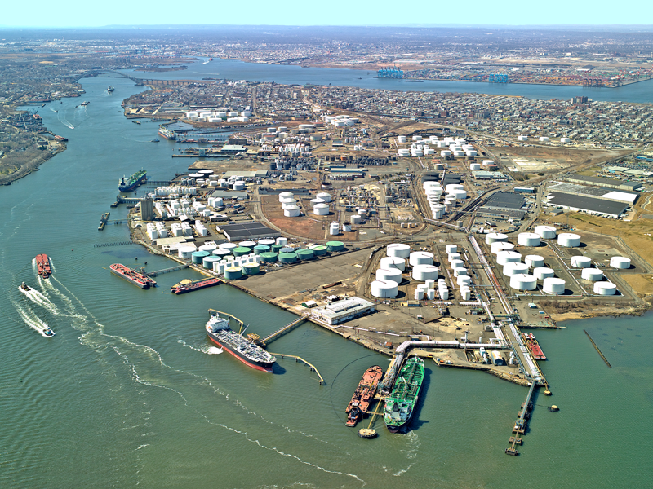
Harbor
a protected area where ships can dock
https://gcaptain.com

Slide 20
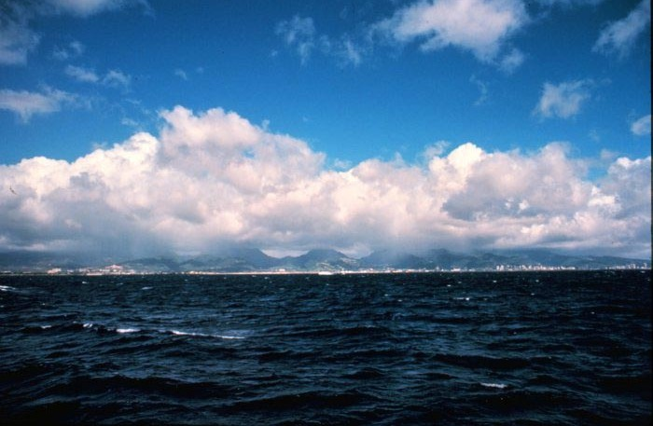
Ocean
large body of saltwater

Slide 21
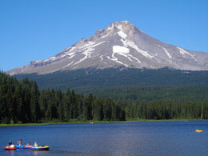
Timberline
top area of a mountain where trees do not grow
http://www.sleeparoundnw.com/destinations/Mt_Hood_more.html

Slide 22
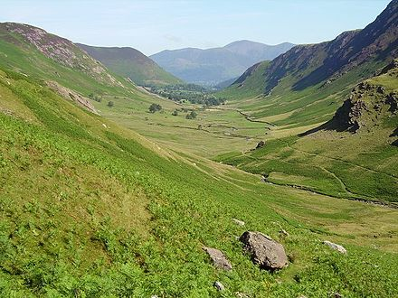
Valley
low land between mountains
https://en.wiktionary.org/wiki/valley

Slide 23
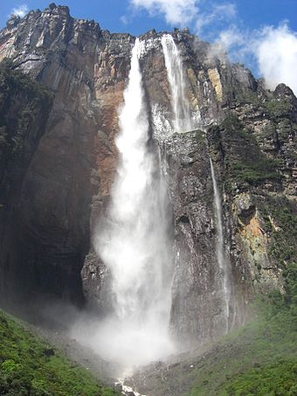
Waterfall
water flowing over a cliff
https://en.wikipedia.org/wiki/Waterfall

Slide 24
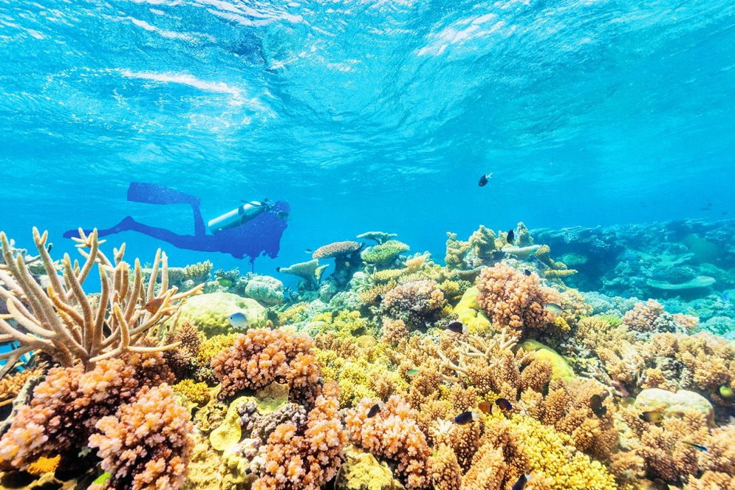
Reef
a rock or coral ridge at or near sea level
https://www.barrons.com/

Slide 25
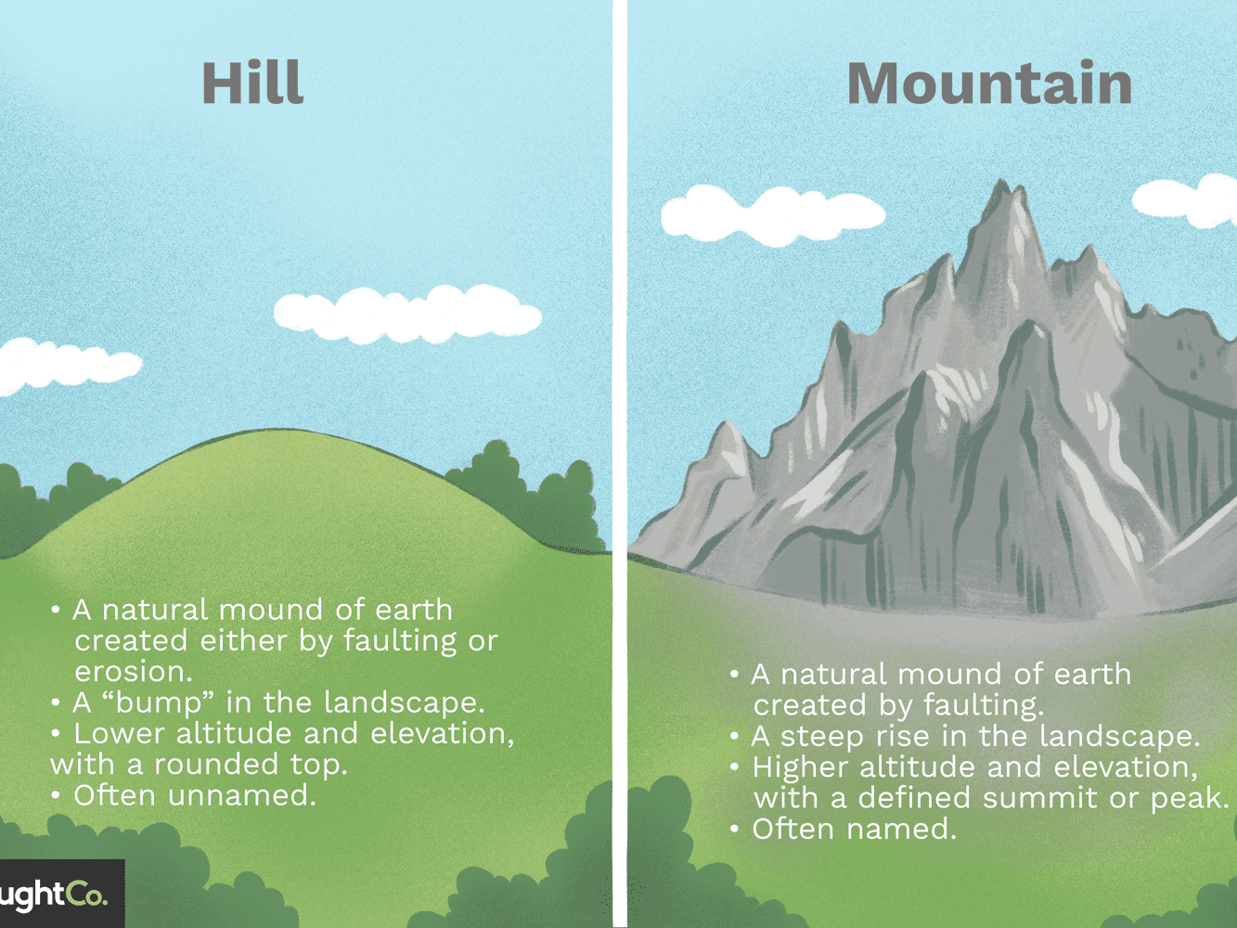
Hill
small, rounded elevated landform lower than a mountain
https://www.thoughtco.com

Slide 26
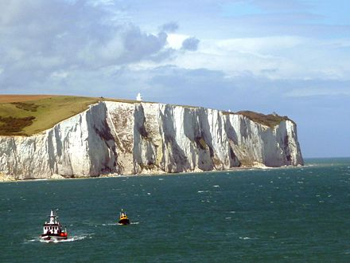
Cliff
a high, steep face of the mountain, or land
https://en.wikipedia.org/wiki/Cliff

