Slide 1
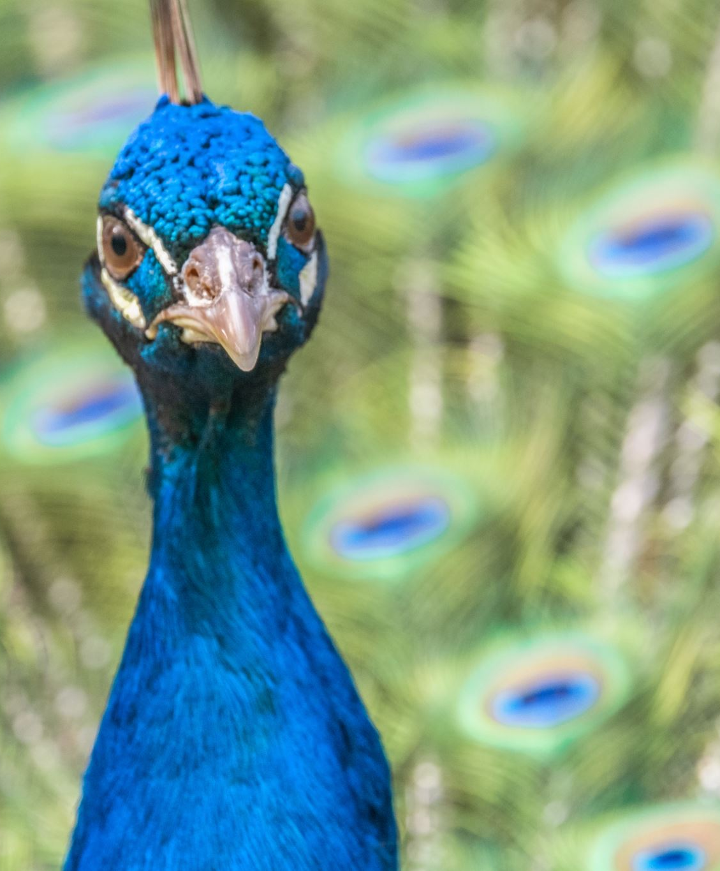
Connecting to Our Roots Using the Novel: Me, Frida and the Secret of the Beautiful Peacock Ring
by
Shalini Tripathi
Grade 6

Slide 2
Paloma Marquez is traveling to Mexico City, birthplace of
her deceased father, for the first time. She is hoping that spending some time in Mexico will help her unlock memories of the too brief time they spent together.
While in Mexico, Paloma meets Lizzie and Gael who present
her with an irresistible challenge. The twin siblings want her to help them find a valuable ring that once belonged to beloved, Mexican artist, Frida Kahlo.
What better way to honor her father than returning a priceless piece of jewelry that once belonged to his favorite artist?
But the twins have a secret. Do they really want the ring or are they after something else entirely?
Look for the cultural traditions of Mexico as you read this mystery.

Slide 3
Reading the Novel
Me, Frida, and the Secret of the Peacock Ring by Angela Cervantes
https://feedvu.com/fullbook/me-frida-and-the-secret-of-the-peacock-ring-pdf.html?page=4&part=1
and
https://feedvu.com/fullbook/me-frida-and-the-secret-of-the-peacock-ring-pdf.html?page=4&part=2

Slide 4
Listening to the novel
Me, Frida, and the Secret of the Peacock Ring by Angela Cervantes
First chapter (9.25 min)
https://www.youtube.com/watch?v=nZ7gKPLtvUM
If your school has a subscription to YouTube, you may be able to access
all of the chapters at https://www.youtube.com/watch?v=cqV_KGXUzKk&t=57s

Slide 5
Before COVID-19, more Mexicans came to the U.S. than left for Mexico for the first time in years
https://www.pewresearch.org/fact-tank/2021/07/09/before-covid-19-more-mexicans-came-to-the-u-s-than-left-for-mexico-for-the-first-time-in-years/

Slide 6
Mexican Immigrants in the United States
https://www.migrationpolicy.org/article/mexican-immigrants-united-states-2019

Slide 7
Weekly U.S.-Mexico Border Update: December’s migration data; DHS Secretary hears complaints; “Critical Incident Teams”
https://www.wola.org/2022/01/weekly-u-s-mexico-border-update-decembers-migration-data-dhs-secretary-hears-complaints-critical-incident-teams/

