Slide 1
Flash Flood Video
https://www.cbsnews.com/video/flash-floods-tear-across-arizona-desert/

Slide 2
Arizona’s Topography and Rivers map
Rivers of AZ http://geoalliance.asu.edu/sites/default/files/maps/AZTOPO.PDF

Slide 3
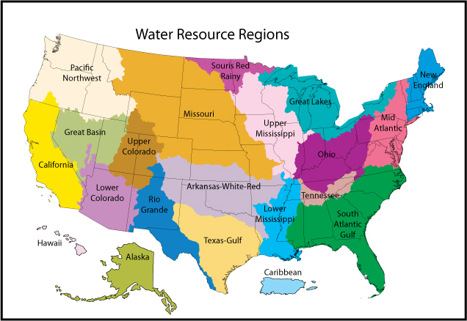
https://water.usgs.gov/wsc/missed.html

Slide 4
Important Rivers, Streams, and Washes of Arizona map
http://geoalliance.asu.edu/sites/default/files/maps/AZ-RIV-K.PDF

Slide 5
Important Dams in Arizona map
Dams of AZ http://geoalliance.asu.edu/sites/default/files/maps/AZ-DAMS.PDF

Slide 6
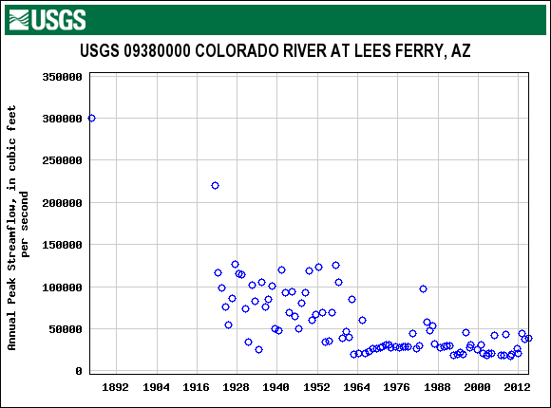

Slide 7
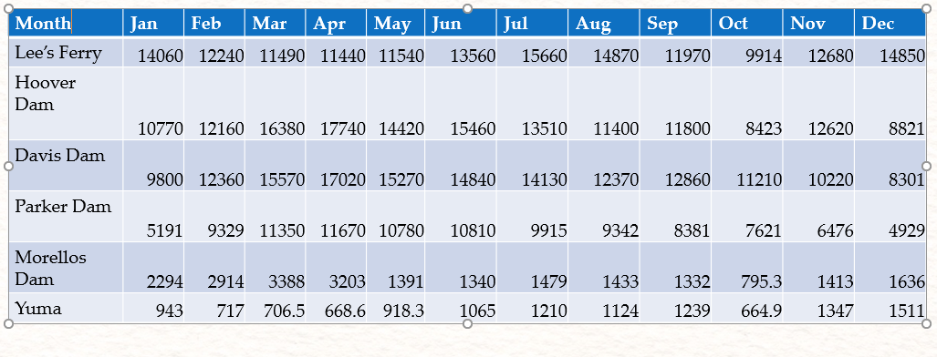
Rivers, Rivers Everywhere
A Map Activity

Slide 8
