Slide 1
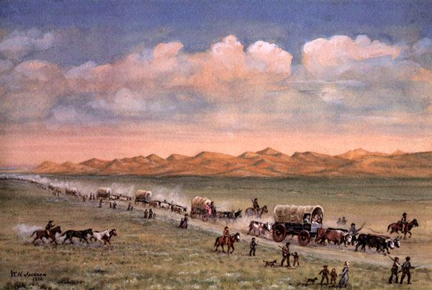
Towards the West
Describe what you see in this painting.
The Oregon Trail by William Henry Jackson
https://goldfieldsbooks.com/2021/05/19/the-first-wagon-train-to-california/

Slide 2
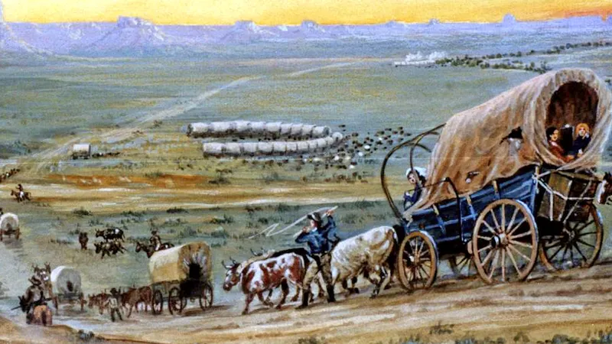
Why Towards the West?
Describe what you see in this painting.
https://donnelly.lili.org/oregon-countdown-to-the-census/

Slide 4
Why Travel to the West?
In the 1800s people living in the East were motivated by difficult economic times they were facing in the East, and they were inspired by dreams of gold and rich farmlands of the West. Diseases like yellow fever and malaria were another reason to leave the East Coast.
Taking a five- to six-month journey across 2000 miles of rugged terrain was no easy task and could take up to a year of research and planning.
First, it was critical for travelers to leave in April or May if they hoped to reach Oregon before the winter snows began.
They also needed enough money to pay for the journey as well as set up a new home in Oregon.

Slide 5
Your Story
Your name is Bradley or Brad. The year is 1843, and you live in Massachusetts. You are the fifth son in the family, and there is no room for you at the family farm.
You are married with two small children, ages 4 and 5.
You have saved $1000 by working at jobs that you hate.
You wish to move west where you can find good farmland and provide a better life for your family.
You have researched the needs for the journey. You have read the list found at: https://cmhuddleston.com/uploads/3/5/8/9/35892337/greg_4_lesson_plans.pdf Read pages 2-4.
You are ready to go. You have your wagon already.

Slide 6
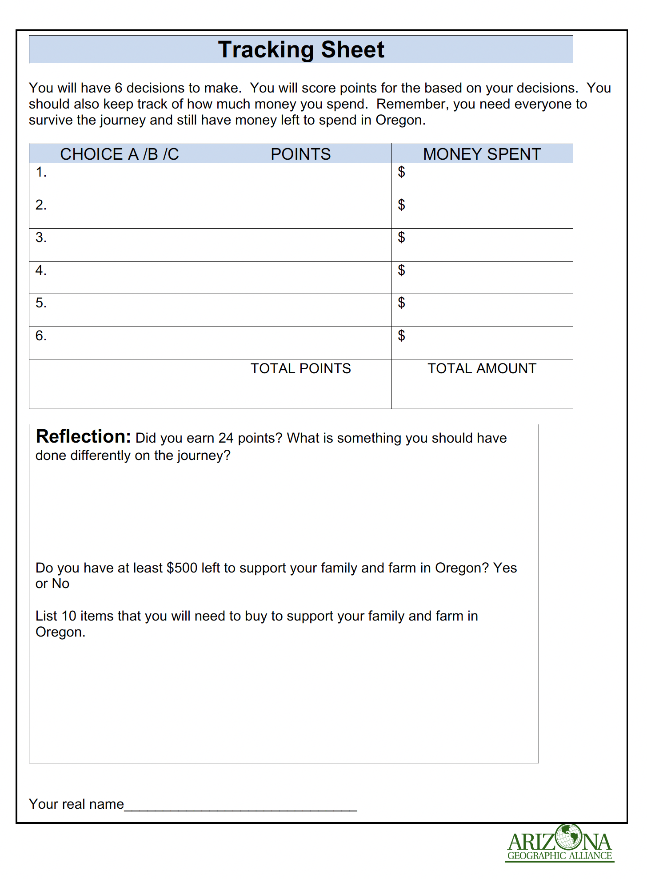
Making Decisions
You will be making various decisions. Your goal is to spend what you need to survive but have money when you reach Oregon.
You will receive points for making good decisions. You want to end up with at least 24 points.

Slide 7
Decision 1
You will need animals to pull your wagon. Which will you choose?
4 Horses ($100)
4 Oxen ($120)
4 Mules ($40)

Slide 8
Rate Your Decision 1
Horses are fast but need more food and are not as strong as oxen. ($100 and 1 point)
Oxen are strong and will survive easily during the journey. ($120 and 5 points)
Mules are fast but stubborn. They are hard to handle. ($40 and 3 points)
Mark your Tracking Sheet with your points and costs.

Slide 9
Decision 2
You will need food for the journey. The food will consist of flour, bacon, salt, lard, rice, corn meal, sugar, dried fruit, pepper, tea, coffee, and beans. Which will you choose?
Buy the recommended amount of food for a family of 4 ($50)
Buy less than the recommended amount to make more room in the wagon for other things. ($35)
Buy only beans, flour and rice and count on shooting animals for food.
($20)

Slide 10
Rate Your Decision 2
Recommended amount will only get you through part of the journey but buying most of your food while traveling will cost you much more for the same items. Better to start with a lot of food. ($50) 5 Points
Buying less than the recommended amount of food. See reasons above and people cannot travel well when hungry and tired. ($35 and 3 points)
Buying only beans, rice, and flour will make a very poor diet without many options of meals. Shooting animals along the way may work some days but if you are traveling, who is going out hunting? ($20 and 1 point)
Mark your Tracking Sheet with your points and costs.

Slide 11
Decision 3
You are approaching the Kansas River. The river is deep and has rapids. Which will you choose?
Build a raft from nearby trees and put the wagon on the raft and cross the river. ($0)
Cross the river by yourself--swimming the animals and floating the wagon. ($0)
Pay someone to take you across the river. ($5)

Slide 12
Rate Your Decision 3
There are few trees at this location, and it would take much time and knowledge to build a raft. ($0 and 0 points)
Crossing the river by yourself would be very dangerous for your family because the rapids might sweep the wagon or animals away. ($0 and 0 points)
Paying an experienced person to ferry you across is the safest way. ($5 and 5 points)
Mark your Tracking Sheet with your points and costs.

Slide 13
Decision 4
You are near Scotts Bluff, Nebraska. As you reach the Platte River, you stop for the night. You need a fire to cook dinner. Which will you choose?
Take a few boards from the side of the wagon and build a fire. ($0)
You decide to not eat dinner tonight and only have some cold food. ($0)
You send the children to gather dried buffalo chips (droppings) and burn them. ($0)

Slide 14
Rate Your Decision 4
Taking boards from the wagon will weaken the structure. Eventually, you will not have a wagon. ($0 and 0 points)
Eating cold food is fine for an occasional dinner but after traveling all day, people need a good meal. ($0 and 3 points)
Dried buffalo chips are fine for fires and are plentiful where buffalo are found. ($0 and 5 points)
Mark your Tracking Sheet with your points and costs.

Slide 15
Decision 5
You have crossed the Rocky Mountains, but your family needs new shoes. Their only pairs of shoes are worn out. Which will you choose?
Buy new shoes at a trading post for the whole family. ($16)
Buy only shoes for the adults. The children can go barefoot. ($10)
Buy moccasins from($0) Native Americans for the whole family. ($2)

Slide 16
Rate Your Decision 5
Buying new shoes for everyone means everyone can walk and make the load on the wagon easier for the animals. ($16 and 5 points)
Buying only shoes for the adults means that the children will risk injury to their bare feet besides being cold at night. ($10 and 0 points)
Moccasins are fine but might take their feet getting used to a soft soled shoes when walking. ($2 and 3 points)
Mark your Tracking Sheet with your points and costs.

Slide 17
Decision 6
You have reached Oregon and found some free land to settle and farm. Which will you choose?
Move to California. ($200)
Stay in Oregon. ($0)
Return to the eastern part of the U.S. ($1000)

Slide 18
Rate Your Decision 6
Moving to California is a problem in 1843. California belongs to Spain and won’t be part of the United States until 1850. ($200 and 3 points)
Staying in Oregon is a good choice. The land was free, and the climate is good for farming. ($0 and 5 points)
Returning home on such a hard journey is not likely and expensive. ($1000 and 0 points)
Mark your Tracking Sheet with your points and costs.

