Slide 1
Shortest Distance: Volcanoes and the Pythagorean Theorem

Slide 2
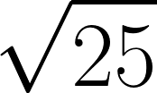

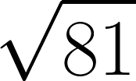
What is the square root of the following numbers?

Slide 3

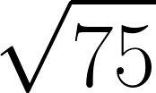
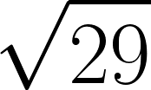
What do you observe about these squares?

Slide 4
Finding the square root using a calculator
TI30XS Multiview Calculator - Square Roots (3.33 min)
https://www.youtube.com/watch?v=isXRsgjZi7A

Slide 5
FIND THE SQUARE ROOT OF THESE USING A CALCULATOR

Slide 6



Find the shortest distance between home and school.
SCHOOL
HOME

Slide 7
Which triangle would work best to determine for the shortest distance and why?
B
A

Slide 8
Find the shortest distance between home and school.
SCHOOL
HOME

Slide 9
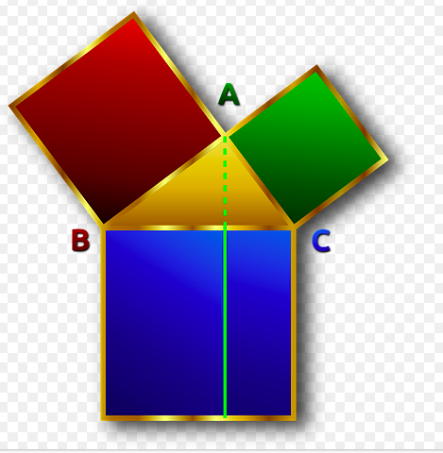
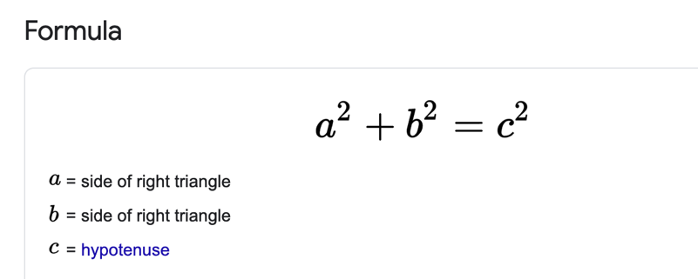
What is the formula for the Pythagorean Theorem?

Slide 10
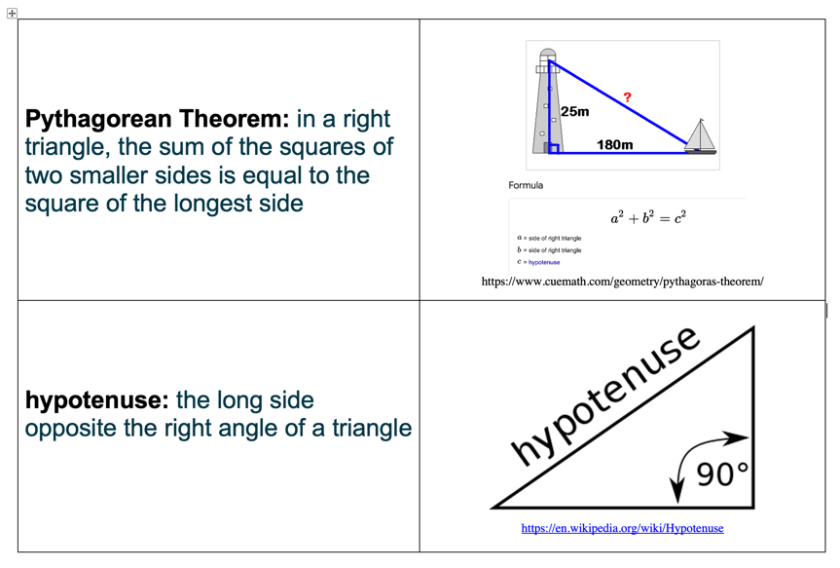
Vocabulary

Slide 11
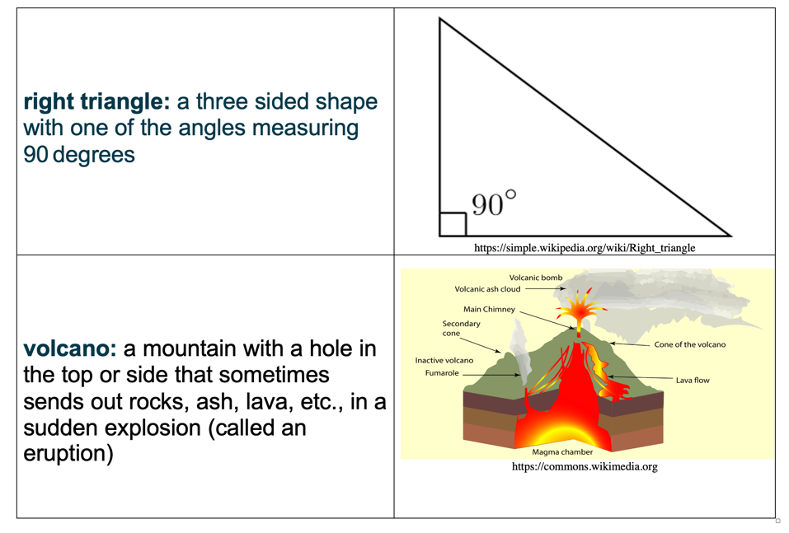
Vocabulary

Slide 12
Share with your partner
What do you know about volcanoes? Volcanoes are…………
What do you know about any active volcano? One active volcano I know about is…………….

Slide 13
Volcanoes
You will select two volcanoes to research. You must locate and label the two volcanoes on the World map. Then you must create a right-angle triangle between the two and figure out the miles for sides a and b of the triangle using the map scale. Then use the Pythagorean Theorem to figure out the hypotenuse (c)(the shortest distance to travel from one volcano to another).

Slide 14

Map Example
Mary Volcano
c
a
b
John Volcano

Slide 15
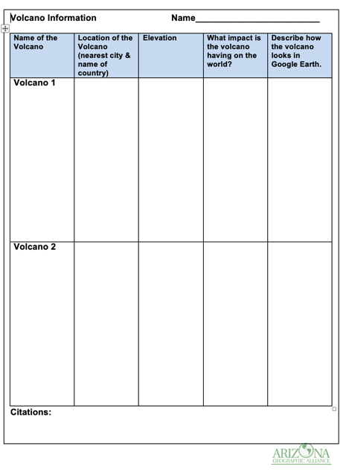
Graphic Organizer
You will also complete the graphic organizer describing your volcanoes.

Slide 16
Sources of Information
https://interestingengineering.com/a-closer-look-at-the-worlds-9-most-active-volcanoes (You can choose one of these nine most active volcanoes or any other active volcano)
https://earth.google.com
https://en.wikipedia.org/ or another website featuring your volcano(es)

Slide 17
Scoring Guide
Map Work Requirements | Points Possible | Points Earned
2 volcanoes are located and labeled properly on the map | 10
Hypotenuse is figured correctly using Pythagoream Theorem | 15
Graphic Organizer Requirements | Points Possible | Points Earned
Names of 2 volcanoes are given | 5
Nearest cities and names of countries are identified correctly | 10
Correct elevation is given for both volcanoes | 10
The impact of both active volcanoes is stated | 20
The volcanoes as viewed on Google Earth are well-described | 20
Correct grammar/mechanics | 10
Total | 100

