Slide 1
Iran-Contra Affair

Slide 2
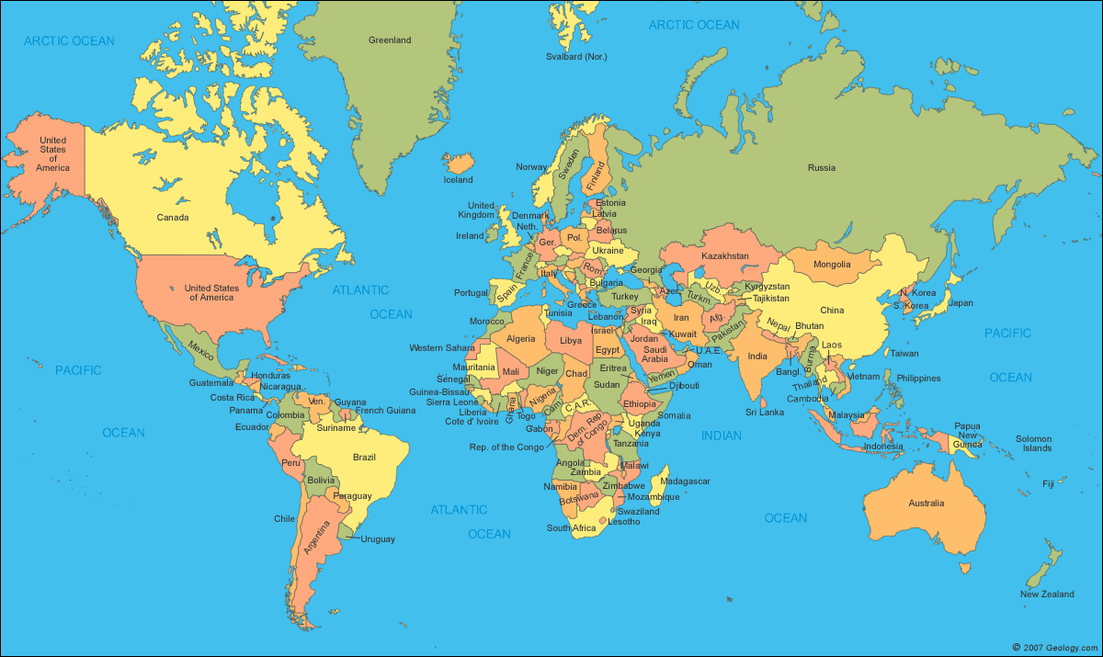

Slide 3
Iran

Slide 4
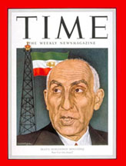
British and American corporations had controlled the bulk of Iran’s petroleum reserves almost since their discovery–a profitable arrangement that they did not want to change.
1951 Iran’s newly elected Prime Minister, a European-educated nationalist named Muhammad Mossadegh, announced a plan to nationalize the country’s oil industry. This means the oil will belong to the Iran and not the private companies of the U.S. or Britain.

Slide 5
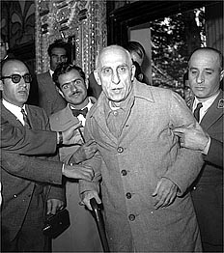
1. What is happening in the image?
2. What do you see that makes you say that?
3. What else is happening?
4. What more can we find?

Slide 6
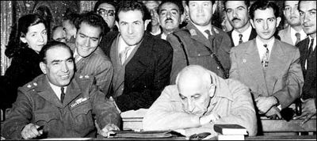
1. What is happening in the image?
2. What do you see that makes you say that?
3. What else is happening?
4. What more can we find?

Slide 7
1953 Iranian coup d'état
coup d'état : a sudden, violent, and illegal seizure of power from a government
Beginning in January 1953, the U.S. and Britain agreed to work together toward Mosaddegh’s removal. The plot is known as Operation Ajax

Slide 8
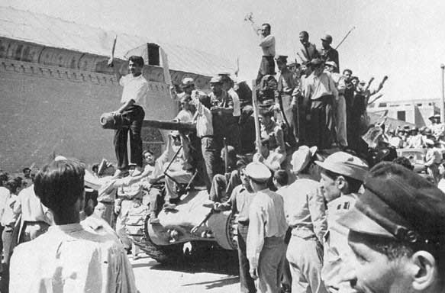
1. What is happening in the image?
2. What do you see that makes you say that?
3. What else is happening?
4. What more can we find?

Slide 9
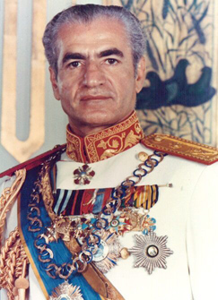
The C.I.A. fostered a coup and in 1953, it was a success.
In fact, it served as a model for other covert operations during the Cold War
The Shah quickly returned to take power and, as thanks for the American help, signed over 40 percent of Iran’s oil fields to U.S. companies!
Shah Mohammad Reza Pahlavi

Slide 10
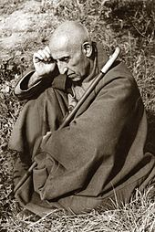
Mossadegh under house arrest in Ahmadabad
On December 21, 1953, he was sentenced to three years' solitary confinement in a military prison.

Slide 11
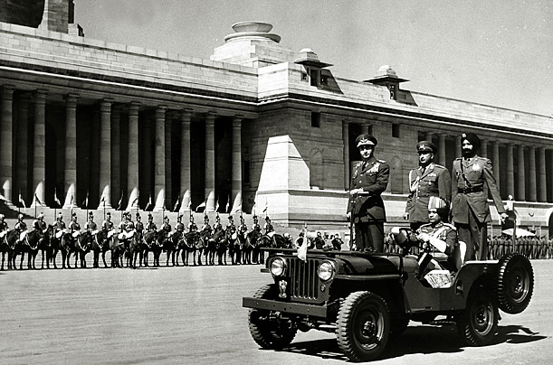
Absolute Monarch
The Shah used the revenues from the agreement between Iran and Western oil companies to solidify his authority.
Though he maintained the appearance of a constitutional monarchy, he ruled with a hard fist, using his secret police and suppressing all forms of opposition.

Slide 12
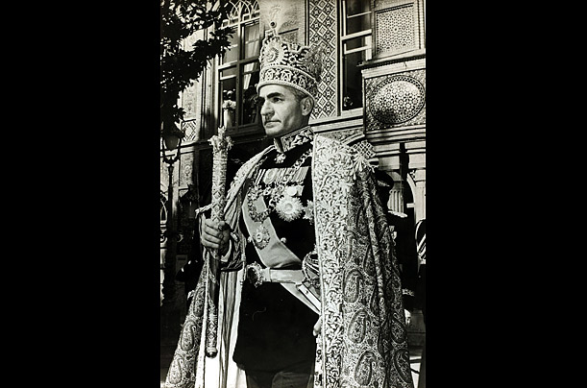
He crowned himself monarch of Iran in 1967 in a lavish ceremony

Slide 13
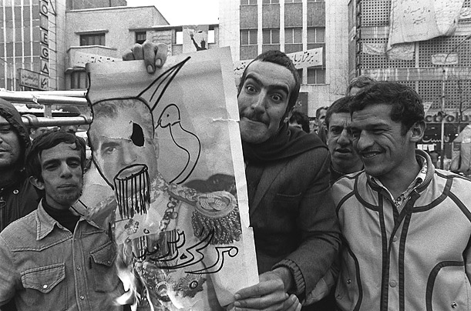
Opposition Views of the Shah

Slide 14
Iran Revolution 1979
By the 1970s, many Iranians were fed up with the Shah’s government.
In July 1979, the revolutionaries forced the Shah to disband his government and flee to Egypt. The Ayatollah installed a militant Islamic government in its place.
In October 1979, President Carter agreed to allow the exiled leader to enter the U.S. for treatment of an advanced malignant lymphoma.

Slide 15
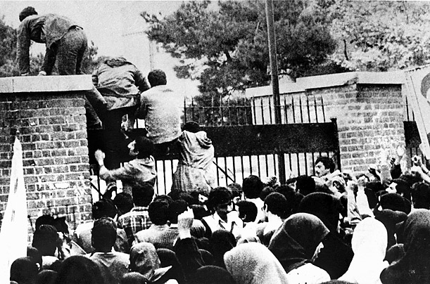
On November 4, 1979, a group of Iranian students stormed the U.S. Embassy in Tehran taking more than 60 American hostages.

Slide 16
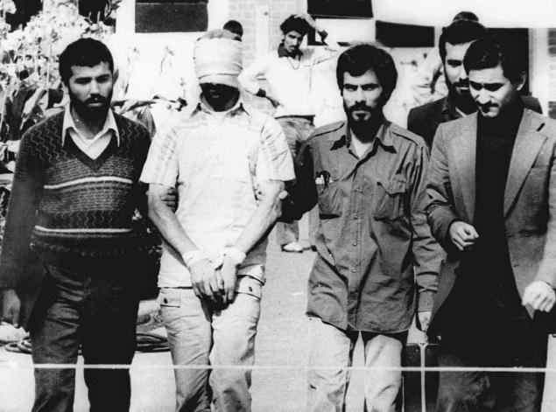
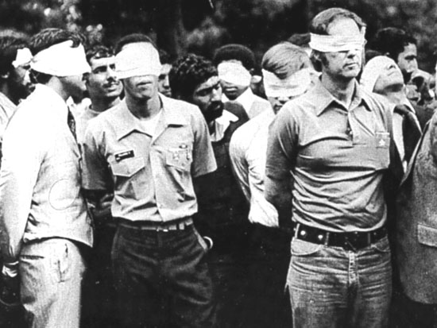

Slide 17
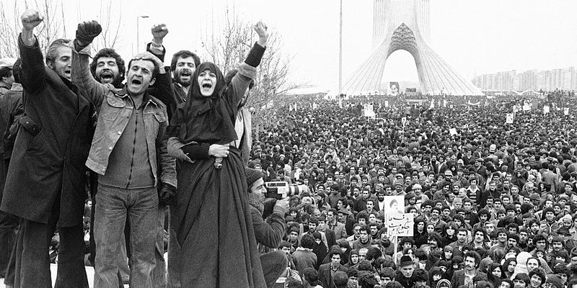
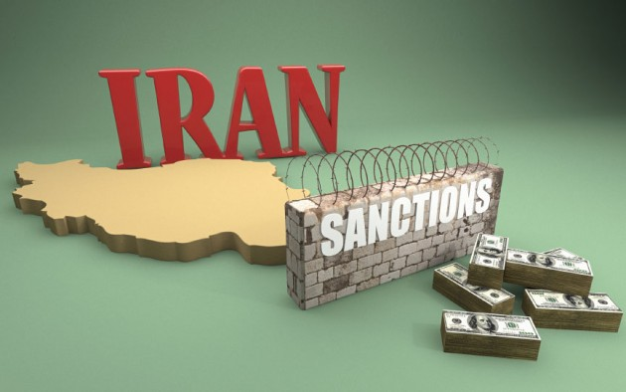
Embargo placed on Iran 1979
As a result:
The United States imposed restrictions on Iran under various legal authorities following the seizure of the U.S. Embassy in Tehran, the capital of Iran.
United States imposed economic sanctions against Iran. (embargo)

Slide 18
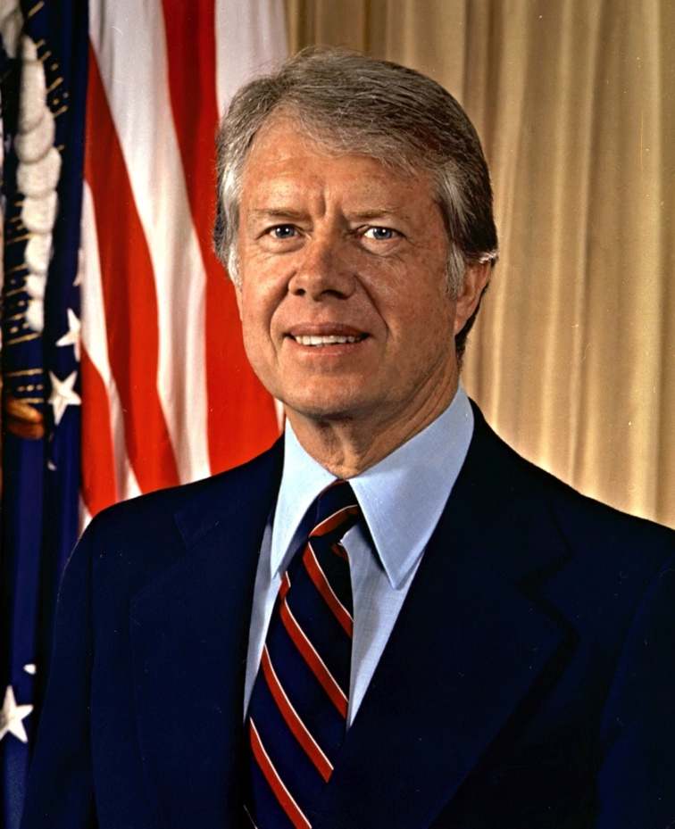
Hostages release
The constant media coverage of the hostage crisis in the U.S. served as a demoralizing backdrop for the 1980 presidential race.
President Carter’s inability to resolve the problem made him look like a weak and ineffectual leader. At the same time, his intense focus on bringing the hostages home kept him away from the campaign trail.
Hostages were releases after 444 days just prior to Ronald Reagans inauguration in 1981.

Slide 19
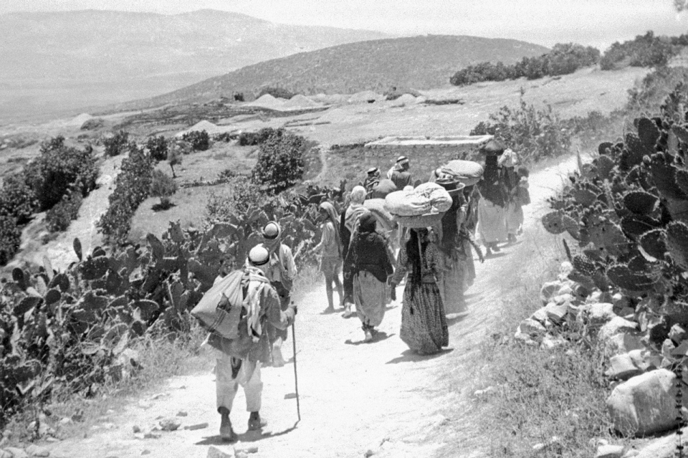
In the early 1970s, tension along the Israel-Lebanon border increased especially after the relocation of armed Palestinian elements to Lebanon.

Slide 20
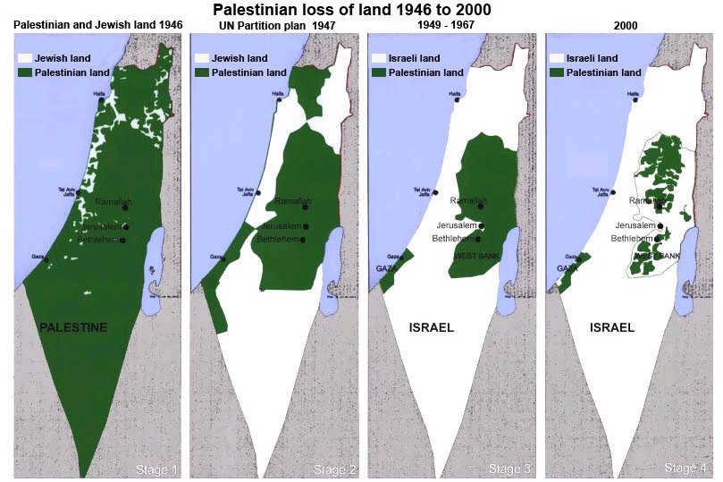
Palestine Liberation Organization (PLO) wanted their land back from Israel. PLO leadership took refuge in Lebanon.

Slide 21
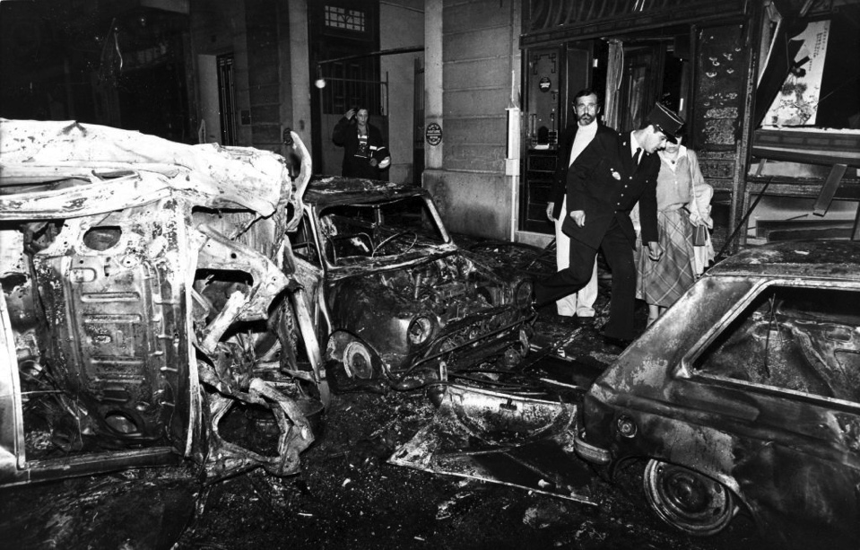
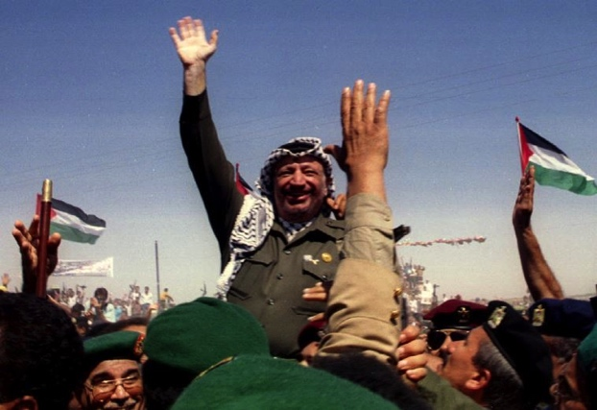
PLO attacks Israel
On March 11, 1978, an attack in Israel resulted in many dead and wounded; the Palestine Liberation Organization (PLO) claimed responsibility for that raid.
Leader of the Palestine Liberation Organization Yasser Arafat

Slide 22
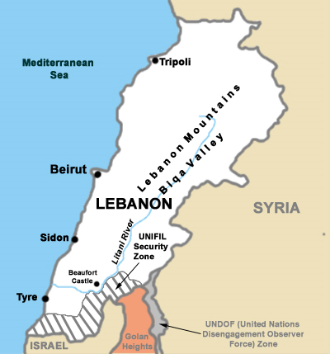
Israel invades Lebanon
In response, Israeli forces invaded Lebanon on the nights of March 14 & 15, 1978, and in a few days occupied the entire southern part of the country.

Slide 23
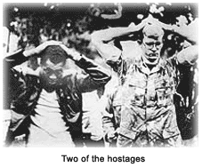
96 hostages taking by Lebanese Government
Those taking responsibility for the kidnapping used different names, but the testimony of former hostages indicates that almost all the kidnappings were done by a single group of about a dozen men coming from various clans within the Hezbollah organization
Hezbollah is the Shi'a Islamist militant group and political party based in Lebanon
Notes:
Lebanon’s Hezbollah is a Shiite Islamist militia, political party, social welfare organization, and
U.S. State Department-designated terrorist organization. Its armed element receives support from
Iran and Syria and possesses significant paramilitary and unconventional warfare capabilities. In
the wake of the summer 2006 war between Israel and Hezbollah and an armed domestic
confrontation between Hezbollah and rival Lebanese groups in May 2008, Lebanon’s political
process is now intensely focused on Hezbollah’s future role in the country. Lebanese factions are
working to define Hezbollah’s role through a series of “National Dialogue” discussions.
Hezbollah and other Lebanese political parties have long emphasized the need to assert control
over remaining disputed areas with Israel. However, current Hezbollah policy statements suggest
that, even if disputed areas were secured, the group would seek to maintain a role for “the
resistance” in providing for Lebanon’s national defense and would resist any Lebanese or
international efforts to disarm it. Hezbollah continues to define itself primarily as a resistance
movement and remains viscerally opposed to what it views as illegitimate U.S. and Israeli
intervention in Lebanese and regional affairs. It categorically refuses to recognize Israel’s right to
exist and opposes all concluded and pending efforts to negotiate resolutions to Arab-Israeli
disputes on the basis of mutual recognition, including the Israeli-Palestinian conflict.

Slide 24
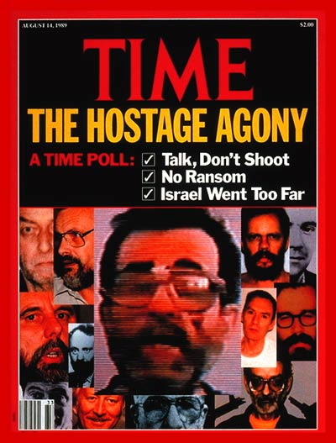

Slide 25
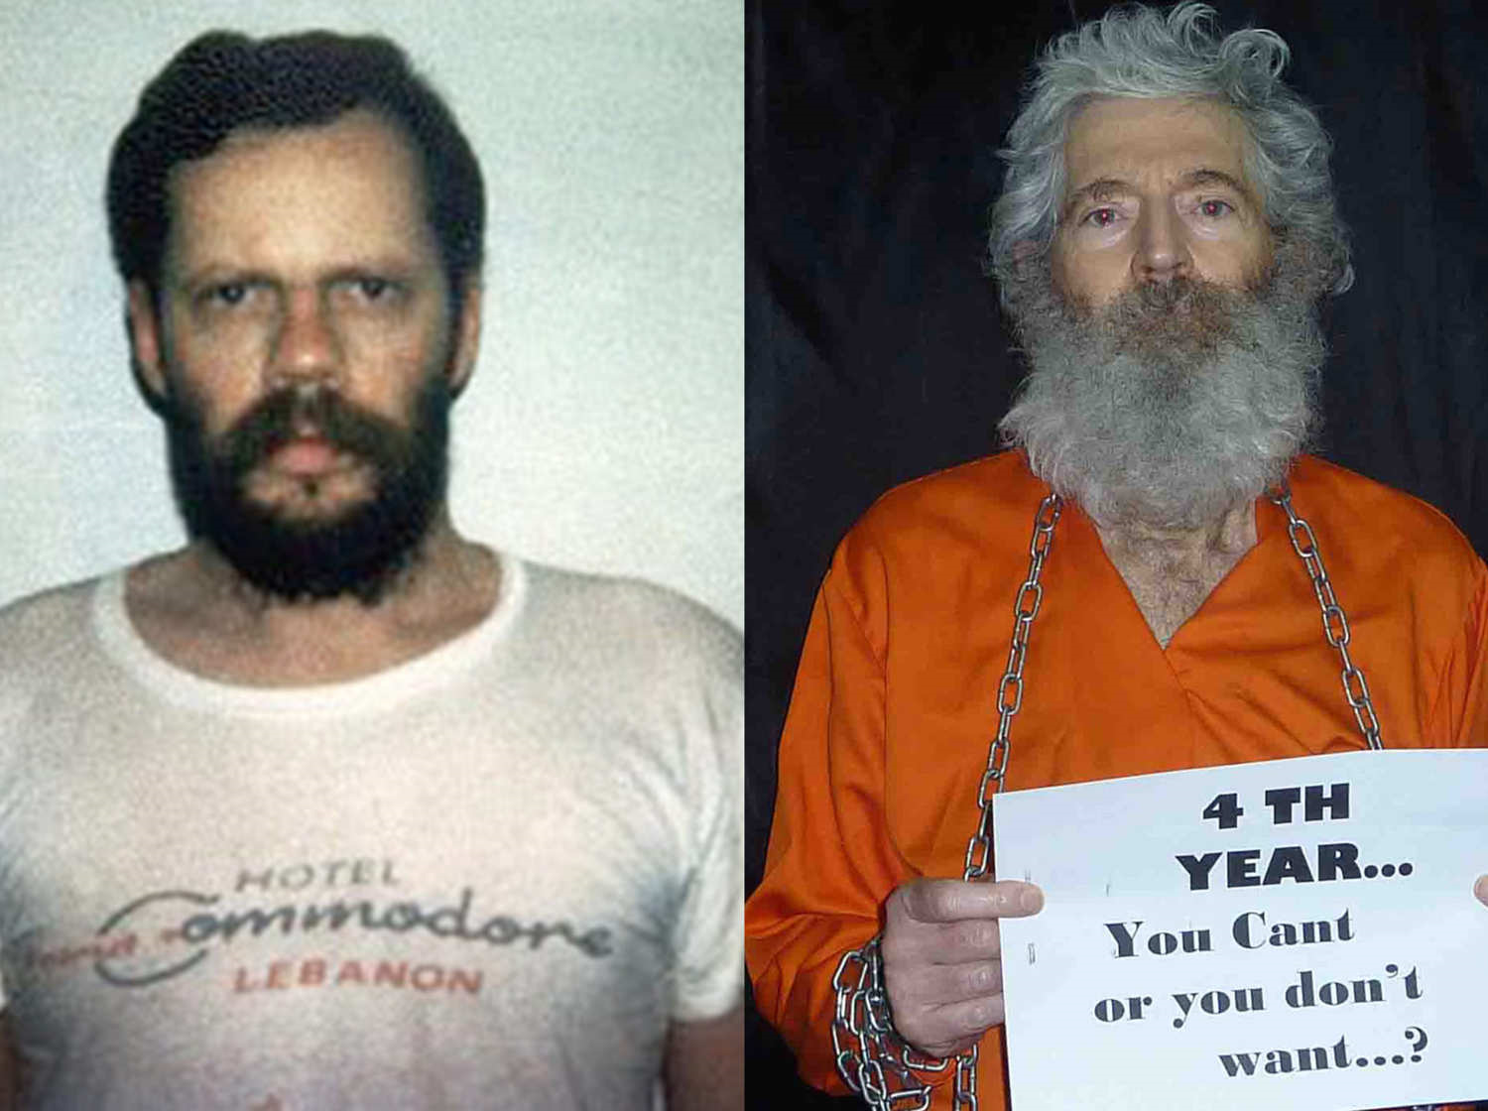

Slide 26
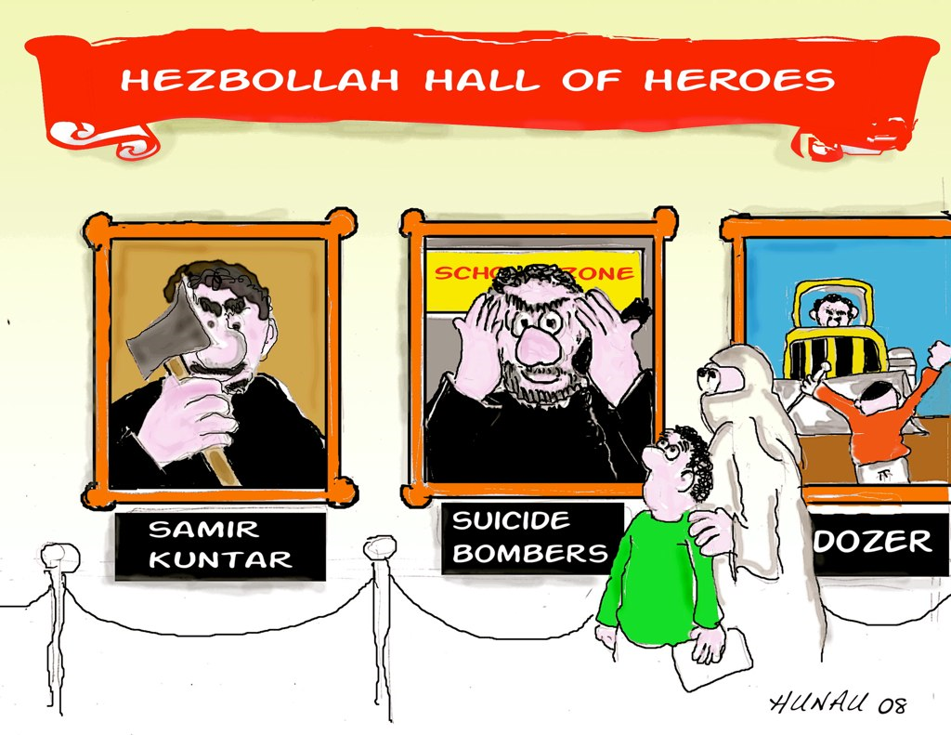

Slide 27
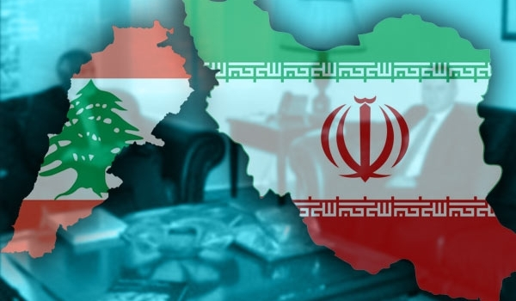
Iran and Lebanon Mutual nations
Since the Hezbollah party was founded in the early 1980s, Hezbollah has received financial, military, and political support from Iran.

Slide 28
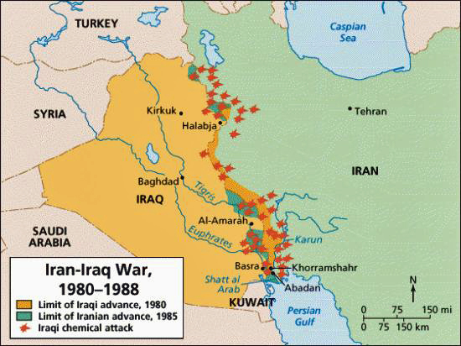
Iran-Iraq War
On Sept. 22, 1980, Iraqi armed forces invaded western Iran along the countries’ joint border.
The roots of the war lay in a number of territorial and political disputes between Iraq and Iran. Iraq wanted to seize control of the rich oil-producing Iranian border region.

Slide 29
Nicaragua

Slide 30
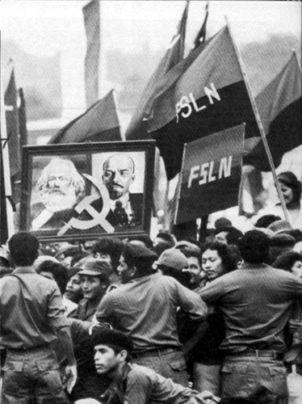
Sandinistas
Sandinistas were members of a left-wing (communist leaning) Nicaraguan political party.
The Sandinista National Liberation Front overthrew President Anastasio Somoza Debayle in 1979, ending 46 years of dictatorship by the Somoza family.
Street sign in Managua in 1983: Death to Yankee Imperialism!

Slide 31
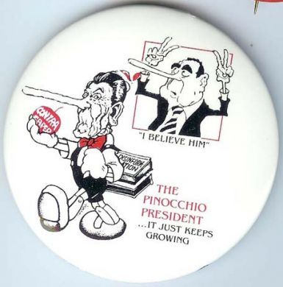
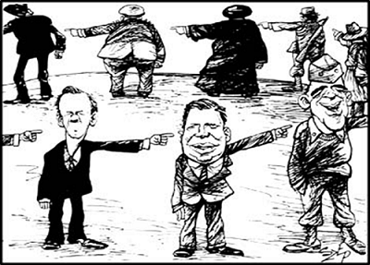
12 groups
Document Analysis Poster
Your group will make a poster summarizing an assigned document.
Be prepared to explain your poster to the class.

Slide 32
Poster
Document Analysis Poster should consist of;
Title
Key details of the document
Good grammar and spelling
HIPP Analysis
H-Historical context of document (What’s happened or happening?)
I –Intended Audience (Who was this document mean for?)
P- Point of View (Whose side is portrayed?)
P- Purpose (What is the purpose of this document?)

Slide 33
Connections Between the Documents
Each group will present their posters to the class in chronological order. In other words, you will tape up your poster so everyone can see it and explain how your document adds to the story.
While each group is taking their turn, you should be taking notes and making a small timeline on your Timeline Project worksheet.

Slide 34
Post in Order of Events

Slide 35
Assessment
Your essay will make an analysis of the Iran-Contra Affair timeline. Be sure to include how the documents connect to show the big picture of the Iran-Contra Affair.
Your essay should include whether you think President Regan knew what was happening? What is your evidence?
Your essay should include your opinions on taking hostages, terrorism, and buying weapons.
Look at the Scoring Guide so you see how the points will be assigned.

