Slide 1
Racism, Relocation, and Redress: The Japanese-Canadian Experience
Images of the Japanese-Canadian Experience Before, During, and After World War II
Dennis Rees
Arizona Geographic Alliance Teacher-Consultant
K-12 Study Canada Teacher Associate

Slide 2
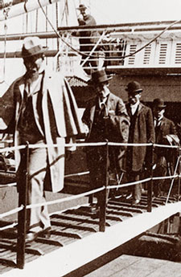
Japanese immigrants arriving in Canada.
www.cic.gc.ca
Notes:
www.cic.gc.ca

Slide 3
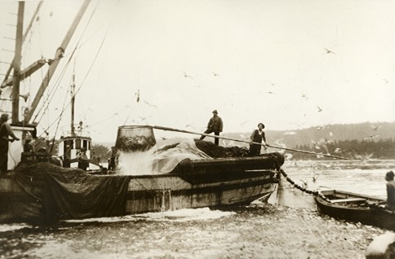
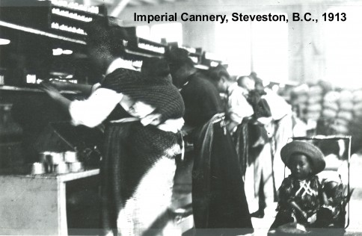
They worked in the fishing industry, agriculture,
www.sedai.ca
www.sedai.ca
Notes:
www.sedai.ca

Slide 4
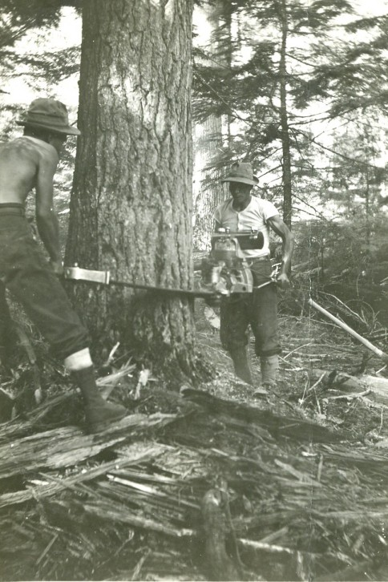
lumber industry, and mines.
www.sedai.ca
Notes:
www.collectionscanada.gc.ca

Slide 5
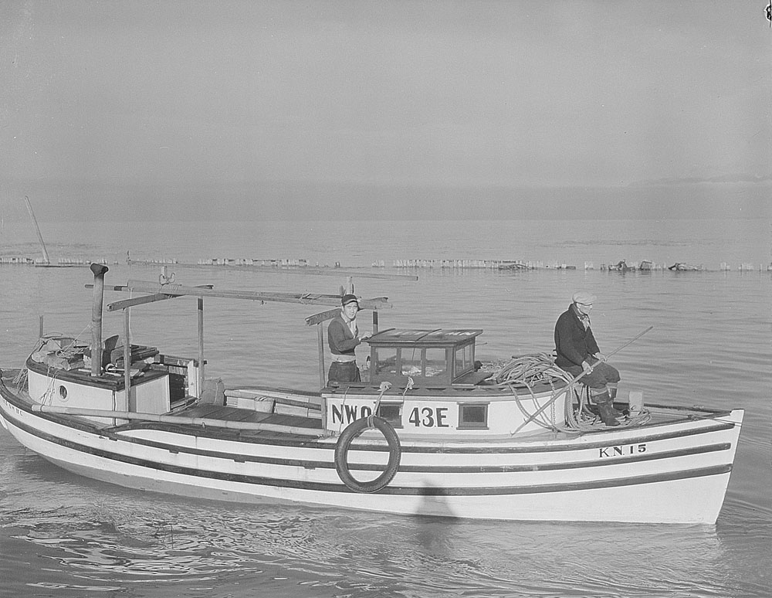
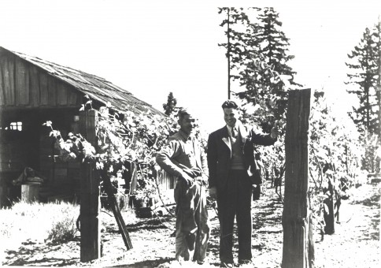
In time, they bought and owned their own fishing boats, farms,
www.collectionscanada.gc.ca
www.sedai.ca
Notes:
www.sedai.ca

Slide 6
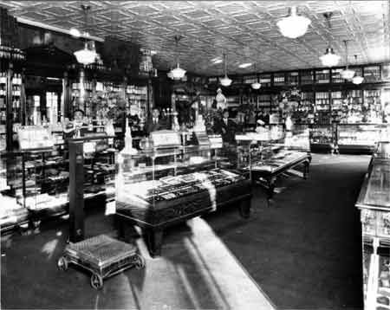
and businesses.
www.japanesecanadianhistory.net
Notes:
www.japanesecanadianhistory.net

Slide 7
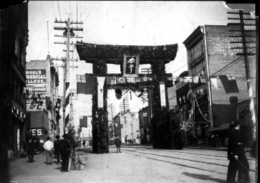
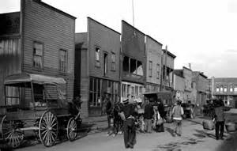
Japanese-Canadians clustered in their own neighborhoods
www.vancouversun.com
www.vancouverisawesome.com
Notes:
www.vancouverisawesome.com

Slide 8
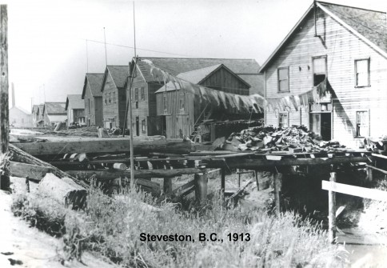
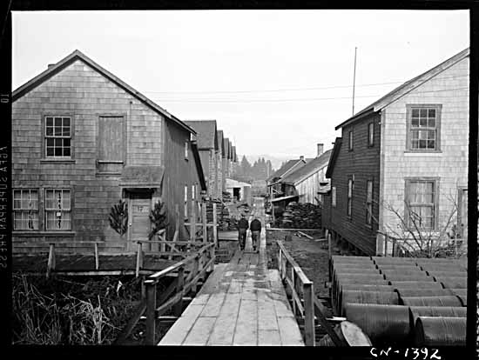
and towns.
www.thecanadianencyclopedia.ca
www.sedai.ca
Notes:
www.sedai.ca

Slide 9
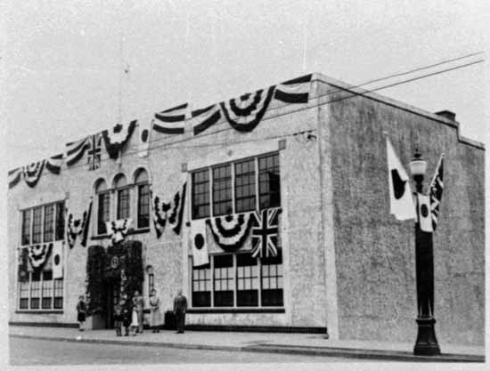
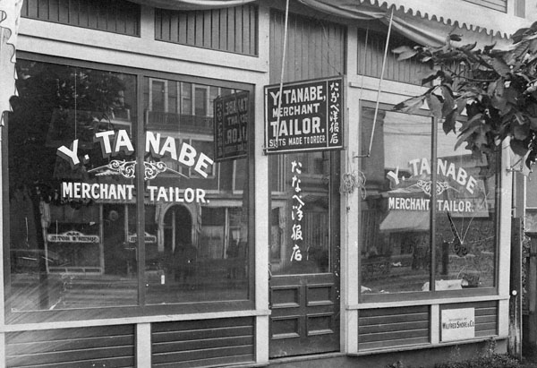
Here they established their own institutions like social clubs and businesses.
www.thecanadianencyclopedia.ca
www.collectionscanada.gc.ca
Notes:
www.collectionscanada.gc.ca

Slide 10
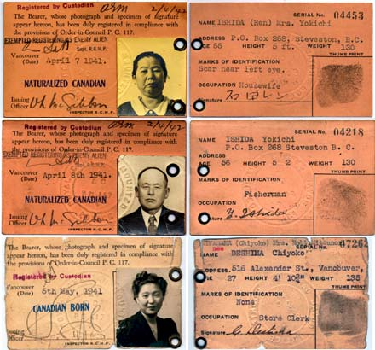
These are Japanese-Canadian registration cards.
www.japanesecanadianhistory.net
Notes:
www.japanesecanadianhistory.net

Slide 11
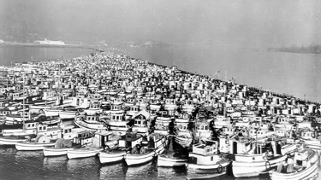
These are confiscated Japanese-Canadian fishing boats.
www.lib.washington.edu
Notes:
www.lib.washinton.edu

Slide 12
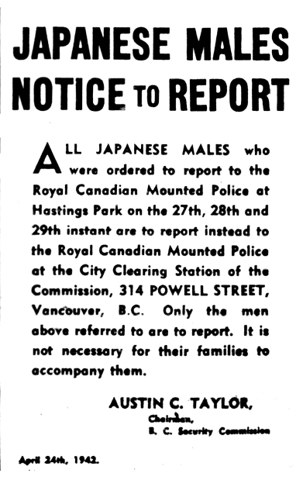
Relocation Notice For Japanese-Canadian Men
www.ottawacitizen.com
Notes:
www.ottawacitizen.com

Slide 13
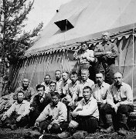
Road Camp
www.whenintime.com
Notes:
www.whenintime.com

Slide 14
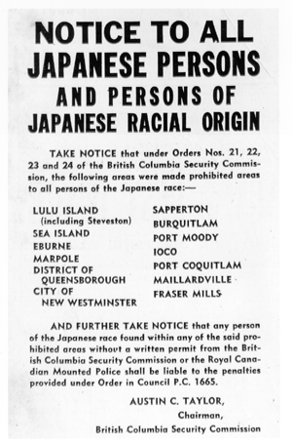

Relocation Notice for All Japanese-Canadians and Liquidation of Assets
www.windsorstar.com
www.lib.washington.edu
Notes:
www.windsorstar.com

Slide 15
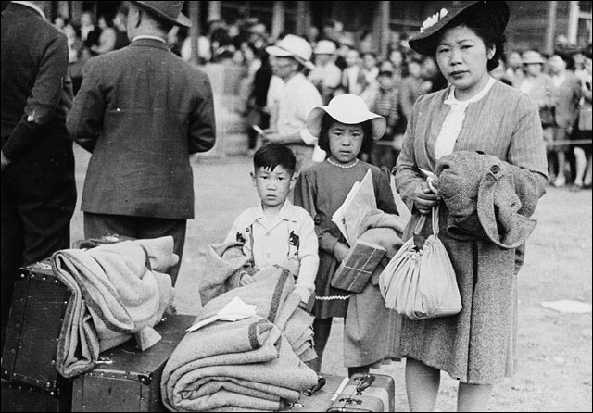
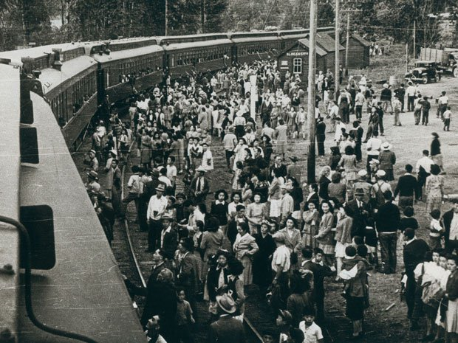
Reporting for Relocation
www65.statcan.gc.ca
www.news.nationalpost.com
Notes:
www.news.nationalpost.com

Slide 16
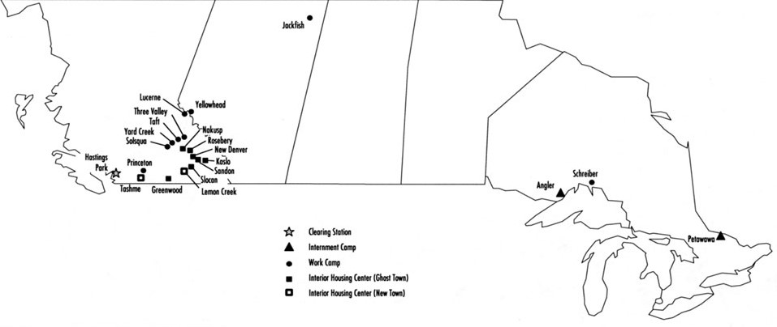
Map of Internment Camp Locations
www.awesomestories.com
Notes:
www.awesomestories.com

Slide 17
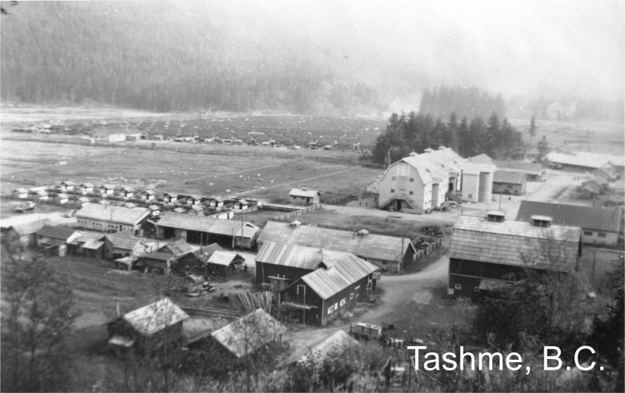
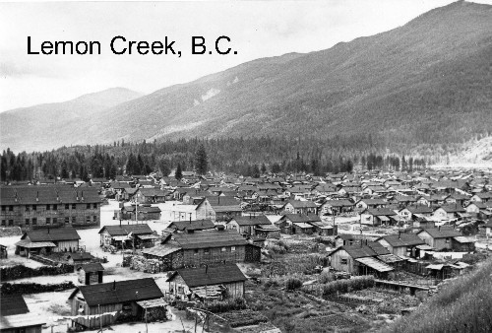
The Camps
www.sedai.ca
www.japaneseinternment101.blogspot.com
Notes:
www.japaneseinternment101.blogspot.com

Slide 18
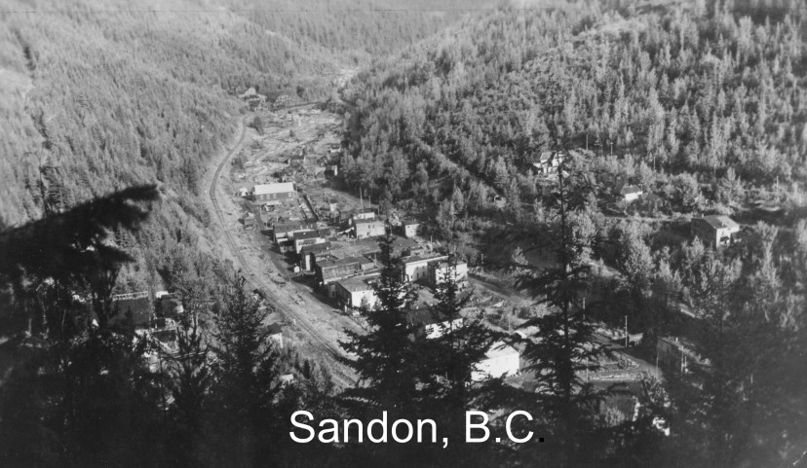
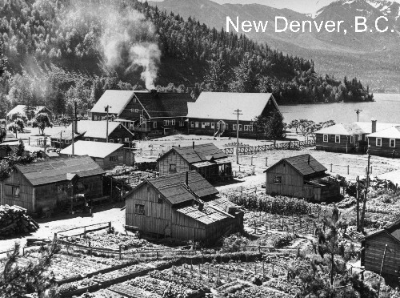
www.sedai.ca
www.discovernikkei.org
Notes:
www.discovernikkei.org

Slide 19
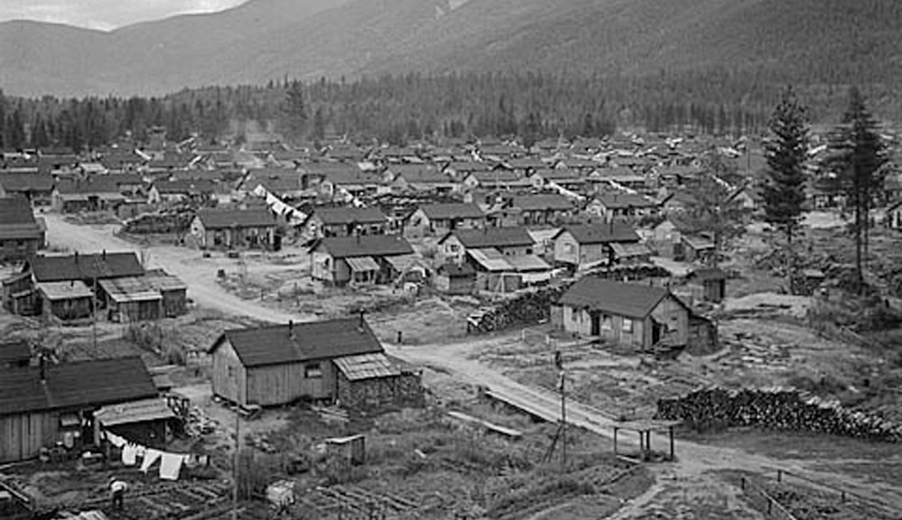
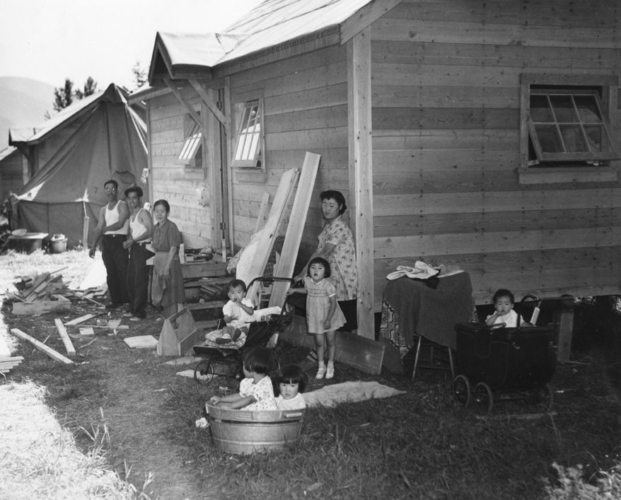
www.ufv.ca
www.lorimer.ca
Notes:
www.lorimer.ca

Slide 20
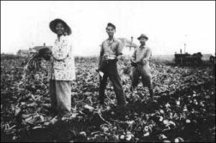
Internees Working on Sugar Beet Farm
www.postalhistorycorner.blogspot.com
Notes:
www.postalhistorycorner.blogspot.com

Slide 21
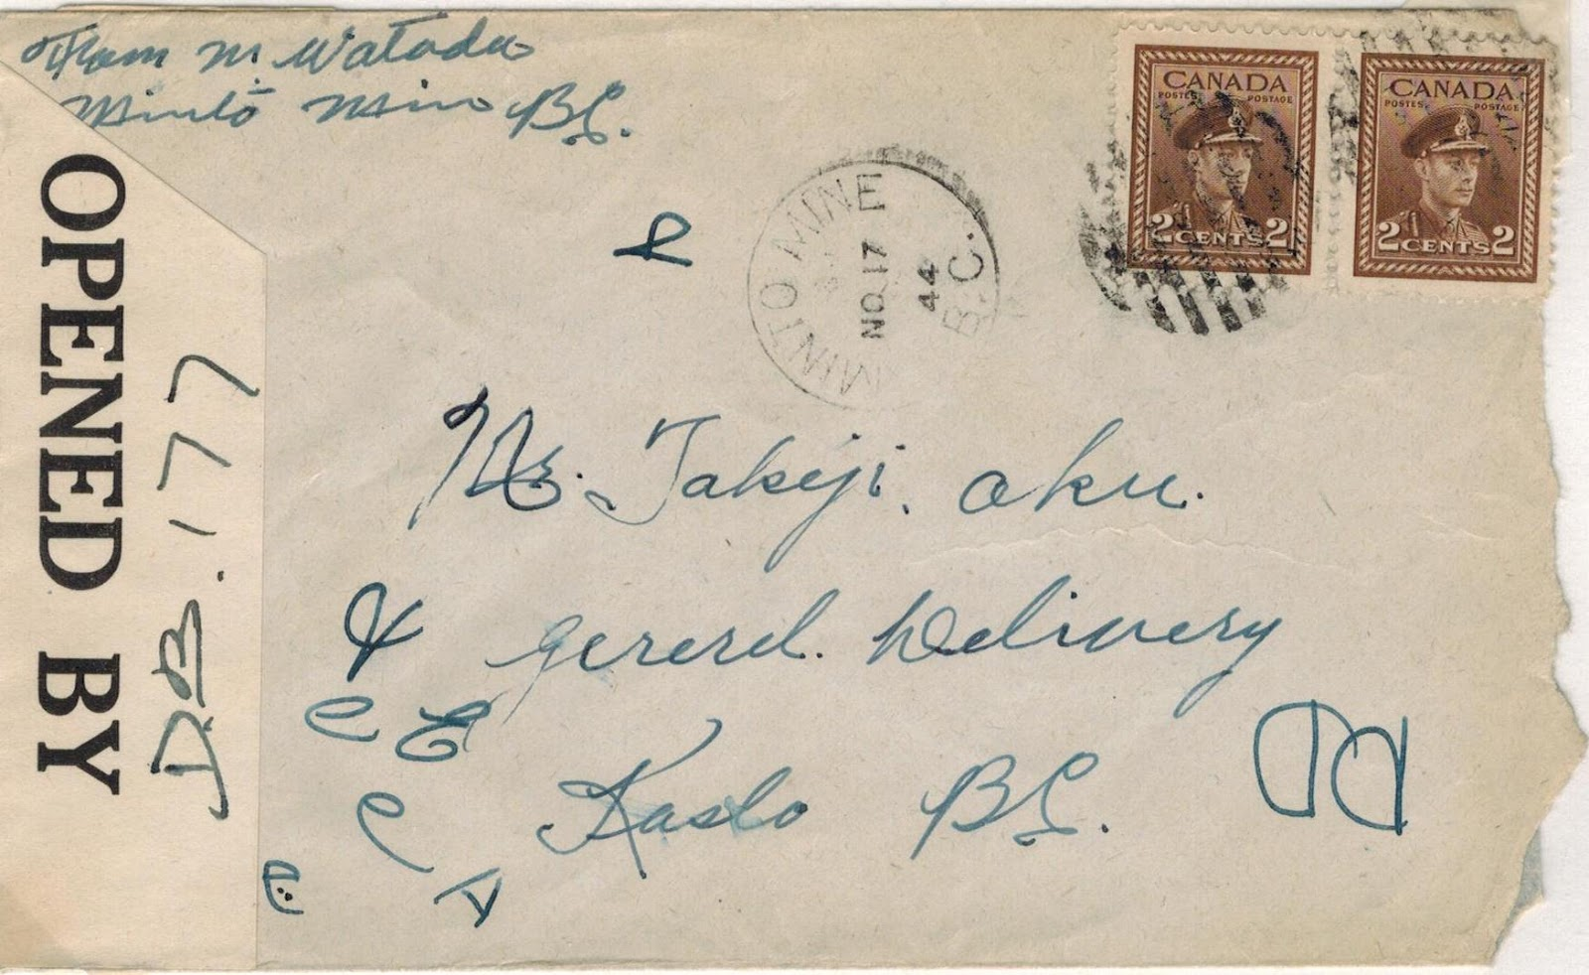
Example of Censored Mail
www.postalhistorycorner.blogspot.com
Notes:
www.postalhistorycorner.blogspot.com

Slide 22
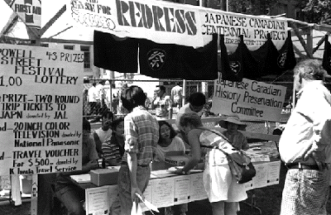
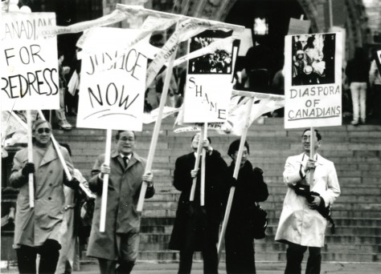
The Redress Movement
www.bcandnorth.blogspot.com
www.sedai.ca
Notes:
www.sedai.ca

Slide 23
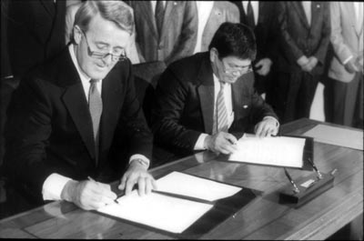
Redress
www.japanesecanadianhistory.net
Notes:
www.japanesecanadianhistory.net

