Slide 1
The Canadian Caper
Images of how Canada aided the United States during the Iranian Hostage Crisis
Dennis Rees
Arizona Geographic Alliance Teacher-Consultant
K-12 Study Canada Teacher Associate

Slide 2
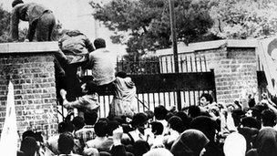
Storming the embassy
www.bbc.co.uk
Notes:
Storming the embassy

Slide 3
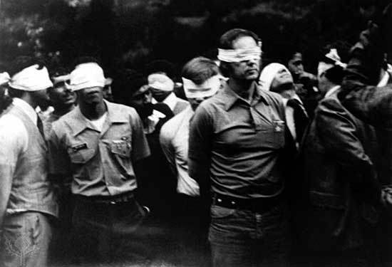
Hostages taken
www.iconphotos.wordpress.com
Notes:
Hostages taken

Slide 4
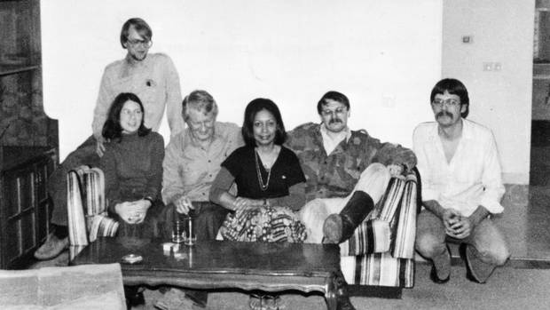
The six who escaped
www.cdfai3ds.wordpress.com
Notes:
The Six who escaped

Slide 5
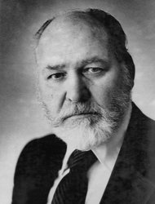
John Sheardown
www.pinterest.com
Notes:
John Sheardown

Slide 6
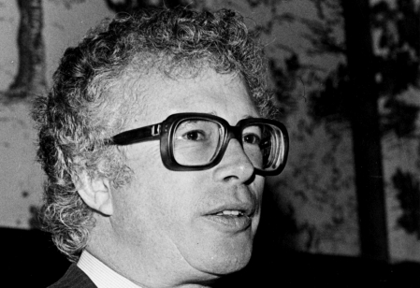
Ken Taylor
www.themoviepatrol.blogspot.com
Notes:
Ken Taylor

Slide 7
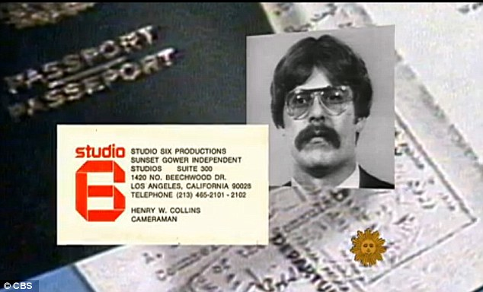
Fake Passports
www.gazingattheflag.blogspot.com
Notes:
Fake Passports

Slide 8
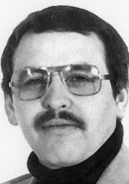
Tony Mendez
www.historyvshollywood.com
Notes:
Tony Mendez

Slide 9
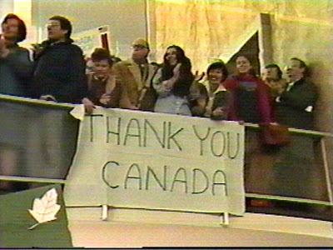
Thank-you banners
www.gazingattheflage.blogspot.com
Notes:
Thank-you banners

Slide 10
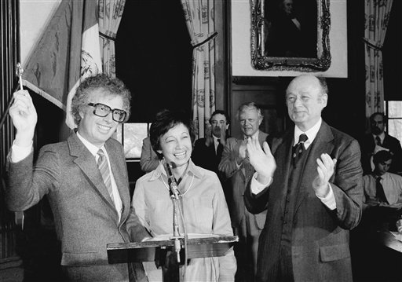
Keys to the city
www.bigstory.ap.org
Notes:
Keys to the city

Slide 11
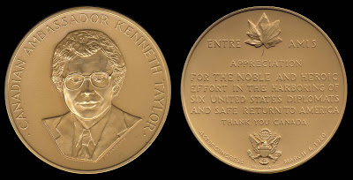
Congressional Gold Medal
www.gazingattheflag.blogspot.com
Notes:
Congressional Gold Medal

Slide 12
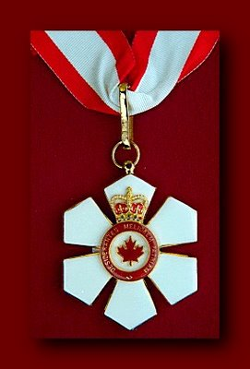
Order of Canada
Notes:
Order of Canada

Slide 13
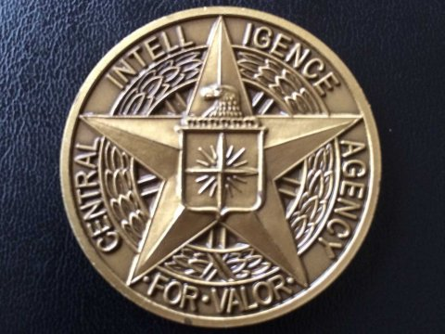
CIA Intelligence Star for Valor
www.businessinsider.com
Notes:
CIA Intelligence Star for Valor

Slide 14
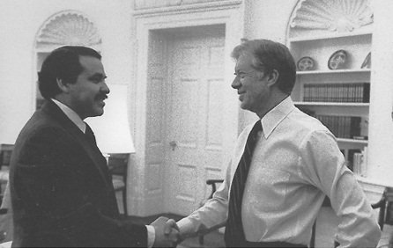
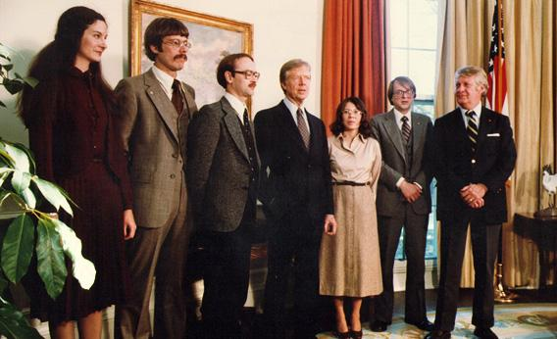
Meeting President Carter
www.diadehistoria.com.ar
www.starcasm.net
Notes:
Meeting President Carter

Slide 15
Movie: Argo
Trailer to the Movie
http://www.imdb.com/title/tt1024648/
http://qz.com/293887/the-cia-finally-sets-the-record-straight-on-the-true-story-behind-argo/
http://www.thedailybeast.com/articles/2012/09/17/the-true-story-behind-operation-argo-to-rescue-americans-from-iran.html

