Slide 1
Which Region Is It?
Directions: When each slide is shown, write in the appropriate box on your Which Region Is It? Recording Form the name of the region you think it represents and a reason why.

Slide 2
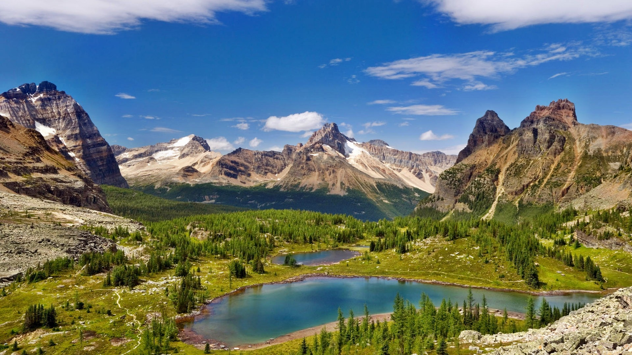
www.listofimages.com
Notes:
www.listofimages.com

Slide 3
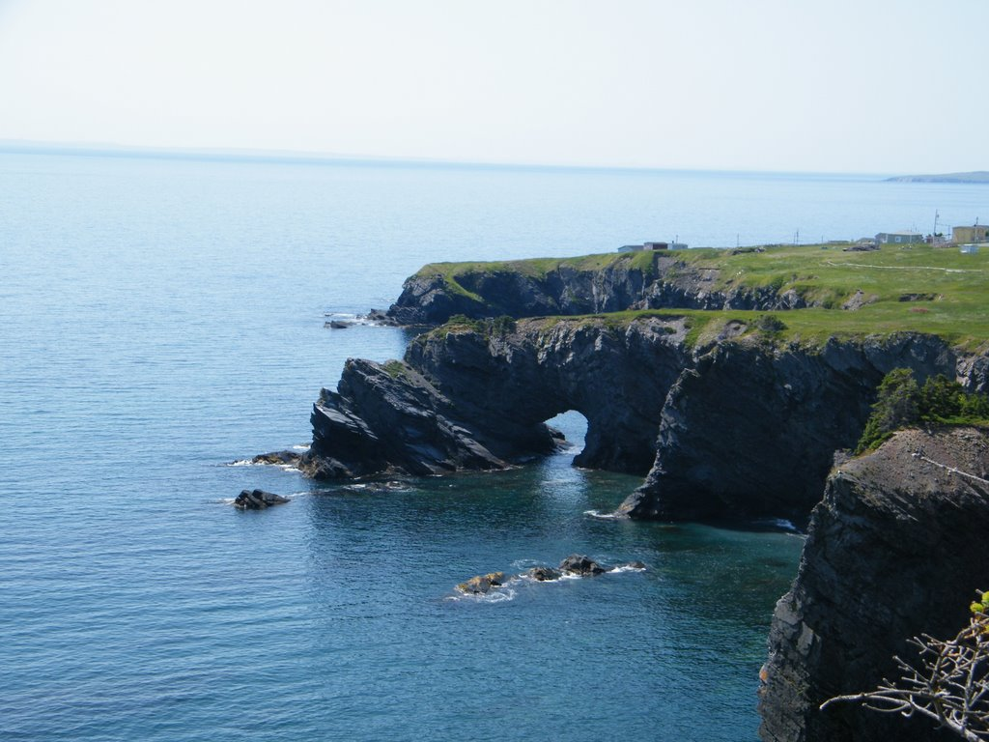
www.panoramio.com
Notes:
www.panoramio.com

Slide 4
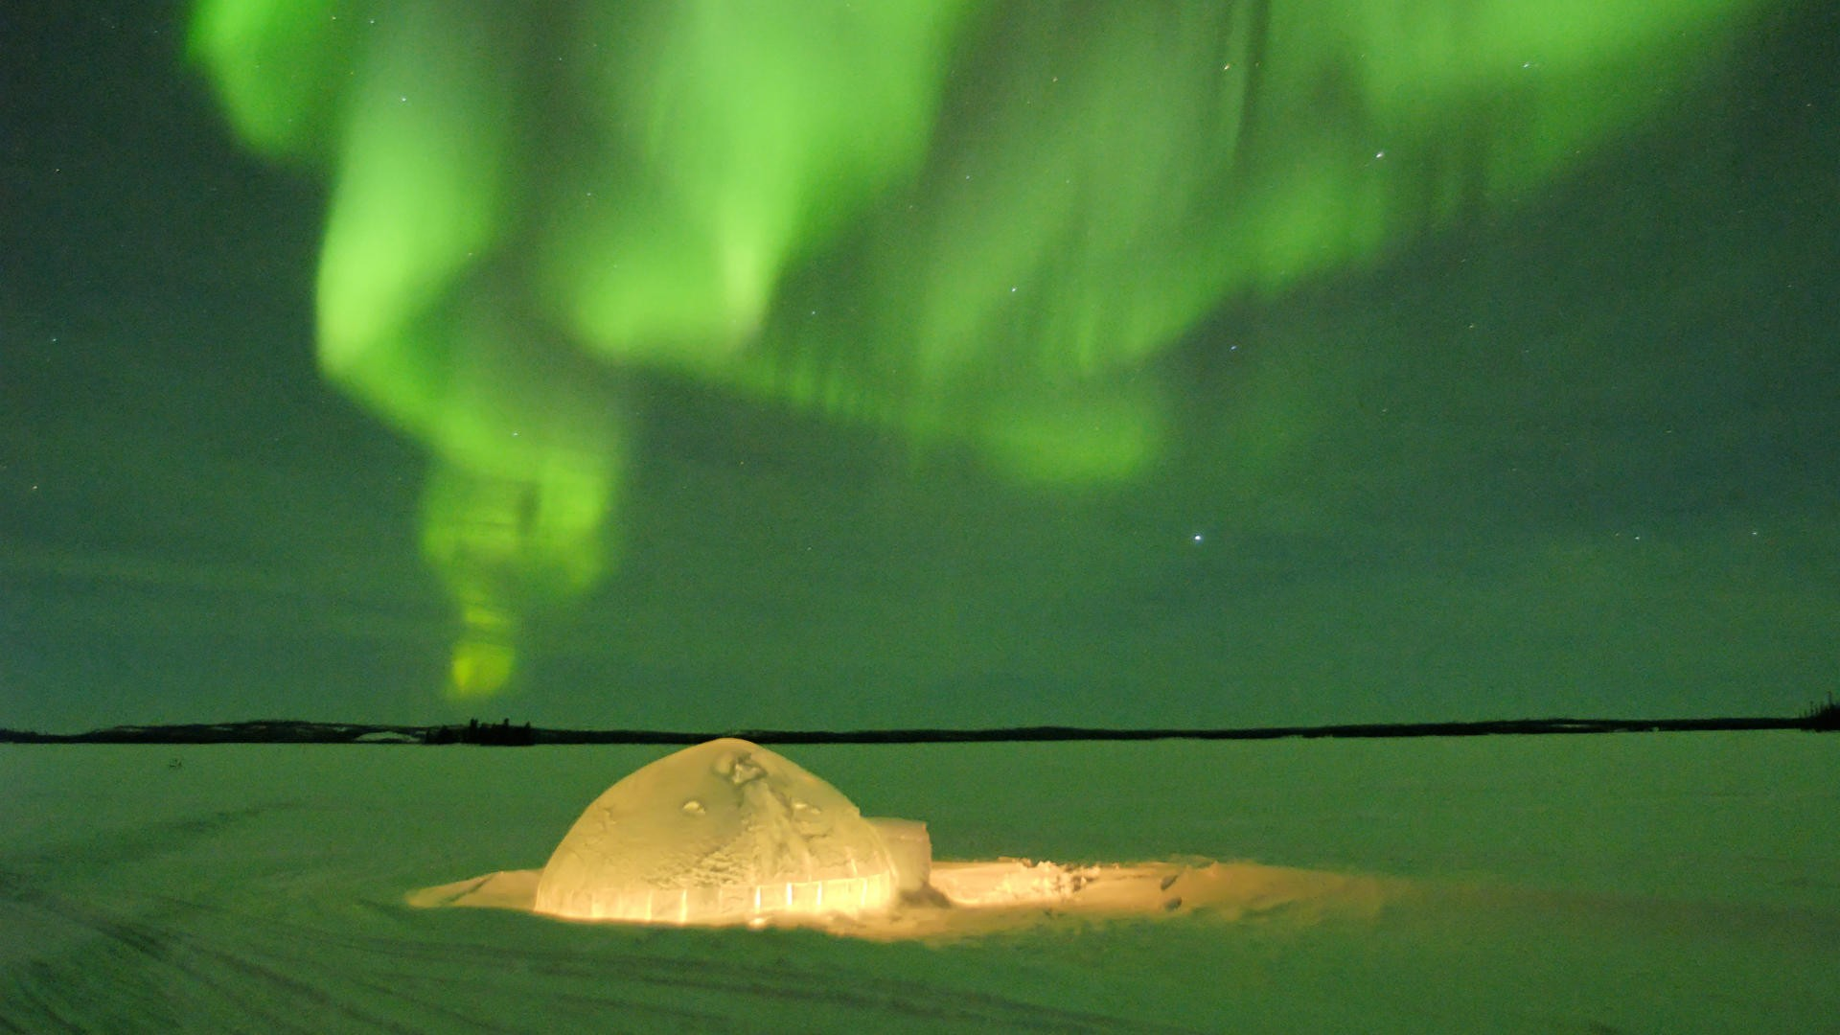
www.wallpaper.com
Notes:
www.wallpaper.com

Slide 5
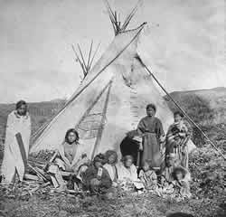
www.visitmt.com
Notes:
www.visitmt.com

Slide 6
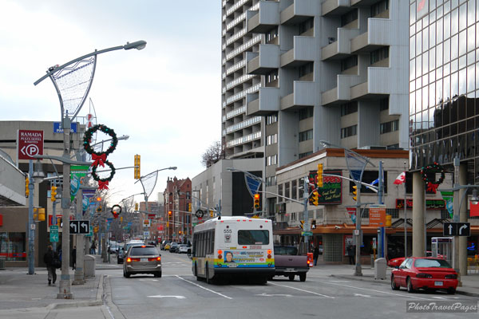
www.datuopinion.com
Notes:
www.datuopinion.com

Slide 7
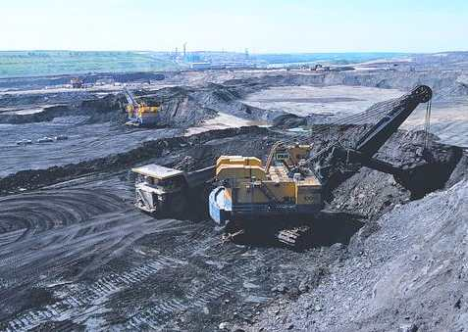
www.solarnavigator.net
Notes:
www.solarnavigator.net

Slide 8
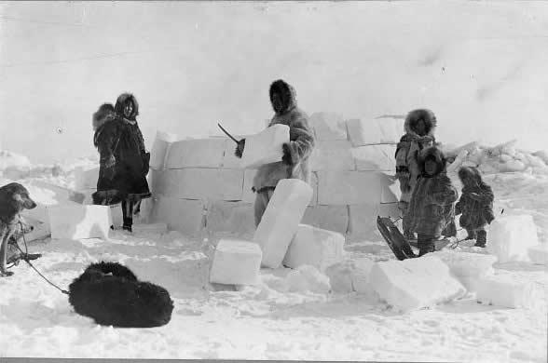
www.thecanadianencyclopedia.com
Notes:
www.thecanadianencyclopedia.com

Slide 9
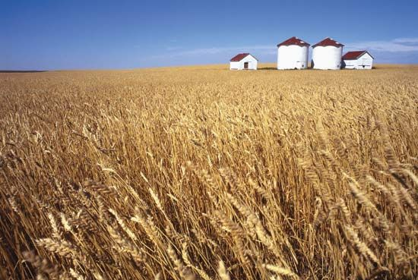
www.pinterest.com
Notes:
www.pinterest.com

Slide 10
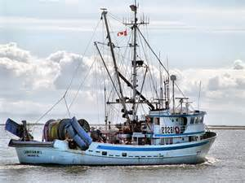
www.flicker.com
Notes:
www.flicker.com

Slide 11
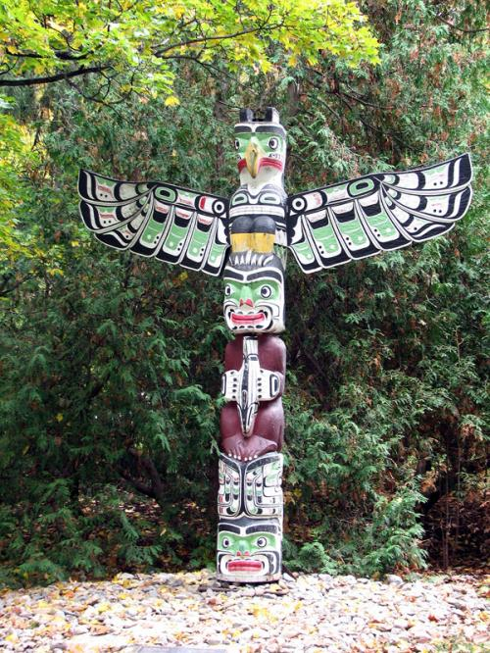
www.ontariopics.com
Notes:
www.ontariopics.com

