Slide 1
The Gift of Water
Alejandro’s Gift

Slide 2
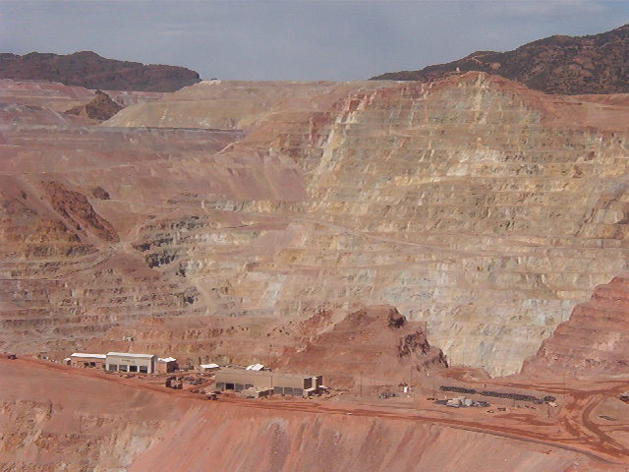
Geography Vocabulary
natural resources: materials that we use that come from nature, like water, or coal
Copper Mining in Morenci, AZ Photo by Gale Ekiss

Slide 3
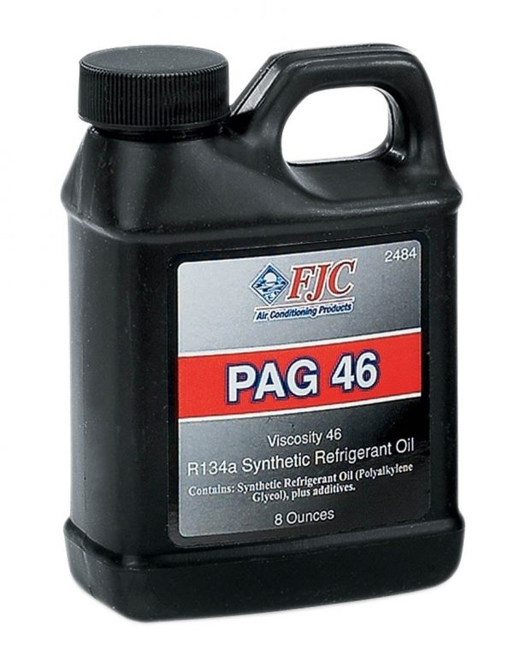
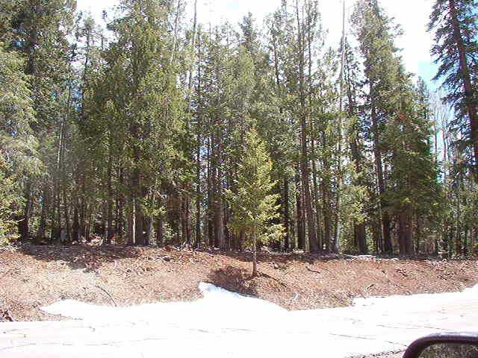
Other Natural Resources include:
Oil Trees
https://metrocouncil.us/8m7wwa/
Photo by Gale Ekiss

Slide 4
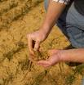
Soil
edcintl.cr.usgs.gov
www.bawbawshire.vic.gov.au

Slide 5
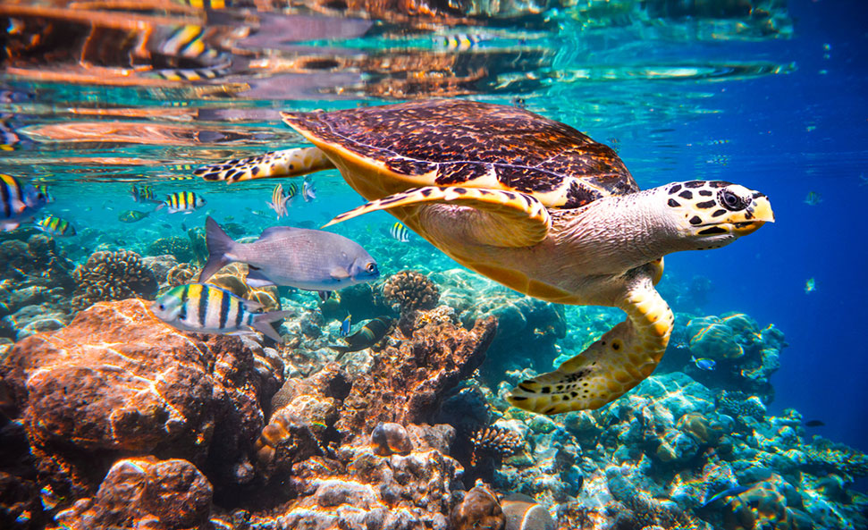
Environment:
Soil, climate, and living things that influence the the ability of a plant or animal to survive
https://e-csr.net/definitions/ecosystem-definition-example/

Slide 6
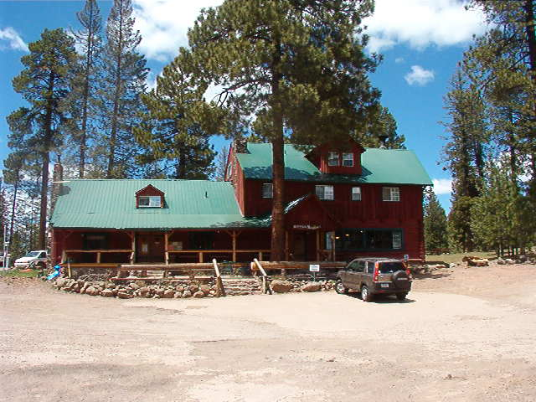
Modification:
A change that alters the environment
Photo by Gale Ekiss

Slide 7
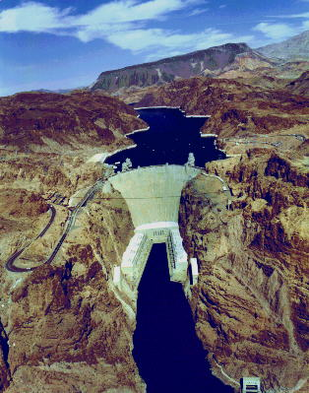
An Aerial View of Hoover Dam
What natural resource do you see in this photo?
What modifications were made to the physical environment?
geochange.er.usgs.gov

Slide 8
A Golf Course in the Desert
How was the physical environment modified
to make this golf course?
What natural resources must be used to maintain this golf course?
www.hawaii.gov

Slide 9
Farming
How was the physical environment modified to make the farm?
What natural resources does the farm need?
www.maine.gov
portal.delaware.gov

Slide 10
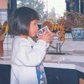
Drinking Water
How has the physical environment been modified to provide your drinking water?
pubs.usgs.gov
https://innovativeh2o.com/

Slide 11
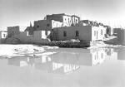
Words from Alejandro’s Gift
Adobe: A brick or building material made of sun dried earth and straw
www.archives.gov

Slide 12
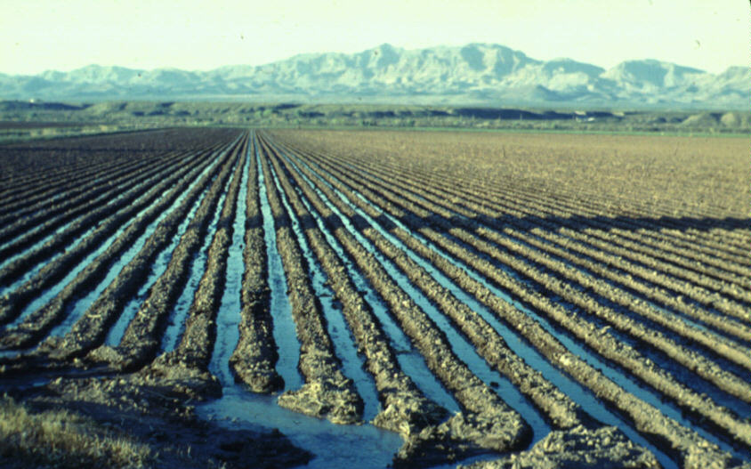
Words from Alejandro’s Giift
Furrow: a narrow groove made in the ground
http://www.ers.usda.gov/Briefing/WaterUse/Images/furrow1.jpg

Slide 13
Words From Alejandro’s Gift
Cherish: To keep or care for with affection.
http://english.taipei.gov.tw/web/upload/112313820972800.jpg

Slide 14
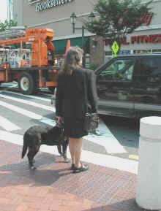
Words From Alejandro’s Gift
Hesitate: To hold back in doubt or uncertainty
http://www.access-board.gov/research/roundabouts/fig6.jpg

Slide 15
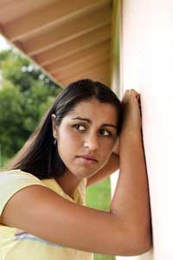
Words From Alejandro’s Gift
Lonely: Sad from being alone
http://www.4girls.gov/mind/depression.jpg

Slide 16
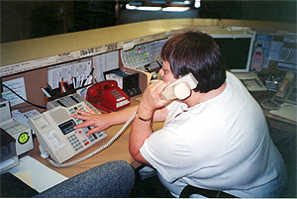
Words From Alejandro’s Gift
Drudgery: Dull and tiring work.
http://www.oregon.gov/DHS/news/staff/images/fimages/MarieSmith2.jpg

Slide 17
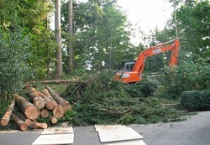
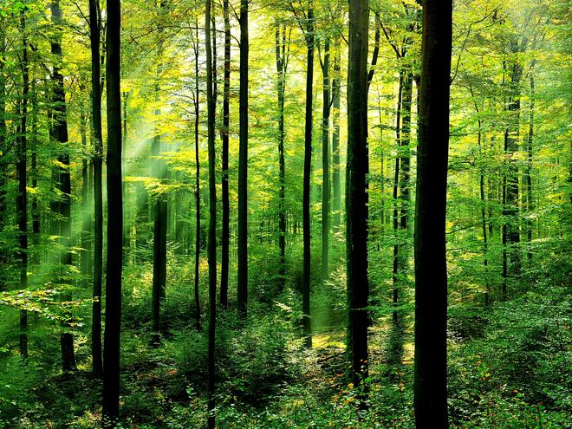
Model for student assessment
Natural Resource Modification
Trees
Logging

