Slide 1
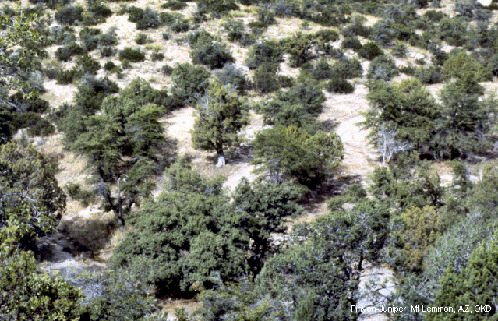
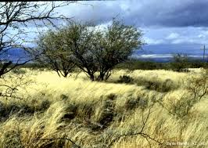
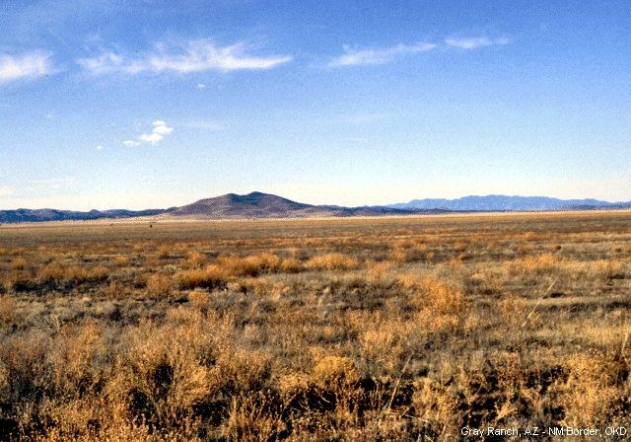
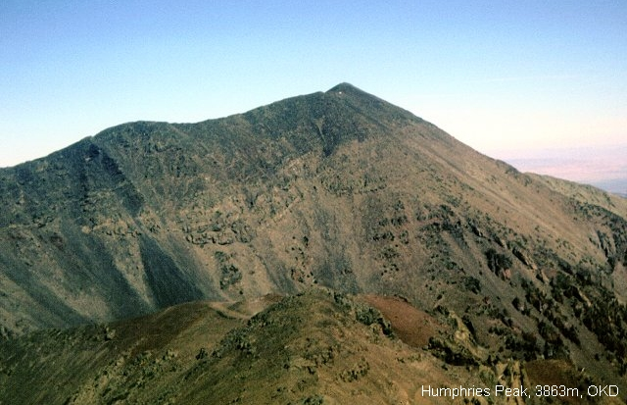
Learning the 6 Biomes of Arizona
Geo.Arizona.edu

Slide 2
6 biomes of Arizona are:
Tundra
Forest
Woodlands
Chaparral
Desert Grasslands
Desert

Slide 3
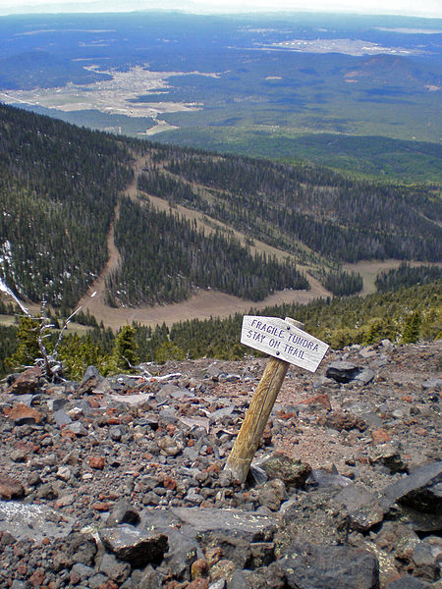
Tundra
Of all of the biomes in Arizona, the tundra is the most easily hurt. It is only found on the top of the San Francisco Mountains and on top of Mt. Baldy (Arizona’s highest mountain peak). The ground of the tundra is typically frozen, year round. Tundra doesn’t have any trees.
https://askabiologist.asu.edu/anatomy-tundra

Slide 4
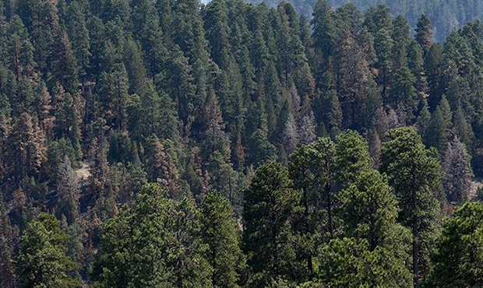
Forest
National Forests cover 15% of Arizona. There are 6 National Forests in the state. They are:
Apache-Sitgraeaves
Coconino
Coronado
Kaibab
Prescott
Tonto
https://www.signalsaz.com
https://ktar.com

Slide 5
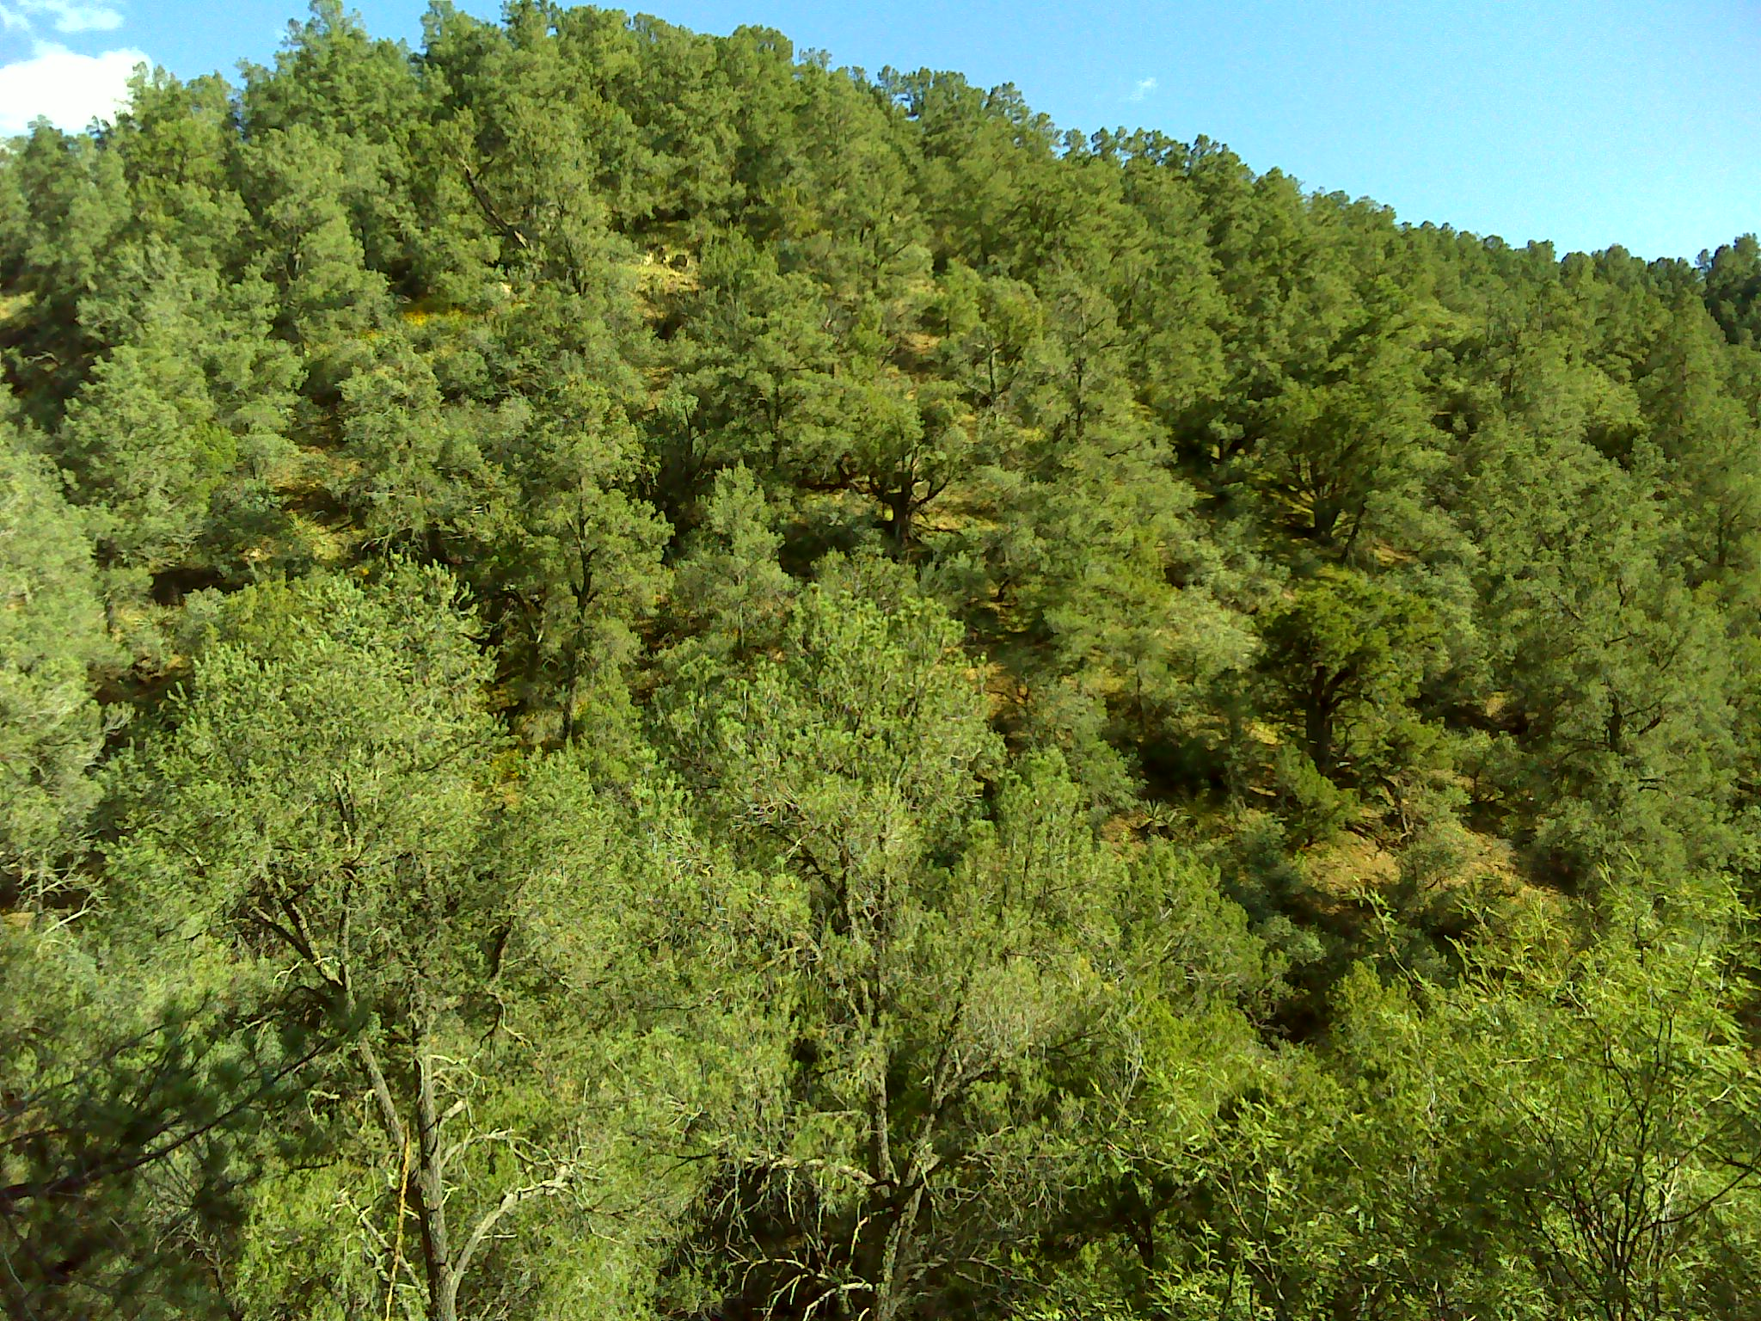
Woodland
Woodlands
The woodlands biome is very similar to the forests biome, with the exception of one major factor. The woodlands are more open, or not as dense as the forests. The animals tend to be smaller in woodlands, compared to those of the forests.
https://www.fs.fed.us
https://www.azfirescape.org

Slide 6
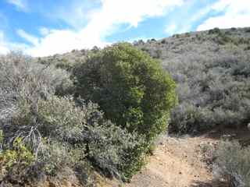
Chaparral
The word chaparral comes from the Spanish word chaparro, which means SCRUB OAK. This is one of the lesser known biomes. It is semi-arid, and mostly dominated by shrub-like (bush-like) plants. Animals in this biome are smaller then those that inhabit the woodlands and forests.
https://cals.arizona.edu/

Slide 7
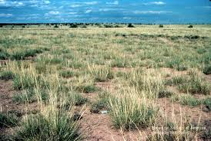
Desert Grassland
The desert grassland experiences the most damage by humans and livestock! The plants of this biome are mostly grasses that grazing animals prefer to eat.
https://www.usgs.gov

Slide 8
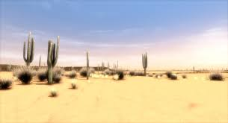
Desert
This is the hottest and driest part of Arizona. The definition of a desert states that this area will receive (on average) less than 10 inches of rain in a year. There are parts of 4 deserts in Arizona. They are the:
Sonoran
Mojave
Great Basin
Chihuahuan
https://www.rei.com

Slide 9
Websites
Tundra
https://askabiologist.asu.edu/anatomy-tundra (Be sure to look at the Read More About)
Forest https://askabiologist.asu.edu/explore/temperate-forest (Be sure to look at the Read More About)
Woodland
https://www.desertmuseum.org/visit/exhibits_mountainwoodland.php

Slide 10
Websites
Chaparral
https://www.conserve-energy-future.com/chaparral-biome.php
Desert Grassland
https://www.desertmuseum.org/visit/exhibits_desertgrassland.php
Desert (Be sure to look at the Read More About)
https://askabiologist.asu.edu/plants-desert

