Slide 1
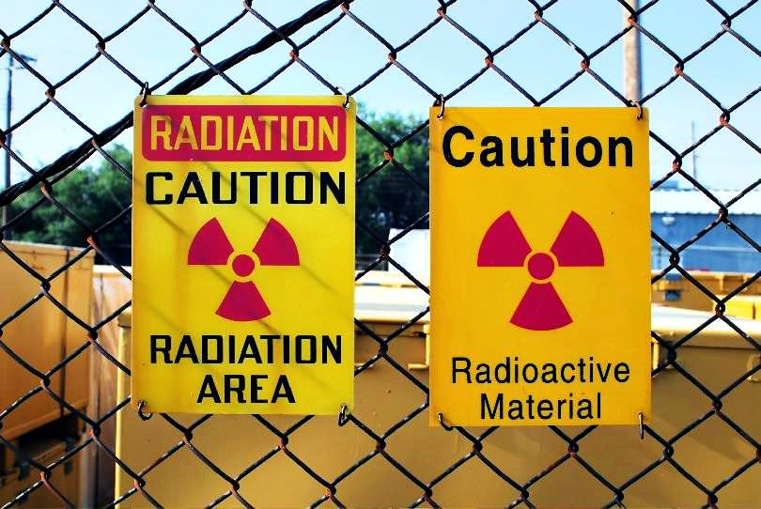
Our Radioactive Backyard
By Ruth Luevanos

Slide 2
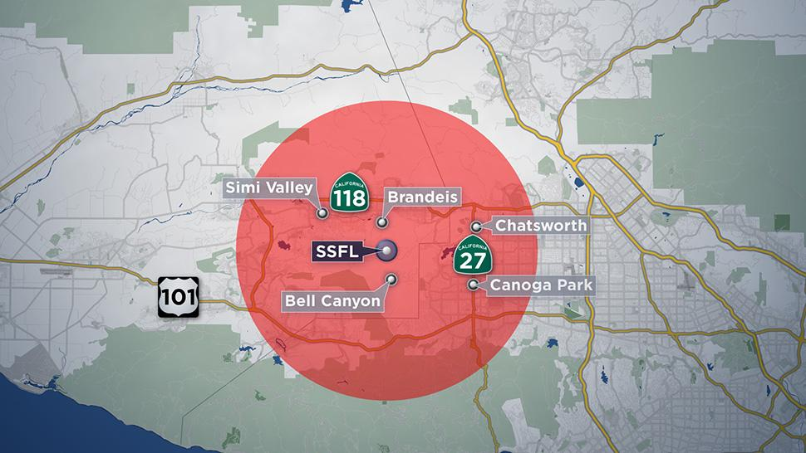
Area of the Disaster (Los Angeles, CA)

Slide 3
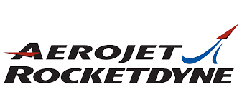
Background of Rocketdyne, NASA and Boeing
In 1947 the Santa Susana Field Lab (SSFL) began operations as North American Aviation and later became Rocketdyne. SSFL sits in unincorporated land in both Ventura and Los Angeles Counties. It is 30 miles from downtown Los Angeles.
The Santa Susana Field Lab was used to develop and test liquid rocket engines (1949-2007) that were later used for NASA space missions including the Mercury, Gemini and Apollo missions.

Slide 4
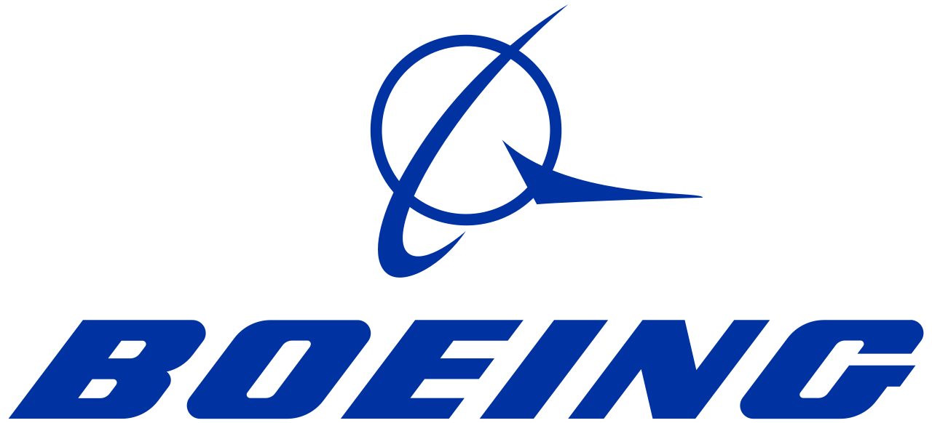
Background of Rocketdyne, NASA and Boeing
The Santa Susana Field Lab also had a sodium reactor where they developed nuclear energy on behalf of the US Department of Energy (DOE) starting in 1955. Under the regulations of DOE, there was energy-related research and testing. The electricity created was used by nearby cities.
NASA began using the Santa Susana Field Lab in 1973 for its own operations.
Boeing buys Rocketdyne and now owns part of the SSFL property in 1996.

Slide 5
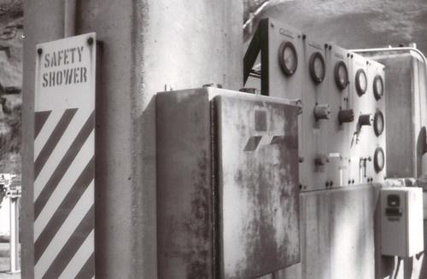
More about Santa Susana Field Lab aka. SSFL
The SSFL was regulated by the federal government but operated by various companies including Rockwell International, Atomics International, North American Aviation, Rocketdyne, and Boeing.
Another federal agency, NASA, also used the facility when it purchased some adjacent land from the US Air Force in 1973.
The facility contained several buildings and various outdoor operations as well for industrial, aerospace and nuclear research and experimentation.
The facility sits on 2,850 acres of land next to a camping facility called Sage Ranch and next to Brandeis-American Jewish University.

Slide 6
Map

Slide 7
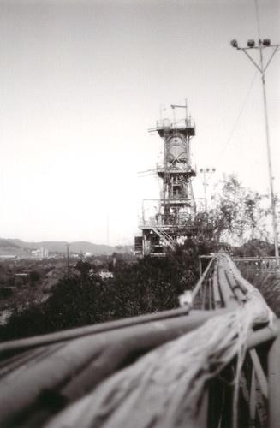
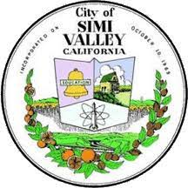
Rocket Testing and the Sodium Reactor
Rocket stands were used to test over 17,000 rocket engines in 60 years (1949-2007).
Residents in nearby Simi Valley, Chatsworth, Canoga Park and West Hills like Edwin Krupp said “You would hear those engines rip out, then see the hills around Chatsworth glowing at night. It was a significant and considerable orange, fiery glow on the mountains, a phenomenon of the neighborhood.”
The City of Simi Valley even incorporated the atomic symbol and rocket into its city seal.

Slide 8
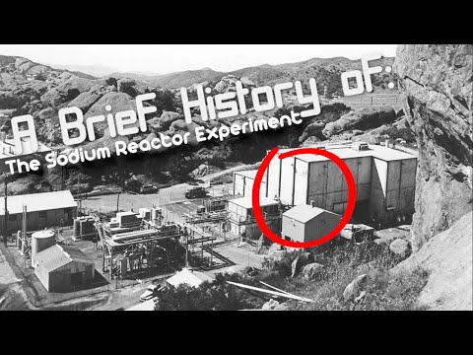
The Nuclear Meltdown in 1959

Slide 9
More Contamination at the SSFL
The sodium reactor experiment led to the partial nuclear meltdown in 1959 that released many toxic fumes and radioactive chemicals into the ground, air and water in the surrounding communities.
There were 10 reactors, a hot lab, a plutonium fabrication facility, and an open sodium burn pit that released toxic and radioactive chemicals into the atmosphere.
There were also nuclear accidents at SSFL in 1964, 1969, several radioactive fires in the hot lab and chemical spills of toxic chemicals.
In 1991 two workers were killed in an explosion when the US Attorney found out they were disposing of toxic chemicals illegally including shooting barrels of chemicals with guns.
In 2018 there was a fire that started at the SSFL called the Woolsey Fire that eventually burned over 90,000 acres. Many residents were concerned that the fire burned and spread radioactive and toxic chemicals that were never cleaned up at SSFL

Slide 10
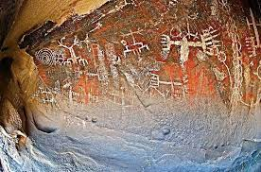
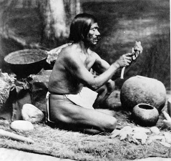
Chumash Painted Cave
The 2,850 acres that include the 4 areas of SSFL contain important cultural artifacts from the indigenous people of the area called the Chumash.
In 1971, the Chumash Tribe asked Rocketdyne to protect the painted cave with their ancestors pictographs that is estimated to be dated sometime between 1200 and 1500 CE but they said no.
In 1976 Burro Flats Cave and 25 surrounding acres, which contains the painted cave with the Chumash pictographs was added to the National Registry of Historic Places.

Slide 11
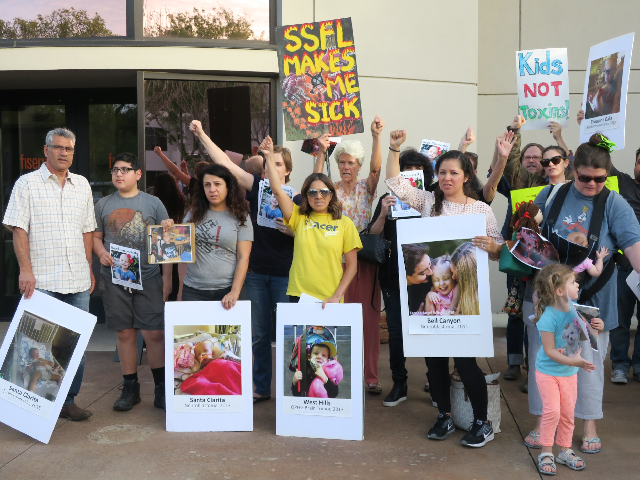
Impact to the Community
A legal agreement in 2007 was signed by Boeing, NASA, and DOE to clean up the area in conjunction with the California Department of Toxic Substances Control (DTSC).
This is a group of parents, community members and environmental activists who are still protesting the contamination that remains.
Parents and residents are upset because they believe that many of the cancers, thyroid issues, dental issues and learning disabilities in local residents have been caused by the toxic and radioactive chemicals that SSFL never cleaned up.

Slide 12
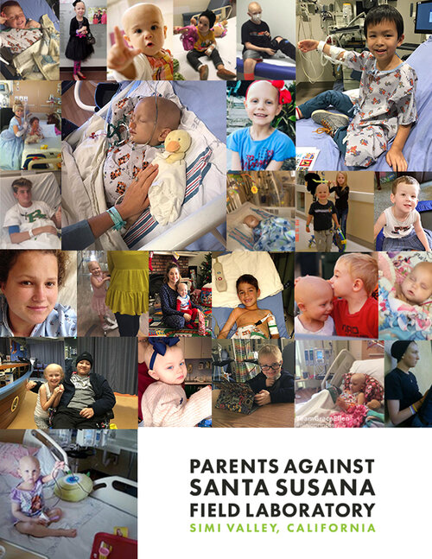
Cancer Clusters Near SSFL
After dozens of parents in adjacent areas discovered that their children had rare types of cancers caused by exposure to radiation they started investigating the radiation at SSFL.
A study done by the University of Michigan in 2007 showed that residents who lived within 2 miles of SSFL had a 60% higher cancer rate.
1.500 former SSFL workers were also diagnosed with cancer.
A UCLA study showed that SSFL workers exposed to radiation and chemicals at the site had a higher cancer related mortality rates.

Slide 13
Government Involvement
FEDERAL
The Department of Energy (DOE) and National Aeronautics and Space Administration (NASA) are both federal agencies that are directly involved in the Santa Susana Field Lab as owners a majority of the property.
STATE
The Department of Toxic and Substances Control (DTSC) is a California state agency that is responsible for protecting the public health from harm from toxic substances and materials.
LOCAL
The majority of the 2,850 acre parcel of land that the Santa Susana Field Lab sits on is on unincorporated land in Ventura County. The Ventura County Board of Supervisors are responsible for land in Ventura County that is not part of any of the local cities.

Slide 14
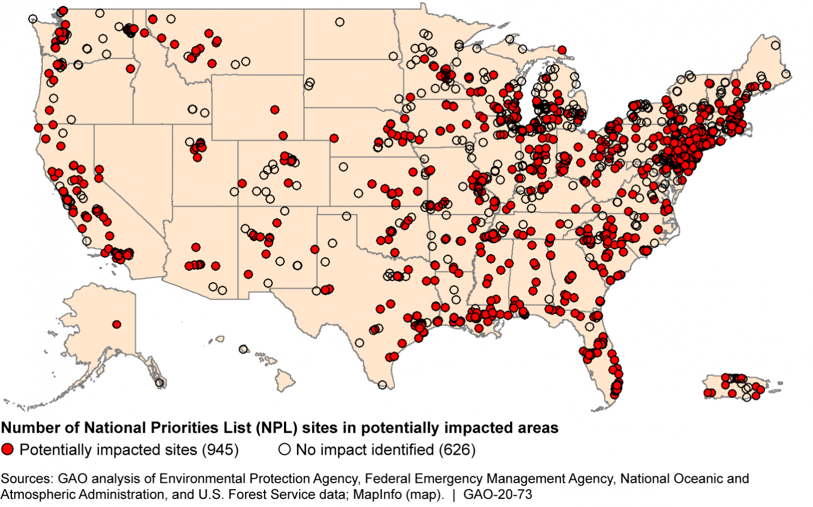
What’s in your backyard?
According to the US Environmental Protection Agency there are over 632 Superfund Sites where hazardous waste areas were redeveloped for recreational, business, commercial or residential use!

Slide 15
Sources
https://www.boeing.com/principles/environment/santa-susana/extraordinary-past.page
https://www.nbclosangeles.com/investigations/la-nuclear-secret/54503/
https://parentsagainstssfl.com/burroflats
https://www.nps.gov/hdp/exhibits/ssfl/intro/index.html
https://www.youtube.com/watch?v=hfQsj04fbRQ
https://www.altaonline.com/dispatches/a5325/pressed-for-space-santa-susana-field-laboratory-nasa-nuclear/
https://www.epa.gov/superfund-redevelopment-initiative#:~:text=Redevelopment%20Economics%20at%20Superfund%20Sites,combined%20income%20of%20%2416.3%20billion.\
http://www.chatsworthhistory.com/Program%20Downloads/Burro%20Flats%20Rocketdyne%20SSFL%20History.pdf

