Slide 1
Location, Location, Location!
The Perfect Home for an Ocean Animal

Slide 2
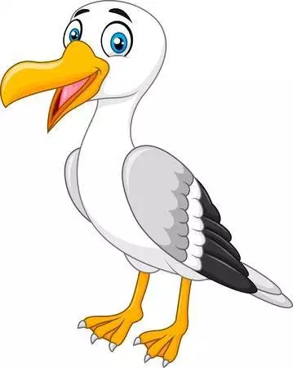
A sea gull is a bird.
I am a bird that lives by all oceans.
I can fly over the ocean to catch fish.
Humans live near the ocean. How do we get food from the ocean?

Slide 3
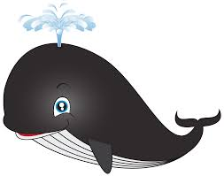
A whale is a mammal.
I am a humpback whale that lives in the Atlantic ocean.
I have blubber to keep me warm.
Humans live near the ocean. How do we keep warm?

Slide 4
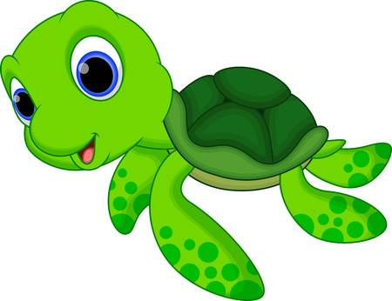
A sea turtle is a reptile.
I am a sea turtle that lives in the Atlantic, Indian, and Pacific oceans.
I have a large shell that protects me from predators
Humans live near the ocean. How do we protect ourselves?

Slide 5
A shark is a fish.
I am a shark that lives in all oceans.
I use seeing, hearing, and smell to find my food.
Humans live near the ocean. How do we find our food?

Slide 6
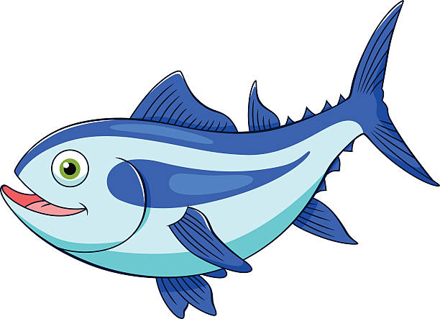
A tuna is a fish.
I am a tuna fish that lives in the Atlantic, Pacific, and Southern oceans.
I swim in schools to keep me safe from predators.
Humans live near the ocean. Why do we go to school?

Slide 7
A clownfish is a fish.
I am a clownfish that lives in the Pacific and Indian Oceans.
I live in coral and the anemones. They provide shelter and help keep me safe.
Humans live near the ocean. What shelters do we live in? How do shelters keep us safe?

Slide 8
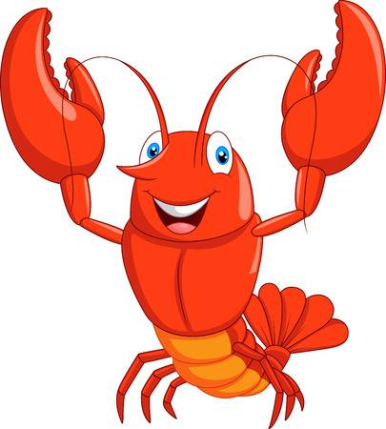
A lobster is an invertebrate.
I am a lobster that lives in the Atlantic Ocean.
I am nocturnal. This means I am awake and eat at night.
Humans live near the ocean. Are humans awake at night? What do we eat at night?

Slide 9
An octopus is a fish.
I am a red octopus that lives in the Pacific Ocean.
I have a complex brain to solve puzzles, find food, and know when I am in danger.
Humans live near the ocean. How do we use our brain to solve problems, find food, and make sure we are safe?

Slide 10
A sea cow is a mammal.
I am a sea cow (manatee) that lives in the Atlantic Ocean.
I can hold my breath for 20 minutes and rise to the surface to breathe oxygen.
Humans live near the ocean. How do we breath oxygen? How long can we hold our breath?

Slide 11
A snake is a reptile.
I am an eel that lives in all oceans.
I can’t see very well but I use shock waves to “feel” my surroundings.
Humans live near the ocean. How do we use our eyes to see? Can we use other parts of our body to see our surroundings?

Slide 12
A pelican is a bird.
I am a pelican that lives near the Atlantic and Pacific oceans.
I plunge into the ocean to scoop up and catch my fish to eat.
Humans live near the ocean. How do we catch fish to eat?

Slide 13
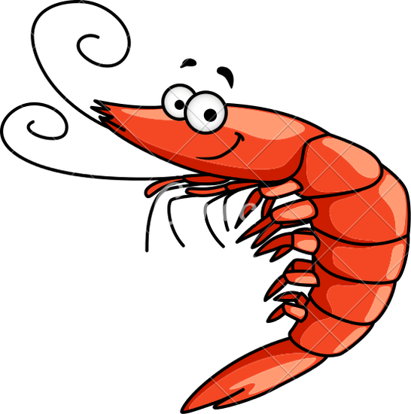
A shrimp is an invertebrate.
I am a shrimp that lives in all oceans.
I eat plants, dead fish, snails, worms, and crabs to survive.
Humans live near the ocean. What do we eat to survive?

Slide 14
A crab is an invertebrate.
I am a crab that lives near all oceans.
I can survive on land or in water as long as I have oxygen.
Humans live near the ocean. Can we survive on land and in water?

Slide 15
Image Credits
https://www.google.com/search?q=sea+gull+clip+art&rlz=1C1CHBF_enUS841US854&source=lnms&tbm=isch&sa=X&ved=0ahUKEwilsobE1IrjAhVoj1QKHZUYBnoQ_AUIECgB&biw=1280&bih=610#imgrc=IV-cWUnBUfWkMM:
https://www.google.com/search?q=whale+clip+art&rlz=1C1CHBF_enUS841US854&source=lnms&tbm=isch&sa=X&ved=0ahUKEwicxrfS1IrjAhUKiFQKHXdjBD8Q_AUIECgB&biw=1280&bih=610#imgrc=V8pgFGUNDHBfoM:
https://www.google.com/search?rlz=1C1CHBF_enUS841US854&biw=1280&bih=610&tbm=isch&sa=1&ei=Dj0VXe78Hof00wLs25-QDQ&q=sea+turtle+clip+art&oq=sea+turtle+clip+art&gs_l=img.3..0l3j0i5i30l7.58515.60032..60320...0.0..0.69.474.8......0....1..gws-wiz-img.......0i67j0i30j0i8i30j0i10i24.0AW34ovoSAQ#imgrc=h9hpyQ915XwFGM:
https://www.google.com/search?rlz=1C1CHBF_enUS841US854&biw=1280&bih=610&tbm=isch&sa=1&ei=Sz0VXYiBLqGP0gLGjZeABw&q=shark+clip+art&oq=shark+clip+art&gs_l=img.3..0l5j0i10j0j0i7i30l3.62279.65778..65933...0.0..0.67.425.7......0....1..gws-wiz-img.......0i8i30j0i67j0i7i10i30.OFfV1YV64ck#imgdii=Mv6w5sR4BkFBIM:&imgrc=KZC56i5CQSH-GM:
https://www.google.com/search?rlz=1C1CHBF_enUS841US854&biw=1280&bih=610&tbm=isch&sa=1&ei=jj0VXaWDIaTi9AP_rZWYBA&q=tuna+fish+clip+art&oq=tuna+fish+clip+art&gs_l=img.3..0.152999.157220..158181...0.0..0.65.550.10......0....1..gws-wiz-img.......0i7i30j0i7i10i30j0i7i5i30j0i5i30j0i8i7i30.lXJ5lqYPW2w#imgrc=JiE_VDb9eMZWTM:
https://www.google.com/search?rlz=1C1CHBF_enUS841US854&biw=1280&bih=610&tbm=isch&sa=1&ei=LT4VXY-kJO2x0PEPnNy5gAM&q=clownfish+clip+art&oq=clownfish+clip+art&gs_l=img.3..0.72895.74862..75098...0.0..0.67.595.10......0....1..gws-wiz-img.......0i7i30j0i7i10i30.40ffEnDBWCE#imgrc=XCXT5hHdRX7aYM:
https://www.google.com/search?rlz=1C1CHBF_enUS841US854&biw=1280&bih=610&tbm=isch&sa=1&ei=eT4VXYS7I8nF-gTMqqHQBQ&q=lobsterclip+art&oq=lobsterclip+art&gs_l=img.3..0i7i30l10.56000.57080..57193...0.0..0.65.398.7......0....1..gws-wiz-img.......0i7i10i30.Pbm-tT2lafo#imgrc=bzpdXCHiRddXUM:
https://www.google.com/search?rlz=1C1CHBF_enUS841US854&biw=1280&bih=610&tbm=isch&sa=1&ei=-T4VXcGGEsPM0PEPpoyc6AM&q=sea+cow+clip+art&oq=sea+cow+clip+art&gs_l=img.3...75716.77892..78031...0.0..0.62.448.8......0....1..gws-wiz-img.......0i7i10i30j0i7i30j0j0i7i5i10i30j0i7i5i30j0i8i7i30.1_V8QTQwdJU#imgrc=mq7dVESiR4tF0M:
https://www.google.com/search?q=sea+snake+clip+art&rlz=1C1CHBF_enUS841US854&source=lnms&tbm=isch&sa=X&ved=0ahUKEwiy-5m92IrjAhXEjp4KHdnZC_wQ_AUIECgB&biw=1280&bih=610&dpr=1.5#imgrc=b8Co23xEapDQzM:
https://www.google.com/search?rlz=1C1CHBF_enUS841US854&biw=1280&bih=610&tbm=isch&sa=1&ei=3j8VXd-vBcjc-gSP8rPQBQ&q=pelican+clip+art&oq=pelican+clip+art&gs_l=img.3..0l2j0i7i30l2j0i5i30l2.98952.101060..101631...0.0..0.75.461.7......0....1..gws-wiz-img.......0i7i10i30j0i67j0i7i5i30.bIXki2r0a18#imgrc=d-omL3dJ2eb-aM:
https://www.kisspng.com/png-royalty-free-drawing-shrimp-clip-art-shrimps-697471/download-png.html
http://www.clipartpanda.com/clipart_images/use-this-clip-art-whenever-you-1859545
https://www.google.com/search?rlz=1C1CHBF_enUS841US854&biw=1280&bih=610&tbm=isch&sa=1&ei=sz4VXZ_eJI_L-gSghJagDA&q=octopus+clip+art&oq=octopus+clip+art&gs_l=img.3..0l3j0i5i30l3j0i8i30l2j0i10i24.64759.68746..68924...0.0..0.65.768.13......0....1..gws-wiz-img.......0i10j0i67j0i7i30j0i7i10i30j0i7i5i30j0i8i7i30.CgNQH7wVMjY#imgrc=UwbpyH7TCpTPiM:

