Slide 1
Learning Physical Features
Grades 1 and 2

Slide 2
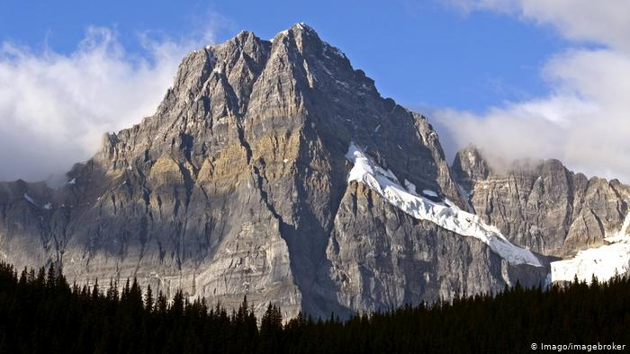
mountain
https://www.dw.com

Slide 3
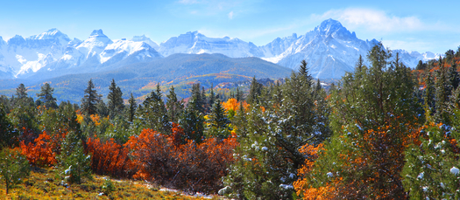
mountain range
http://worldlandforms.com

Slide 4
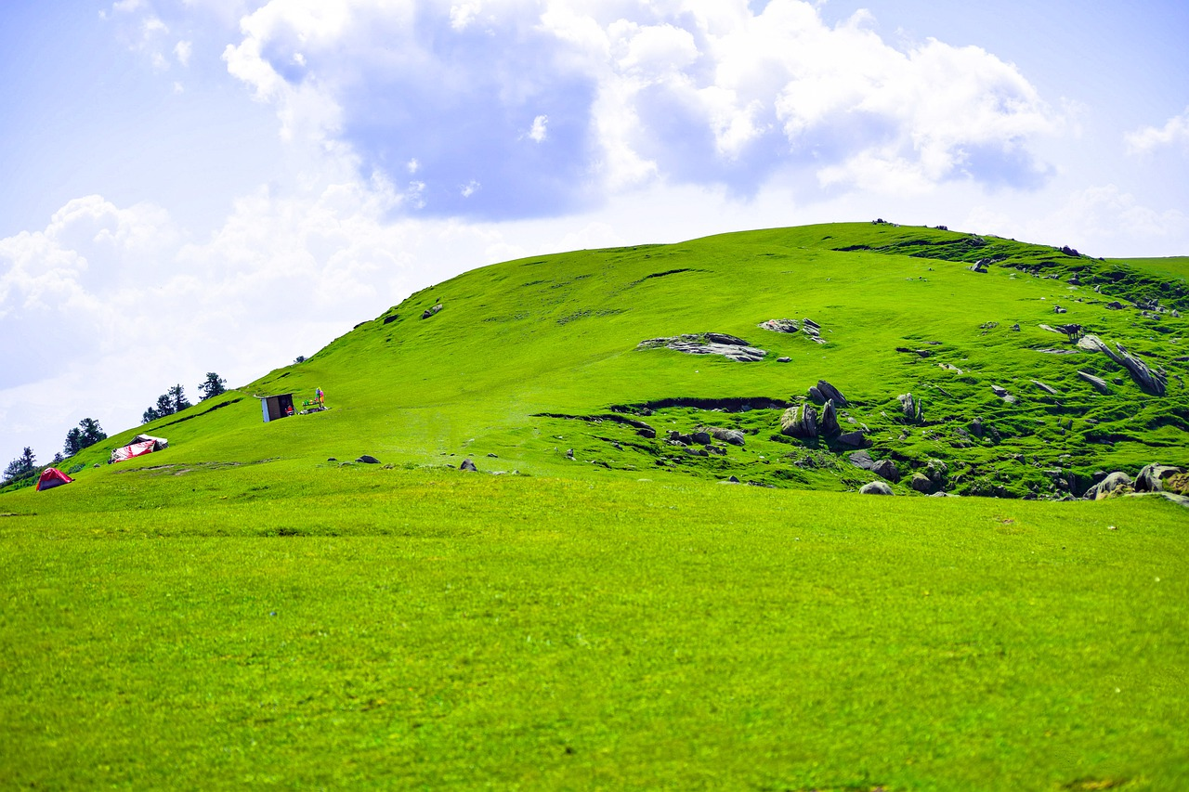
hill
https://www.altassets.net

Slide 5
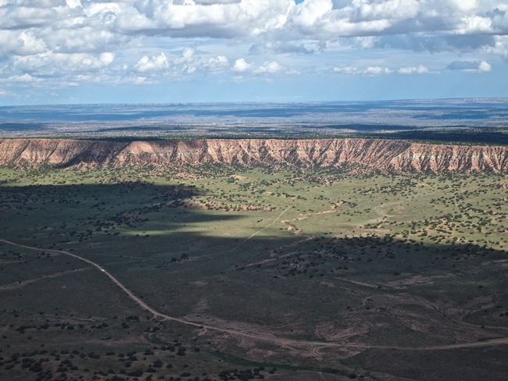
plateau
https://unbounce.com

Slide 6
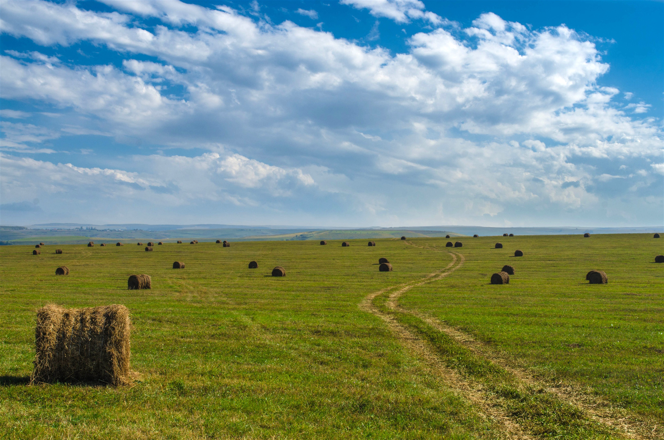
plain
http://miriadna.com

Slide 7
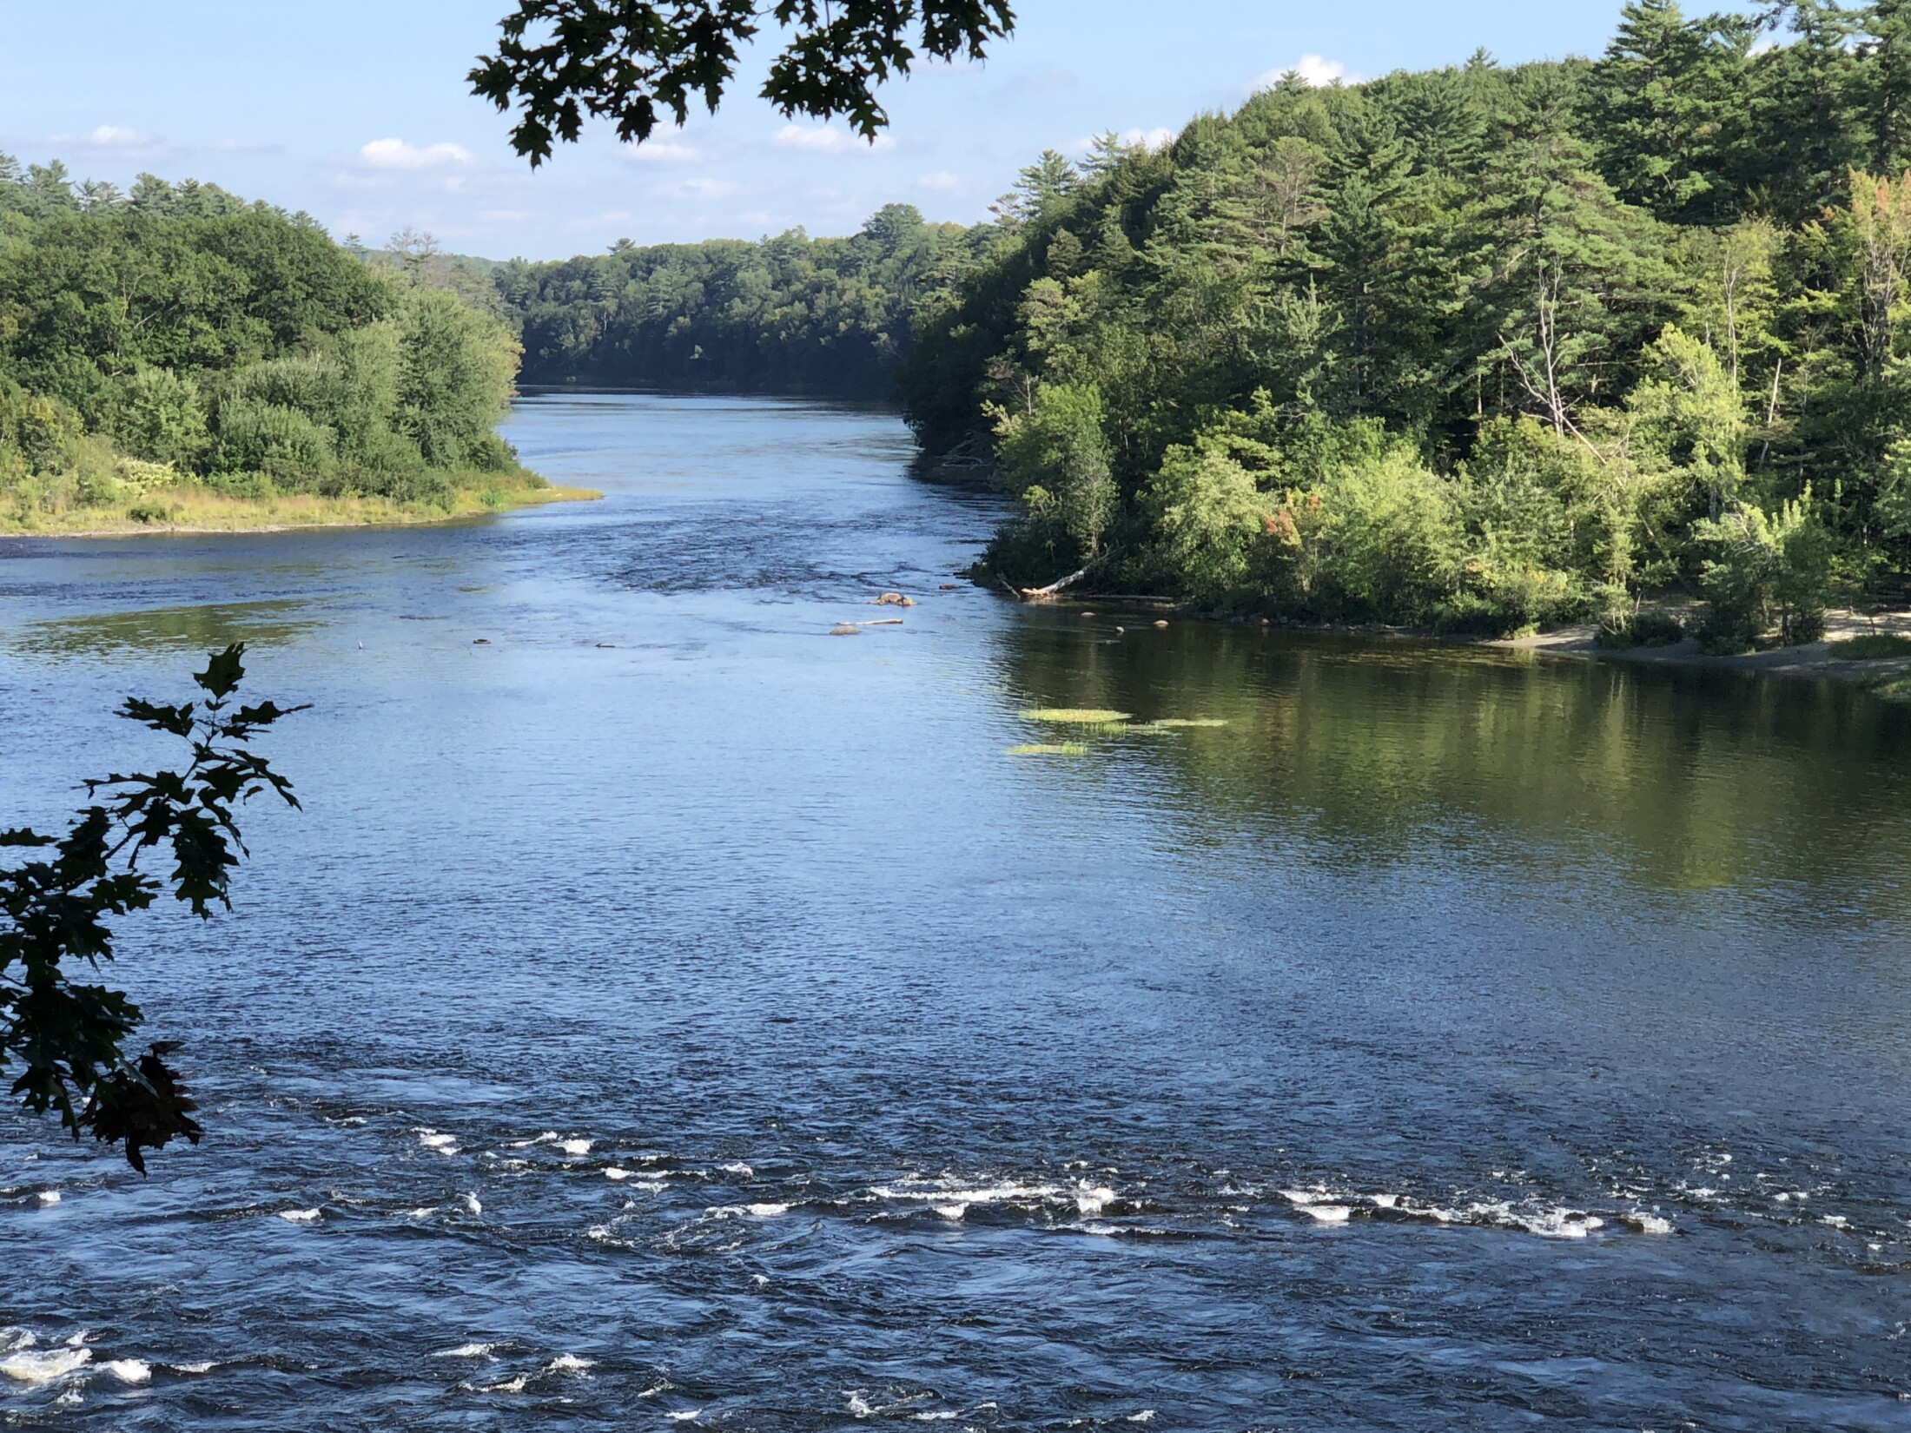
river
https://www.centralmaine.com

Slide 8
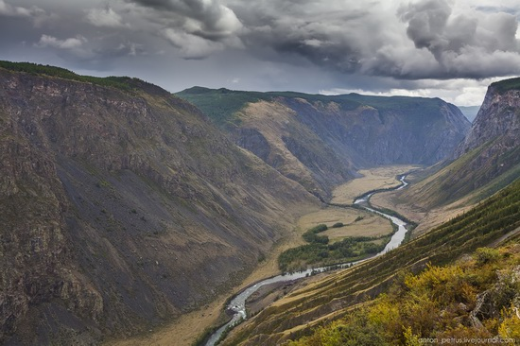
river valley
https://russiatrek.org

Slide 9
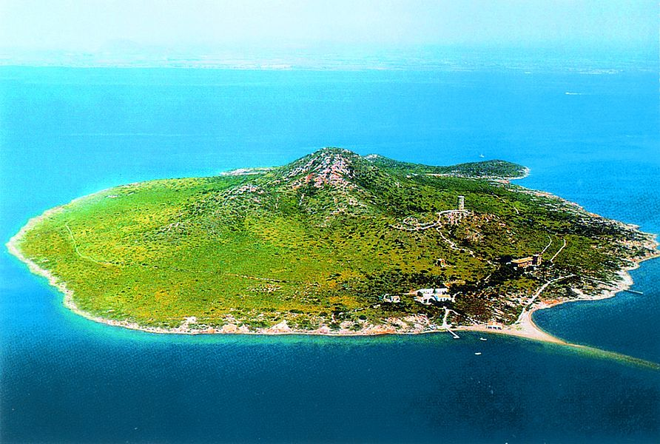
island
https://www.vladi-private-islands.de

Slide 10
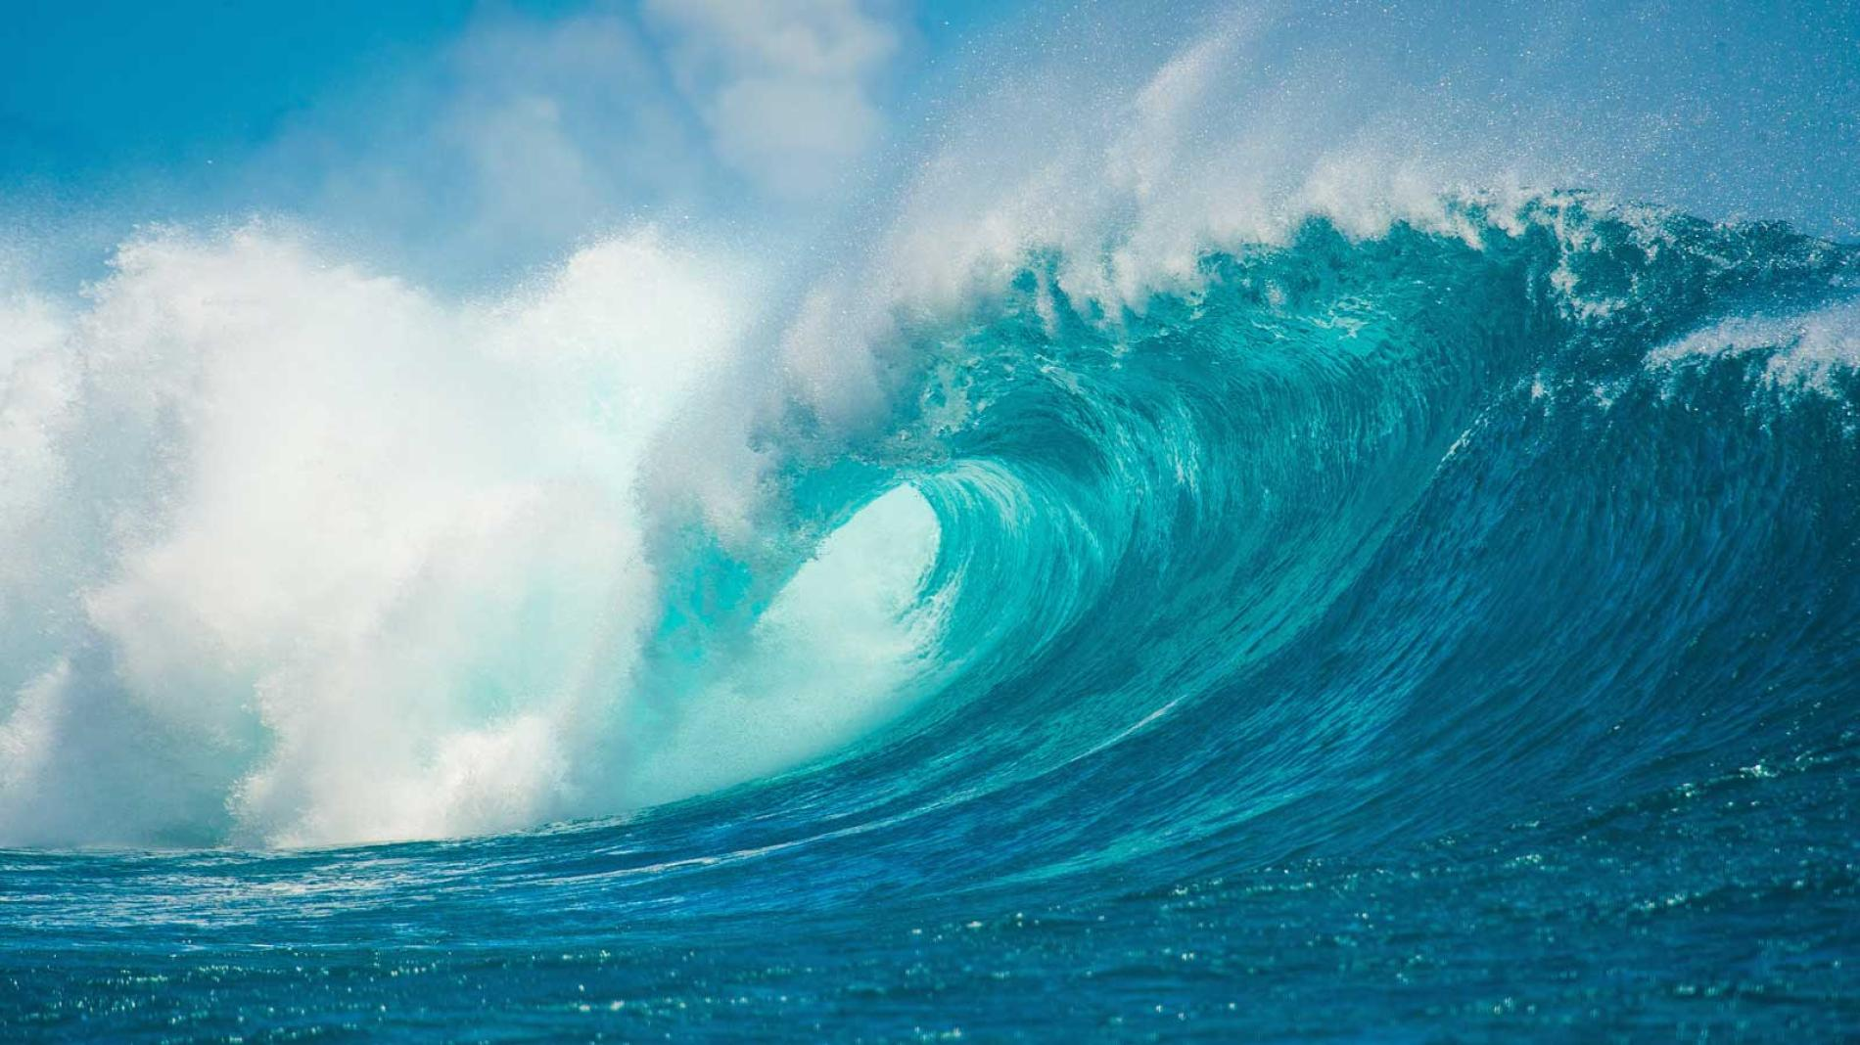
ocean
https://kids.nationalgeographic.com

Slide 11
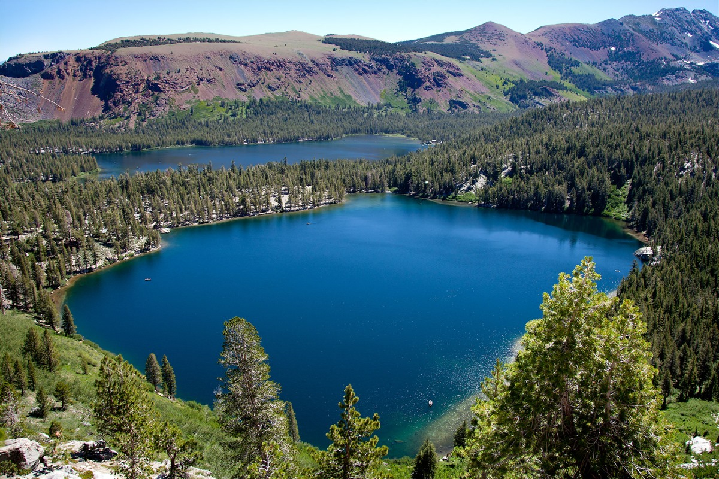
lake
https://www.mammothtrails.org

