Slide 1
Finding the Americas
windy.com

Slide 2
What is Geography?
It is the study of Earth and all of its variety. Physical geography includes land, water, plants and animals. Human geography includes where people live, how they live, and how they change and are influenced by their environment.

Slide 3
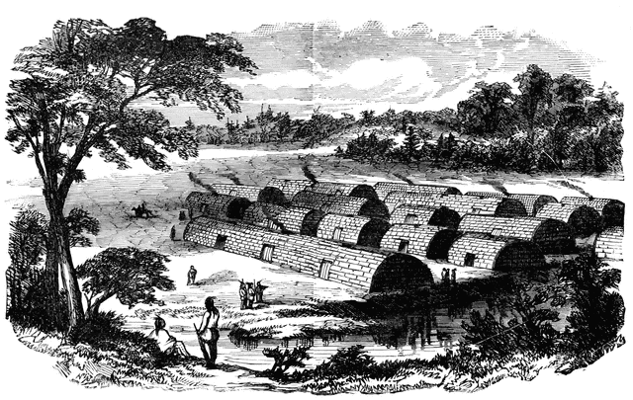
The BIG Question!
How do the Earth’s physical features impact human settlement?
https://etc.usf.edu/clipart/5600/5605/manhattan_island_1.htm

Slide 4
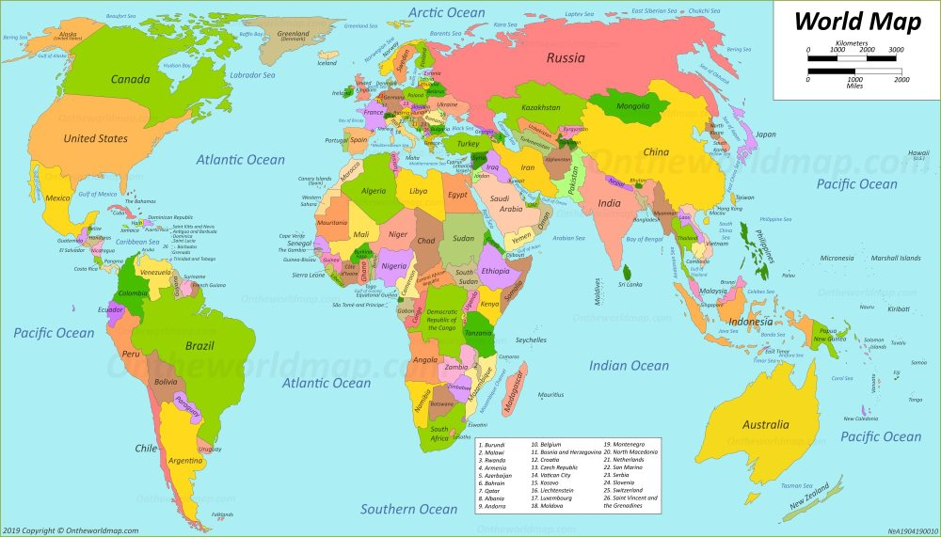
What Do You See?

Slide 5
The largest land (white) areas on the map are known as _________________.

Slide 6
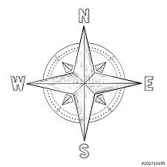
North East South West
Scale

Slide 7
Why Do People Move?

Slide 8
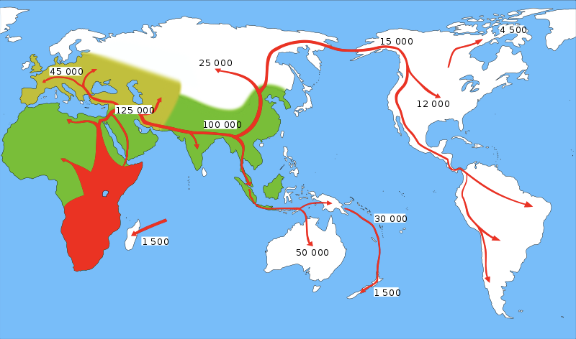
Early Human Migration
Approximate Timeline of Early Human Migration
Oldest
Newest
https://commons.wikimedia.org/wiki/File:Expansion_d_homo_sapiens.svg

Slide 9
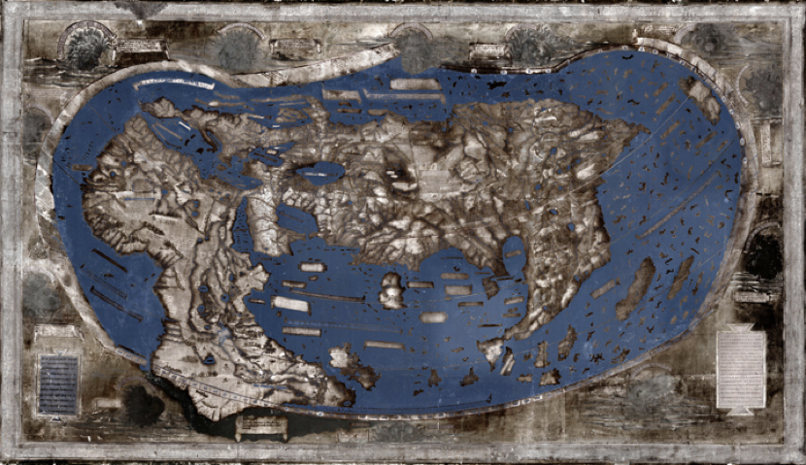
World Map from 1491 (Cartographer: Henricus Martellus)
Retrieved 7-13-2019 from https://news.yale.edu/2015/06/11/hidden-secrets-yale-s-1491-world-map-revealed-multispectral-imaging

Slide 10
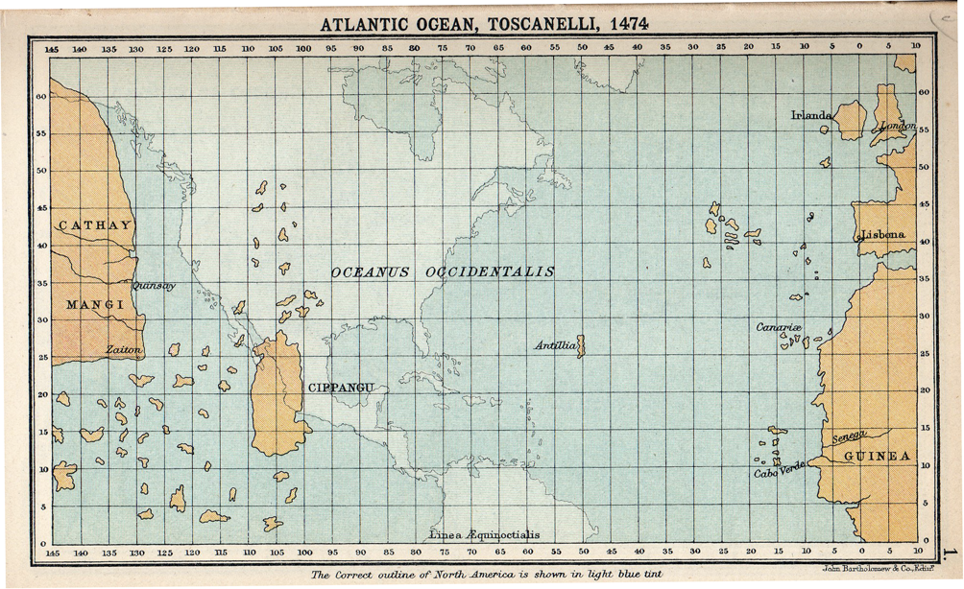

Slide 11
Big Questions
In the 1300’s, why were Europeans trading with Asia?
What geographic challenges did they face?

Slide 12
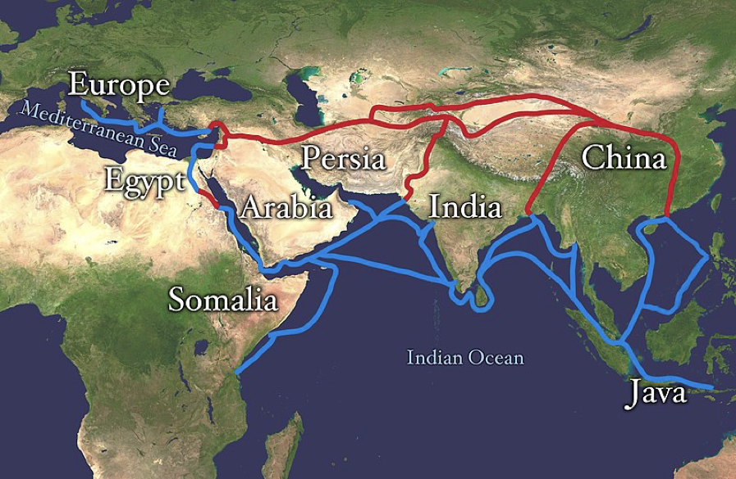
Major West/East Relations in the 1300’s (700 years ago)
Items of Value
silk
jade
metals
spices
grain
glassware
porcelain
horses
gunpowder
weapons
armor
textiles
ideas
culture
Retrieved 7/13/2019 from: https://en.wikipedia.org/wiki/Silk_Road#/media/File:Silk_route.jpg

Slide 13

Items of Value
silk
jade
metals
spices
grain
glassware
porcelain
horses
gunpowder
weapons
armor
textiles
ideas
culture

Slide 14
In the late 1400’s, why would Europeans try to
find an ocean trade route to Asia?

Slide 15
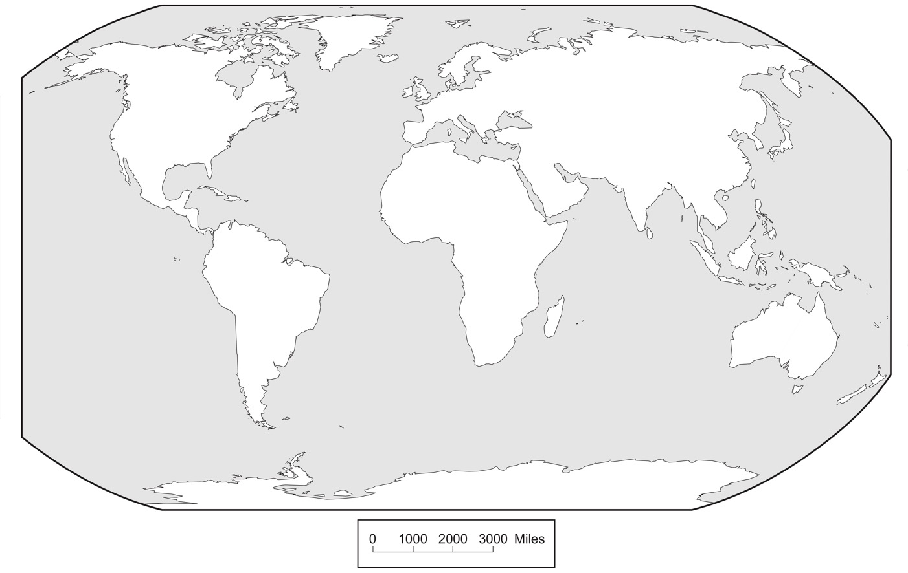

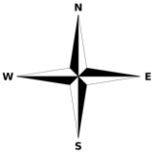
Now What, Europe? ~ 500 Years Ago
The Silk Road
Trade is Broken!
Europe
North
America
Asia
China
India
Africa
Indies
equator
South
America
1. Compass Rose
North, East, South, West
Australia
Ocean
(all of the grey areas)
Antartica
Scale
Arizona Geographic Alliance geoalliance.asu.edu/azga

Slide 16
In the late 1400’s, Europeans strongly desire to find an ocean trade route to Asia…
What geographic challenges did they face?

Slide 18
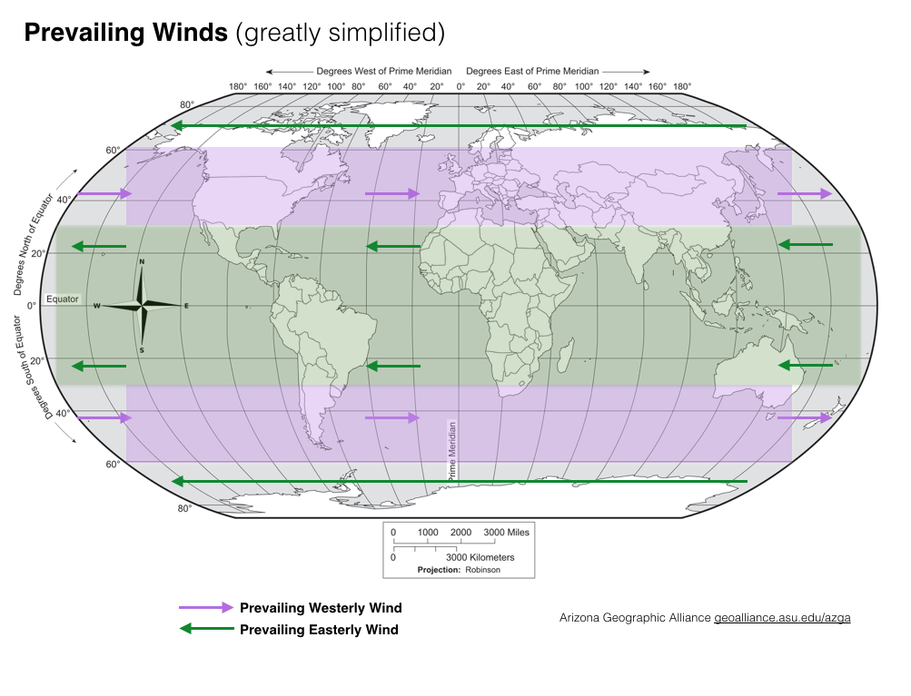

Slide 19
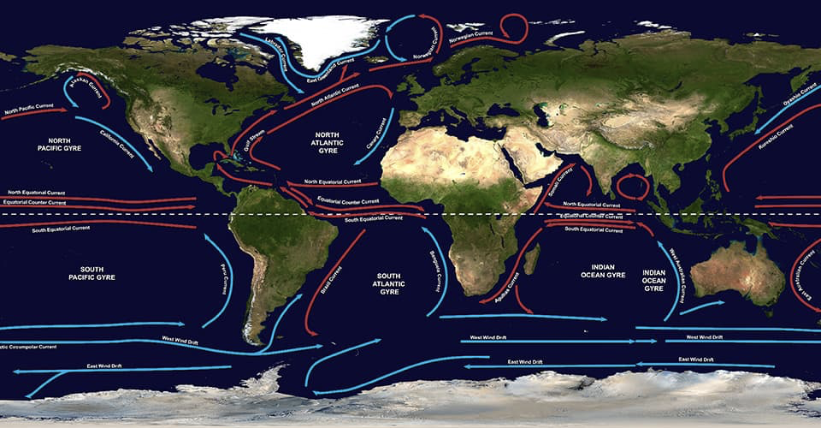
Major Ocean Gyres
https://oceanservice.noaa.gov/facts/gyre.html

Slide 20
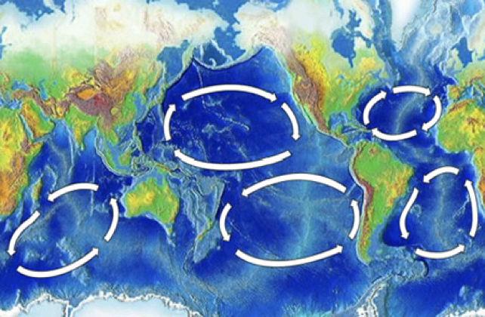
Major Ocean Gyres (simplified)
https://en.wikipedia.org/wiki/Ocean_gyre

Slide 21
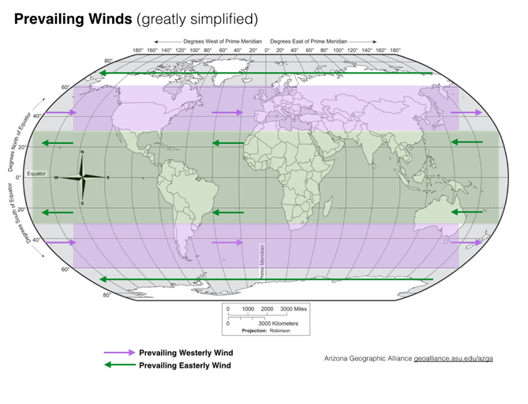
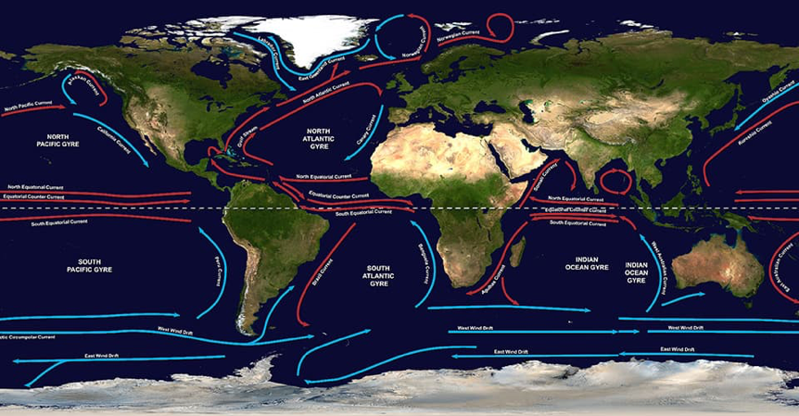
If you sail west from Europe, what prevailing winds would help you?
If you sail west from Europe, what ocean gyre/current would help you?
Wind at your back pushing the boat + water current pushing the boat = faster speed

Slide 22
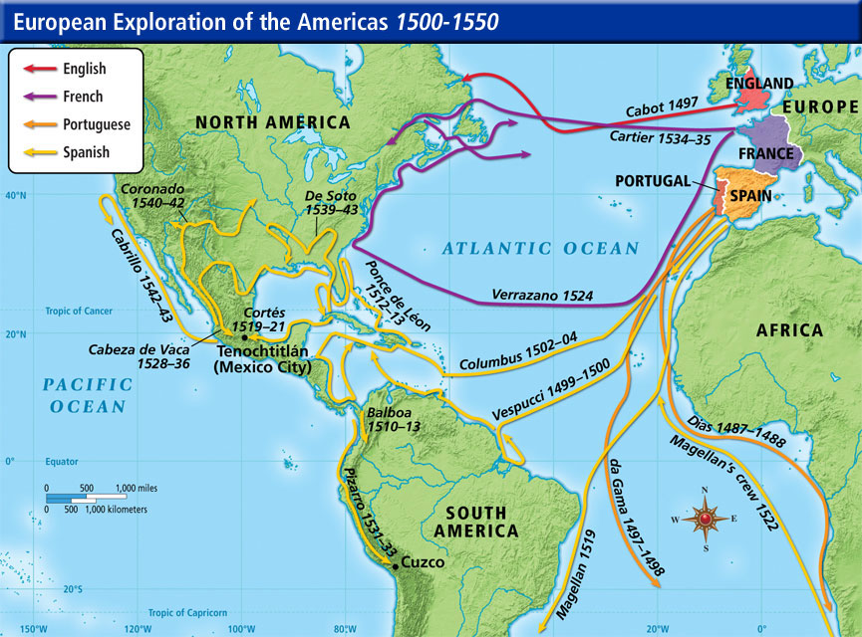
Age of Exploration
https://www.thinglink.com/scene/840686230478782466

Slide 23
Windy.com

Slide 24
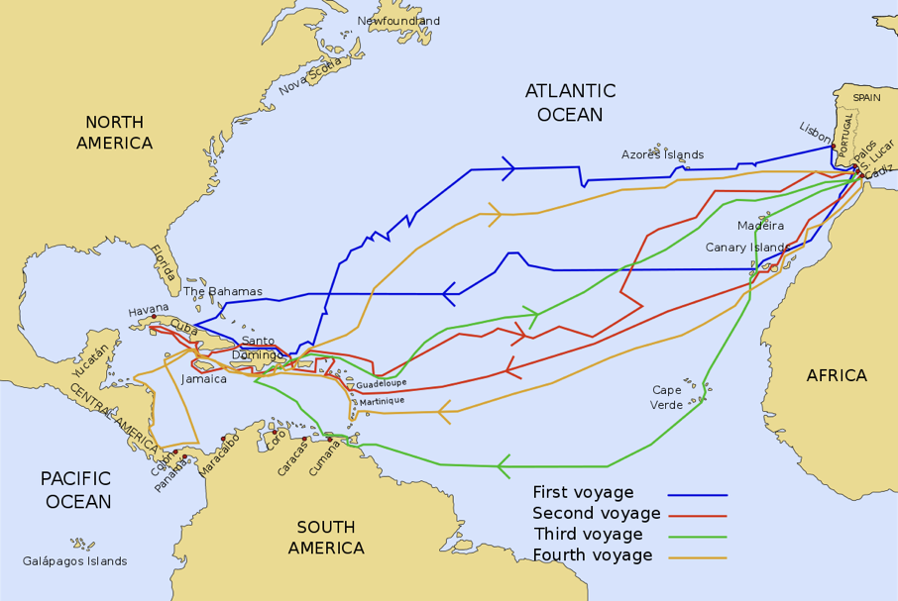
Voyages of Columbus
https://en.wikipedia.org/wiki/Voyages_of_Christopher_Columbus#/media/File:Viajes_de_colon_en.svg

Slide 25
In the late 1400’s, why would Europeans try to
find an ocean trade route to Asia?
What geographic challenges did they face?

