Slide 1
Shhh! Mum’s the Word: Secret Cities of the Manhattan Project
Level: High School
Author: Jeannine Kuropatkin
Teacher Consultant, Arizona Geographic Alliance
World History/Geography Teacher, Red Mountain HS, Mesa, AZ

Slide 2
Quickwrite Mind Map: War
Independent Tasks
2 minutes to Quickwrite (Self-brainstorm)
Write down anything you know about or connect with “War”
People, places, dates, objects, events, etc.
Write words & short phrases; NOT sentences!
Do NOT talk to others during Quickwrite

Slide 3
Quickwrite Mind Map: War
Pair-share Tasks
With your partner . . .
Discuss some of the “war” words generated during the Quickwrite task
Note both similar & different “war” words and ideas
Identify & agree upon 3-4 “war” categories into which your words could be sorted
Color code your agreed upon “war” categories using 3-4 different color highlighters

Slide 4
Quickwrite Mind Map: War
Whole Class Tasks
With teacher guidance . . .
Share out the “war” categories created by various pair-share partners
Discuss the most frequently used “war” categories
Discuss the most unique “war” categories
Go back & CIRCLE any words relating to the category of “Weapons of War”

Slide 5
Weapons of War & the 21st Century
Discuss with your Pair-share partner:
What is the most powerful weapon of war TODAY?
What type of technology is this weapon dependent upon in order to operate?
To what extent is this weapon available to all OR a limited number of countries?

Slide 6
Weapons of War & World War II
Discuss with your Pair-share partner:
What was the most powerful weapon of war in WWII?
What type of technology was this weapon dependent upon in order to operate?
To what extent was this weapon available to all OR a limited number of countries?

Slide 7
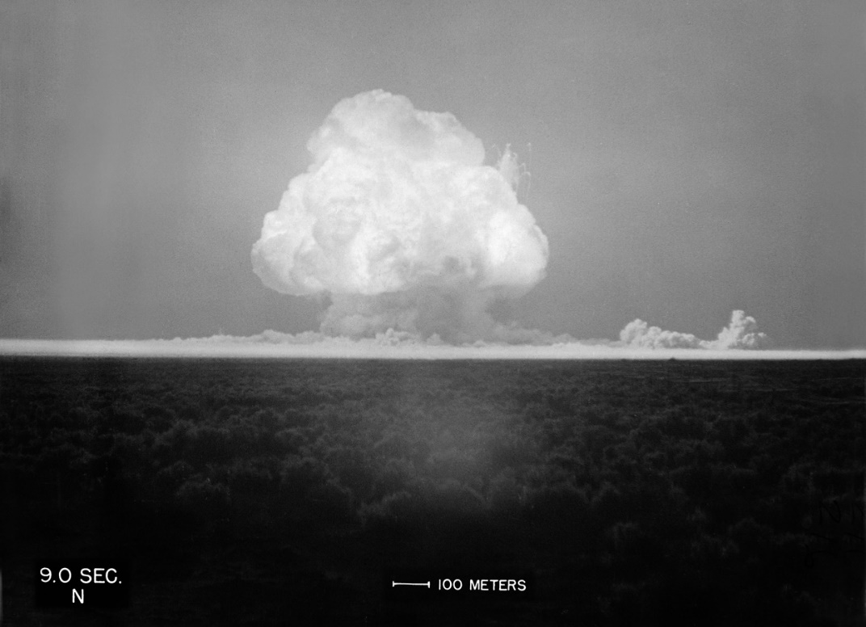
Videoclip: Most Powerful Weapon of WWII
First ever atomic bomb explosion:
Trinity Test Blast
July 16, 1945
New Mexico Desert
EdPuzzle.com (1:08)
https://edpuzzle.com/media/59303bb2a563392760ad7220
In 1-2 words . . . Describe how this test blast makes you feel? What emotions does it touch?
https://www.slideshare.net/guimera/when-we-tested-nuclear-bombs

Slide 8
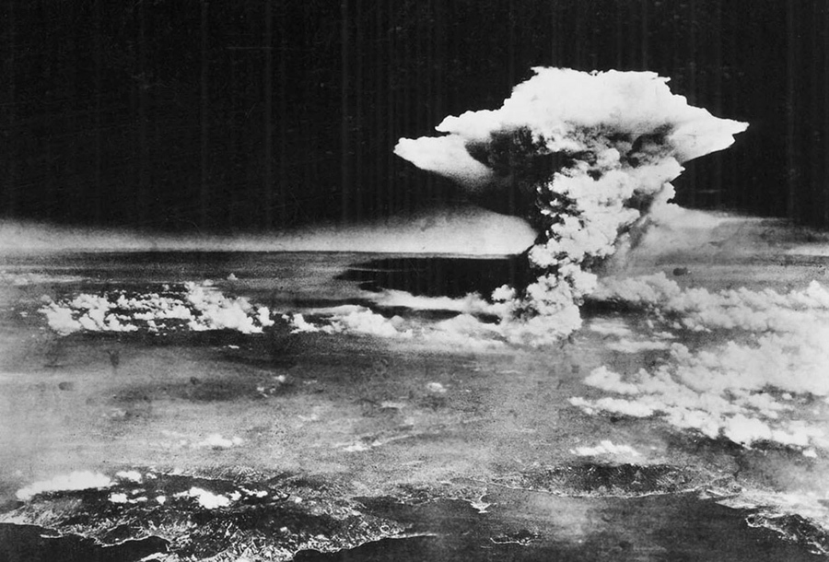
Dropping of Atomic Bomb on Hiroshima August 6, 1945
http://www.historyextra.com/article/premium/should-america-have-dropped-atomic-bombs-hiroshima-nagasaki-justified-debate

Slide 9
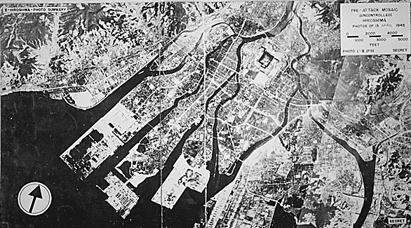
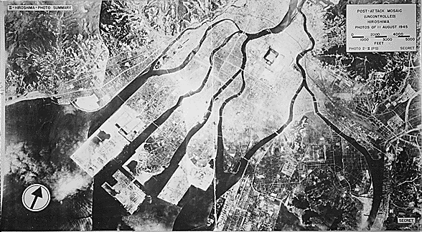
Hiroshima: Before & After the Blast
April 13, 1945
Uranium Bomb
Named “Little Boy”
Detonated 1,900 feet over the city
15 kiloton explosion = 15,000 tons of TNT
August 11, 1945
http://news.bbc.co.uk/2/hi/in_depth/4729407.stm

Slide 10
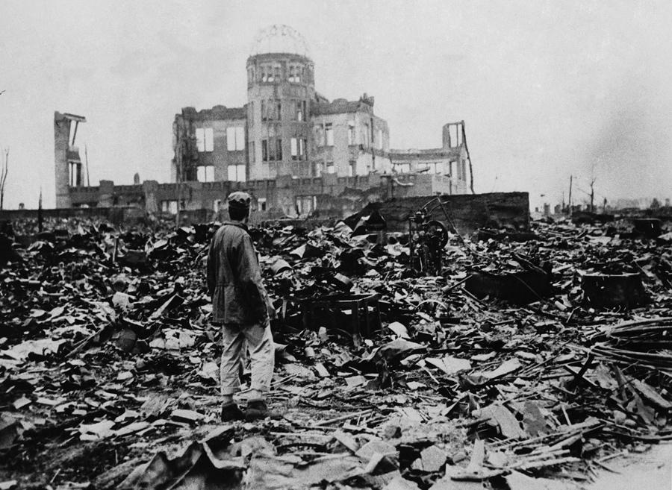
http://www.historyonthenet.com/authentichistory/1939-1945/1-war/4-Pacific/4-abombdecision/3-against/victims/index.html
Hiroshima
Every building within one mile of ground zero destroyed
Total death toll = Estimate 140,000
70,000 died from initial blast, heat, & radiation sickness
Thousands died later from cancers & long-term effects
http://time.com/4346336/atomic-bombs-1945-history/

Slide 11
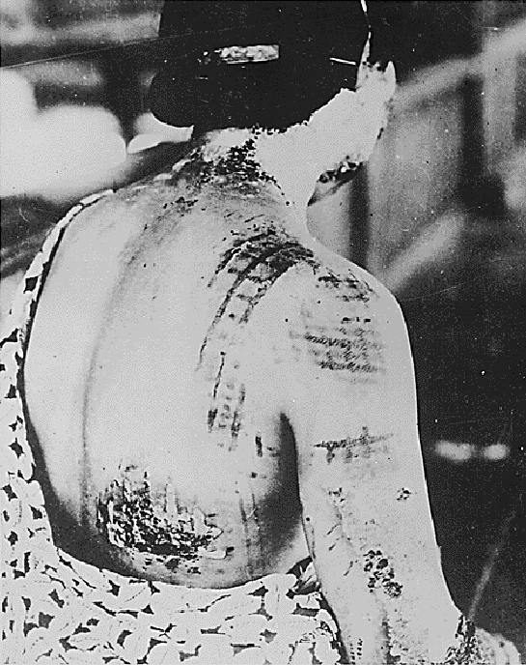
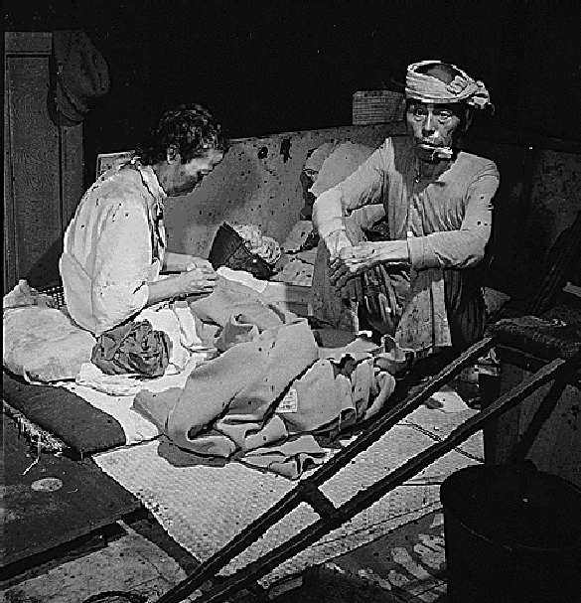
Victims of the Atomic Blast at Hiroshima
Intense heat of the atomic blast, burned the dark pattern of clothing into the victim’s back
https://www.un.org/disarmament/education/slideshow/hibakusha/
https://www.osti.gov/opennet/manhattan-project-history/Events/1945/hiroshima.htm

Slide 12
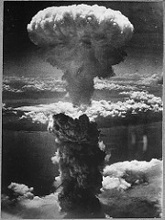
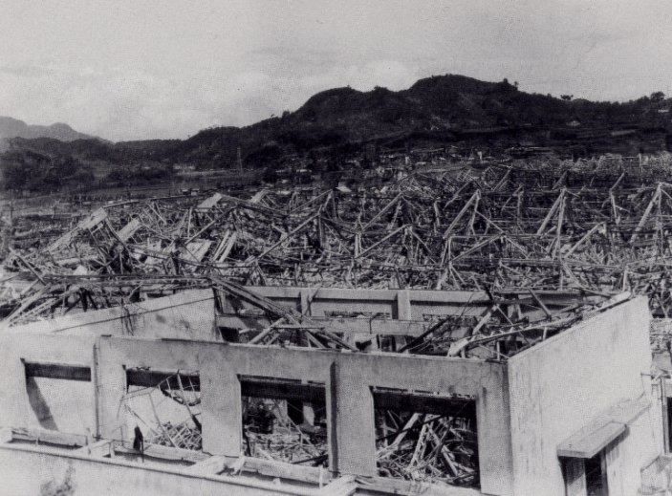
Dropping of Atomic Bomb on Nagasaki August 9, 1945
https://www.osti.gov/opennet/manhattan-project-history/Events/1945/nagasaki.htm
http://www.bbc.com/news/in-pictures-33769566

Slide 13
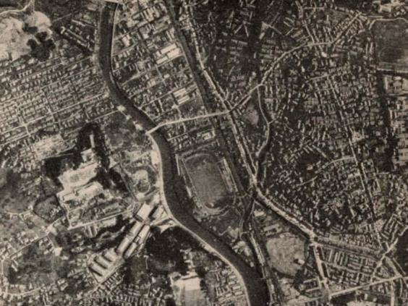
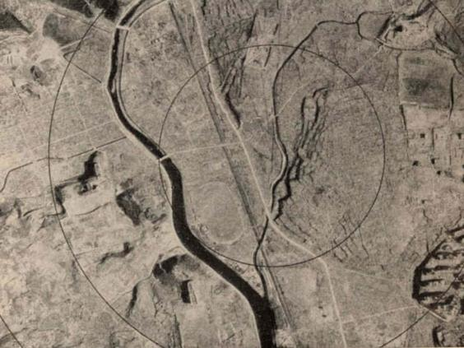
Nagasaki: Before & After the Blast
BEFORE
Plutonium Bomb
Named “Fat Man”
Detonated 1,650 feet over the city
21 kiloton explosion = 21,000 tons of TNT
AFTER
https://www.washingtonpost.com/news/worldviews/wp/2015/08/09/what-nagasaki-looked-like-before-and-after-the-bomb/?utm_term=.5de008819129

Slide 14
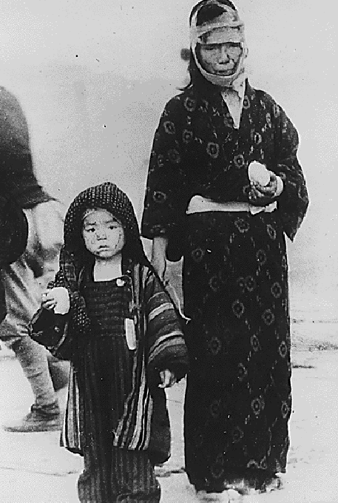
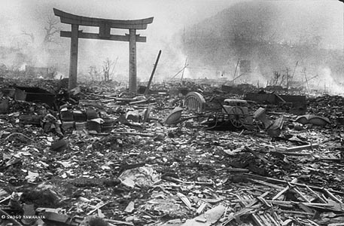
http://www.dailymail.co.uk/news/article-3186815/The-nightmare-aftermath-Hiroshima-Parents-carry-burned-children-past-corpses-rubble-rare-photographs-taken-days-atomic-bomb-killed-140-000-people.html
Nagasaki
Almost all homes within a mile & a half of ground zero were destroyed
Total death toll = Estimate 75,000
40,000 died initially with 60,000 more injured
https://www.icp.org/browse/archive/objects/dazed-boy-his-face-cut-by-glass-standing-with-his-injured-mother-holding

Slide 15
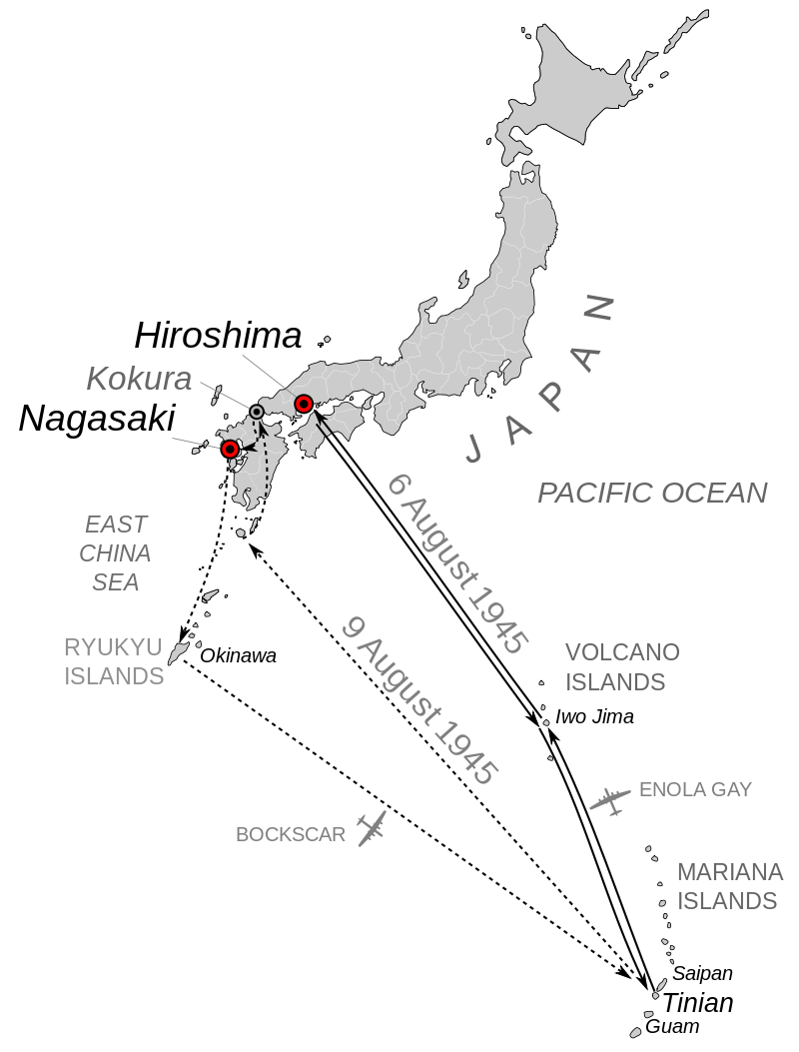
Videoclip: Atomic Bombings of Hiroshima & Nagasaki
Hiroshima
Aug 6, 1945
Nagasaki
Aug 9, 1945
EdPuzzle.com (2:13)
https://edpuzzle.com/media/593059bb406c124f703b30af
After viewing the atomic bombings of Hiroshima
and Nagasaki,
Create an original emoji to express your reaction.
http://www.nebraskastudies.org/0800/frameset_reset.html?http://www.nebraskastudies.org/0800/stories/0801_0610.html

Slide 16
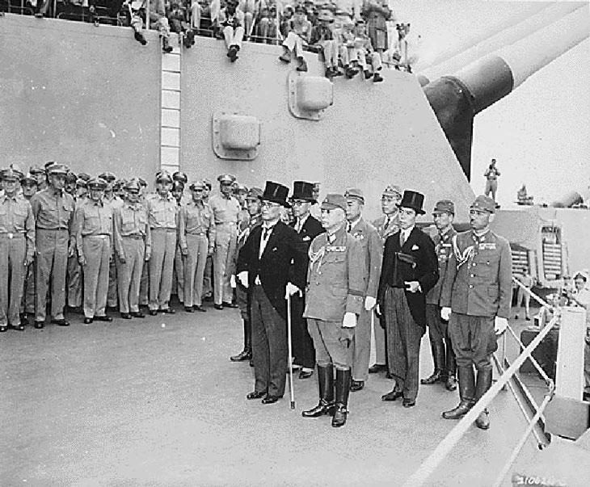
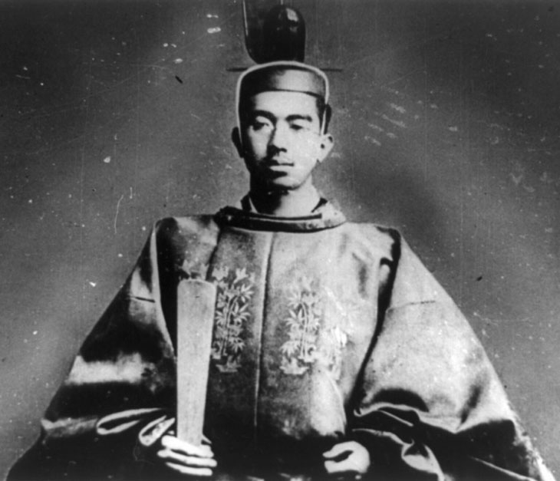
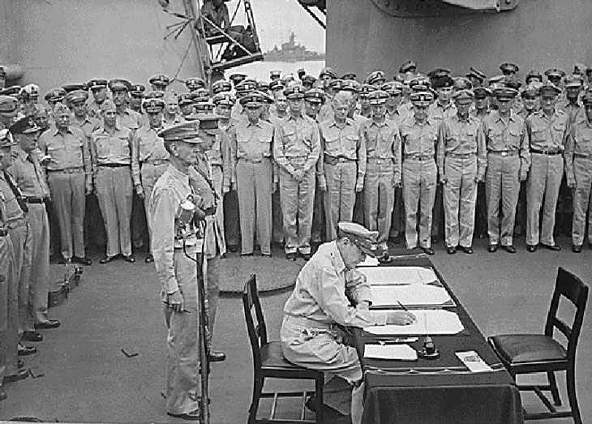
Japan Surrenders & WWII Ends
August 15, 1945
Emperor Hirohito announces Japan’s unconditional surrender to his people over public radio.
September 2, 1945
Japan’s formal surrender takes place on the US battleship Missouri in Tokyo Bay.
https://www.archivesfoundation.org/documents/japanese-instrument-surrender-1945/
https://www.osti.gov/opennet/manhattan-project-history/Events/1945/surrender.htm

Slide 17
USSR
Dictatorship
Communism
USA
Democracy
Capitalism
1945-1990
Fear
Distrust
Tension
M.A.D.*
* M.A.D. is a policy of Mutually Assured Destruction due to nuclear arms build up.

Slide 18
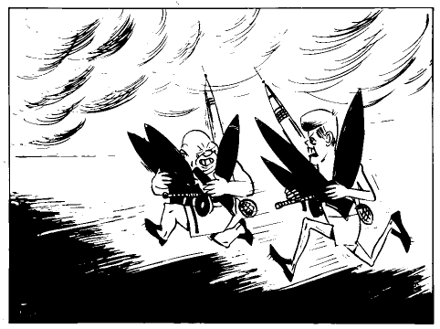
Cold War & the
Nuclear Arms Race
US President Kennedy
Soviet Premier Khrushchev
What message does this political cartoon convey about the relationship between the USSR & the USA?
What “prize” does the winner of this race win for his country?
https://www.timetoast.com/timelines/cold-war-arms-race--2

Slide 19
Ready - Set - Explore . . .
WHAT is the “rest of the story” behind the invention of the atomic bomb?
WHO was involved and HOW was it done in total secrecy?
View videoclip on “Overview of Manhattan Project” (3:01) http://www.history.com/topics/world-war-ii/trinity-test

Slide 20
Vocabulary Flashcards
Pronounce
Say it TWO times
Definition
Meaning of the word
Image
Visual Example

Slide 21
Vocabulary Flashcards
Concept of fission
https://edpuzzle.com/media/5931c1f510a91d6c027223ac

Slide 22
Vocabulary Flashcards

Slide 23
Vocabulary Flashcards

Slide 24
Vocabulary Flashcards

Slide 25
Vocabulary Graphic Organizer
Review vocab & definition
Read “Teacher Example” & underline vocab word
Discuss “Part of Speech” use in Teacher Example
Write “Your Sentence” using the vocab word in the appropriate context
The site of the new mall will be downtown Mesa.

Slide 26
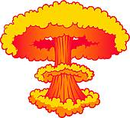
Reading Background: The Manhattan Project
Focus: TWO Quotes at the top of the page
Both stated by men involved with the Manhattan Project
Both witnessed the Trinity Test Blast – the first ever atomic bomb explosion

Slide 27
Reading Background: The Manhattan Project
What is the difference between primary sources & secondary sources?
Primary Sources:
Eyewitness account of a historical event
Materials created in the past by people living at the time.
Is the photo a Primary Source?
Only color photo of Trinity Test Blast, taken by Jack Aeby, just outside Base Camp, July 16, 1945

Slide 28
Reading Background: The Manhattan Project
Richard Rhodes is the author or editor
of 25 books including
The Making of the Atomic Bomb
which won a Pulitzer Prize in Nonfiction, a National Book Award and a National Book Critics Circle Award.
What is the difference between primary sources & secondary sources?
Secondary Sources:
Writings by historians & other experts who use available sources to interpret the past.
Materials created to analyze & summarize, events of the past by people who were NOT present at the event.
Is the book a Secondary Source?

Slide 29
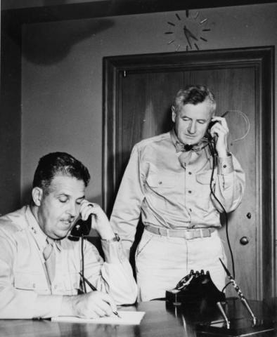
“The effects could well be called unprecedented, magnificent, beautiful, stupendous and terrifying. No man-made phenomenon of such tremendous power had ever occurred before. The lighting effects beggared description. The whole country was lighted by a searing light with the intensity many times that of the midday sun. It was golden, purple, violet, gray and blue. It lighted every peak, crevasse and ridge of the nearby mountain range with a clarity and beauty that cannot be described but must be seen to be imagined. It was the beauty the great poets dream about but describe most poorly and inadequately.”
-- Brigadier General Thomas F. Farrell, Deputy Commander to General Leslie R Groves
Quote #1
By Brigadier General Thomas F. Farrell
Farrell was 2nd in command to General Leslie R. Groves, the head of the Manhattan Project
Farrell viewed the Trinity Blast from an observation shelter at the test site
Is this a primary or secondary source?
http://www.atomicheritage.org/key-documents/groves-farrell-watching-trinity

Slide 30
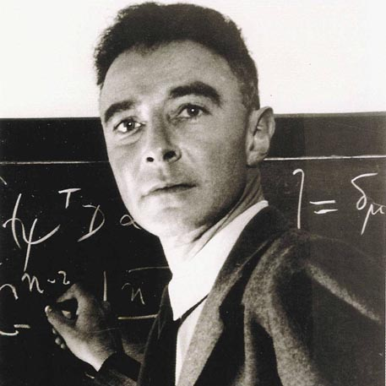
"We knew the world would not be the same. A few people laughed, a few people cried, most people were silent. I remembered the line from the Hindu scripture, the Bhagavad-Gita. Vishnu is trying to persuade the Prince that he should do his duty and to impress him takes on his multi-armed form and says, ‘Now, I am become Death, the destroyer of worlds.’ I suppose we all felt that one way or another." -- J. Robert Oppenheimer, Scientific Director of the Manhattan Project
Quote #2
By J. Robert Oppenheimer
Oppenheimer was the Scientific Director of the Manhattan Project at Los Alamos
Oppenheimer viewed the Trinity Blast from an observation shelter at the test site
Is this a primary or secondary source?
http://www.atomicheritage.org/profile/j-robert-oppenheimer

Slide 31
Reading Background: The Manhattan Project
1. Students work with pair-share partners.
2. Students “mark the text” while reading as follows:
Draw brackets around [geographic locations].
Underline names of people in red.
Highlight key points about the Manhattan Project

Slide 32
Worksheet Background: The Manhattan Project
1. Students work with pair-share partners.
2. Discuss and answer the worksheet questions with pair-share partners.

Slide 33
Answer Key Background: The Manhattan Project
1. As a class, correct the “Background: Manhattan Project” Worksheet.
2. Pay close attention to the answers to Questions 6,7 & 9 as they give important information about the three “secret cities” of:
Hanford
Oak Ridge
Los Alamos

Slide 34
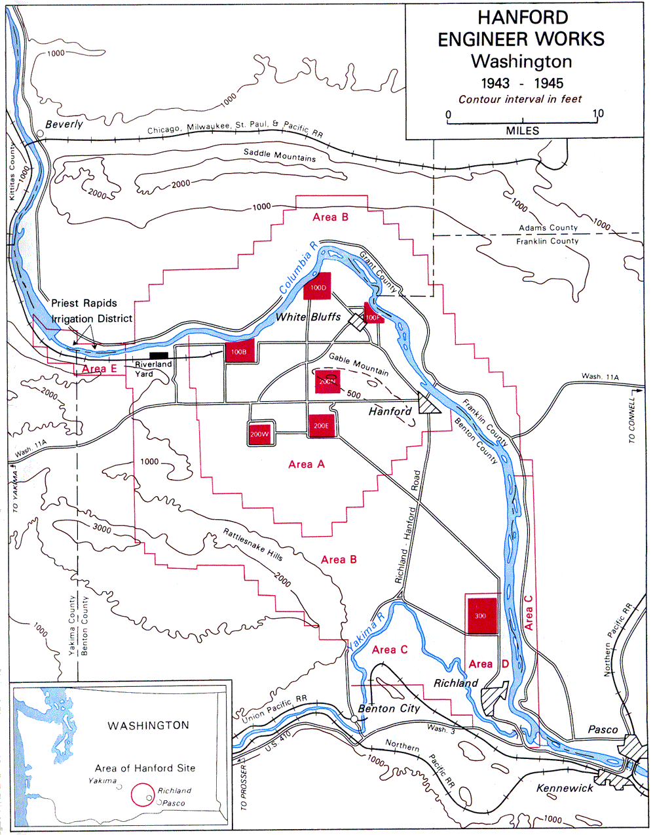
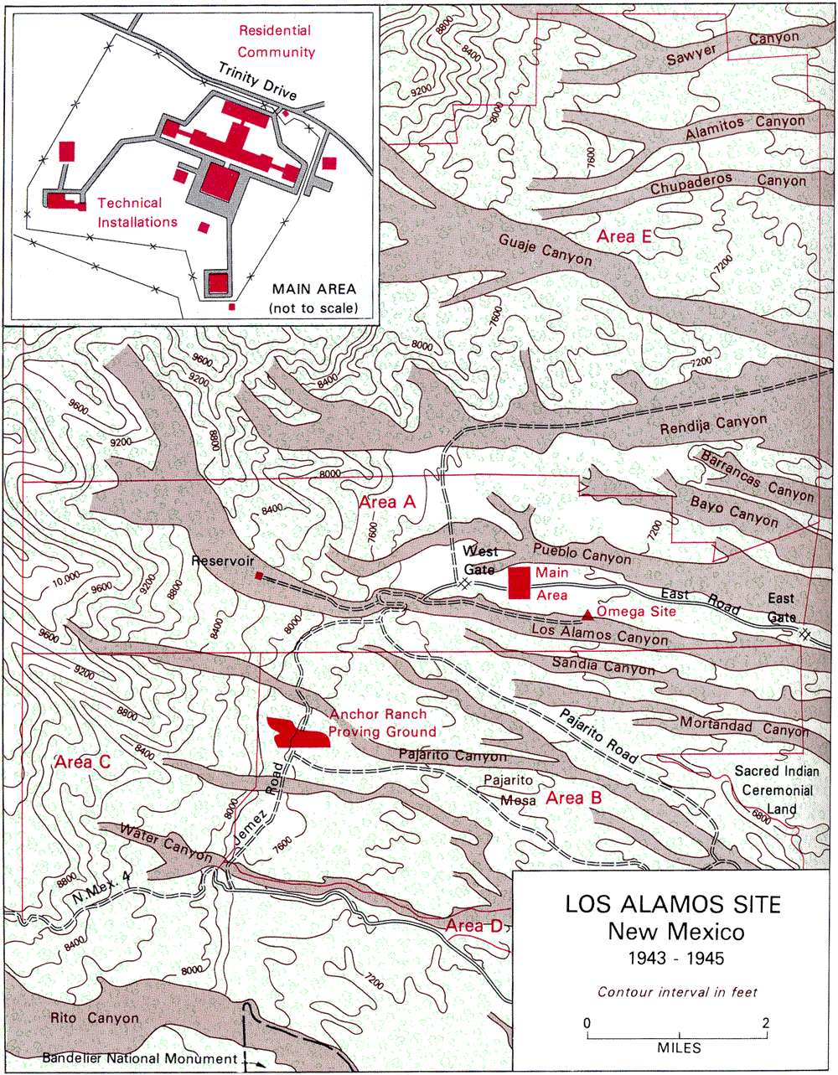
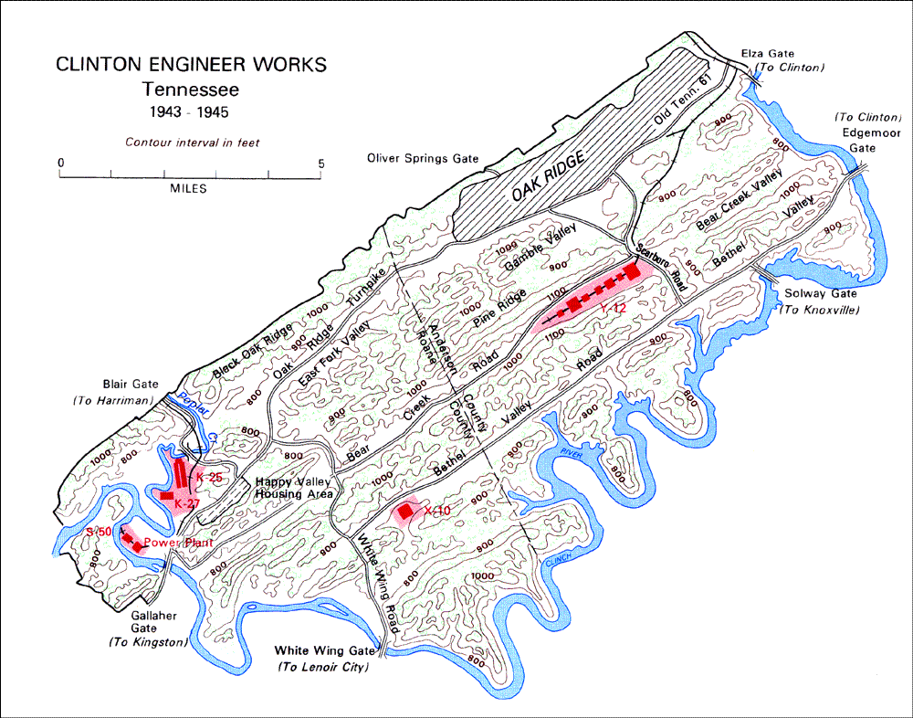
Map Analysis
1. Class is divided evenly into 3 groups.
2. Each group is assigned to analyze one of the “secret city” maps.
Hanford
Oak Ridge
Los Alamos
3. Students work with pair-share partners to complete the Map Analysis Worksheet.

Slide 35
Map Analysis Worksheet
1. Student partners meet with others from the same “secret city” group.
2. Discuss and compare answers on the Map Analysis Worksheet especially for the:
Map legend
Answers to Questions 9-12 (site’s geographic features)

Slide 36
Summary Paragraph
1. Use knowledge gained from the map analysis to write a paragraph that answers the question:
“What geographic features influenced the site’s selection?”
2. The paragraph should consist of:
A topic sentence
3 supporting statements
A concluding sentence
3. A Paragraph Frame is available for students who may need additional support with writing.

Slide 37
“Secret City” Digital Poster or Infographic
1. Partners collaborate to create a digital poster or infographic.
2. Checklist outlines the criteria for images & text that address 3 thematic components of the “secret city”:
Geography
Contributions
Past to Present

Slide 38
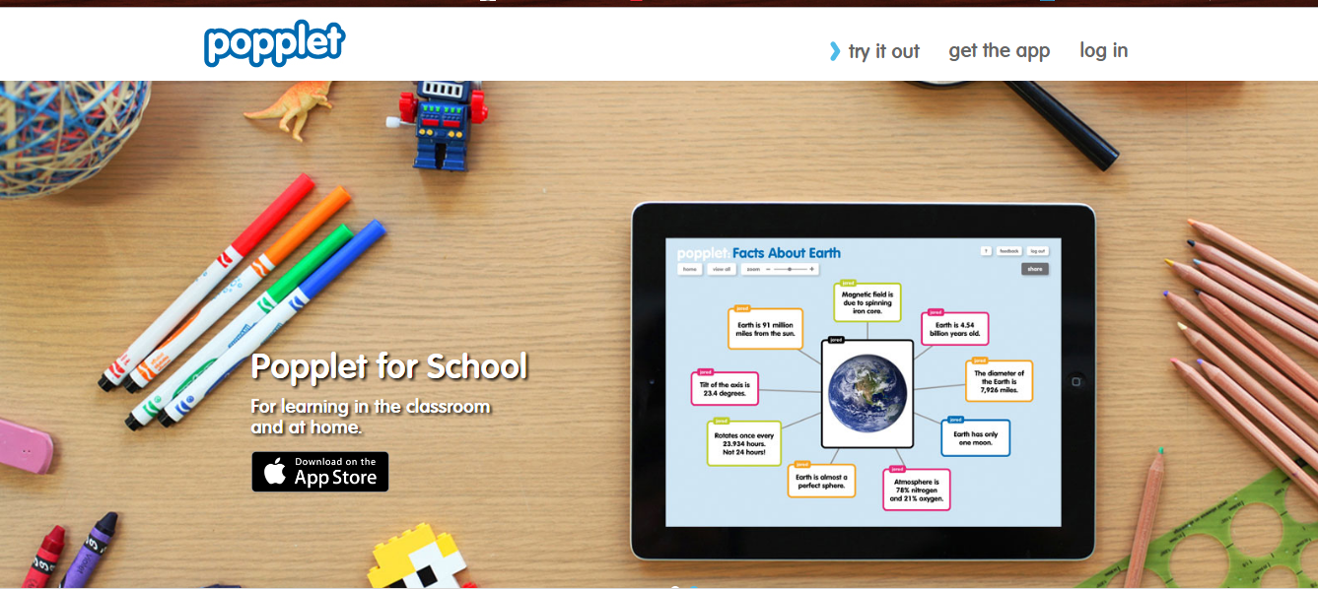
Create a digital poster using Popplet http://popplet.com/ OR . . .

Slide 39
Create a digital poster or infographic using Canva https://www.canva.com/

Slide 40
Investigation Guides Manhattan Project “Secret Cities”
Los Alamos
1. Each Investigation Guide has vetted websites to assist with research & image (photo) searches.
2. Collaborate with your partner & divide the workload in an equitable manner.
Oak Ridge
Hanford

Slide 41
Rubric: Manhattan Project “Secret Cities”
1. Look over each of the TEN rubric categories to understand how the digital poster or infographic will be graded.
2. The highest score per category is a “4”.
3. A score of 80% or higher is considered Mastery.
4. Before turning in your project, both partners should use this rubric to self-assess your poster/infographic.

