Slide 1
TOO MUCH PLASTIC IN THE OCEAN
What will you engineer to solve the problem?

Slide 2
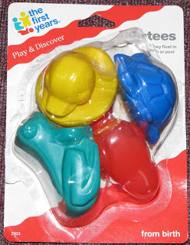
THE CARGO SHIP THAT CARRIED THE PLASTIC BATH TOYS

Slide 3
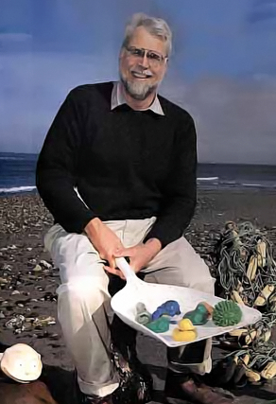
TOYS HAVE BEEN FOUND ON BEACHES

Slide 5
THE PLASTIC BREAKS UP INTO LITTLE PIECES IN THE OCEAN AND IN THE SAND

Slide 6
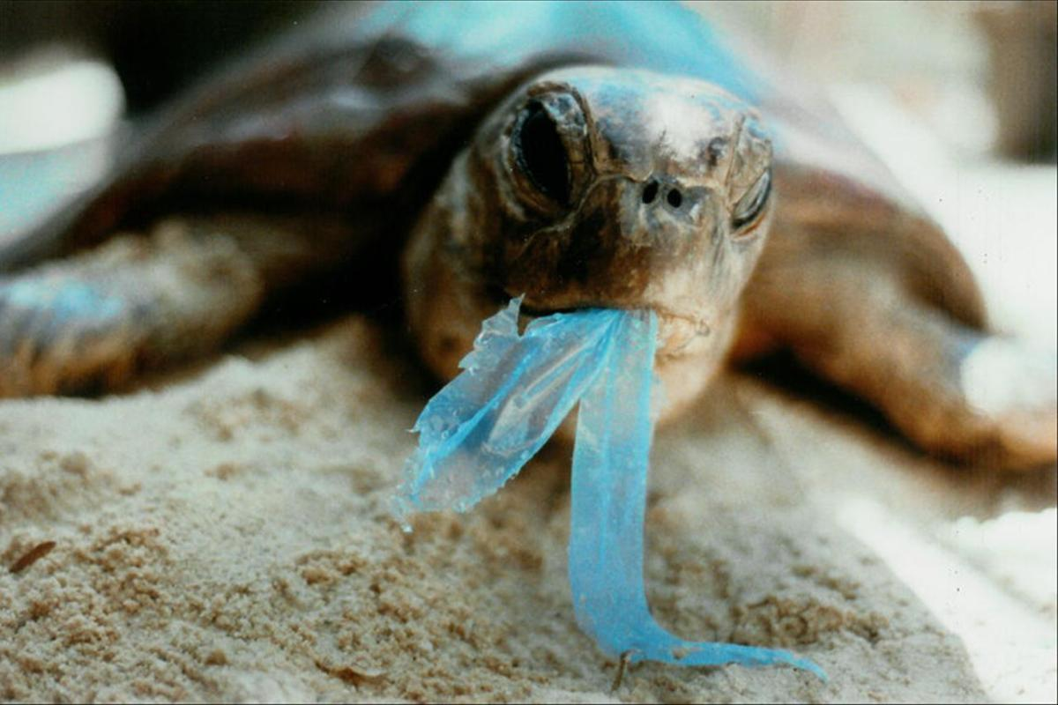
WHEN PLASTIC GOES INTO THE OCEAN, ANIMALS CAN GET TRAPPED IN IT AND EVEN EAT IT.

Slide 7
A MACHINE SCOOPS PLASTIC OUT OF THE OCEAN

Slide 8
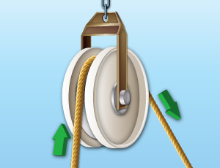
PULLEY
http://leos-bridge.org/pulley/
https://www.flickr.com/photos/loopsoup/5737255688

Slide 9
WHEEL AND AXLE
http://weclipart.com/wheel+and+axle+clipart
http://squadteamofinterone.blogspot.com/2010/11/wheel-and-axle.html

Slide 10
SCREW
This Photo by Unknown Author is licensed under CC BY-SA
This Photo by Unknown Author is licensed under CC BY-SA

Slide 11
RAMP/INCLINED PLANE
This Photo by Unknown Author is licensed under CC BY-SA
This Photo by Unknown Author is licensed under CC BY-SA

Slide 12
LEVER
This Photo by Unknown Author is licensed under CC BY-SA
https://thediyplaybook.com/2014/06/how-to-openclose-paint-can-without-mess.html

Slide 13
WEDGE
This Photo by Unknown Author is licensed under CC BY-NC-SA
http://www.aperfectworld.org/office.html

Slide 14
WHAT CAN YOU BUILD TO HELP SOLVE THE PROBLEM?
Draw and plan what you are going to build to help clean up the plastic pollution from the ocean.
This Photo by Unknown Author is licensed under CC BY-NC-SA

Slide 15
SOURCES
http://donovanhohn.blogspot.com/2012/09/bath-toy-lost-at-sea-found-in-brooklyn.html
http://www.shipspotting.com/gallery/photo.php?lid=1728138
https://i.pinimg.com/originals/29/0c/1d/290c1d8cf77097e82eeb1e671ac0532e.jpg
http://blogs.ei.columbia.edu/2011/01/26/our-oceans-a-plastic-soup/
http://coastalcare.org/2009/11/plastic-pollution/

