Slide 1
Steps to Dyeing with Cochineal
by
Sara Jenkins

Slide 2
Supplies and Information
Dharma trading co.
Cochineal Dye Company
Two 3.5 oz. hanks of 100% natural undyed worsted wool

Slide 3
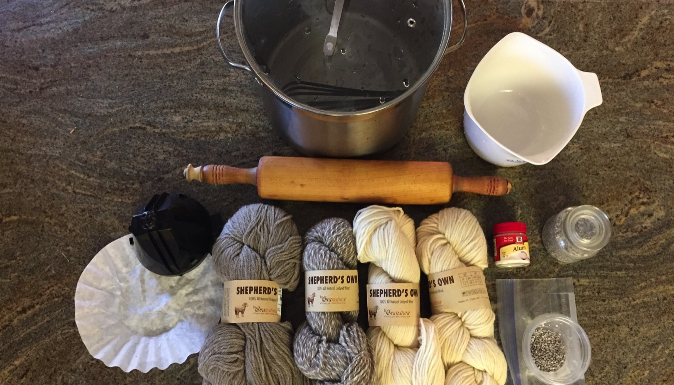
Materials: wool, (only 1 skein is used for dyeing) alum, dried cochineal, 2 coffee filters, rolling pin, stockpot, standard measuring cup and spoons

Slide 4
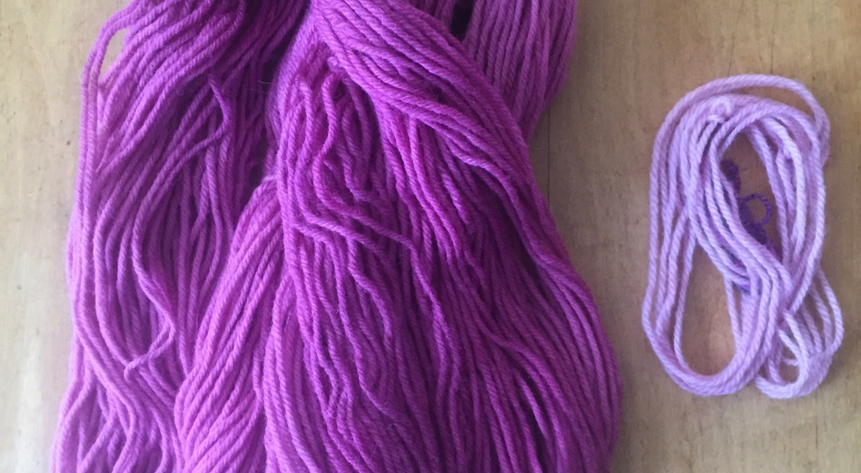
Mordant the wool at home and bring it to school to save time. Notice the difference between yarn with mordant (deep color) and yarn without (pale).

Slide 5
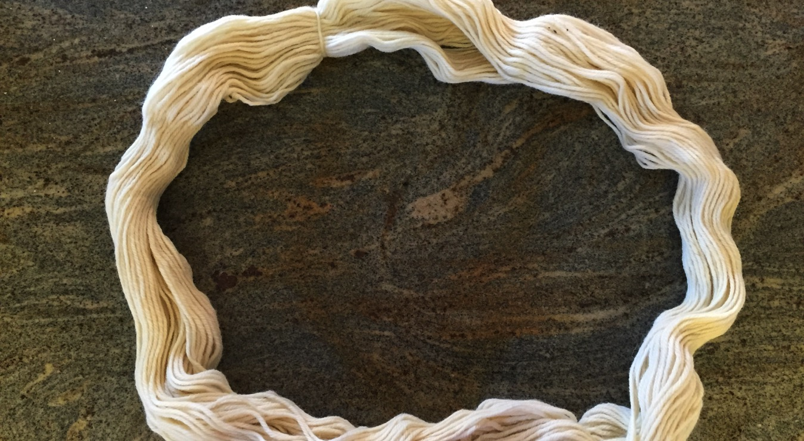
Mordant: Soak 1 hank of wool in water for several hours.

Slide 6
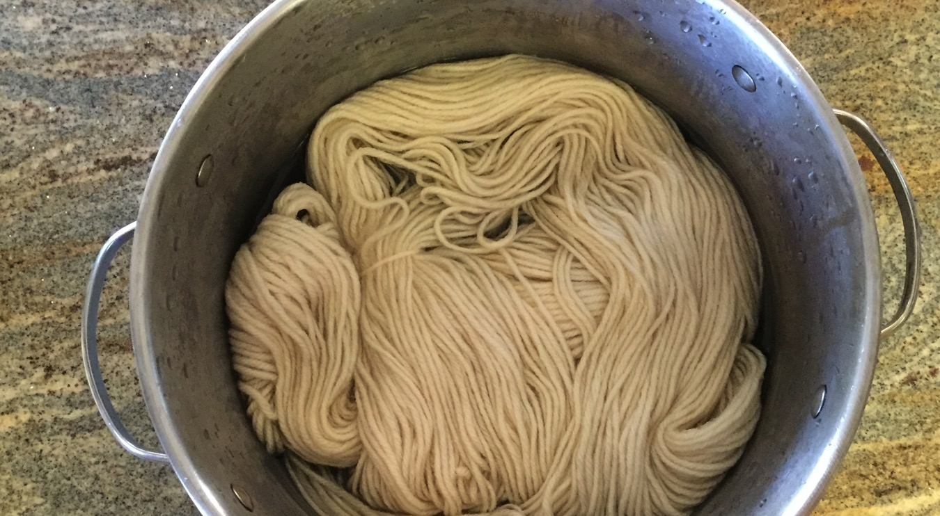
Fill a stockpot with water, leaving enough room for the wool. Add 2 tsp. of alum and dissolve completely. Bring the bath to room temperature and add the wool.

Slide 7
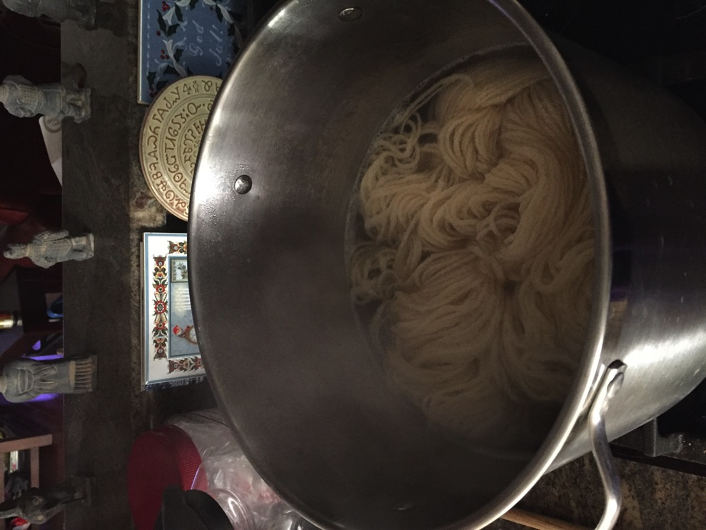
Bring to a simmer and hold there for an hour. Do not boil.

Slide 8
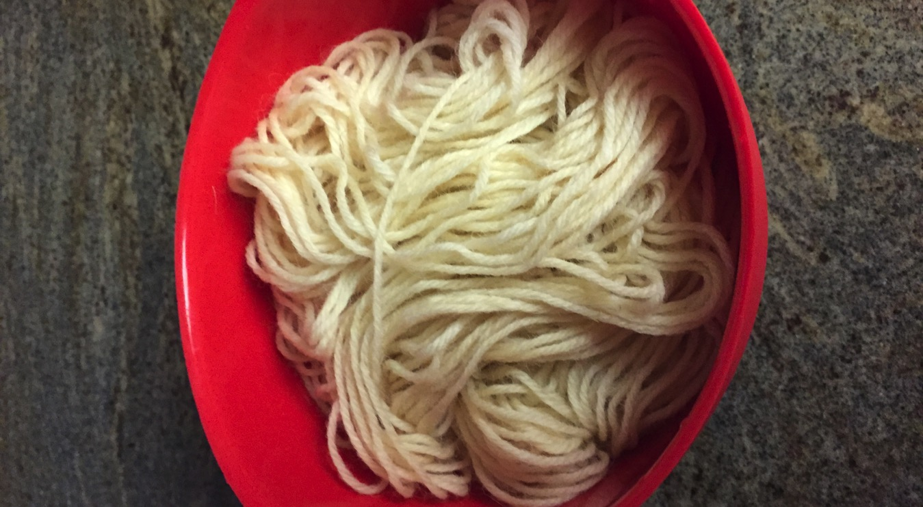
Remove pot from heat and let cool. Remove wool from pot. It is ready to be dyed.

Slide 9
Dyeing Cochineal
Safety first! While you are demonstrating this be sure to wear gloves, glasses, and mask.

Slide 10
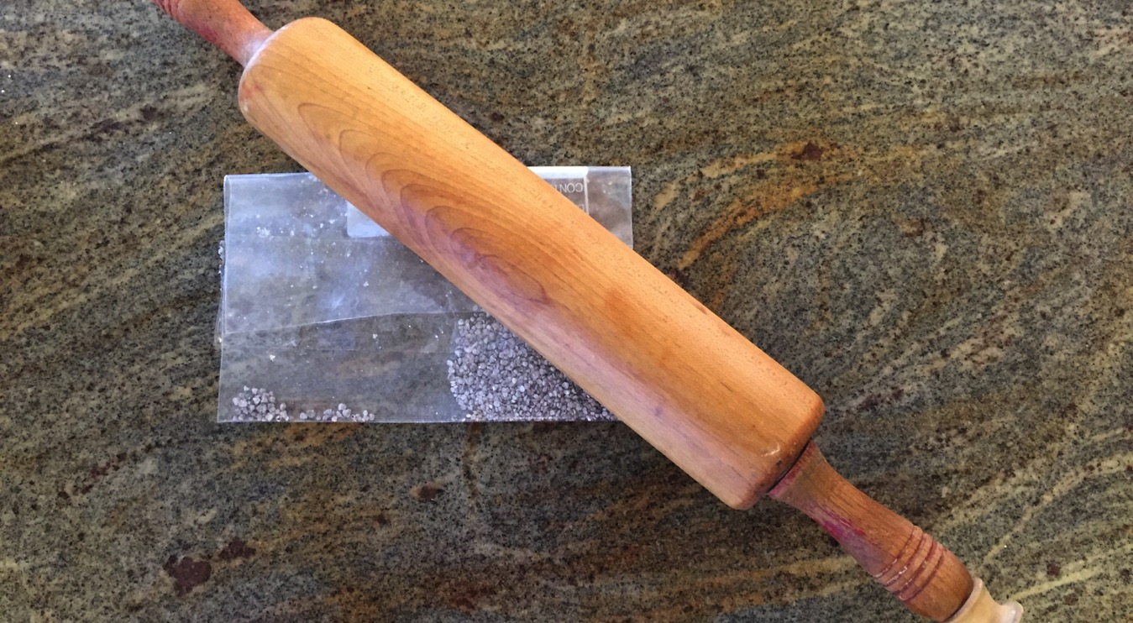
Put dried cochineal (2 ½ tsp.) in a strong plastic bag. Seal it with tape. Gently press with a rolling pin until it is a powder.

Slide 11
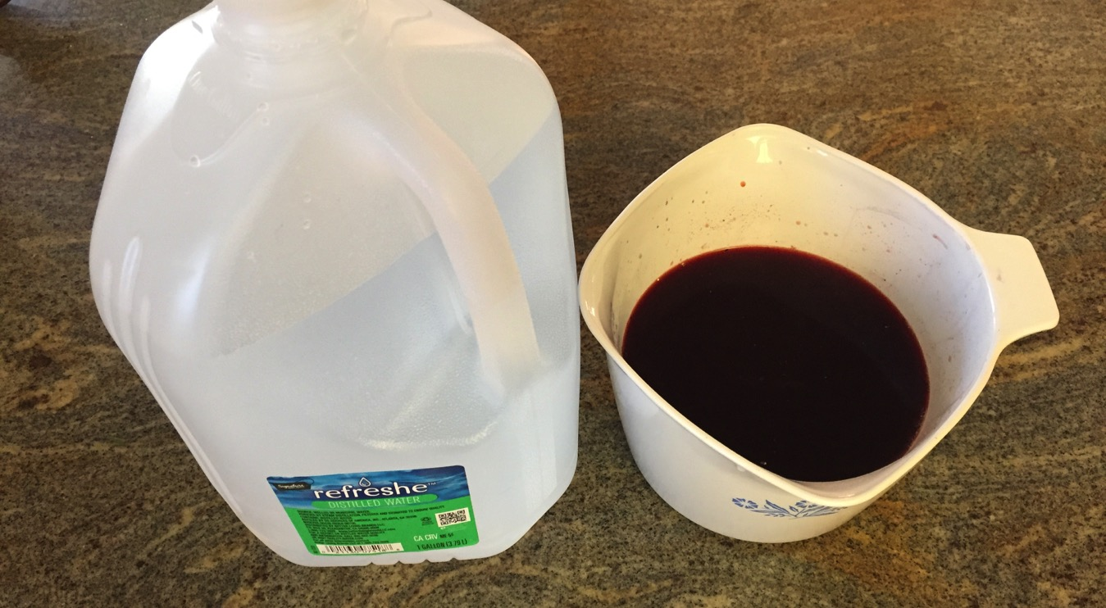
Use soft water, rainwater, or distilled water to get the darkest color. Boil 2 cups of soft water, pour it over the ground cochineal and let it soak overnight.

Slide 12

Add more distilled water (I used 4 cups.) and heat the cochineal dye bath to near boiling for 15 to 20 minutes. Let the water cool.

Slide 13
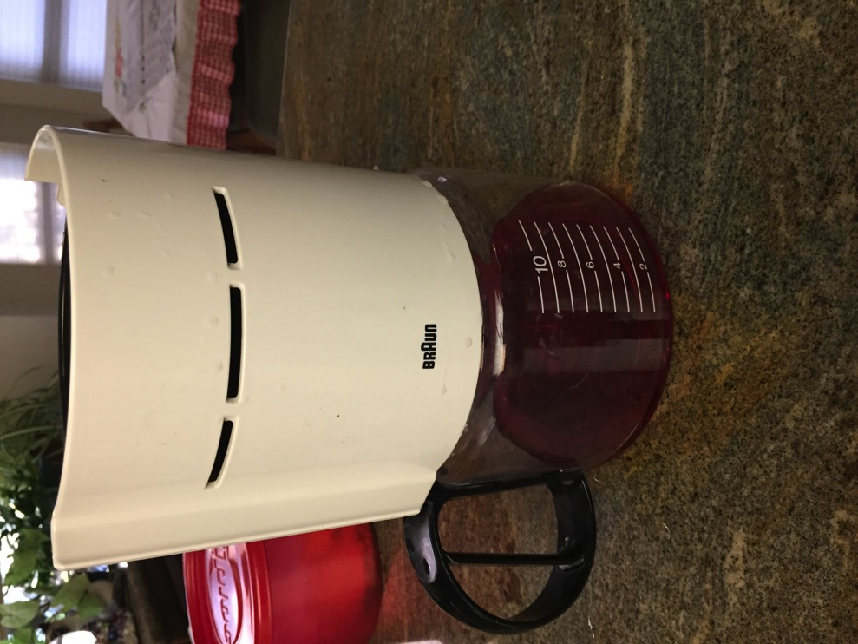
Filter the dye bath through a coffee filter.

Slide 14
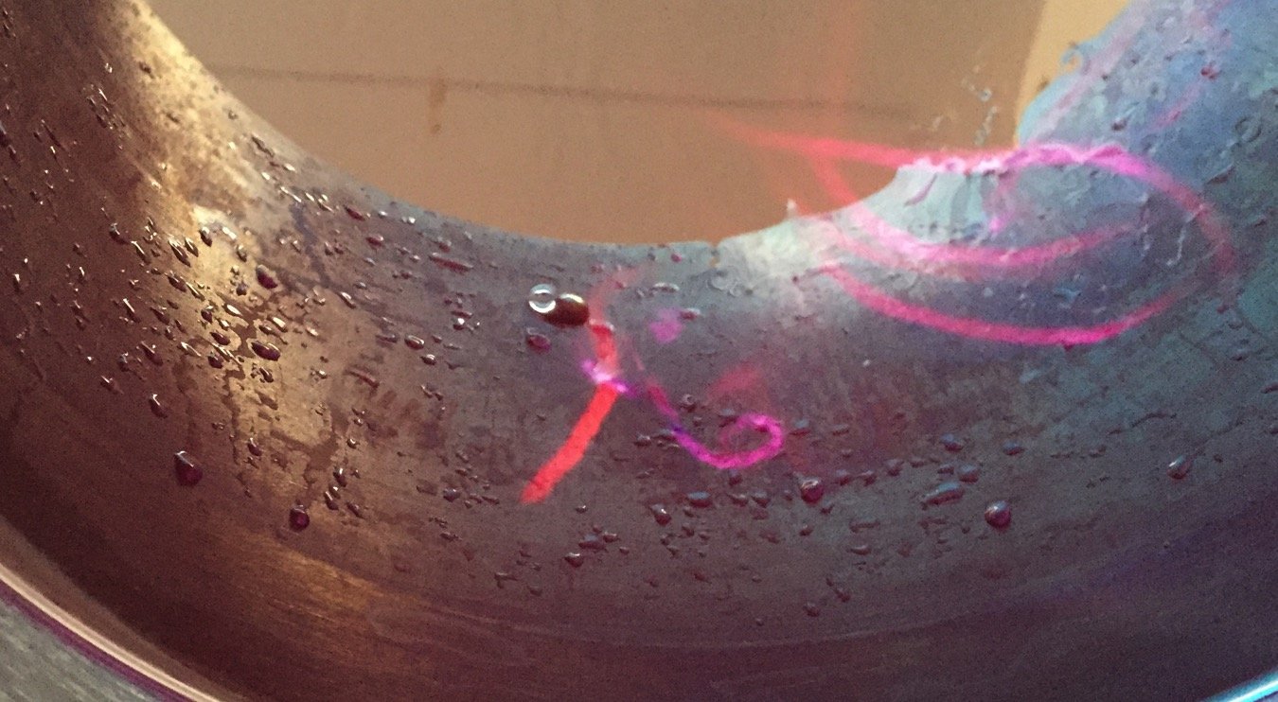
Add the mordanted fiber. Leave overnight.

Slide 15
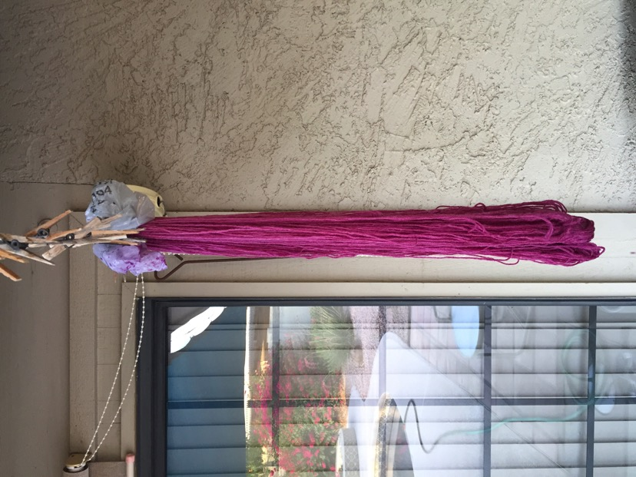
Remove the fiber from the dye bath. Let dry before washing it.

Slide 16
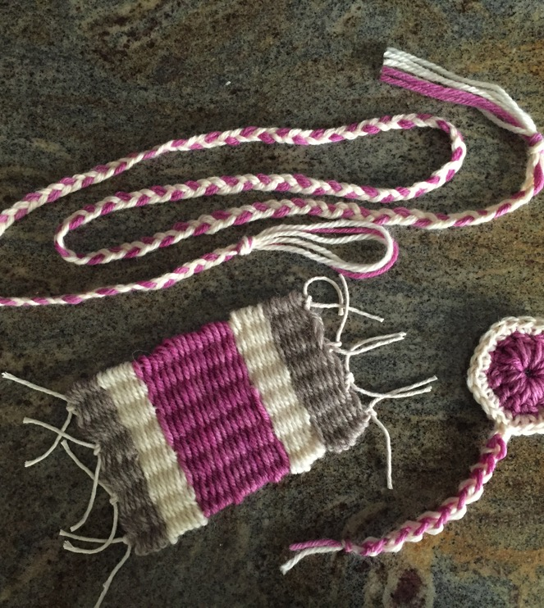
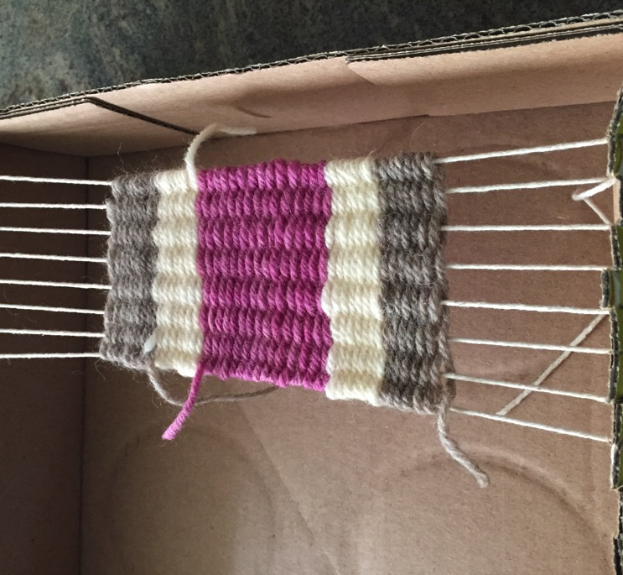
Use this yarn and the other natural undyed yarn to make an art project. You can braid a cord, make a friendship bracelet, weave on a box loom, or crochet. Use your imagination!

