Slide 1
Cochineal Farming in Oaxaca, Mexico
Written and illustrated by
Sara Jenkins

Slide 2
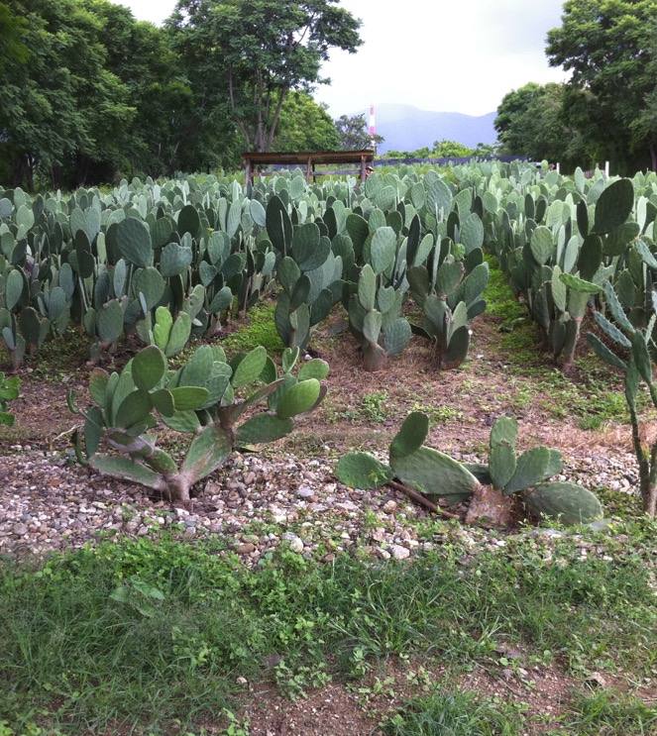
Welcome to Rancho La Nopalera, home of Tlapanochestli products made from cochineal near the Oaxaca, Mexico airport. Here prickly pear cactus will be used to farm cochineal insects.

Slide 3
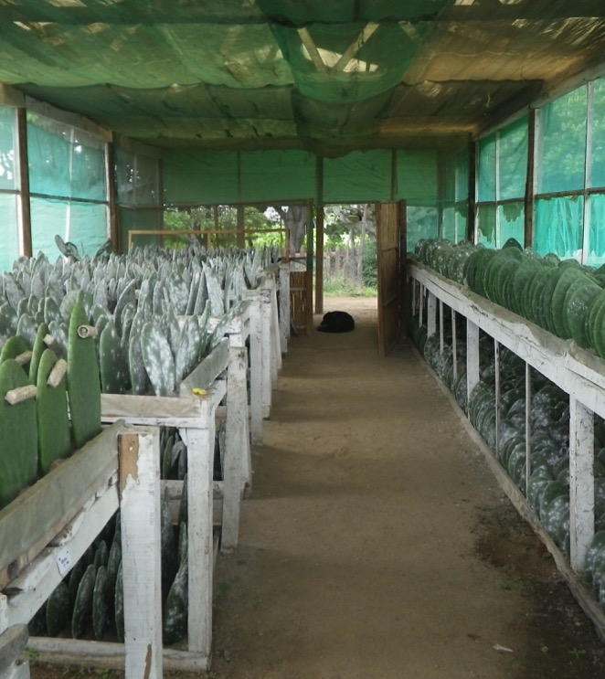
The branches or pads, called pencas in Spanish, will be the home to the cochineal scale insect.

Slide 4
Males have long white wings and legs and are half the size of the female.

Slide 5
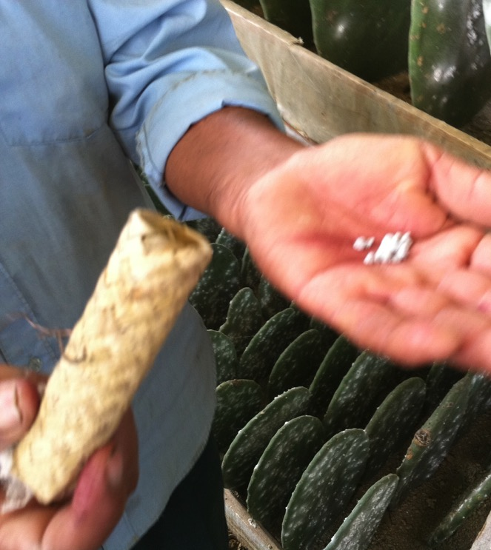
Cochineal insects are picked off the cactus pads and placed in the container.

Slide 6
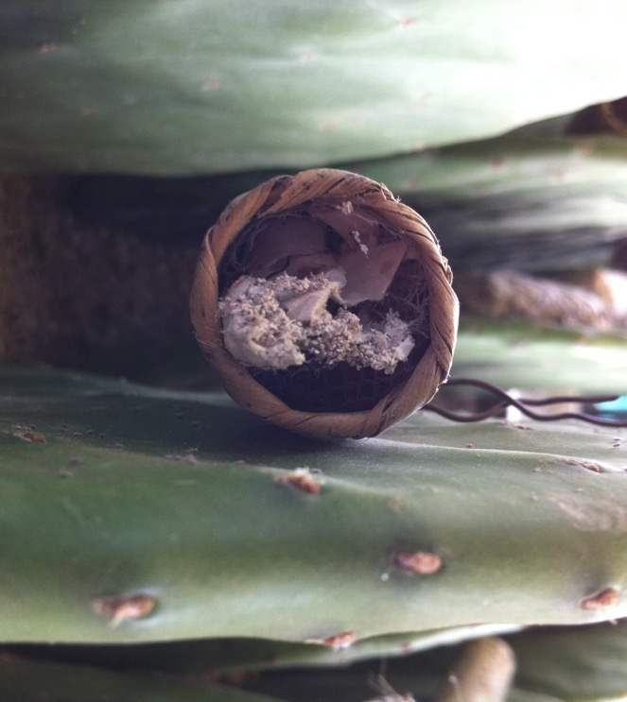
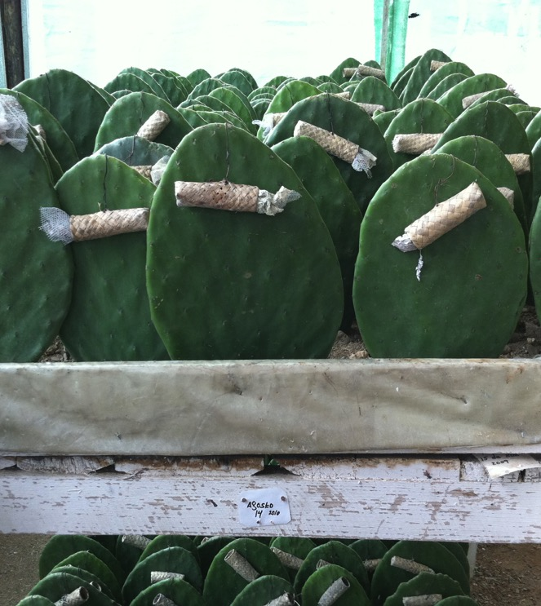
After mating, females lay their eggs. Nymphs hatch and begin molting and feeding. Juveniles produce long wax filaments. In the wild these are picked up by the wind which disperses the insects to other plants, where they begin feeding and mating.

Slide 7
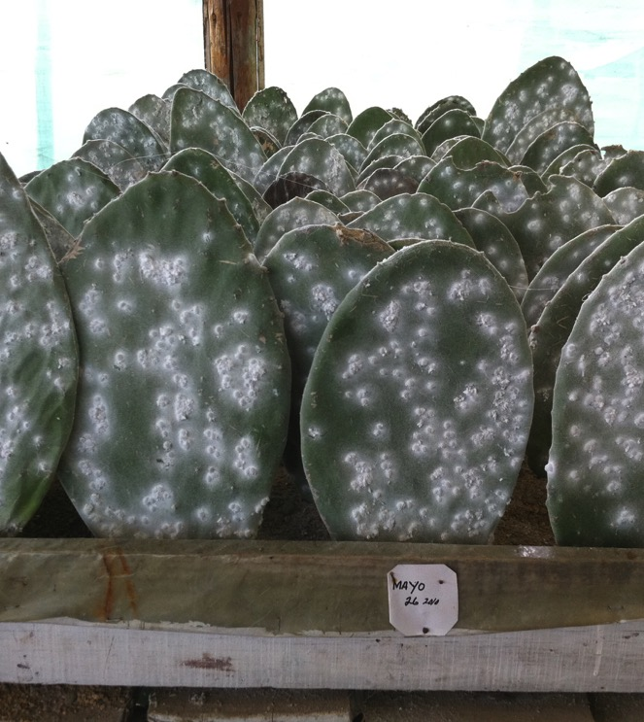
While eating, adult females produce a type of acid called carminic acid. This helps to protect it from predators.

Slide 8
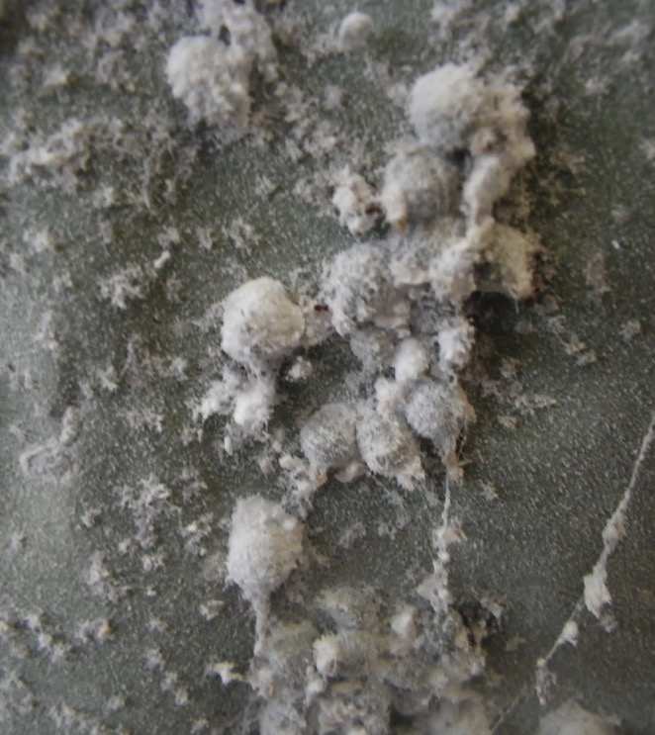
Cochineal before and after harvest. Farmers scrape the insects off the pad. The insects are heated to kill them. Farmers hope to get at least 3 harvests a year.

Slide 9
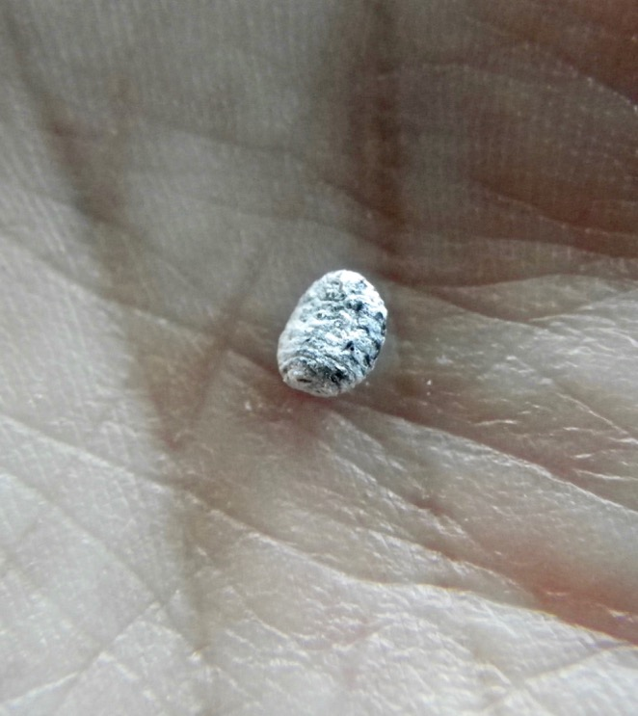
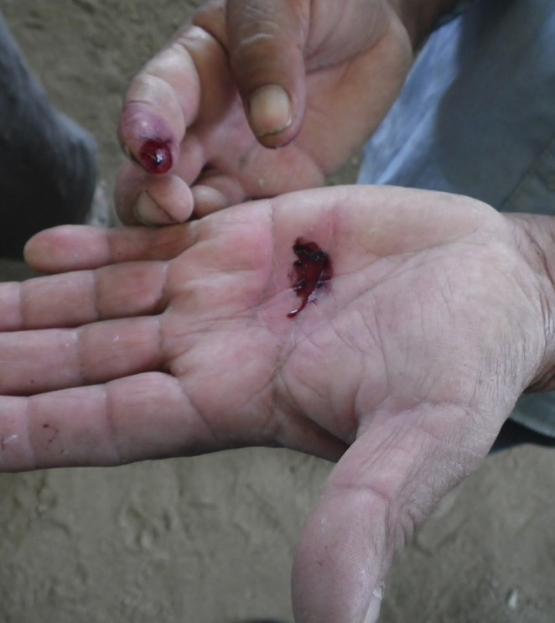
Rub the cochineal to see carminic acid. A pound of dried cochineal is made up of roughly 70,000 dead females.

Slide 10
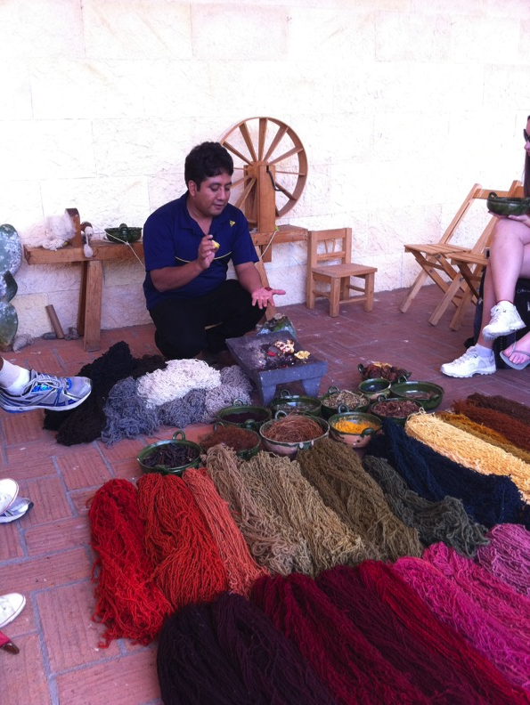
The carminic acid is used for dyeing fiber in Oaxaca and throughout the world.

