Slide 1
Introduction

Slide 2
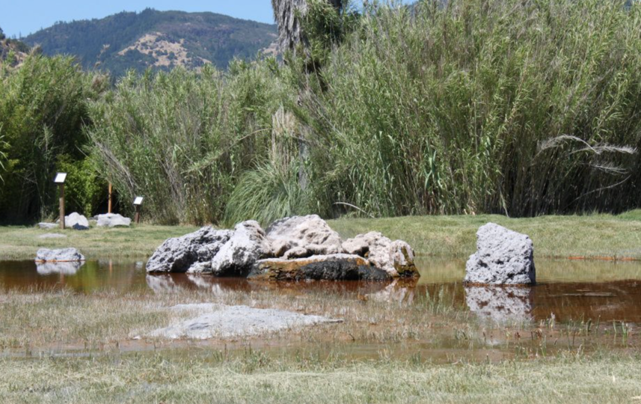
Notes:
Old Faithful Geyser - Calistoga, CA

Slide 3
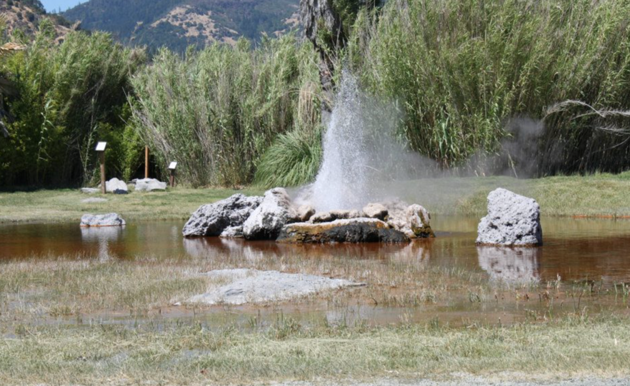
Notes:
Old Faithful Geyser - Calistoga, CA

Slide 4
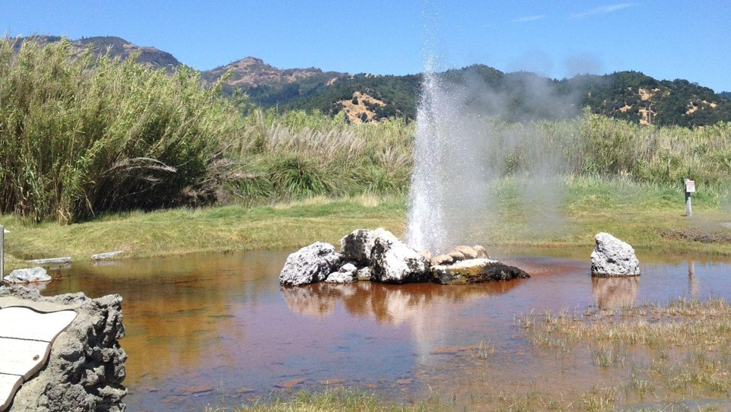
Notes:
Old Faithful Geyser - Calistoga, CA

Slide 5
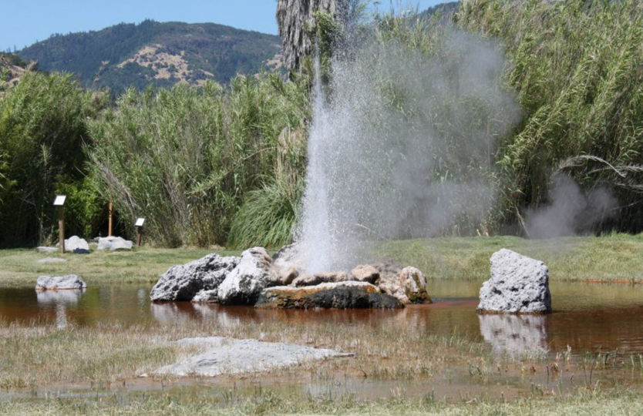
Notes:
Old Faithful Geyser - Calistoga, CA

Slide 6
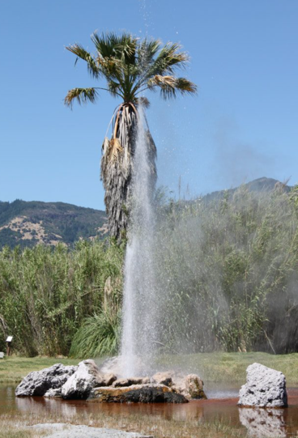
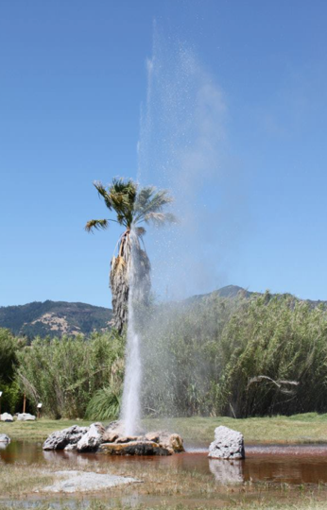
Notes:
Old Faithful Geyser - Calistoga, CA

Slide 7
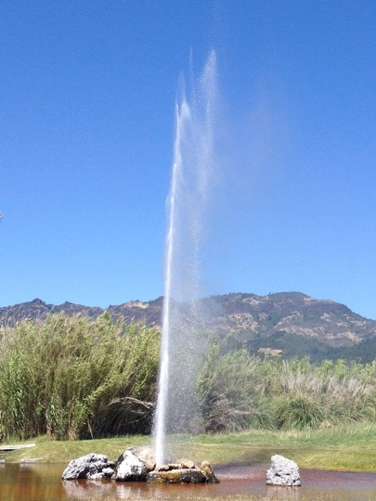
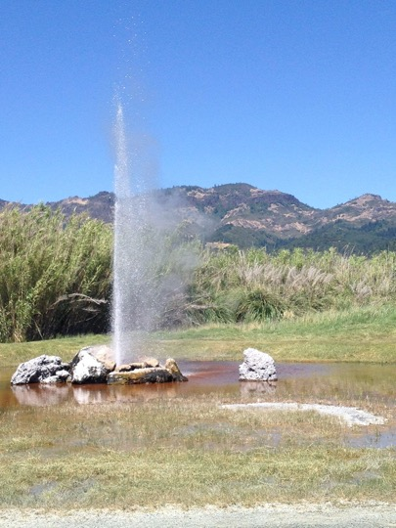
Notes:
Old Faithful Geyser - Calistoga, CA

Slide 8
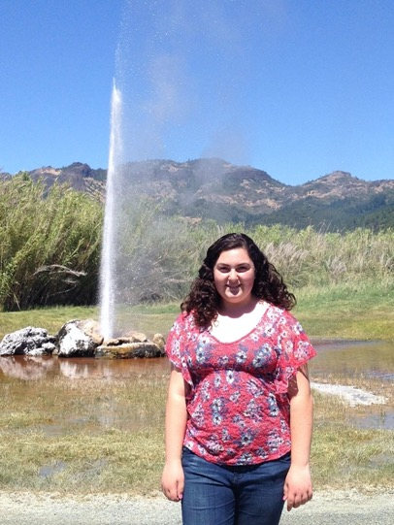

Slide 9
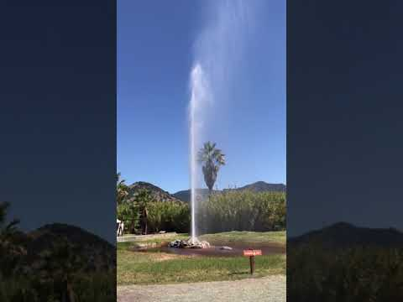
Notes:
https://www.youtube.com/watch?v=37-9h02IU_Y&t=6s

Slide 10
Old Faithful Geyser: Calistoga, CA
Eons ago, a part of what is now Napa Valley was a volcano. The volcano exploded in a massive eruption about 4.3 million years ago and expended much of its energy in the process. The explosion was so powerful that it flattened a grove of redwood trees about 3.5 miles (5.6 km) to the southwest. The trees were buried in volcanic ash and fossilized, creating a present-day Petrified Forest. The remains of the volcano continue to simmer gently beneath the valley today, creating the geothermal features and hot springs that the area is famous for.
Notes:
https://www.atlasobscura.com/places/california-s-old-faithful
https://www.roadsideamerica.com/story/12648
https://californiathroughmylens.com/old-faithful-geyser/

Slide 11
Old Faithful Geyser: Calistoga, CA - History
Centuries ago, the people of the native Wappo Indian tribe believed in the “Legend of the Healing Waters.” The Wappos noticed steam rising through the earth and the mineral waters bubbling out of the ground. Having discovered the healing properties of the waters and their therapeutic effect on tired and aching muscles, the Wappos used the mud to treat bee stings and sunburns with great success. Before long, word of the legend spread, leading people to travel great distances to experience the benefits of the healing waters. Visitors would relax in bamboo sweat lodges, soak in the natural pools, and take in the serenity of Mount Saint Helena.
Notes:
https://www.atlasobscura.com/places/california-s-old-faithful
https://www.roadsideamerica.com/story/12648
https://californiathroughmylens.com/old-faithful-geyser/

Slide 12
Facts about Old Faithful Geyser: Calistoga, CA
Erupts every 10-45 minutes depending on the time of year
Eruption lasts 2-6 minutes
Water shoots 20-80 feet into the air at a temperature of 350ºF
Created on accident - a settler in the late 1800s was drilling for a well when he drilled into a natural steam pocket and the well erupted, nearly killing him in the process
Later, the land was purchased by ranchers who drilled a second well, creating a second geyser
For a while, the two geysers coexisted but the second one was used to feed a therapeutic pool built out of lava rock
In 2009, the second well was put out of service and the pool is now empty
Notes:
https://www.atlasobscura.com/places/california-s-old-faithful
https://www.roadsideamerica.com/story/12648
https://californiathroughmylens.com/old-faithful-geyser/

Slide 13
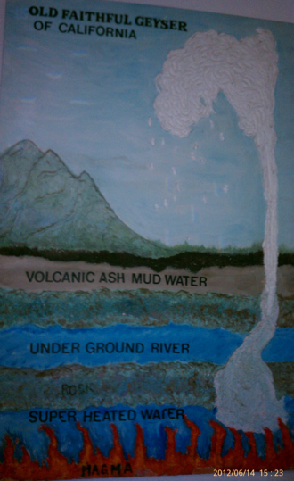

Slide 14
Old Faithful Geyser: Calistoga, CA
The site has been the subject of geology studies by groups from the U.S. Geological Survey, U.C. Berkeley, and the Carnegie Institute.
From 1990 to 2002, there was a seismograph in use at the property to measure and document seismic activity.
The geyser is a partial predictor of earthquakes: its eruption cycles slow down from 2 days to 2 weeks before an earthquake.
Notes:
https://www.atlasobscura.com/places/california-s-old-faithful
https://www.roadsideamerica.com/story/12648
https://californiathroughmylens.com/old-faithful-geyser/

Slide 15
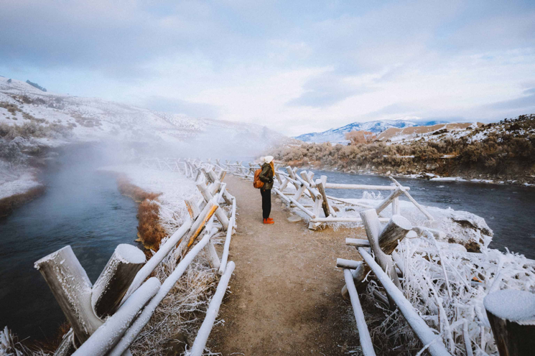
https://www.themandagies.com/boiling-river-yellowstone/
Notes:
Yellowstone

Slide 16
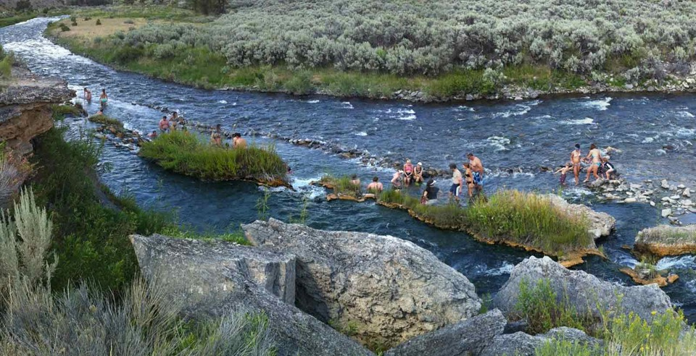
https://www.yellowstonepark.com/things-to-do/rafting-water-activities/swim-yellowstones-boiling-river/
Notes:
Yellowstone

Slide 17
Talk to Your Table:
What do you know about boiling rivers? Have you ever heard of a boiling river?
How do you think boiling rivers work?

Slide 18
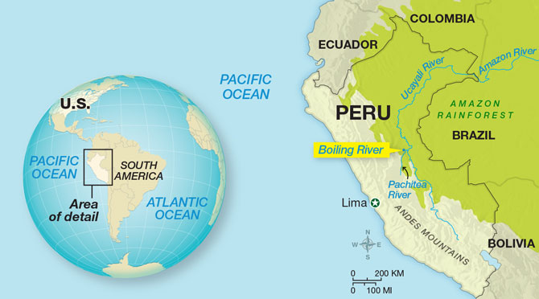
https://scienceworld.scholastic.com/issues/2021-22/092021/mysteries-of-the-boiling-river.html

Slide 19
Boiling River TED Talk
Notes:
https://www.youtube.com/watch?v=k4N2SxUZwiU&feature=emb_logo

