Slide 1
A Greater Killer than the War:
The INFLUENZA Pandemic of 1918-1919

Slide 2
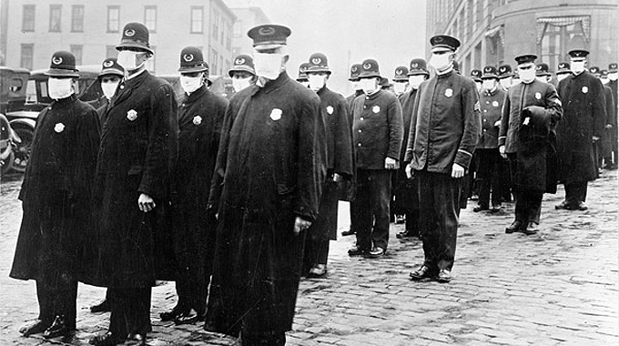
What is going on?
Notes:
Who do you think these people are? (police officers)
Where do you think these people are? (Seattle)
When do you think this picture was taken? (circa 1918)
Why are they wearing masks? (protection from the flu – both getting it or spreading it)
What do you think they are doing? (going to enforce laws that protect public from spread of the flu)

Slide 3
Key Vocabulary
PANDEMIC – an outbreak of a disease that occurs over a wide geographic area and affects an exceptionally high proportion of people
EPIDEMIC – an outbreak of a disease that spreads quickly and affects many people at the same time
VIRUS – an extremely small particle that causes a disease and spreads from one person or animal to another

Slide 4
Key Vocabulary
INFLUENZA – a common respiratory illness that is caused by a virus and that causes fever, weakness, severe aches and pains, and breathing problems
GLOBAL – involving the entire world
MORTALITY RATE – the number of a particular group of people who die each year

Slide 5
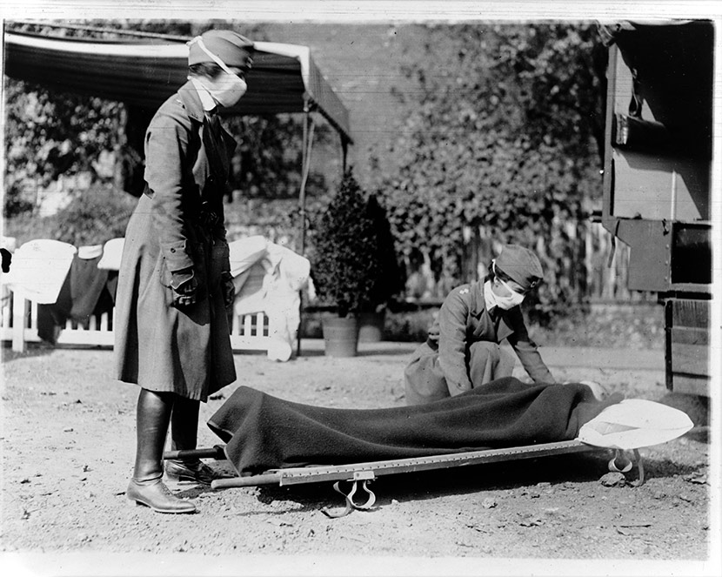
Deadlier Than the War
Estimated 30 to 100 million people died worldwide.
Approximately 116,500 Americans died in World War I.
Approximately 675,000 Americans died from Influenza in 1918-1919.
Millions more were infected but did not die.
Unlike other diseases, this one killed young people – ages 15-45 – at greater rates than any other age.
The mortality rate for this age group is usually the lowest, which made this disease one of the most unusual in history.
Notes:
It is difficult to know the exact amount of people who died since many countries did not keep accurate records and some deaths were recorded as pneumonia. But there are a lot of other records about the disease like: medical records, newspaper accounts, personal letters, and stories that people told from generation to generation.
In many places, there were so many bodies, that the people were buried in mass graves with no markers. Entire villages and towns were wiped out in some places in the world.
The flu and other diseases usually affect the very young and the very old much worse than 15-45 year olds. In fact, this age group usually recovers. But the Spanish Flu was particularly deadly to this age group.

Slide 6
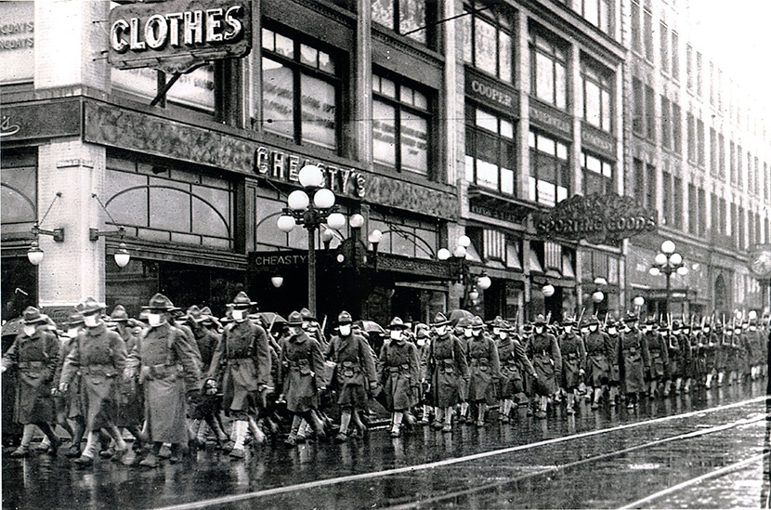
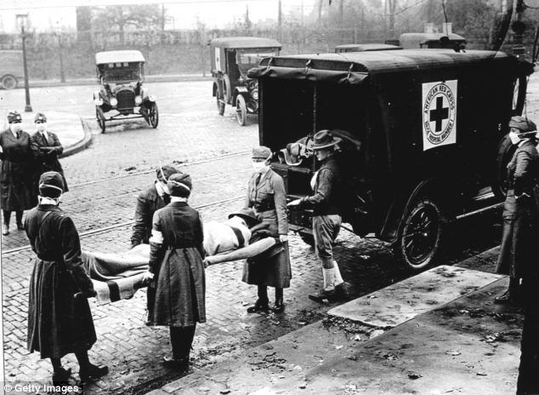
3 Waves of the Flu
The disease spread to other countries mainly through ports.
Wave 1 – Spring 1918. Camp Riley, KS then to other military bases, and onto Europe to the Western Front and ports in Africa.
Wave 2 – August 1918. France then across the world. This was the deadliest time of all.
Wave 3 – February 1919. Less deadly version, but killed many weakened people.
Notes:
Germans were infected just as badly as Americans in the War, some say even worst of all. In fact, both sides had such depleted troops that the disease altered plans for attacks and affected the outcome of some battles.

Slide 7
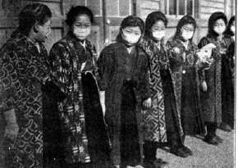
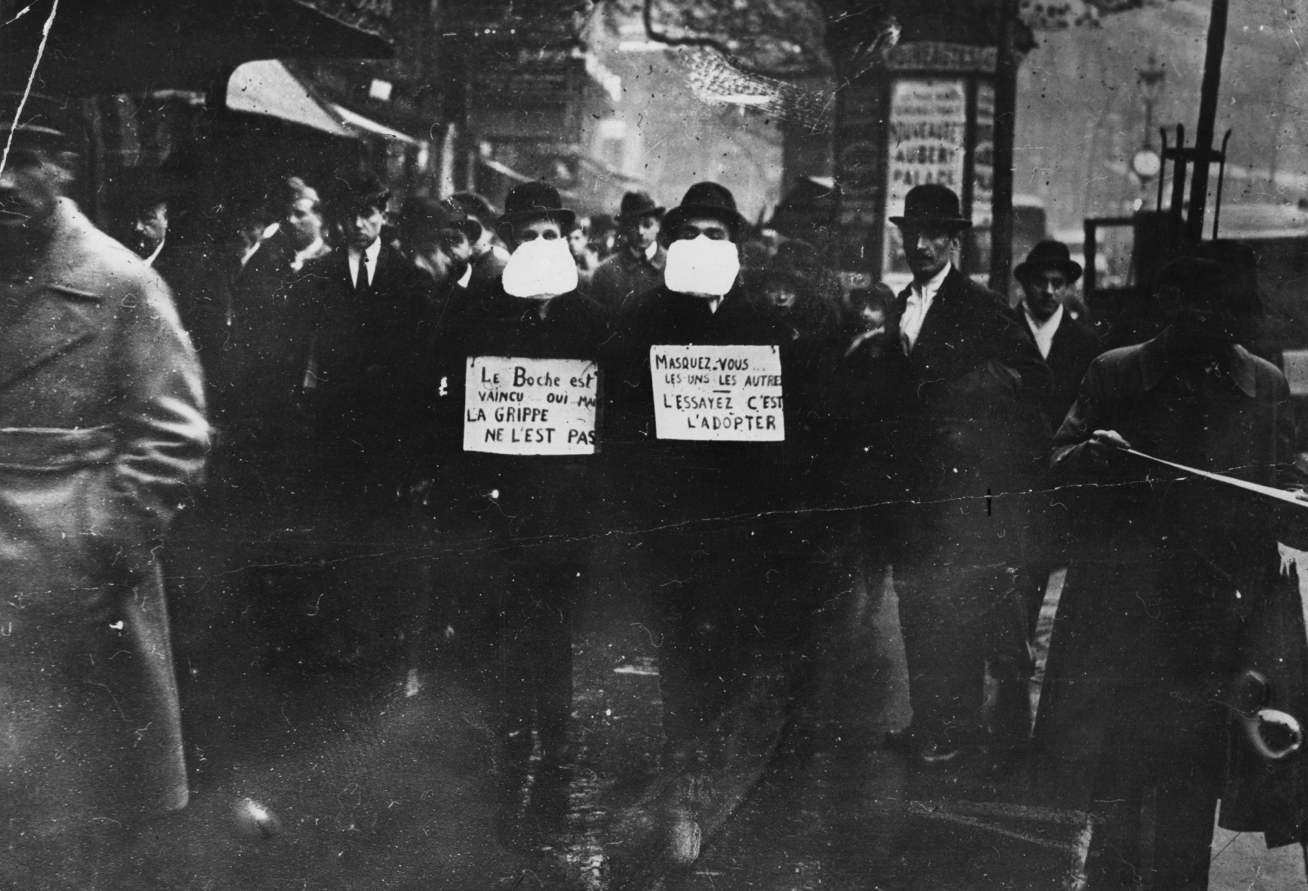
A Global Disaster
Also called the Spanish Flu since Spain’s newspapers reported the disease widely and people thought it started there.
In the U.S. the disease first appeared in military bases, then spread rapidly to other bases and points around the world.
Notes:
Spain was not involved in WWI, and their newspapers were not embargoed. That is, European countries restricted the news that was allowed out of their countries, but Spain did not. So, they reported the news about this disease that was killing thousands of people.
The picture on the opening slide is from Fort Riley, Kansas, where many people believe the disease first struck.
The pictures are from Tokyo and France.

Slide 8
Countries Infected All Over The World
Using the map packs, locate these countries that were affected by the Flu and shade each one on the outline map.
India Denmark
Indonesia Norway
England France
Colombia Poland
Portugal Saudi Arabia
Spain Brazil
Mexico Australia
Peru New Zealand
U.S.A. Egypt
Italy Sierra Leone
Germany Argentina
Nigeria Paraguay
Japan Kenya
Costa Rica Canada
South Africa Iceland
Sweden Philippines
Afghanistan Russia
China Congo
Samoan Islands Cuba
Madagascar Chad
Notes:
These are not all the countries that were infected – the virus spread to virtually every place human inhabited. These provide an example, though, of how widespread the disease was.
The disease was widespread throughout Africa, but many countries’ names have changed since then, so only a few are listed here.

Slide 9
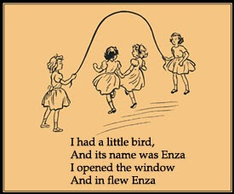
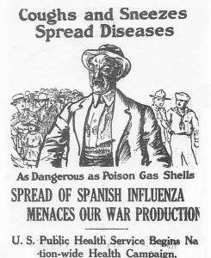
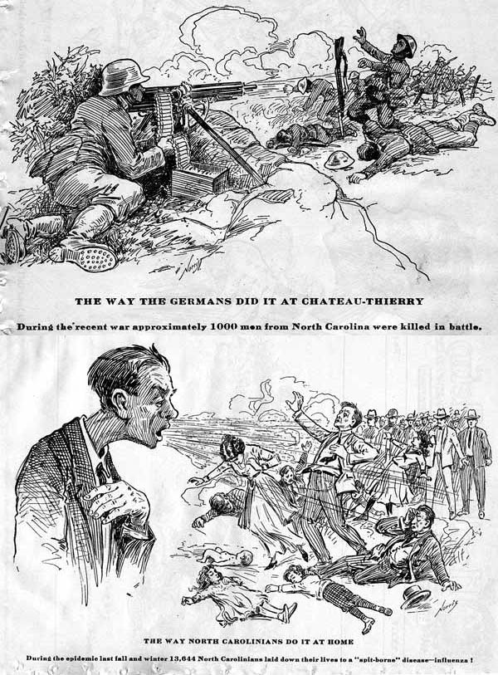
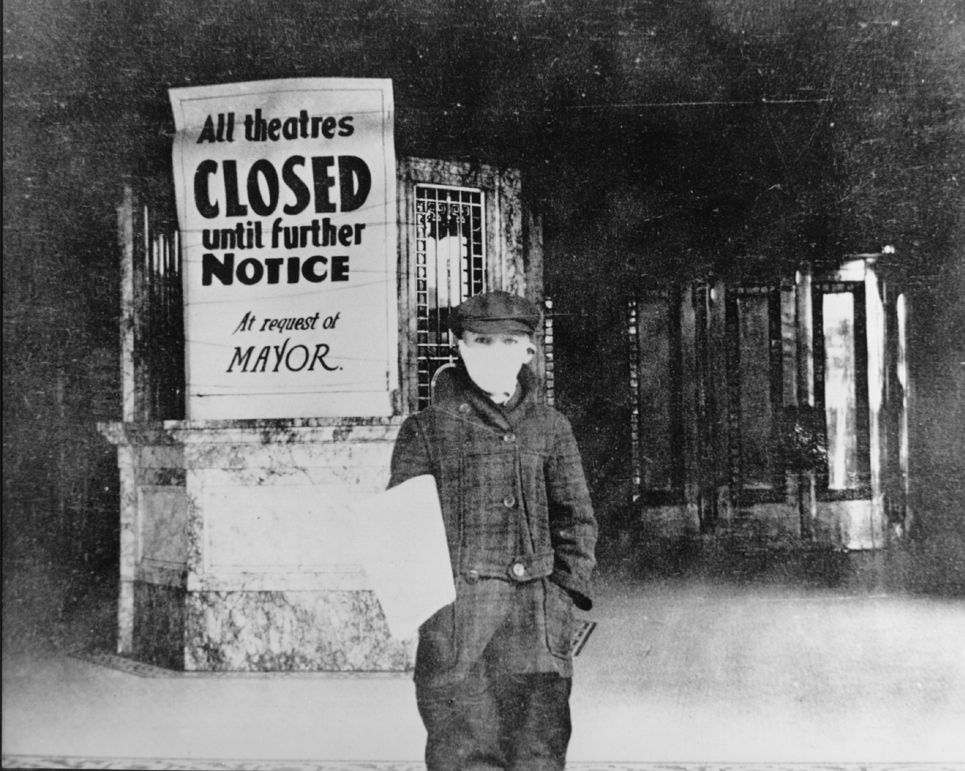
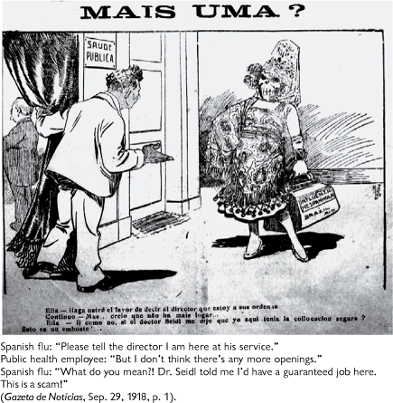
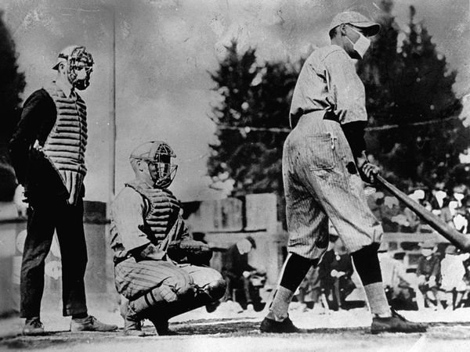
Notes:
There were public notices all over the world about the flu, and many steps were taken to prevent the spread of the disease. Most notably, wearing gauze masks and shutting down public events. Schools, churches, theatres, stores, and many other places were closed and events cancelled to prevent people from gathering. But, life went on for many. Kids played and made songs about the flu, baseball games were played with masks, and newspapers made fun of public officials.

Slide 10
Notable Survivors of the Spanish Flu
President Woodrow Wilson
Franklin D. Roosevelt, future President of the U.S.
John J. Pershing, U.S. General, WWI
Wilhelm II, German Emperor, WWI
David Lloyd George, Prime Minister of Britain, WWI
Alfonso XIII, King of Spain
Haile Selassie I, future Emperor of Ethiopia
Walt Disney
Edvard Munch, famous artist
Georgia O’Keefe, famous painter
Katherine Anne Porter, famous writer (Pale Rider)
Mary Pickford, silent film star
Lillian Gish, famous actress
Leo Szilar, inventor of nuclear chain reaction

Slide 11
References
Crosby, A. W. (2003). America’s forgotten pandemic: the influenza of 1918. Cambridge: Cambridge University Press.
Influenza Encyclopedia. Retrieved from http://www.influenzaarchive.org/.
Kent, S. K. (2013). The influenza pandemic of 1918-1919: A brief history with documents. New York: Bedford/St. Martin’s.
The Influenza Pandemic of 1918. Retrieved from https://virus.stanford.edu/uda/.

