Slide 1
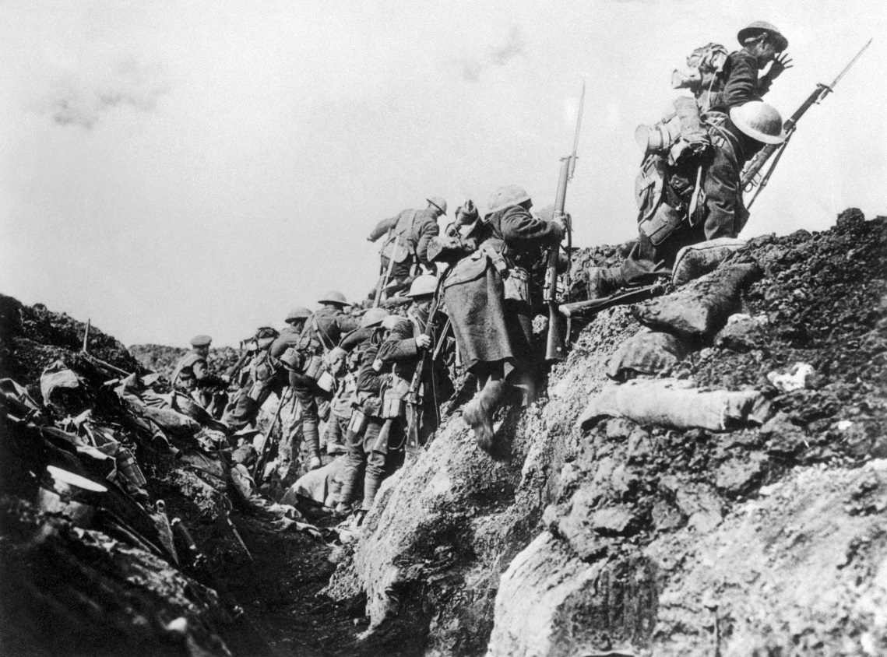
Treacherous Trenches
BY MEGHAN HAUTER
GRADE: HIGH SCHOOL
Photo Source: www.history.com

Slide 2
Objectives
I can…
describe the conditions of WWI trenches
analyze the effectiveness of trench warfare as a defensive military strategy
explain the consequences of trench warfare in terms of relationships between nations and the balance of power

Slide 3
Military Strategy throughout History
Analyze the following images and be ready to discuss the advantages and disadvantages of each strategy.

Slide 4
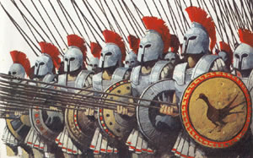
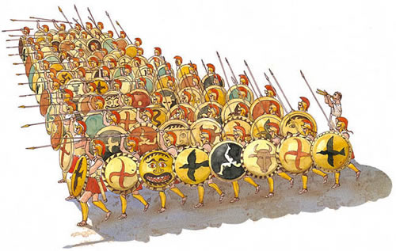
Military Strategy Throughout History phalanx: (in ancient Greece) a group of heavily armed infantry formed in ranks and files, close and deep, with shields joined and long spears overlapping
Ancient Greece
Photo Source: http://www.ancientgreekbattles.net/Pages/90087_PhalanxHistory.htm
Definition: http://www.dictionary.com/

Slide 5
Military Strategy Throughout History volley: the simultaneous discharge of a number of missiles or firearms.
American Revolution
Photo Source: http://www.themilitaryminute.com/?cat=152
Definition: http://www.dictionary.com/

Slide 6
Military Strategy Throughout History blitzkrieg: swift intensive military attack using tanks supported by aircraft, designed to defeat the opposition quickly, 1935-40, German Blitz = lightning + Krieg = war
World War II
Photo Source: http://european-theater.weebly.com/german-blitzkrieg-warfare-and-battle-of-the-bulge.html
Definition: http://www.dictionary.com/

Slide 7
Military Strategy Throughout History Guerrilla Warfare: the use of hit-and-run tactics by small, mobile groups of irregular forces operating in territory controlled by a hostile, regular army
Vietnam
Photo Source: http://www.businessinsider.com/15-poignant-photos-that-show-what-life-was-like-during-the-vietnam-war-2015-4#
Definition: http://www.dictionary.com/

Slide 8
Military Strategy Throughout History Trench Warfare: Fortification. a long, narrow excavation in the ground, the earth from which is thrown up in front to serve as a shelter from enemy fire or attack.
World War I
Photo Source: http://www.iwm.org.uk/history/10-photos-of-life-in-the-trenches
Definition: http://www.dictionary.com/

Slide 9
Human Ingenuity
How and why do humans create?
What are the consequences of our creations?
How does the creation of new technologies impact us?In specific, Why was trench warfare created? What were its consequences?

Slide 10
You will:
Analyze a trench warfare map/diagram.
Participate in a trench warfare simulation.
Discuss WWI technology and the nature of warfare.

Slide 11
The Geography of Trench Warfare
Map Activities:
A. Look closely at the 2 maps of the trenches with a partner
B. Answer the questions using the document analysis worksheet provided to the best of your ability based on what you see
C. Be sure to provide evidence to support your answers
Credit: Aurthur Guy Empey's "Over The Top" (1917)
Image Source: http://www.vox.com/a/world-war-i-maps

Slide 12
The Geography of Trench Warfare
The frontline was the most dangerous. Soldiers could not be expected to endure there for long. Battalions rotated regularly from frontline, to support line, to reserve line, and then to the rear before returning to the frontline to begin again. Still, stress of the trenches caused many to suffer from nervous breakdowns and shell shock.
Image Source: http://www.vox.com/a/world-war-i-maps

Slide 13
The Geography of Trench Warfare
Aerial Photo Discussion:
Where do you see the most shell damage in the photo?
Can you locate the trenches?
Can you locate the roads? How important were roads?
What else do you see? What does the terrain look like?
Image Source: http://www.dailymail.co.uk/news/article-2581167/Aerial-images-horrifying-scale-trenches-WWI.html

Slide 14
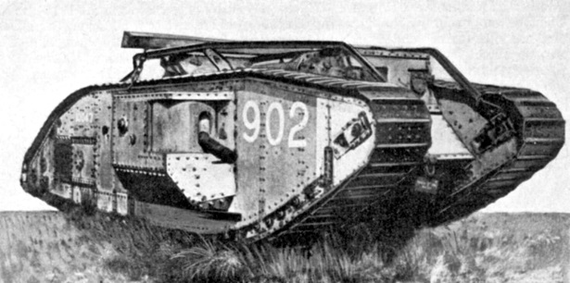
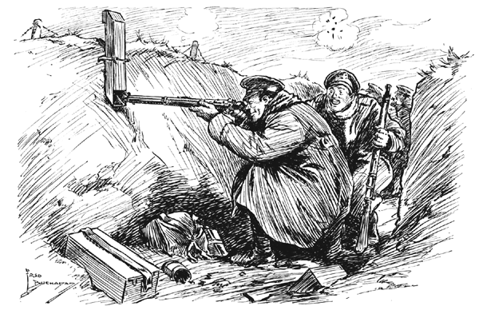
Trench Construction
Why do you think the trenches were constructed in a zigzag pattern?
What were some possible advantages/disadvantages in the layout or construction of the trenches?

Slide 15
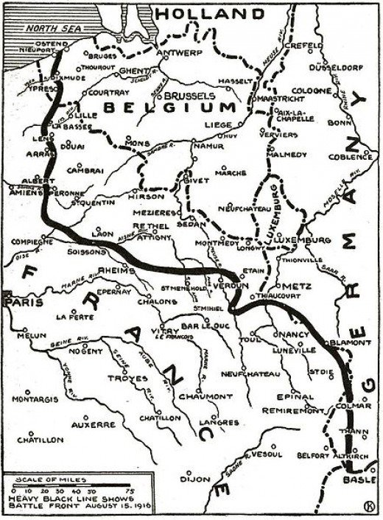
The Geography of Trench Warfare
Trenches stretched 475 miles from the English Channel to the Swiss Alps.
Laid end-to-end (straightened), the trenches would stretch 25,000 miles.
From 1914 to 1918, the trenches only shifted a few hundred yards.
A great battle would move the lines a few miles.
This led to…stalemate: A situation in which no side is winning.
Image Source: hubpages.com

Slide 16
The Geography of Trench Warfare
This map shows the movement of troops throughout WWI. In the Western Front, the red line represents the furthest position that the Central Powers advanced during the war.
Image Source: mastromaurowh.wikispaces.com

Slide 17
What is Stalemate?
Image Source: www.play.google.com

Slide 18
Diagram of the Trenches
Image Source: https://ieper.wikispaces.com/WW12+Trench+Warfare

Slide 19
Over the Top- Simulation Would you venture into No-Man’s Land? Would you go “Over the Top?”
Simulation: http://www.warmuseum.ca/overthetop/
Image Source: www.okmilmuseum.ca
Image Source: www.smithsonianmag.com

Slide 20
Simulation Follow-Up
Brainstorming Activity- After completing the simulation, brainstorm as many challenges that existed for soldiers fighting in the trenches as you possibly can.
Use a digital (Popplet) or paper concept web to record your ideas.
http://popplet.com/
Image Source: https://s-media-cache-ak0.pinimg.com

Slide 21
More WWI Technology
Image Source: www.thinglink.com
Image Source: elginhistory12.wikispaces.com

Slide 22
Which tank is a WWI tank?
Which tank is a WWII tank?
Image Source: https://c1.staticflickr.com/7/6144/5943325290_5819d0f0bb_b.jpg
Image Source: https://upload.wikimedia.org/wikipedia/commons/b/bd/Christie_T3E2_tank_LOC.hec41005.jpg

Slide 23
Which technology is from WWI?
Which technology is from WWII?
Image Source: www.greatwarflyingmuseum.com
Image Source: www.bocalifemagazine.com

Slide 24
CLOSURE: Why trench warfare?
Why hasn’t trench warfare been used on such a large scale in any other war before or since World War I?
Did the advancements in technology following WWI make trench warfare obsolete? Why wasn’t trench warfare used once WWII broke out?
Image Source: https://s-media-cache-ak0.pinimg.com

Slide 25
Trench Warfare Video- 4 Minutes
http://www.history.com/topics/world-war-i/world-war-i-history/videos/life-in-a-trench

Slide 26
Your Assignment
You will be assigned to one of six groups.
Your group will have a reading activity on a specific challenge faced in trench warfare.
Your group will create a poster presentation on your assigned challenge.

Slide 27
Reading Activity
Color Coding Activity- Be sure to read your text more than once if needed. Your assigned reading contains both primary and secondary sources. Highlight the reading in the following manner:
Pink- Challenges faced by soldiers
Green- Things that can be perceived with the 5 senses
Blue- Methods of overcoming the challenges

Slide 28
Group Presentation
Your presentation must contain:
5 important facts about life in the trenches in relation to your assigned challenge
A warning sign with a symbol that relates to your assigned challenge
A direct quote from a primary source (provided)
All group members must have a speaking role
Presentation should be less than 3 minutes
Be prepared to take notes while other groups present information

Slide 29
The Heavy Cost of Trench Warfare
Image Source: http://www.worldwar1.com/stats/nmob.gif

Slide 30
Make Predictions-
What happens when WWI ends?
How do you think the heavy casualties of war on both sides of the conflict affect relationships and the balance of power between nations?
Do you think that feelings of resentment can overpower reason?
Can peace be established?

Slide 31
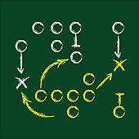
Battle Plan Writing Activity
Write a battle plan that would avoid deadlock (stalemate) in the trenches. If you were a general in charge, how would you have conducted war in order to assure that you effectively achieve your goals, ensure the fewest casualties and achieve swift victory?
Your plan must include the following considerations:
Analyze how trench warfare contributed to WWI stalemate.
Describe the new types of war technologies used in the trenches.
Describe how you would you have used the new technologies more
effectively, therefore getting your troops out of the trenches.

Slide 32
Grading
Students will score a 4 or higher on their battle plan writing assignment based on the 6 Traits Paragraph Writing Rubric.
Students demonstrate proficiency in the areas of idea, organization, and voice
Evidence should be cited.

Slide 33
Share your battle plan
Share your battle plan with a partner
What did you like about your partner’s battle plan?
Did anything surprise you?
In what ways does your partner’s battle plan incorporate effective use of technology?
How will your partner’s battle plan save lives?
Image Source: https://s-media-cache-ak0.pinimg.com

Slide 34
Learning Goal
Today I am going to identify the military strategies and technological advancements used during WWI so that I can analyze how technology changes the nature of conflict between nations. I have got it when I can describe and come up with a possible solution to a problem that existed for soldiers fighting in the trenches during WWI.

