Slide 1
European
Colonialism
in
Africa
World History

Slide 2
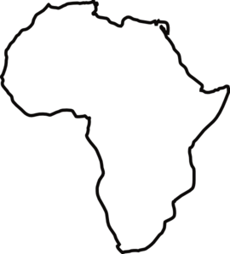
Today’s Objective
Topic- Scramble for Africa
Objective- I can explain European motives for and the process by which Europeans colonized Africa during the the 19th and 20th century.
Day #1

Slide 3
Bell Work- Day 1
Five minutes.
5
4
3
2
1
0
Can you think of a situation when it is ok to take what doesn’t belong to you? (5 sentences)
Notes:
Using this PowerPoint break timer
This PowerPoint slide uses images, custom animation, and timing to provide a countdown timer that you can use in any presentation. When you open the template, you’ll notice that the timer is set at 00:00. However, when you start the slide show, the timer will start at the correct time and count down by 1-minute intervals until it gets to 1 minute. At that point, it will count down in two 30-seconds intervals to 00:00.
To insert this slide into your presentation
Save this template as a presentation (.ppt file) on your computer.
Open the presentation that will contain the timer.
On the Slides tab, place your insertion point after the slide that will precede the timer. (Make sure you don't select a slide. Your insertion point should be between the slides.)
On the Insert menu, click Slides from Files.
In the Slide Finder dialog box, click the Find Presentation tab.
Click Browse, locate and select the timer presentation, and then click Open.
In the Slides from Files dialog box, select the timer slide.
Select the Keep source formatting check box. If you do not select this check box, the copied slide will inherit the design of the slide that precedes it in the presentation.
Click Insert.
Click Close.

Slide 4
What is Imperialism?
In your own words, define Imperialism.
a policy or practice by which a country increases its power by gaining control over other areas of the world
the effect that a powerful country or group of countries has in changing or influencing the way people live in other poorer countries
"Imperialism." Merriam-Webster.com. Merriam-Webster, n.d. Web. 6 July 2015. <http://www.merriam-webster.com/dictionary/imperialism>.

Slide 5
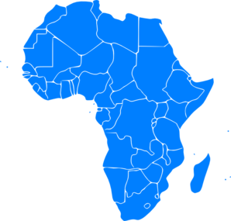
Five minutes.
5
4
3
2
1
0
Making Predictions:
Think, Pair, Share
Why do you think there was such demand for African land?
Which regions in Africa do you think that Europeans most desired? Why?
Does this act of imperialism relate to any other acts in world history?
Notes:
Using this PowerPoint break timer
This PowerPoint slide uses images, custom animation, and timing to provide a countdown timer that you can use in any presentation. When you open the template, you’ll notice that the timer is set at 00:00. However, when you start the slide show, the timer will start at the correct time and count down by 1-minute intervals until it gets to 1 minute. At that point, it will count down in two 30-seconds intervals to 00:00.
To insert this slide into your presentation
Save this template as a presentation (.ppt file) on your computer.
Open the presentation that will contain the timer.
On the Slides tab, place your insertion point after the slide that will precede the timer. (Make sure you don't select a slide. Your insertion point should be between the slides.)
On the Insert menu, click Slides from Files.
In the Slide Finder dialog box, click the Find Presentation tab.
Click Browse, locate and select the timer presentation, and then click Open.
In the Slides from Files dialog box, select the timer slide.
Select the Keep source formatting check box. If you do not select this check box, the copied slide will inherit the design of the slide that precedes it in the presentation.
Click Insert.
Click Close.

Slide 6
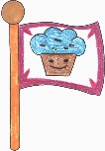
Classroom Simulation
Create Your Own Country
Create groups of 4-5
Read each step carefully. Be sure to gain permission from the teacher before continuing to the next step!

Slide 7
Classroom Simulation
Discussion Questions
Which “territories” did you claim?
Was some “territory” more valuable than others? Explain why.
Which groups acquired more territory? Why did this happen?
Was it possible to take land that had already been claimed?
How can we relate this to Imperialism in Africa? Why did certain European countries successfully acquire more territory than others?
In what areas of Africa do you think the Europeans were most interested? Why?

Slide 8
European Nationalism
Source for
Raw
Materials
Industrial
Revolution
Missionary Activity
European
Motives
For Colonization
Markets for Finished Goods
Military & Naval Bases
Social Darwinism
European Racism
Places to Send Unwanted/ Excess Pop.
Humanitarian Reasons
Soc. & Econ. Opportunities
“White Man’s Burden”

Slide 9
African Trade [15c.-17c.]
http://www.slidego.com/go/10507

Slide 10
Pre- 19c European Trade in Africa
http://www.slidego.com/go/10508

Slide 11
Today’s Objective
Topic- Scramble for Africa
Objective- I can analyze the effects of European colonization on their colonies
Day #2

Slide 12
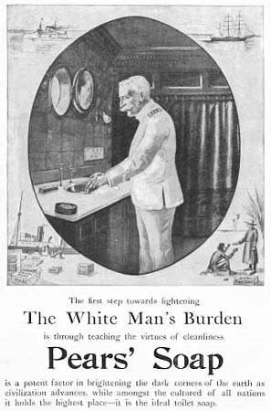
Bell Work- Day 2 (option 1)
Five minutes.
5
4
3
2
1
0
What motive for European colonization is represented here in this advertisement? Provide evidence.
What is your reaction to this kind of advertisement?
Do you think that some advertisements today could be considered offensive in the future? Provide evidence.
https://www.wwnorton.com/college/english/nael/victorian/topic_4/illustrations/imburden.htm
Notes:
Using this PowerPoint break timer
This PowerPoint slide uses images, custom animation, and timing to provide a countdown timer that you can use in any presentation. When you open the template, you’ll notice that the timer is set at 00:00. However, when you start the slide show, the timer will start at the correct time and count down by 1-minute intervals until it gets to 1 minute. At that point, it will count down in two 30-seconds intervals to 00:00.
To insert this slide into your presentation
Save this template as a presentation (.ppt file) on your computer.
Open the presentation that will contain the timer.
On the Slides tab, place your insertion point after the slide that will precede the timer. (Make sure you don't select a slide. Your insertion point should be between the slides.)
On the Insert menu, click Slides from Files.
In the Slide Finder dialog box, click the Find Presentation tab.
Click Browse, locate and select the timer presentation, and then click Open.
In the Slides from Files dialog box, select the timer slide.
Select the Keep source formatting check box. If you do not select this check box, the copied slide will inherit the design of the slide that precedes it in the presentation.
Click Insert.
Click Close.

Slide 13
Bell Work- Day 2 (option 2) http://www.loc.gov/pictures/item/2011649074/
Five minutes.
5
4
3
2
1
0
Fill in the political cartoon analysis worksheet based on what you see.
Notes:
Using this PowerPoint break timer
This PowerPoint slide uses images, custom animation, and timing to provide a countdown timer that you can use in any presentation. When you open the template, you’ll notice that the timer is set at 00:00. However, when you start the slide show, the timer will start at the correct time and count down by 1-minute intervals until it gets to 1 minute. At that point, it will count down in two 30-seconds intervals to 00:00.
To insert this slide into your presentation
Save this template as a presentation (.ppt file) on your computer.
Open the presentation that will contain the timer.
On the Slides tab, place your insertion point after the slide that will precede the timer. (Make sure you don't select a slide. Your insertion point should be between the slides.)
On the Insert menu, click Slides from Files.
In the Slide Finder dialog box, click the Find Presentation tab.
Click Browse, locate and select the timer presentation, and then click Open.
In the Slides from Files dialog box, select the timer slide.
Select the Keep source formatting check box. If you do not select this check box, the copied slide will inherit the design of the slide that precedes it in the presentation.
Click Insert.
Click Close.

Slide 14
Africa Regions
Assign each group a region.
What kinds of maps can you use to identify geographical features or natural resources in your region?
Exploring Africa Regions Map → http://exploringafrica.matrix.msu.edu/images/allregions.jpg

Slide 15
African Regions & Natural Resources
Identify your assigned region on your printed map.
Use the next map showing “Africa’s Resources” to identify the kinds of natural resources that your region contains.
Draw symbols on your map to represent each of these resources and create a key to identify the symbols.
Report to Class- What geographical features or natural resources that your region contains may led Europeans to settle there?
← Arizona Geographic Alliance: African Region’s Map:
http://geoalliance.asu.edu/sites/default/files/maps/AFREGNM_0.pdf

Slide 16
Africa’s Resources
http://geoalliance.asu.edu/sites/default/files/maps/Africa%20Resources_10_20_15.pdf

Slide 17
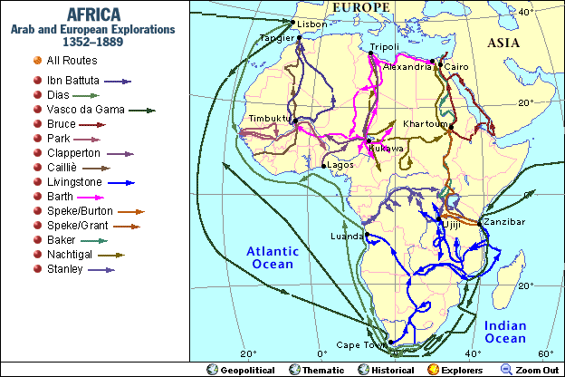
European Explorers in Africa
19 c. → Europeans Map the Interior of Africa
http://go.grolier.com/atlas?id=me00001

Slide 18
19th and
20th Centuries:
Mysteries
& Adventures

Slide 19
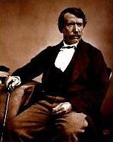
David Livingstone
Some of this push for expansion of the European way of life came from missionaries.
One of the most famous of these missionaries was David Livingstone, a minister from Scotland who went to Africa to preach the Gospel and helped to end the slave trade there.

Slide 20
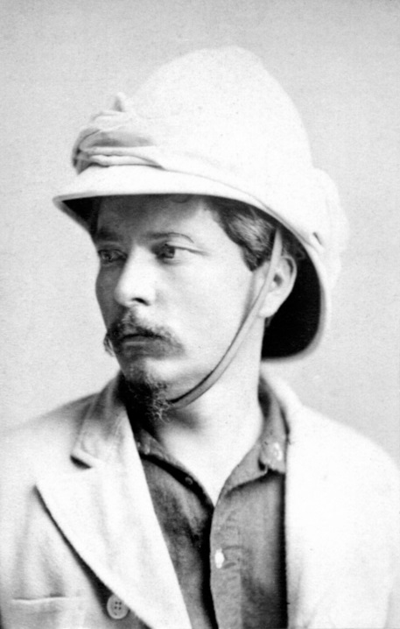
Henry Stanley
In the 1800s, Europeans and Americans were eager to read about adventures in distant places.
Newspapers competed for readership by hiring reporters to search the globe for stories.

Slide 21
Stanley
One of the most famous reporters of the day was Henry Stanley.
Stanley was hired in 1871 to find David Livingstone who had traveled deep into the heart of Africa and hadn’t been heard from in some years.
Ten months later, Stanley caught up with Livingstone and his account of their meeting made headlines around the world. Stanley became an instant celebrity.

Slide 22
European Explorations in mid-19c: “The Scramble for Africa”
http://www.slidego.com/go/10508

Slide 23
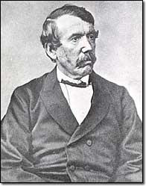
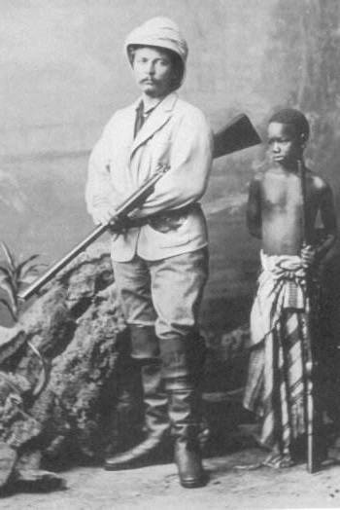
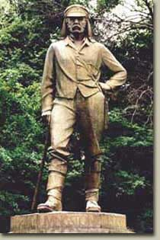
Where Is Dr. Livingstone?
Doctor Livingstone, I Presume?
Sir Henry Morton Stanley
Dr. David Livingstone

Slide 24
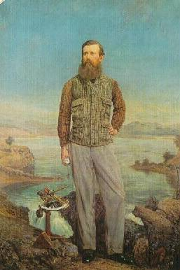
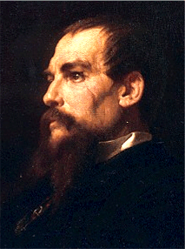
What is the Source of the Nile?
Sir Richard Burton
John Speke

Slide 25
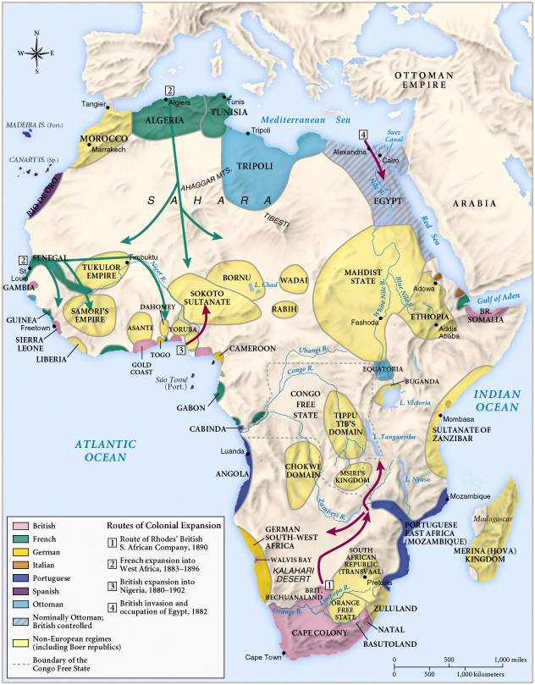
Africa 1890
….before

Slide 26
Partitioning of Africa
Africa
in
1914
….after
http://ontrack-media.net/gateway/worldgeography/g_wgm6l5s1c.html

Slide 27
Primary Source
[Africa].
Wells Missionary Map Co.
CREATED/PUBLISHED [1908?]
Notes
Shows European colonies and independent countries in Africa ca. 1908.
http://lccn.loc.gov/87692246 Wells Missionary Map Co. [Africa]. [1908?] Scale [ca. 1:11,000,000] (W 15⁰--E 50⁰/N 40⁰--S 35⁰). 1 map : ms., col., cloth ; 86 x 81 cm. G8200 1908 .W4

Slide 28
European Countries involved in the that partitioning of Africa
England, France, Germany, Italy, Portugal, Spain, Belgium, and Holland. These were known as the major spheres of influence.
Looking at the map: Which countries controlled the most territory?
Which countries controlled the least?

Slide 29
Berlin Conference
European nations did not want to fight over land in Africa
Met at the Berlin Conference in 1884-85
Agreed that any nation could claim any part of Africa by telling the others & by showing control of the area
How does this relate to the “Create Your Own Country” classroom simulation?

Slide 30
Berlin Conference
Europeans quickly grabbed land.
By 1914, only Liberia and Ethiopia were free from European control.
Menelik II – the emperor of Ethiopia, only African ruler to hold off Europeans

Slide 31
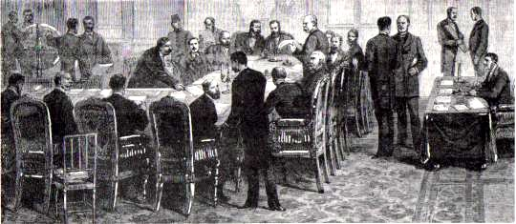
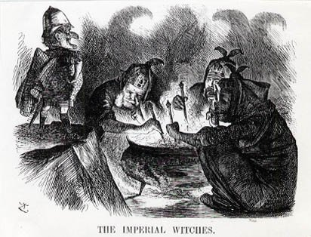
Berlin Conference of 1884-1885
Another point of view? →

Slide 32
Paternalism
Imperialist nations also developed two basic methods to manage their colonies.
1. France and other European nations used direct control. They felt native peoples could not handle the tough job of running a country – instead the imperialist power governed – this policy was called paternalism

Slide 33
Assimilation
2. The French also had a policy of assimilation where all colonial institutions were patterned after French institutions – the French hoped that the native peoples would learn French ways

Slide 34
Forces Driving Imperialism after 1880:
Economic – Money!
Europeans wanted colonies to provide raw materials
New markets to sell their goods

Slide 35
Driving Forces
National pride (nationalism) gain colonies to show national strength
Christian missionaries
desire to convert people
they thought that European trade would end the slave trade

Slide 36
Driving Forces
Racism the belief that one race is superior than another
Social Darwinism – use of Charles Darwin’s ideas about evolution “survival of the fittest” which meant the strongest species (Europeans) would survive
Europeans believed that non-Europeans were weak
Europeans equated their wealth, success & progress with superiority

Slide 37
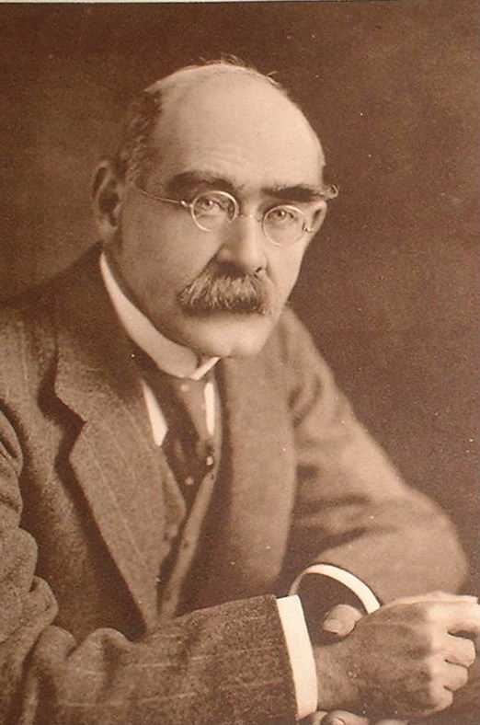
The “White Man’s Burden”
Rudyard Kipling

Slide 38
The Belgian Congo:
"King Leopold's
Ghost"

Slide 39
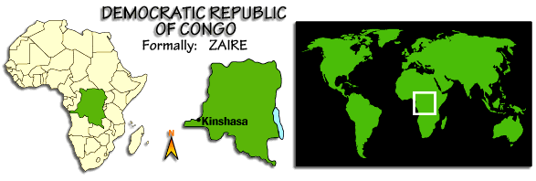
The Congo Free State or The Belgian Congo

Slide 40
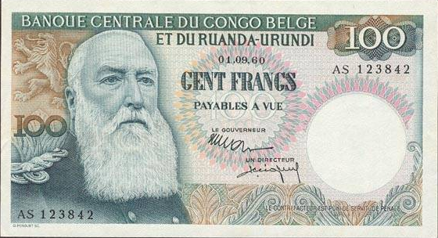
King Leopold II: (r. 1865 – 1909)

Slide 41
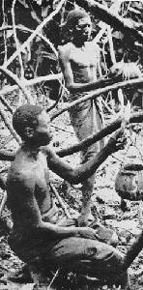
Harvesting Rubber

Slide 42
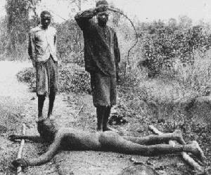
Punishing “Lazy” Workers

Slide 43
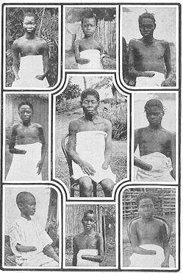
5-8 Million Victims! (50% of Population)
It is blood-curdling to see them (the soldiers) returning with the hands of the slain, and to find the hands of young children amongst the bigger ones evidencing their bravery...The rubber from this district has cost hundreds of lives, and the scenes I have witnessed, while unable to help the oppressed, have been almost enough to make me wish I were dead... This rubber traffic is steeped in blood, and if the natives were to rise and sweep every white person on the Upper Congo into eternity, there would still be left a fearful balance to their credit. -- Belgian Official

Slide 44
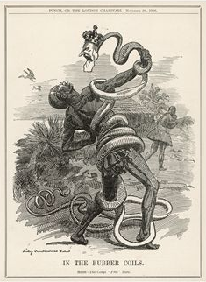
Belgium’s Stranglehold on the Congo

Slide 45
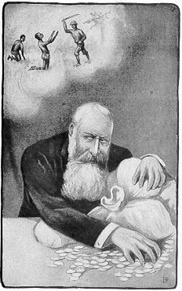
Leopold’s Conscience??

Slide 46
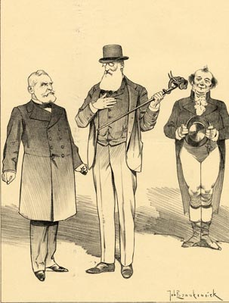
Leopold Defends Himself in Paris, 1903
King Leopold (to Loubert) : How about that! John Bull claims that I tortured, robbed and murdered more than he did. . . Loubert : No, your Majesty, that's impossible .

Slide 47
The Effects Of European Colonialism On Their Colonies
Artificially drawn boundaries
One-crop economies
Creation of economic dependence
Population relocation
Cultural suppression

Slide 48
The Struggle
For
South Africa

Slide 49
Response to Imperialism
Zulu Wars
During the 1820s-1830s, the Zulu people aggressively attacked and defeated tribes in southern Africa. Their success was due to Zulu chief, Shaka Zulus, military brilliance. The British eventually defeated the Zulus and made Zululand, a colony in 1887.

Slide 50
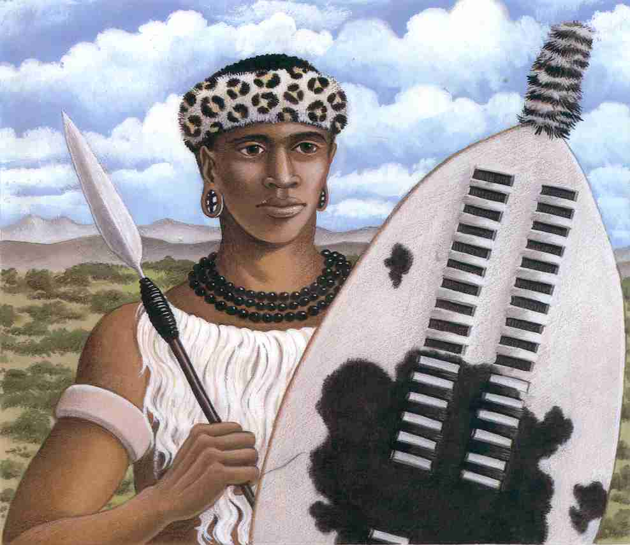
Shaka Zulu (1785 – 1828)

Slide 51
Boers
From Holland (Dutch)
1652, Dutch East India Co. established a supply base at the Cape of Good Hope.
Dutch settlers (farmers) who defeated the Zulus and took over native south African lands called themselves Boers and Afrikaners

Slide 52
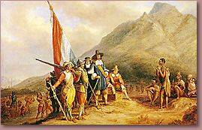
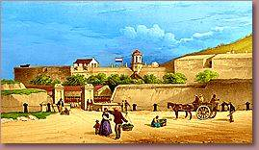
Dutch Landing in 1652

Slide 53
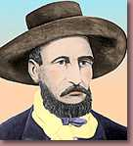
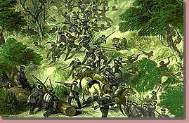
Boers Clash With the Xhosa Tribes
Boer Farmer

Slide 54
Boer War
1815- gave up Cape Colony to England
Dutch resented the British
1830’s, Boers left English Territory in a mass migration called the Great Trek
Eventually founded two republics: Orange Free State and Transvaal

Slide 55
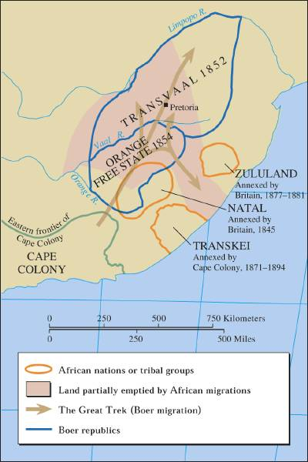
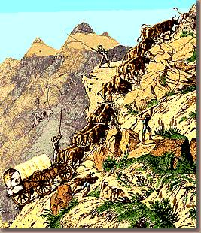
The Great Trek, 1836-38
Afrikaners
http://images.slideplayer.com/18/6147393/slides/slide_6.jpg

Slide 56
Boer War
In the 1800s gold and diamonds were discovered in these two states.
English defeated the Dutch settlers in the Boer War
In 1910’s, England combined all of its colonies.
South Africa becomes a country.
Boers have political control because they outnumber the British.

Slide 57
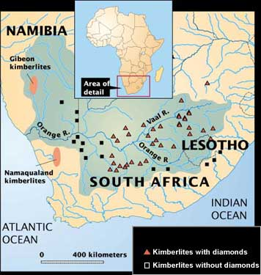
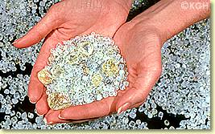
Diamond Mines
Raw Diamonds

Slide 58
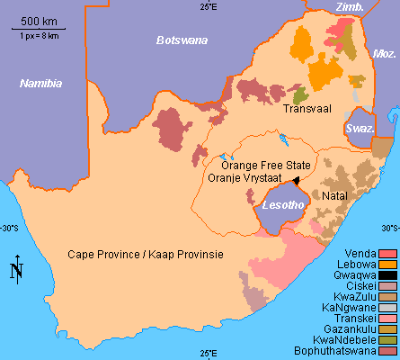
The Struggle for South Africa

Slide 59
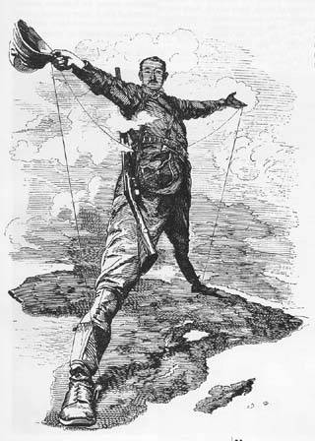
Cecil Rhodes (1853-1902)
“The Colossus of Rhodes”

Slide 60
Boer-British Tensions Increase
Britain annexed the Transvaal.
1883 – Boers fought the British in the Transvaal and regained its independence. - Paul Kruger becomes President.
1880s – Gold discovered in the Transvaal.

Slide 61
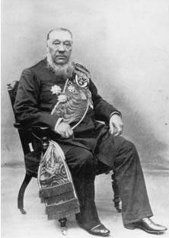
Paul Kruger (1825-1904)

Slide 62
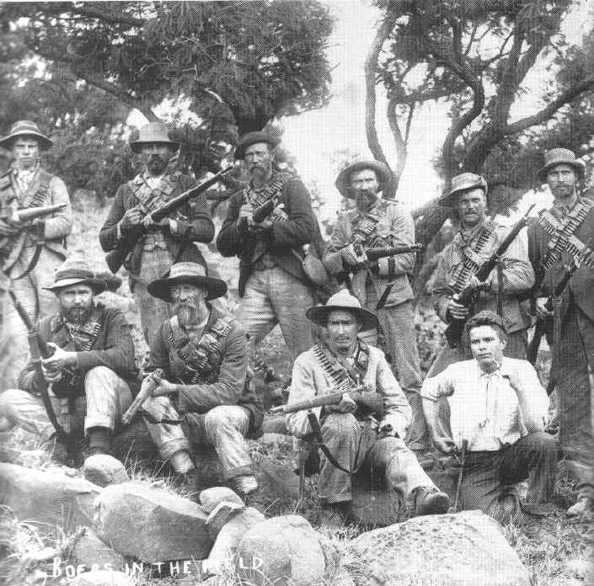
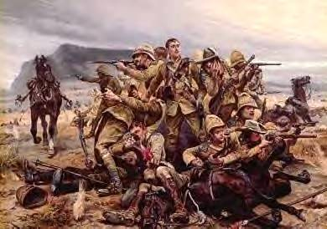
The Boer War: 1899 - 1900
The British
The Boers

Slide 63
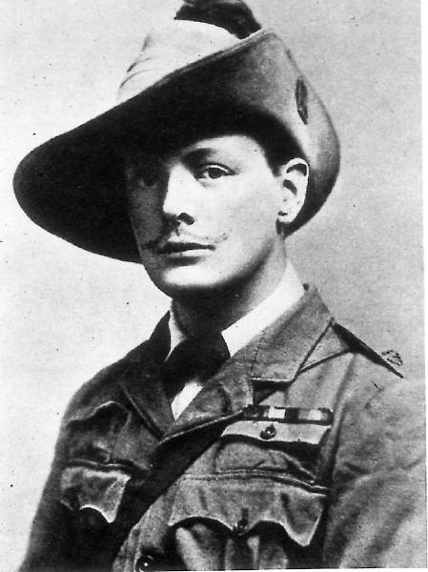
A Future British Prime Minister
British Boer War Correspondent, Winston Churchill

