Slide 1
Comparing Physical Features of South Sudan and Arizona
For use with the novel,
“A Long Walk to Water”

Slide 2
Locations
Arizona
South Sudan

Slide 3
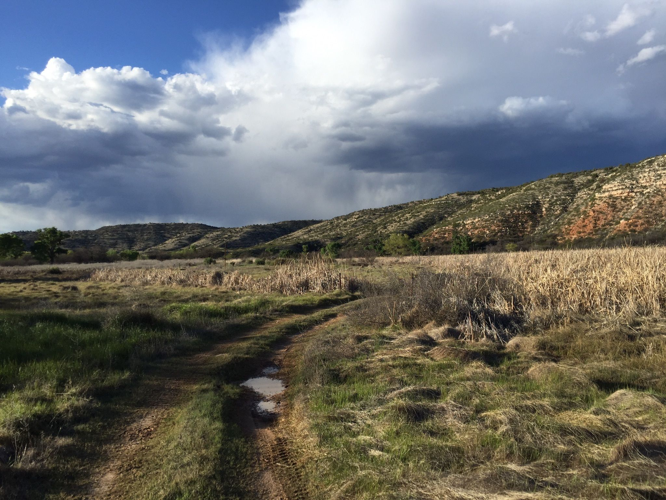
swamp
Arizona
South Sudan
https://www.nytimes.com/2015/11/08/magazine/the-displaced-chuol.html
https://www.alltrails.com/trail/us/arizona/tavasci-marsh-trail

Slide 4
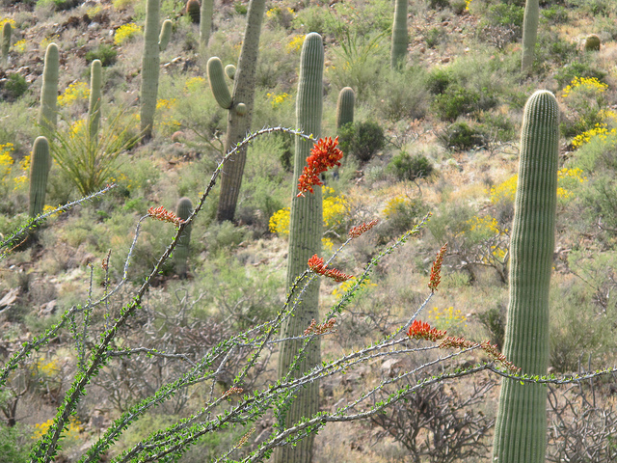
savanna
Arizona
South Sudan
https://en.wikipedia.org/wiki/Sudan_(region)
The Lost Savannas of Arizona
http://www.zocalopublicsquare.org/2014/11/15/the-lost-savannas-of-arizona/ideas/nexus/

Slide 5
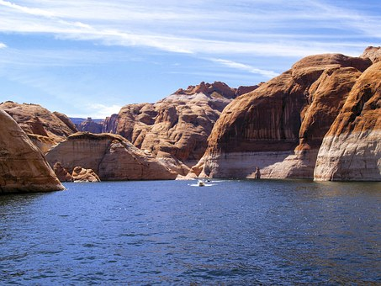
lake
Arizona
South Sudan
Lake Powell, Arizona
https://www.pinterest.com.au/pin/570760952753590846/?lp=true

Slide 6
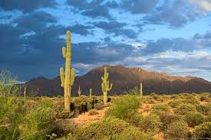
mountain
Arizona
South Sudan
McDowell Mountains
visitphoenix.com
https://steemit.com/travel/@farukcom/travel-06-imatong-mountains-in-south-sudan

Slide 7
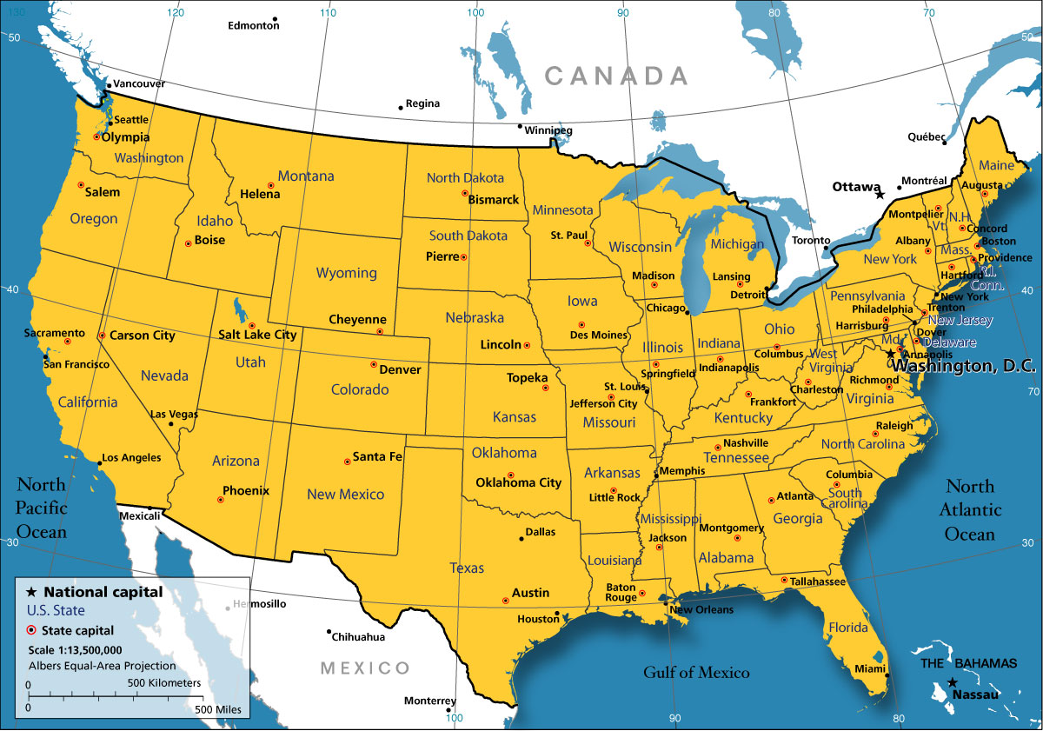
landlocked
Arizona
South Sudan
http://www.nationsonline.org/oneworld/usa_map.htm
http://s223195111.mialojamiento.es/images/africa-landlocked-countries

Slide 8
climate
Arizona
South Sudan
http://www.allcountries.org/maps/world_climate_maps.html

Slide 9
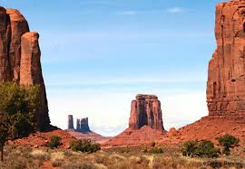
plateau
Arizona
South Sudan
http://www.michaelfreemanphoto.com/media/f60f89a8-7011-11e0-b5fc-d31ceb3d5dc9-boma-plateau
Colorado Plateau of Northern Arizona
arizonaexperience.org/land/colorado-plateau

Slide 10
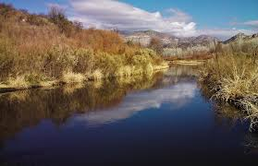
river
Arizona
South Sudan
http://fortuneofafrica.com/southsudan/rivers-in-south-sudan/
Gilaconservation.org

Slide 11
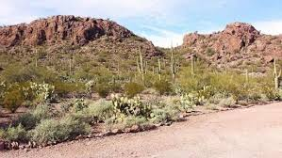
desert
Arizona
South Sudan
https:/ /easyscienceforkids.com/all-about-sudan-and-south-sudan/
Sonoran desert
pinterest.com

Slide 12
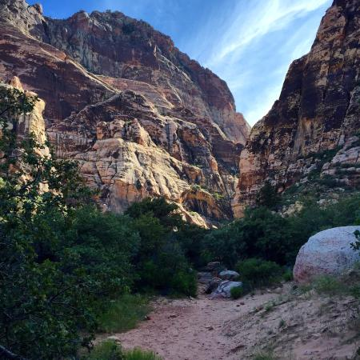
valley
Arizona
South Sudan
el.com/2015/05/04/the-real-lion-king-photographing-a-regal-male-lion-in-uganda/
Red rock Valley

