Slide 1
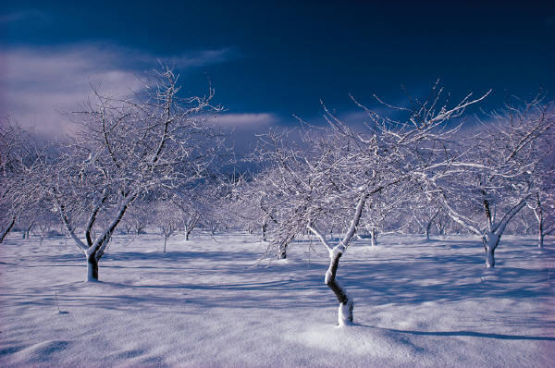
Snow

Slide 2
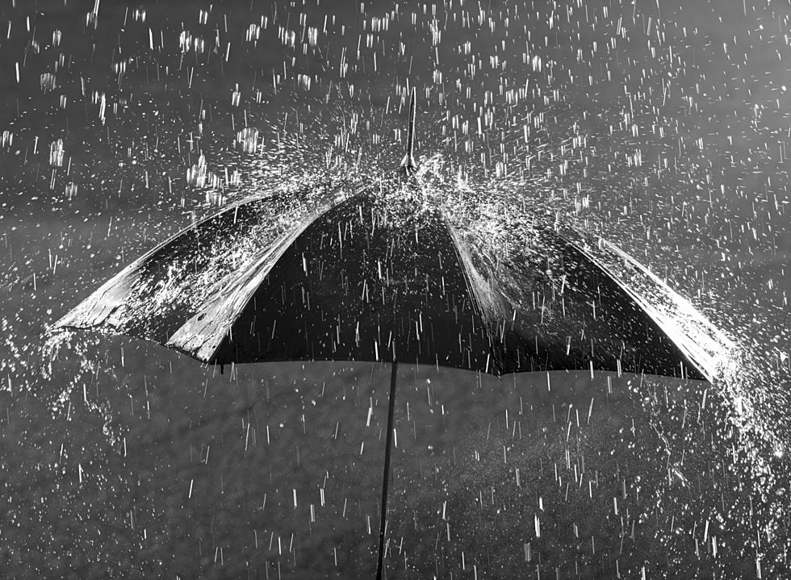
Rain

Slide 3
Sunny

Slide 4
Windy

