Slide 1
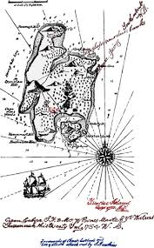
Living the Pirate’s Life

Slide 2
SESSION ONE
Learning about Geocaching App
1. Take out your phone or open your computer.
2. Go to: https://www.geocaching.com/play
3. Click on the sign in button at the top of the screen.
4. Sign up using your school assigned account.

Slide 3
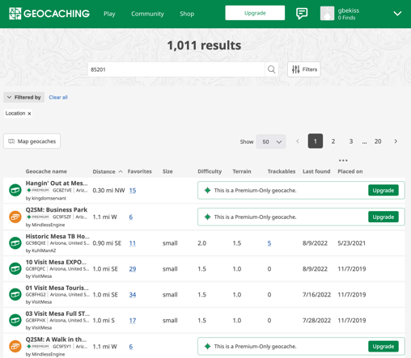
5. Check your email for validation of account.
6. Enter the school’s zip code and check out the geocaches that are free (not Premium).

Slide 4
7. Pick a location and click the title of the geocache to get information to write on your first index card.

Slide 5
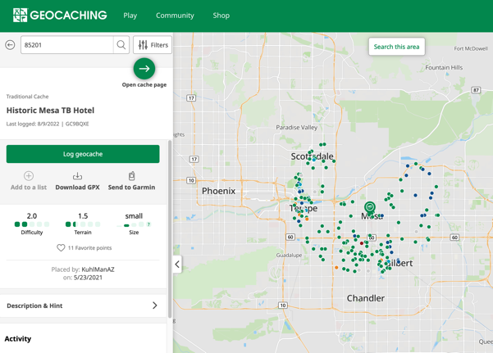
8. Click on Description & Hint. This gives you a summary of what is at that location.
9. Then click on Open cache page. Write down the latitude and longitude and other information.
10. Record on your index card as much information as you find on the website. Be sure to put your names on the index card.

Slide 6
11. Click on the map to see the location of the geocache.
12. Zoom in on the map to find the geocache. The scale for the map is shown in the bottom right corner. It is very tiny.
scale for map

Slide 7
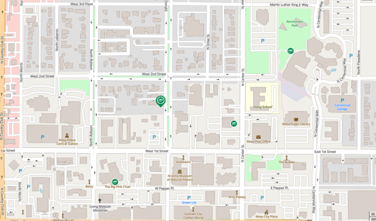
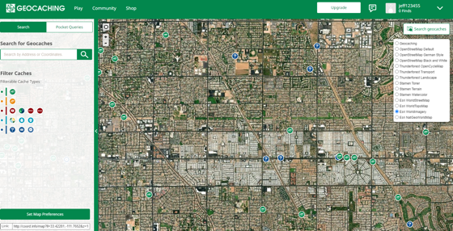
Map control:
Change map layer type
13. Have students change the map using the layering icon. Use MapTiler OSM or Esri Worldimagery.
14. When done, turn your index card into the teacher.
Looks like a stack of papers.
MapTiler OSM
OR

Slide 8
15. On another index card, use Google Earth to find the location of 2 places in the world.
16. Type a researched or made-up latitude and longitude into the search bar. A location should appear.
17. Write the 2 names of the locations on the back of the index card.
17. Exchange your card with another group and use Google Earth to find their locations. Check the answers by looking at the back of the card. Return the card to the original group.

Slide 9
SESSION TWO
Actual Geocaching
17. On the Living the Pirate’s Life worksheet research 10 geocaches in your area or an area assigned by the teacher. Follow the instructions and complete the 4 columns of the worksheet.

Slide 10
SESSION TWO
Online Geocaching
17. On the Living the Pirate’s Life worksheet research 10 geocaches in your area or an area assigned by the teacher. Follow the instructions and complete the 4 columns of the worksheet.

