Slide 1
Do You Want to Play in the Dirt?
Learning About Soil

Slide 2
Soil Vocabulary
soil: the upper layer of Earth in which plants grow
https://pikeconservation.org/soil-profile/

Slide 3
Soil Vocabulary
clay: a sticky kind of soil that can be molded to make bricks and pottery
http://jillrutter.com/ceramics/clay

Slide 4
Soil Vocabulary
silt: dirt that is carried by water and is larger than clay but smaller than sand
https://rashidfaridi.com/2016/03/04/silt-environmental-impact/

Slide 5
Soil Vocabulary
sand: tiny, loose pieces of rock that cover deserts and beaches
http://www.plazaitaliapiazzaargentina.com/say-goodbye-to-pebble-beaches-say-hello-to-sand/

Slide 6
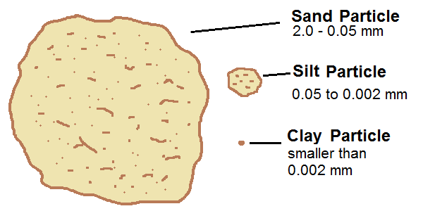
Soil Vocabulary
sand
silt
clay
https://studymorefacts.blogspot.com/2016/08/silt.html
http://www.livingoffgridguide.com/gardening/how-to-create-amazing-garden-soil/

Slide 7
Colors of Soil
https://imaggeo.egu.eu/view/3385/
https://cen.acs.org/content/cen/articles/96/i8/Genetic-screen-soil-microbes-uncovers.html

Slide 8
How Do Humans Use Soil?
https://www.123rf.com/photo_68286027_boy-making-traditional-adobe-mud-bricks-in-paru-paru-community-village-pisaq-district-cusco-region-o.html
https://localrootsfarm.wordpress.com/2011/02/

Slide 9
How Do Humans Use Soil?
https://coursehorse.com/nyc/classes/kids/kids-art/kids-pottery/kids-one-day-pottery-wheel-workshop
https://www.externalworksindex.co.uk/entry/134225/Timberplay/Sand-and-water-play-area-Lytham-Park-View/

Slide 10
How Do Humans Use Soil?
https://www.loc.gov/item/2016802720/

