Slide 1
Location, Location, Location: Arizona and the Gadsden Purchase
By Keith White

Slide 2
Write down several reasons why some land (property) is more valuable than other land (property).

Slide 3
Write down several reasons why some land (property) is more valuable than other land (property).
Size (Acres)
Structures on property, “improvements,” amenities
Resources
Water Rights, wells, ponds, lakes
Terrain and accessibility
Soil quality
Geographic Hazards (land slides, earthquakes, volcanic eruptions)
Transportation Access
Proximity to Shopping/Schools
Utilities (Power/Sewer/Gas/Oil Lines/Water/Telephone/Cable)
Commute Distance (Employment)
Climate
Scenic (trees, coastline, water views, mountain vistas)
Distance to Landfills/Factories/Noise/Mines/Blasting/Smell
Population density

Slide 4
Essential Question: Why Acquire More Land?

Slide 5
Essential Question: Why Acquire More Land?
Profit Motive
Resources
Water
Transportation/Ports
Increase Trade Options
Protection (Military)
Imperialism/Mercantilism

Slide 6
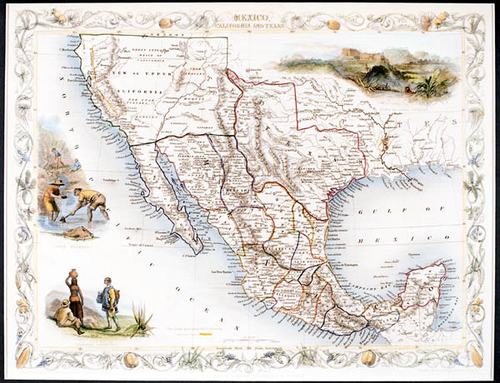
Anticipatory Set: Why would the United States want to purchase more land in the “desert” Southwest?

Slide 7
Gadsden Purchase Vocabulary
boundary/border
compromise
survey/surveyor
treaty
imperialism
mercantilism
utilities
production factors
ratification
territory & statehood
filibuster
opportunity cost
cost/benefit analysis
slavery
appropriation
dictatorship

Slide 8
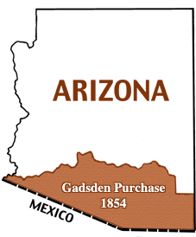
Location, Location, Location
cowpuncher.library.arizona.edu
Westward Expansion: Arizona and the Gadsden Purchase

Slide 9
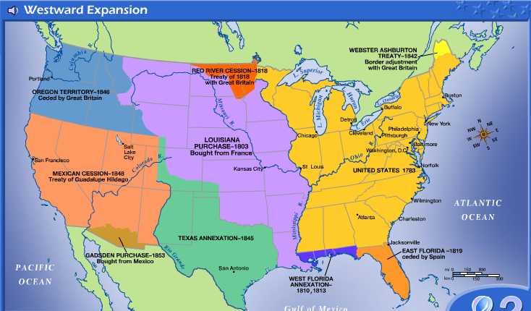
Westward Expansion
http://www.eduplace.com/kids/socsci/books/applications/imaps/maps/g5s_u5/index.html

Slide 10
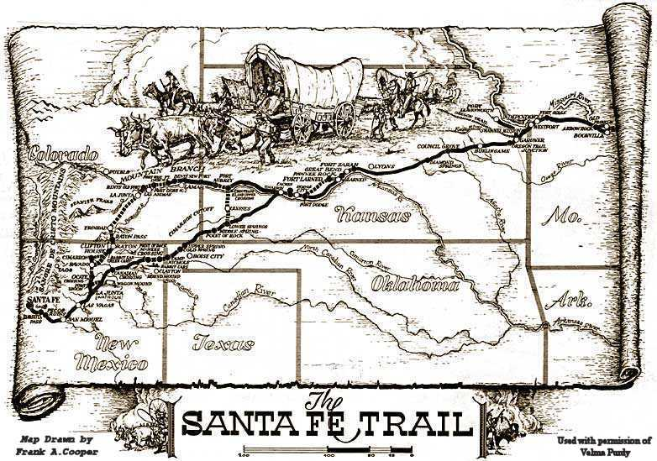
Related Az Events
The Mexican Republic becomes independent from Spain in 1821. The area which is now Arizona saw the following changes:
Catholic missions were not supported and some closed.
Mexican land grants were given to ranchers creating huge cattle ranches.
The Santa Fe Trail became a major trade route and port of entry.
Mountain men came to the area to hunt animals such as beavers.
Native American lands were crossed which often lead to disagreements, especially with the Apache Indians.
Notes:
Keith, this page needs a script. You need to explain each item or put into a timeline. A teacher might have no idea about what to say about some of these. And if this is setting the scene, then we need some background information written up.

Slide 11
Related Az Events
The Mexican American War (1846-1847) resulted from disagreements over Texas’s boundary with Mexico.
The Mormon Battalion enters Tucson with no resistance from the Mexican soldiers stationed there.
The Treaty of Guadalupe Hidalgo ends the war and ended the US/Mexico dispute over boundaries. The Mexican Cession (land given to the US by Mexico) included the present-day states of California, Nevada, and Utah, as well as parts of Arizona, Colorado, Kansas, New Mexico, Oklahoma, and Wyoming.
In exchange for this vast amount of land, the US paid Mexico $15 million.
The Compromise of 1850 said that the areas in the Mexican Cession could decide by popular vote to have slavery or not.

Slide 12
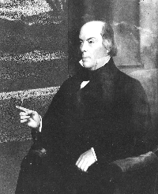
Who was James Gadsden?
Born Charleston, South Carolina-- 3rd of 16 children
Educated Yale (New Haven, CT)
Careers in military and government service
Railroad executive/promoter--wanted Southern transcontinental rail line for economic stimulation of the South
President Franklin Pierce (also a “Southerner”) was convinced about rail line
Serving under President Pierce is Jefferson Davis as US Secretary of War. Jefferson Davis will become the President of the Confederate States of America during the Civil War.
Pierce sends James Gadsden to Mexico City as an American Minister to Mexico to negotiate proposals allowing US to purchase more land from Mexico

Slide 13
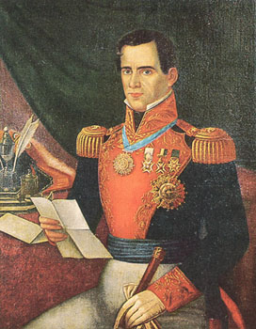
Mexico’s Interest = Why sell?
Antonio Lopez de Santa Anna = Mexican dictator and President
Mexico near bankruptcy
Mexican Army needed money
Feeling United States would take land by force anyway
Settle Indian claims
At the time, no known resources were evident = land was considered lacking in value

Slide 14
Proposals
120,000 sq miles & Baja/$50M
50,000 sq miles & NO Baja/$35M
68,000 sq miles & Indian Claims & Baja/$30M
18,000 sq miles & NO Indian Claims & Baja/$20M
32ºN Lat with access to Gulf/$15M
32ºN Lat & NO access to Gulf/$10M

Slide 15
Time Line for U.S. Senate ratification of the Gadsden Purchase
April 17th, 1854 treaty defeated by 2/3 of the Senate
April 18th, 1854 Senate voted to resume debate
Military protection clause added (for private railroad companies)
Raised purchase price from $7-million to $10-million
Congressional appropriation approval required
Santa Anna upset with new treaty, but he needed the cash
Gadsden Purchase treaty ratified June 19th, 1854,
1st installment of $7-million paid July 1, 1854 (Apparently, only 6-million arrived in Mexico
City…$1-million was missing!)

Slide 16
The “Deal” (Ratified by U.S. Congress 1854)
Beginning in the Gulf of Mexico, three leagues from land, opposite the mouth of the Rio Grande, as provided in the 5th article of the treaty of Guadalupe Hidalgo; thence, as defined in the said article, up the middle of that river to the point where the parallel of 31° 47' north latitude crosses the same; thence due west one hundred miles; thence south to the parallel of 31° 20' north latitude; thence along the said parallel of 31° 20' to the 111th meridian of longitude west of Greenwich; thence in a straight line to a point on the Colorado River twenty English miles below the junction of the Gila and Colorado rivers; thence up the middle of the said river Colorado until it intersects the present line between the United States and Mexico.

Slide 17
Physical Features of the Arizona Territory that were Good for the Building of a RR
Land South of the Gila River relatively easy terrain.
Mormon Battalion had traversed area and wrote of terrain with few mountains or deep valleys
Rail line would connect Texas to California and construction would be rapid without extensive bridges, grades, tunnels and ledges to construct.
Alternatives to the north were much more rigorous and construction costs would be very expensive.
Water tables were deemed acceptable (water stops for steam engines were needed frequently)
Construction costs would be low

Slide 18
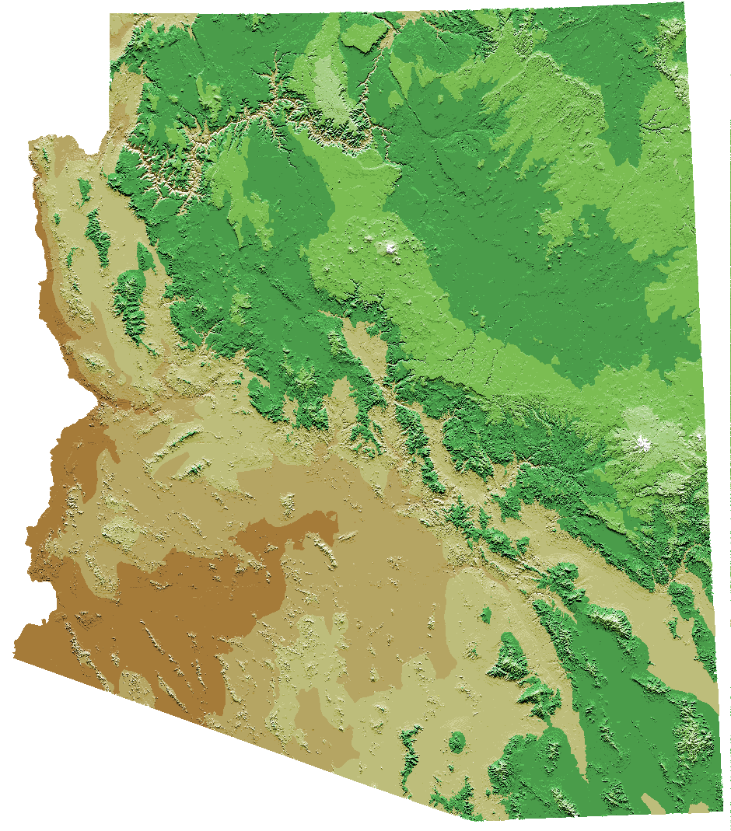
Arizona Topography
Difficult terrain/grades
Mild terrain/low grades
http://alliance.la.asu.edu/azga/

Slide 19
Political Issues with the Gadsden Purchase
Brought the issue of slavery into
Westward Expansion--would new
states be slave or free?
Increased land and port access
Promoted self-interest with railroad construction
Little was known about resources of the area for such a huge cost

Slide 20
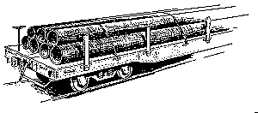
Economic Issues concerning the Importance of Railroads
Develops territory = passenger/materials transport
Supports/Promotes economic growth
Greatly increases payload weights at considerably lower cost
Spur lines connect into main lines (for mining materials)
Improved passenger safety and comfort
Fuels new industry: steam engines, diesel engines, Pullman cars, freight cars, service stops, etc.
Increases trade and resource utilization
Improves standard of living

Slide 21
Economic Issues with the Gadsden Purchase
Southern states wanted more rail lines and connections, especially westward to California.
Mining (copper, gold and other precious metals)
Agriculture
Ranching
Military

Slide 22
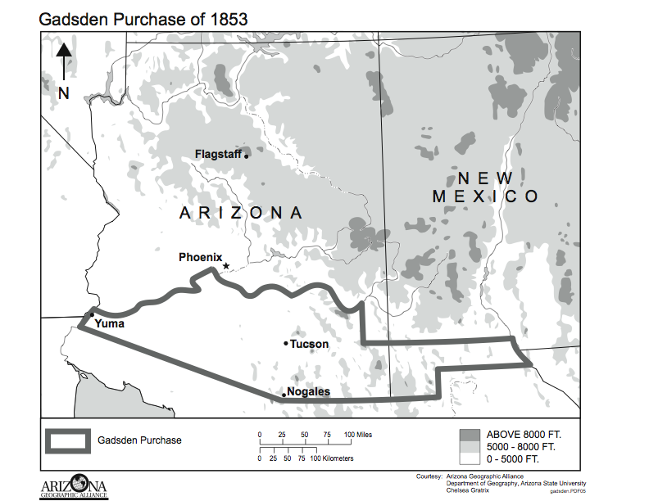
Results of the Gadsden Purchase
Manifest Destiny -- Last section acquired in the continental United States (added 24% more land to “future” Arizona)
Railroads would greatly increase development and standard of living to those in Arizona Territory through increased freight and mail volumes and improved safety and comfort of passengers as well as low cost mining materials transport by adding “spur” lines.
Agricultural and ranching lands increased
Access to gold, silver, copper, and other mined resources
Important stronghold for military
In retrospect, $10-million was a bargain!

Slide 23
Math and the Gadsden Purchase
29,640 square miles (30,000) = Much less area than all six options negotiated!
18,969,600 acres
$10-million dollars paid = about 53 cents/acre or about $337/square mile.
$10-million adjusted (2019) for inflation = approximately $10 billion dollars (or about $527/acre or $337,000/sq mile today)
*Note historical sources differ regarding
acreage and/or square miles possible due
to the various options vs. the final survey
and US Senate ratification modifications.

Slide 24
So what happened to Gadsden, anyway?
1855 Mexico demanded recall of Gadsden
Remains in post until October 1856
Returned to his South Carolina plantation of which 200-300 slaves lived and worked
Died December 26th, 1858 at the age of seventy.
He would never witness the calamity of the U.S. Civil War
The first transcontinental rail line would take a central route and use Chinese labor in challenging and nearly impossible terrain finishing in 1869 at Promontory Point, Utah.
It would be 27 years after his death (1881) before a southern route transcontinental rail line would be completed.

Slide 25
Gadsden Purchase Trivia
When the inhabitants of Arizona asked Congress for a Territorial government in 1854, one of the names suggested for the new Territory was “Gadsonia,” a Latin adaptation of the surname of James Gadsden.
These people of note were born, or lived), in the area encompassing the Gadsden Purchase:
Wyatt Earp - Doc Holliday - Sandra Day O'Conner - Linda Ronstadt - Gary Shandling - Paul and Linda McCartney - Tim McCoy - Alex Kellner - Ray Lindstrom - Travis Edmonson - Morris Udall - William Jennings Bryant - Joe Bonanno - Rose E. Bird - Kerri Strug - Rex Allen - Cochise - Geronimo - Dennis DeConcini - Pete Licavoli - Sean Elliott - Barbara Eden - Will Rogers, Jr. - Ford Burkhart - Burt Schneider - Bonnie Henry Geraldo Rivera - Sean Elliott - Kitty Kelly - Clyde (Skip) Battin - Frank Kalil - Kate Walsh - Gary Paxton

