Slide 1
SURVIVORS IN A HARSH ENVIRONMENT ASSESSMENT

Slide 2
Directions: Number your paper from 1 to 20. Write Mogollon, Ancestral Puebloans, or Hohokam on your notebook paper to select the correct group for the slide shown. Use your notes to help you decide which culture is described.

Slide 3
1. Whose habitat?
Mountain and desert dwellers Gila River Country Mimbres River San Francisco River

Slide 4
2. Whose habitat?
Sonoran Desert by rivers Made homes of ‘jacal’ (adobe) Villages built around plaza

Slide 5
3. Whose habitat?
Stone architecture
Cliff dwellings or pueblos
Kiva built in center of plaza
-underground -for ceremonies -with benches

Slide 6
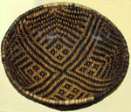
4. Whose food and other goods?
Farmers: corn or maize, squash
Hunter-Gatherers: rabbit, deer, prairie dogs
Basket makers

Slide 7
5. Whose food and other goods?
Hunter-Gatherers: bighorn sheep, elk, mule deer, white-tail deer, antelope, beaver, badger, jackrabbits, cottontails, turkeys
Farmers: corn, beans, squash, cotton
Traders: traded with people from the coast for shells and pots

Slide 8
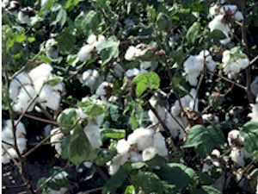
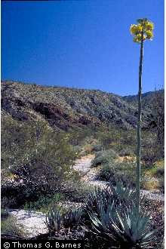
6. Whose food and other goods?
Farmers: corn, beans, cotton, agave, and squash
Hunter-Gatherers: rabbit, prairie dogs, deer

Slide 9
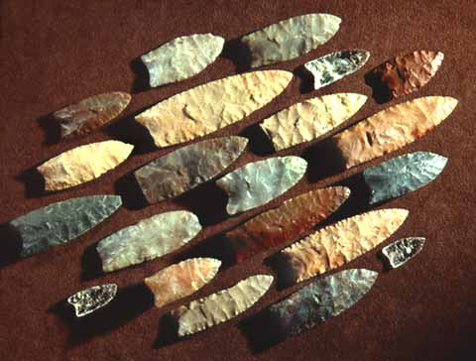
7. Whose artifacts?
Spear points
Stone knives
Grinding bones (deer, rabbit, squirrel, gopher, prairie dog, badger, pronghorn and mountain sheep)

Slide 10
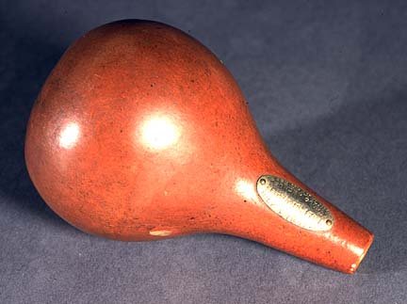
8. Whose artifacts?
Pottery (learned from the Mogollon)
Squash gourds for water
Baskets
Stone tools – spear, throwing stick Digging sticks

Slide 11
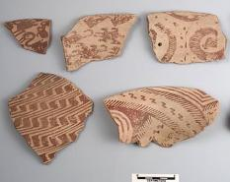
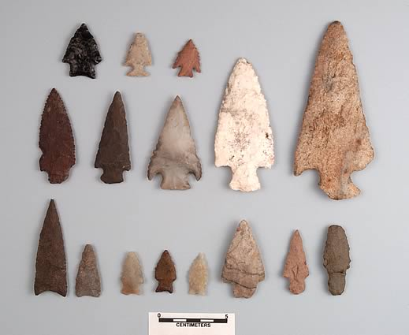
9. Whose artifacts?
Pottery--Red on Buff Shell ornaments Stone tools
Throwing sticks

Slide 12
10. Whose adaptations are described?
Carried water from source to village
Built homes in cliffs for protection from elements and enemies
Built homes facing south for heat in winter

Slide 13
11. Whose adaptations are described?
Totally relied on environment
Followed seasons

Slide 14
12. Whose adaptations are described?
Moved from desert in summer to foothills, then back to desert in winter
Built over 300 miles of canals to irrigate crops

Slide 15
13. What may have happened to them?
Drought
Enemies invaded
Internal conflict

Slide 16
14. What may have happened to them?
May have left area due to climate change or drought which would lead to food shortages

Slide 17
15. What may have happened to them?
May have left due to drought, floods, or climate change

Slide 18
16. Whose ruins?
Gila Cliff Dwelling
Kinishba Pueblo
Grasshopper
Q Ranch Pueblo
Point of Pines Pueblo

Slide 19
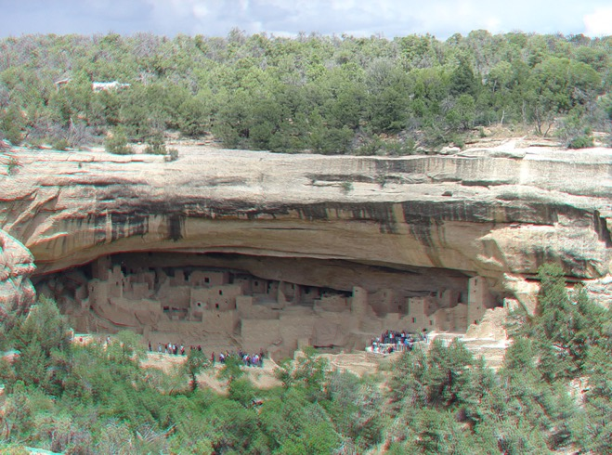
17. Whose ruins?
Mesa Verde Canyon de Chelly Kayenta

Slide 20
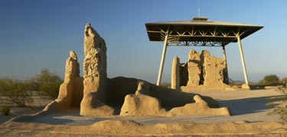
18. Whose ruins?
Casa Grande Snaketown

