Slide 1
The Mogollon, the Hohokam, and the Ancestral Puebloans
Adaptations Made for Survival

Slide 2
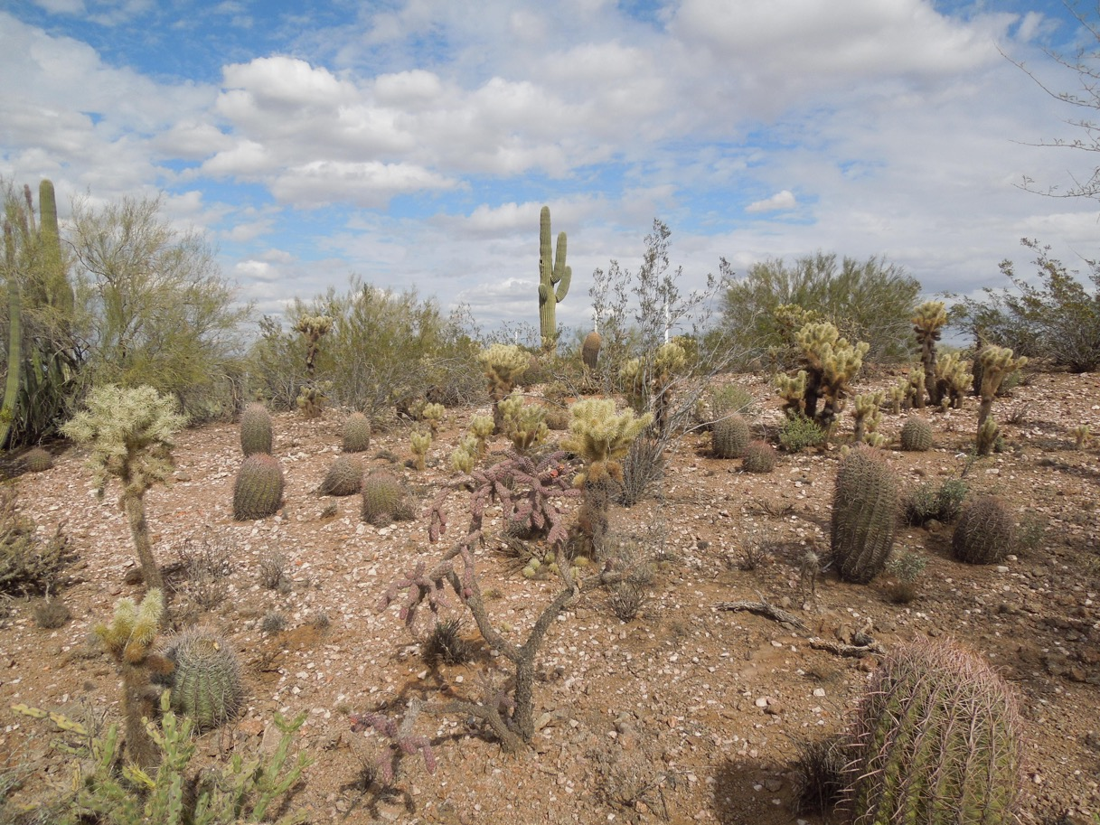
https://upload.wikimedia.org/wikipedia/commons/b/b8/Desert_Botanical_Garden_Phoenix_Arizona_34.JPG

Slide 4
The Mogollon
~1 a.d. – 1450 a.d.

Slide 6
Mogollon Habitat
Mountain and desert dwellers
Gila River Country
Mimbres River
San Francisco River

Slide 7
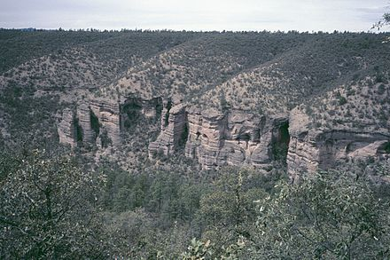
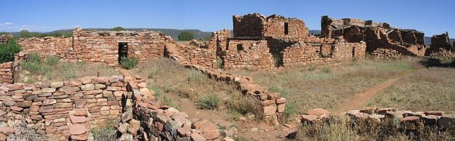
Mogollon Habitat
Mountain Dwellers
Desert Dwellers
Wikipedia

Slide 8
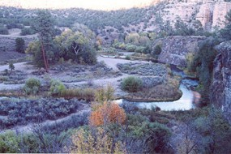
Gila River Country
Mogollon Habitat
blm.gov/az

Slide 9
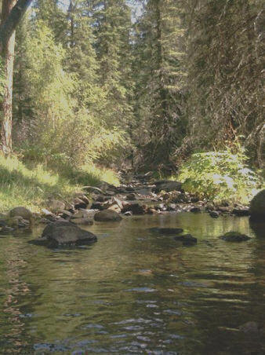
Mimbres & San Francisco Rivers
Mogollon Habitat
nmsu.edu

Slide 10
How the Mogollon got food and other goods
Hunter-Gatherers: bighorn sheep, elk, mule deer, white-tail deer, antelope, beaver, badger, jackrabbits, cottontails, turkeys
Farmers: corn, beans, squash, cotton
Traders: traded with people from the coast for shells and pots

Slide 11
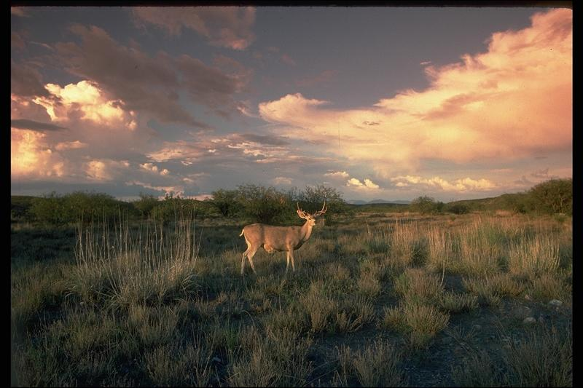
How the Mogollon got food and other goods
Hunter-Gatherers
blm.gov

Slide 12
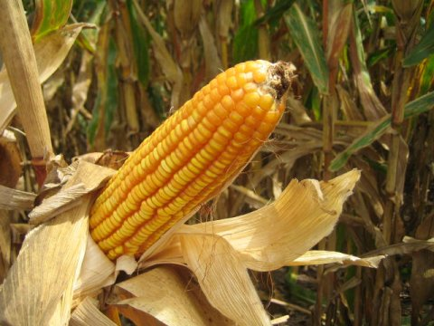
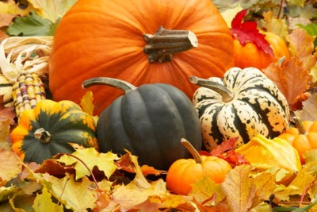
How the Mogollon got food and other goods
Farmers
Corn
Squash
www.pecad.fas.usda.gov
blog.usa.gov

Slide 13
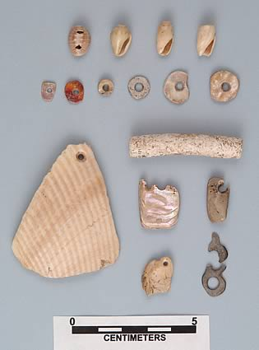
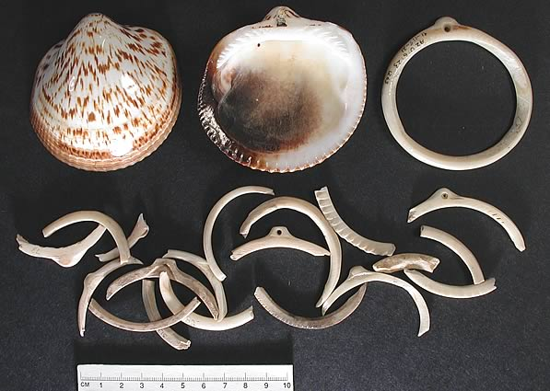
How the Mogollon got food and other goods
Traders
statemuseum.arizona.edu

Slide 14
Mogollon Artifacts
spear points
stone knives
grinding bones (deer, rabbit, squirrel, gopher, prairie dog, badger, pronghorn and mountain sheep)

Slide 15
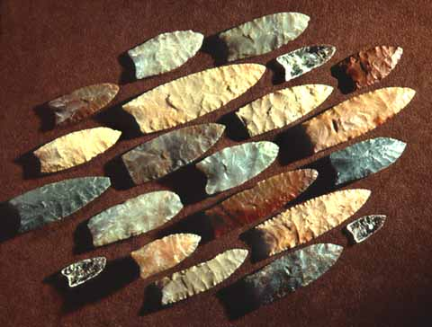
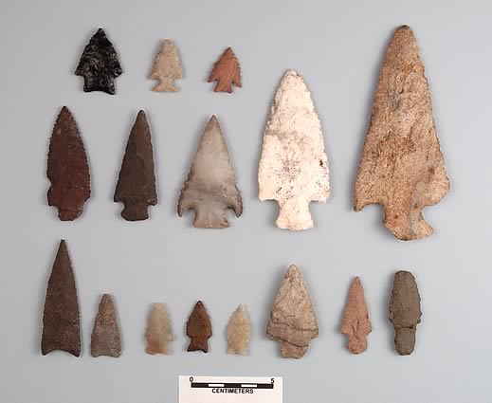
Mogollon Artifacts
Spear Points, Stone Knives
statemuseum.arizona.edu

Slide 16
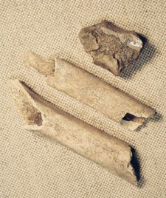
Mogollon Artifacts
Bones
blm.gov

Slide 17
More Artifacts
Pottery
- Brown or red before 900 a.d. - Mimbres (black on white) in 900 a.d.
Stone axes ground on 3 sides
Shell pendants, bone hairpins

Slide 18

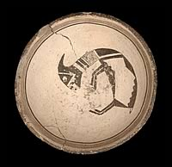

Artifacts
Mimbres Pottery
Blm.gov
statemuseum.arizona.edu
Nps.gov

Slide 19
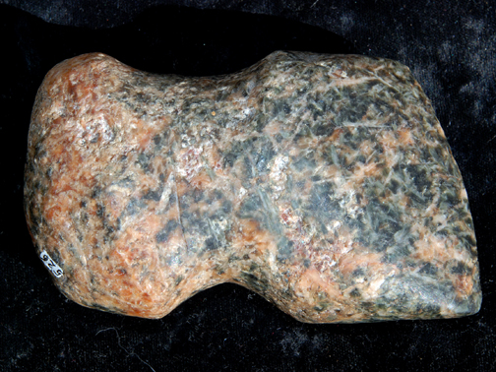
Artifacts
Stone Axes
        Nps.gov

Slide 20

Artifacts
Shell Pendants, Hair Pins
statemuseum.arizona.edu

Slide 21
Mogollon Adaptations
Totally relied on environment
Followed seasons

Slide 22
Mogollon Adaptations—What might have happened to them?
May have left area due to climate change or drought which would lead to food shortages

Slide 23
Mogollon Ruins
Gila Cliff Dwelling
Kinishba Pueblo
Grasshopper
Q Ranch Pueblo
Point of Pines Pueblo

Slide 24
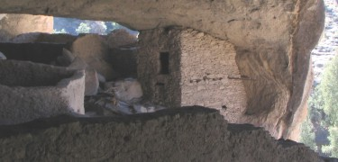
Mogollon Ruins
Gila Cliff Dwellings
nps.gov

Slide 25
Mogollon Ruins
Kinishba Pueblo
https://en.wikipedia.org/wiki/Kinishba_Ruins

Slide 26
The Ancestral Puebloans
~100 a.d. - 1300 a.d.

Slide 28
Ancestral Puebloans Habitat
Stone architecture
Cliff dwellings or pueblos
Kiva built in center of plaza
-underground
-for ceremonies
-with benches

Slide 29
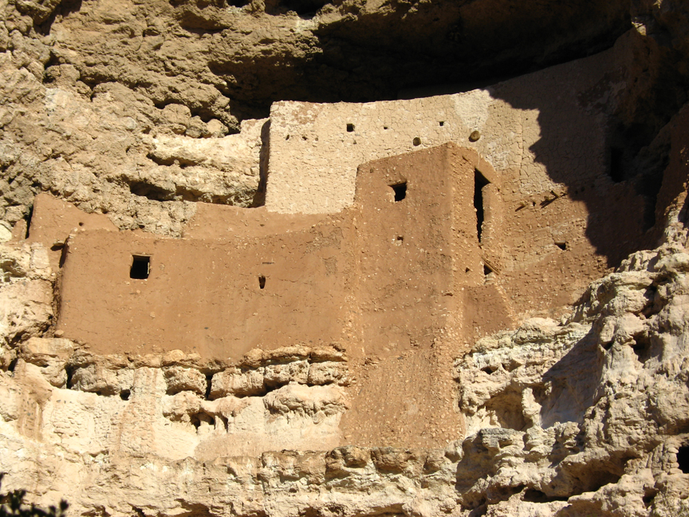
Ancestral Puebloans Habitat
Cliff Dwellings or Pueblos
nps.gov

Slide 30
How the Ancestral Puebloans got food and other goods
Farmers: corn or maize, squash
Hunter-Gatherers: rabbit, deer, prairie dogs
Basket makers

Slide 31

How the Ancestral Puebloans got food and other goods
Farmers
usda.gov
blog.usa.gov

Slide 32
How the Ancestral Puebloans got food and other goods
Hunter-Gatherers
blm.gov

Slide 33
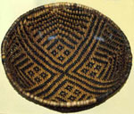
How the Ancestral Puebloans got food and other goods
Basket Makers
Nps.gov

Slide 34
Ancestral Puebloans Artifacts
Pottery (learned from the Mogollon)
Squash gourds for water
Baskets
Stone tools – spear, throwing stick
Digging sticks

Slide 35
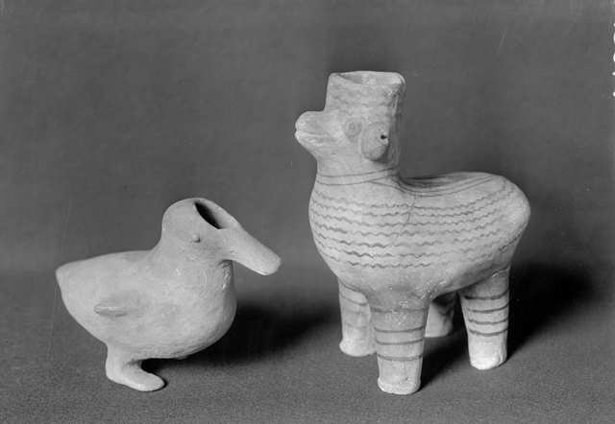
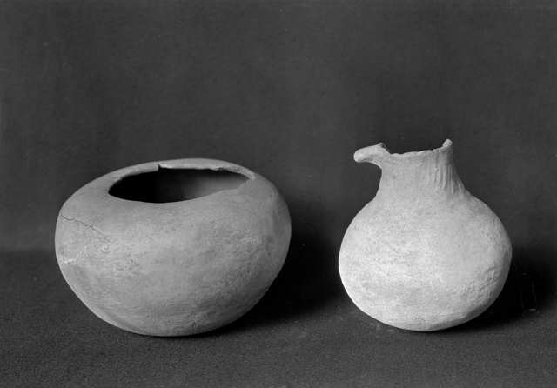
Artifacts
Pottery
Loc.gov

Slide 36
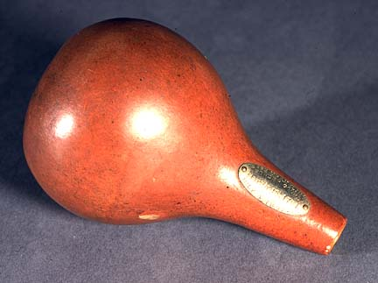
Artifacts
Squash gourds for water
The gourds used to store water would have looked something like this.
Nps.gov

Slide 37
Ancestral Puebloans Artifacts
Baskets
Nps.gov

Slide 38
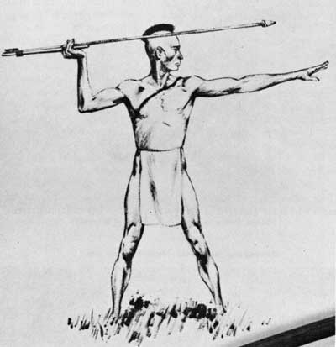

Ancestral Puebloans Artifacts
Stone Tools
Throwing Sticks
and Spears
Nps.gov

Slide 39
Ancestral Puebloans Artifacts
Digging Sticks
Can you imagine
using a stick to dig
a hole to plant a
seed in order to get
food?

Slide 40
Ancestral Puebloans Adaptations
Carried water from source to village
Built homes in cliffs for protection from elements and enemies
Built homes facing south for heat in winter

Slide 41
Ancestral Puebloans Adaptations and Alterations
nps.gov

Slide 42
Ancestral Puebloans Adaptations---What might have happened to them?
Drought
Enemies invaded
Internal conflict

Slide 43
Ancestral Puebloans Ruins
Mesa Verde
Canyon de Chelly
Kayenta

Slide 44
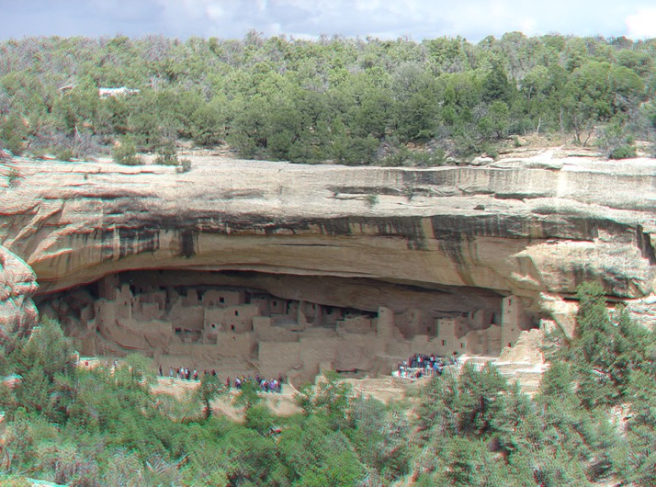
Ancestral Puebloans Ruins
Mesa Verde
usgs.gov

Slide 45
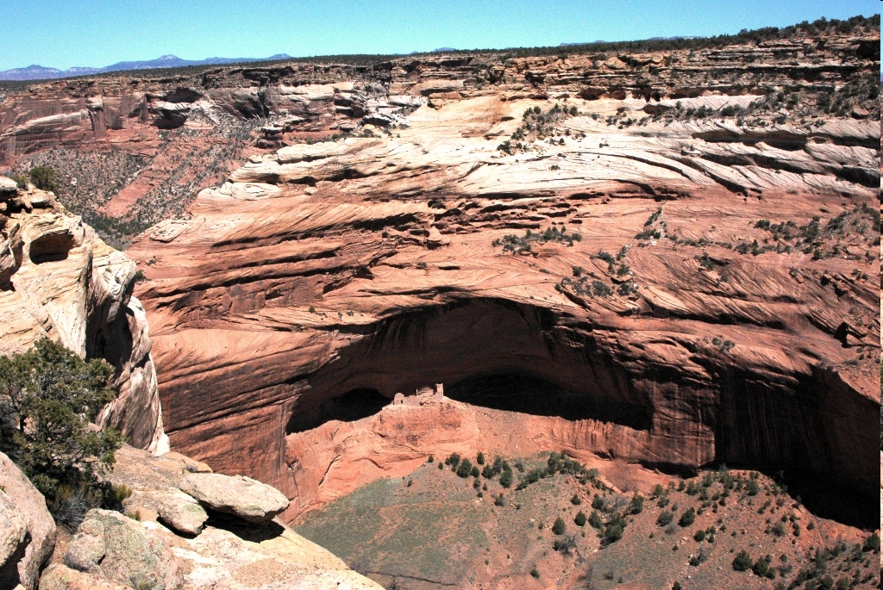
Ancestral Puebloans Ruins
Canyon de Chelly
nasa.gov

Slide 46
The Hohokam
~1 a.d. – 1450 a.d.

Slide 48
Hohokam Habitat
Sonoran Desert near rivers
Made homes of ‘jacal’ (adobe)
Villages built around plaza

Slide 49
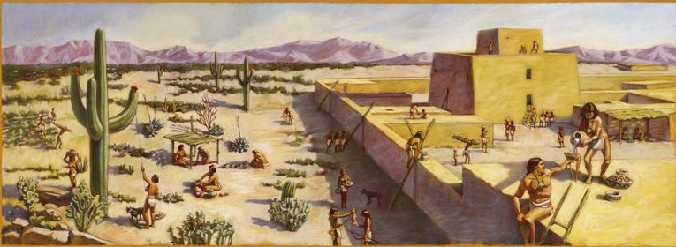
Hohokam Habitat
Hohokam adobe dwelling
Nps.gov

Slide 50
How the Hohokam got food and other goods
Farmers: corn, beans, cotton, agave, and squash
Hunter-Gatherers

Slide 51
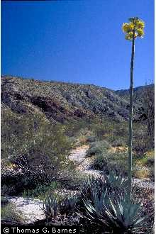
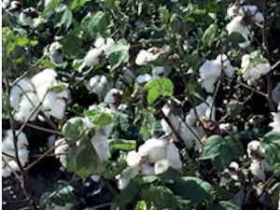

How the Hohokam got food and other goods
Farmers
Corn
Cotton
Agave
Virginia.gov
usda.gov
usda.gov

Slide 52
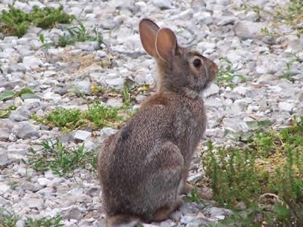
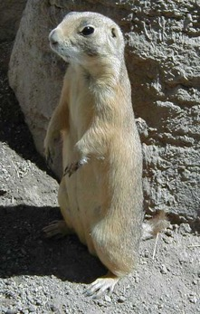

How the Hohokam got food and other goods
Hunter-Gatherers
Blm.gov
Mo.gov
fws.gov
Rabbits
Prairie dogs
Deer

Slide 53
Hohokam artifacts found
Pottery--Red on Buff
Shell ornaments
Stone tools

Slide 54
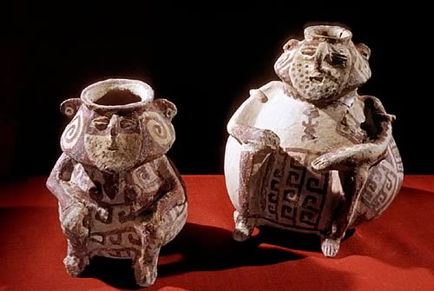
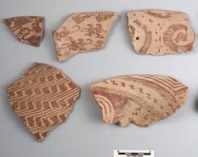
Hohokam Artifacts
Pottery – Red on Buff
statemuseum.arizona.edu

Slide 55
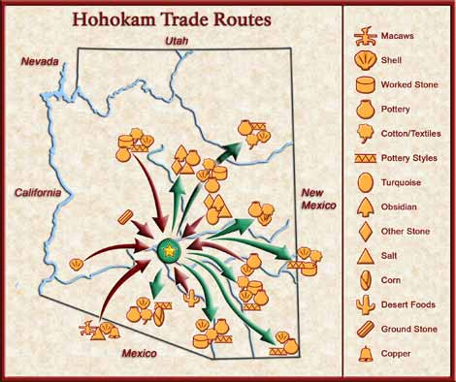
Artifacts
Shell ornaments
statemuseum.arizona.edu

Slide 56
Artifacts
Stone tools
statemuseum.arizona.edu

Slide 57
Hohokam Adaptations
Moved from desert in summer to foothills, then back to desert in winter
Built over 300 miles of canals to irrigate crops

Slide 58
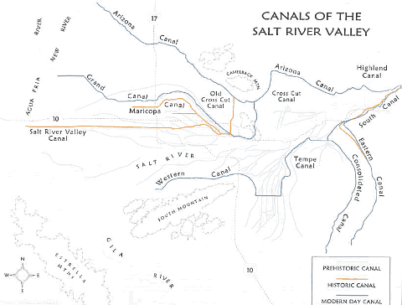
Hohokam Adaptations
Canal system--Old and New
waterhistory.org

Slide 59
Hohokam Adaptations---What might have happened to them?
May have left due to: drought floods climate change

Slide 60
Hohokam Ruins
Casa Grande
Snaketown

Slide 61
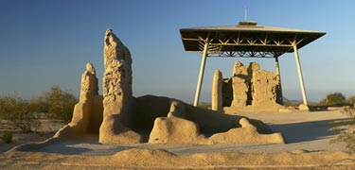
Hohokam Ruins
Casa Grande
nps.gov

Slide 62
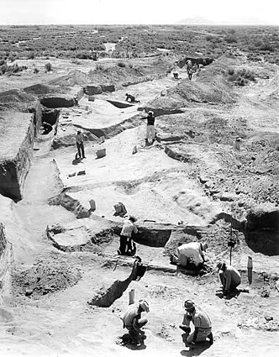
Hohokam Ruins
Snaketown
statemuseum.arizona.edu

