Slide 1
EVEN THE ROCKS CRY OUT!
ROCK ART IN THE PETRIFIED FOREST NATIONAL FOREST
By
Cheri Stegall

Slide 2
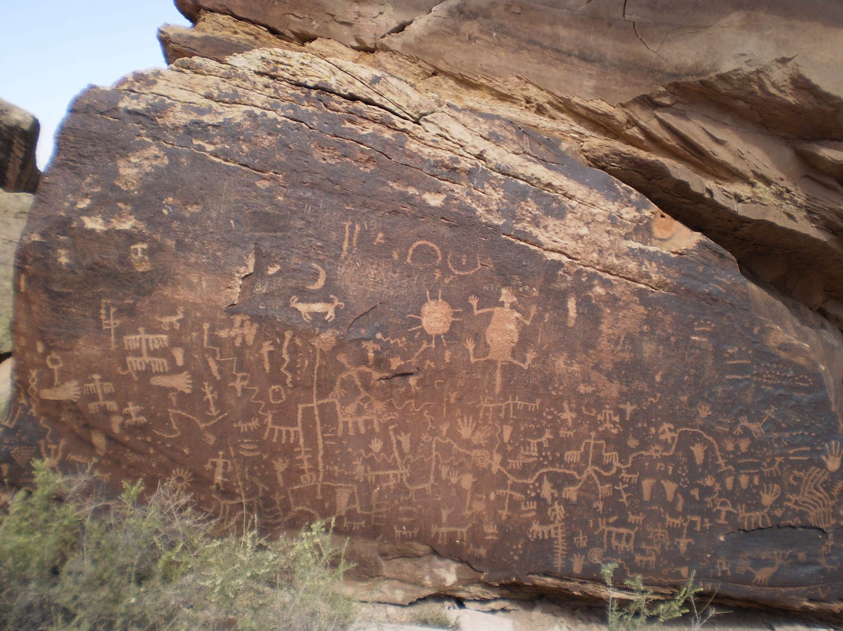
phs
Notes:
Newspaper Rock pictographs (painted) and petroglyphs (chiseled)

Slide 3
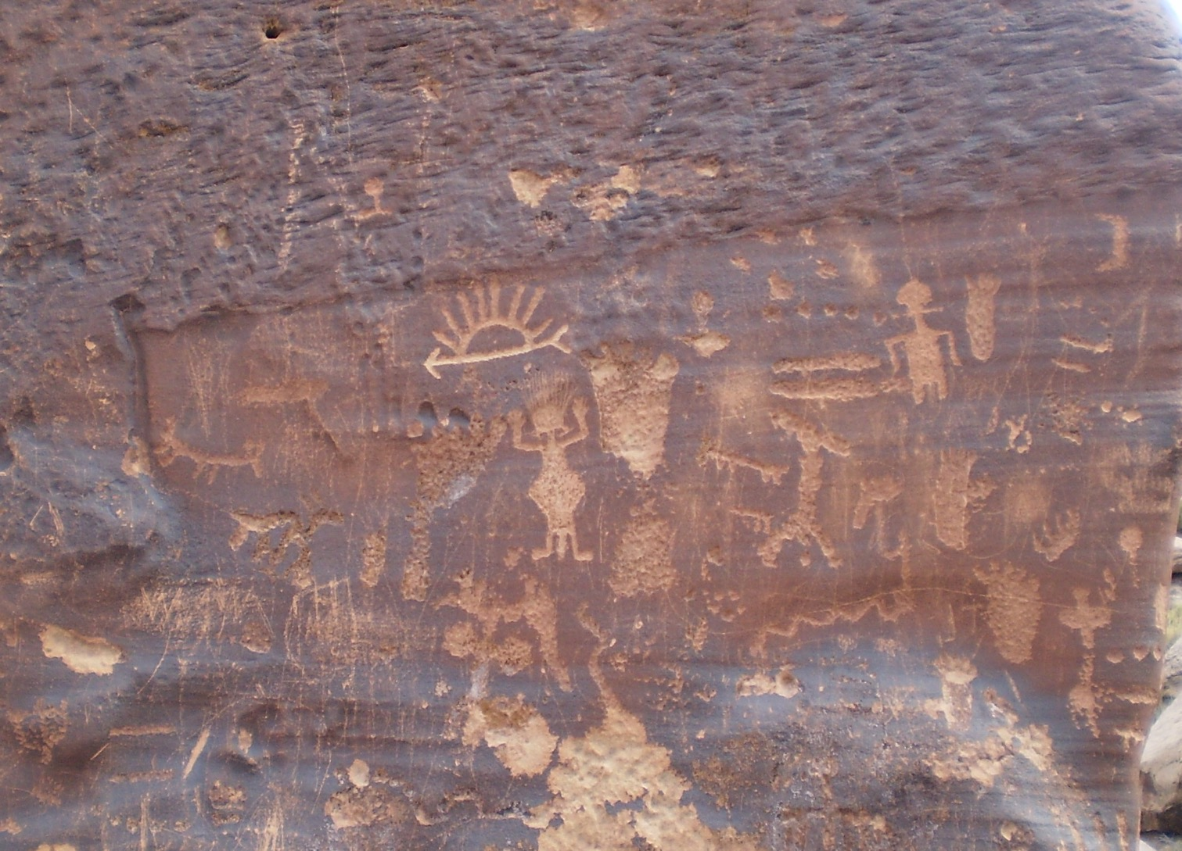
Per Rock
Notes:
Petroglyphs close to Newspaper Rock

Slide 4
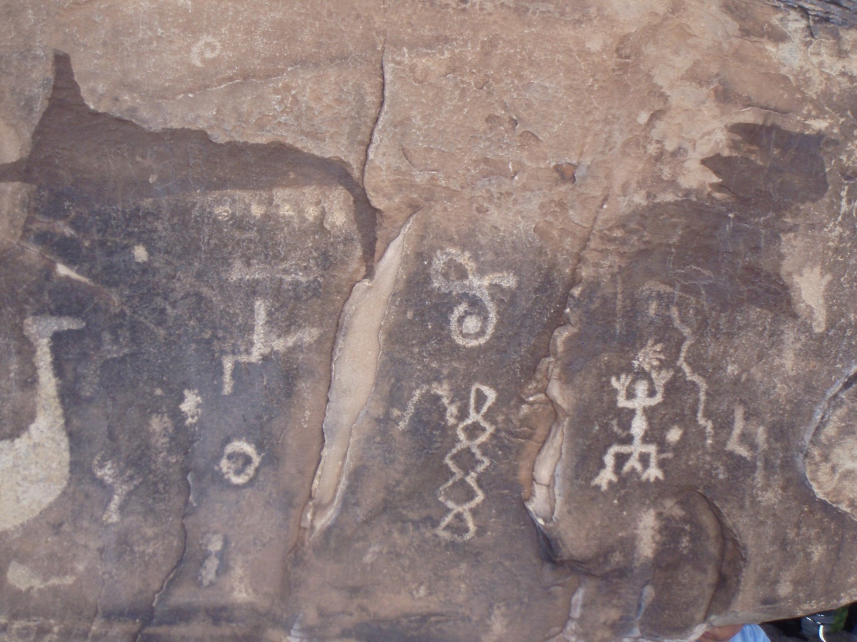
Notes:
Animals, people, water?

Slide 5
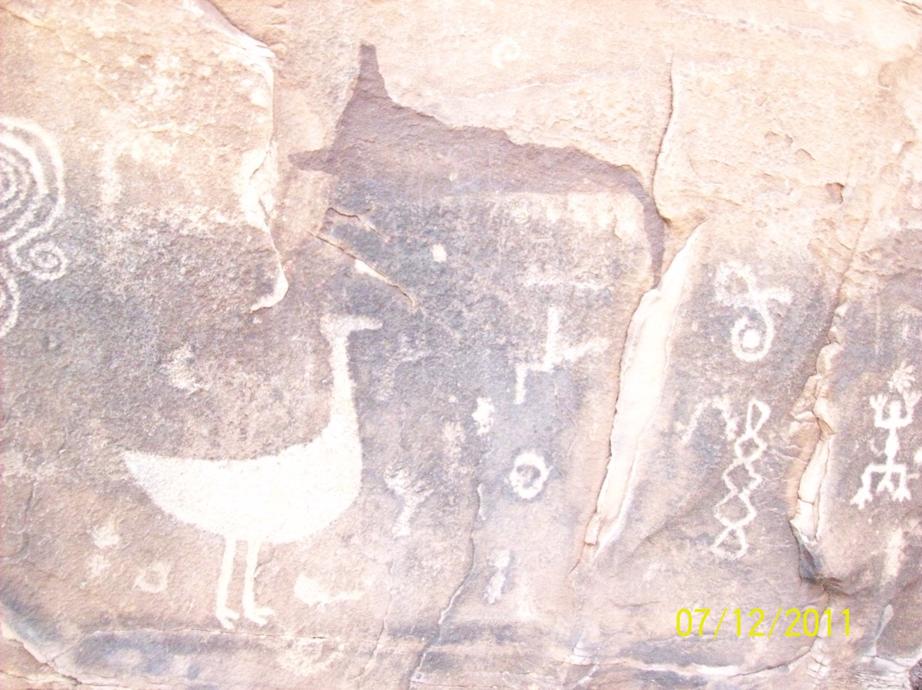
Sl
Notes:
Another view of Slide 4

Slide 6
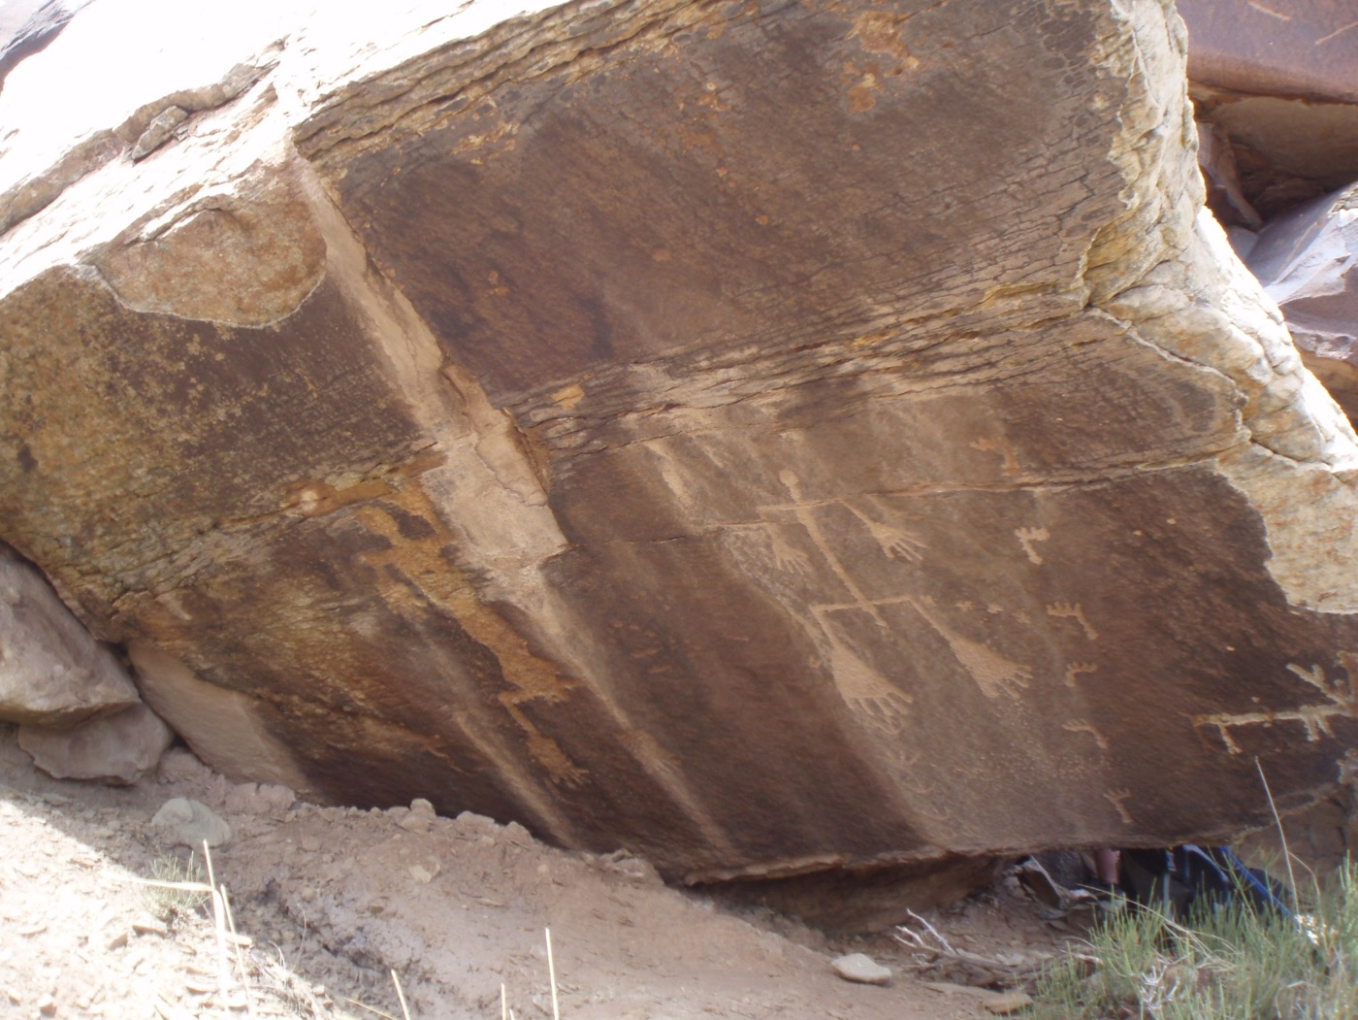
Ge
Notes:
Large feet thought to symbolize drought. Notice how the rock is deteriorating.

Slide 7
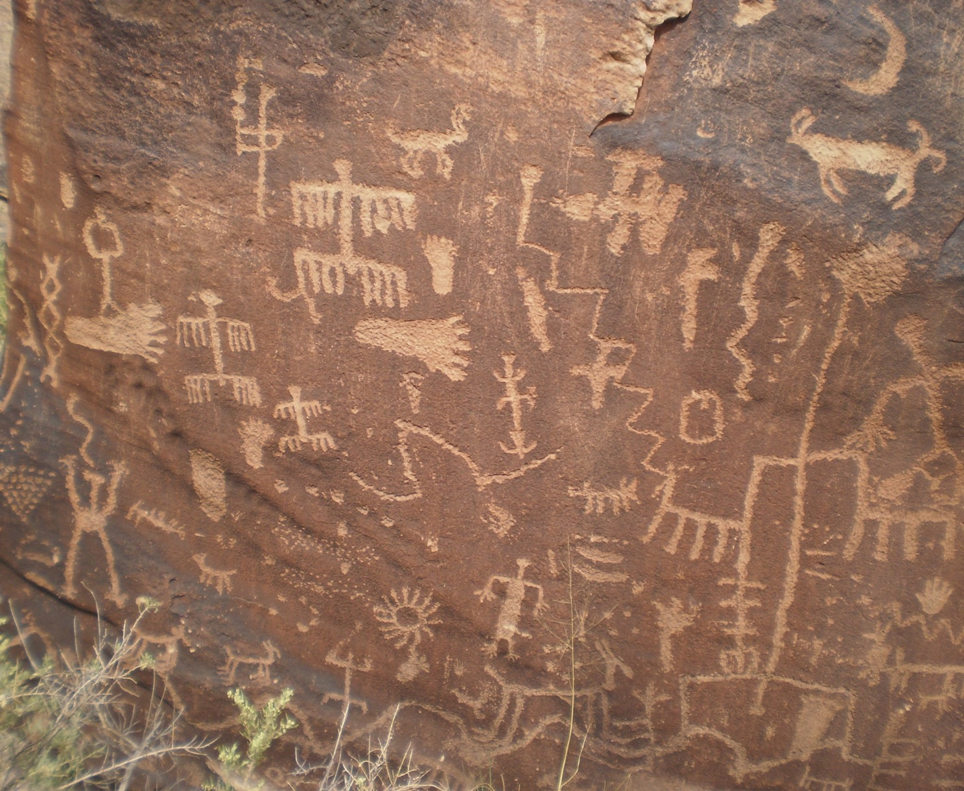
Notes:
Animals, footprints, people?

Slide 8
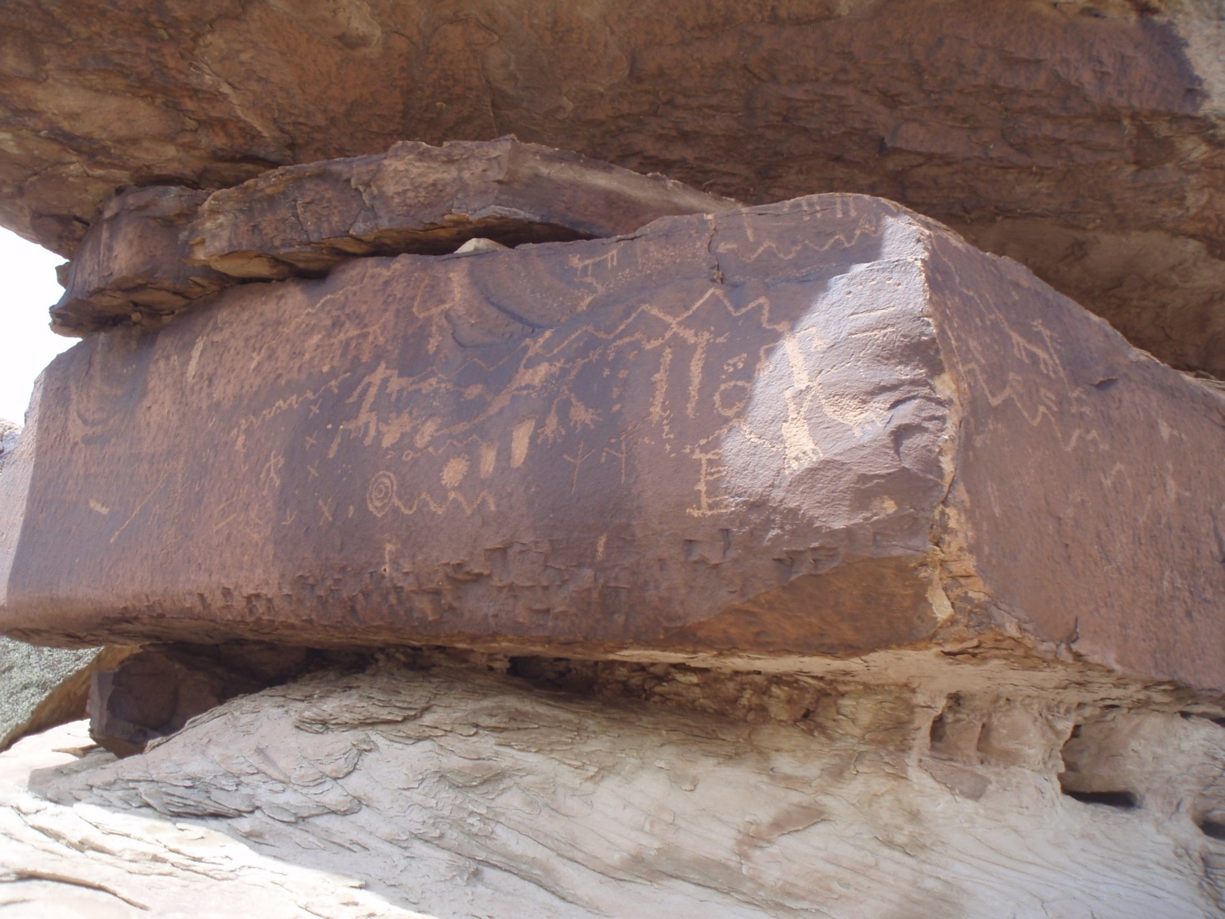
Noti
Notes:
Notice how this rock is under a large overhang, so protected a bit more from the elements

Slide 9
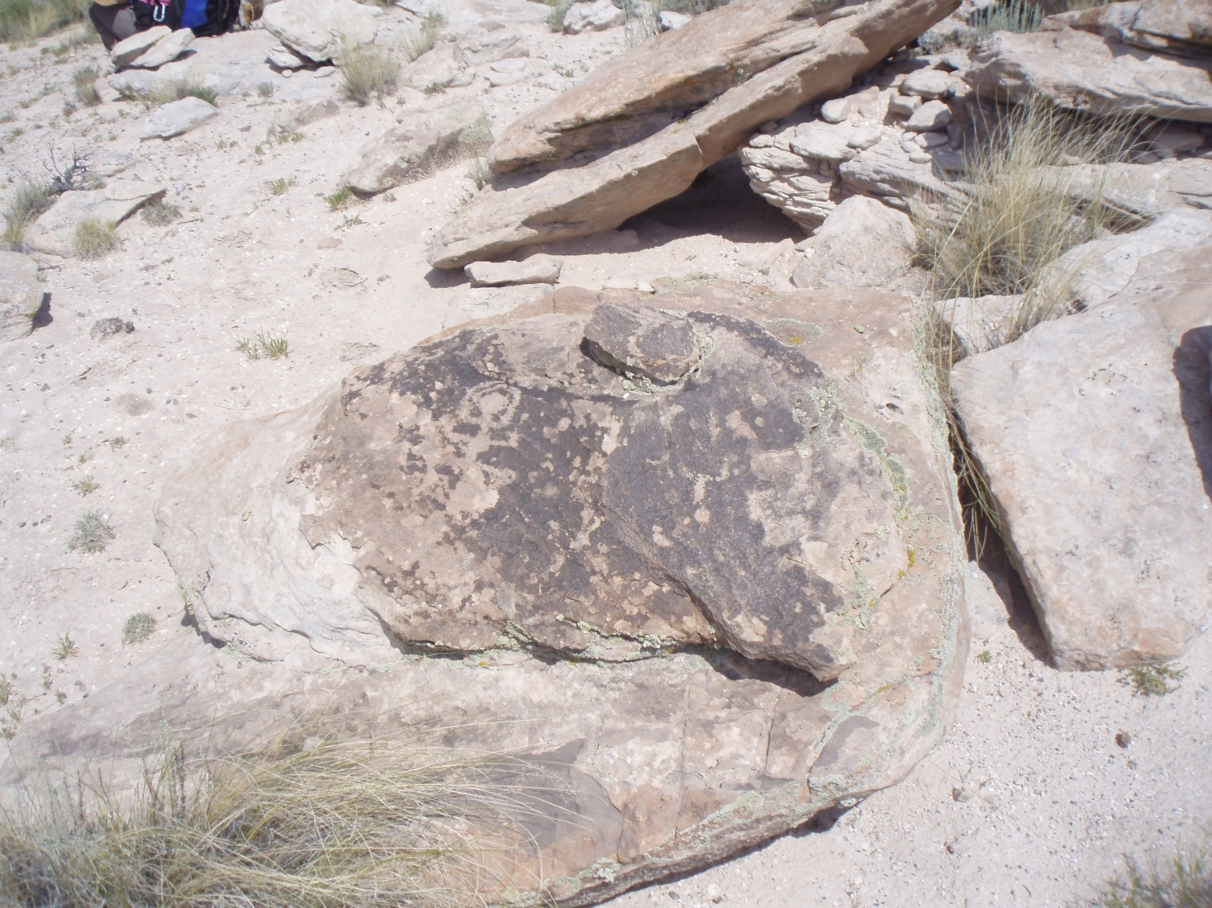
Notes:
But-like glyph in rock coating – hard to see

Slide 10
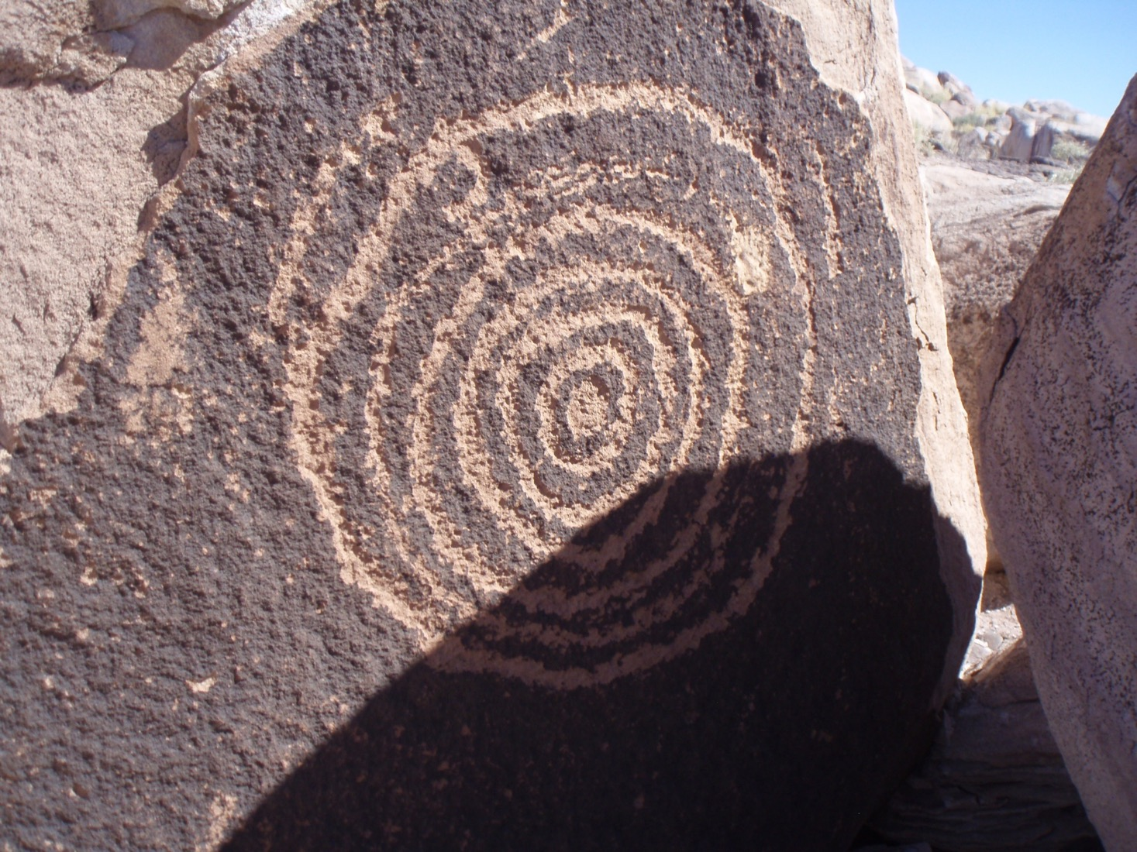
E
Notes:
Etched into the rock

Slide 11
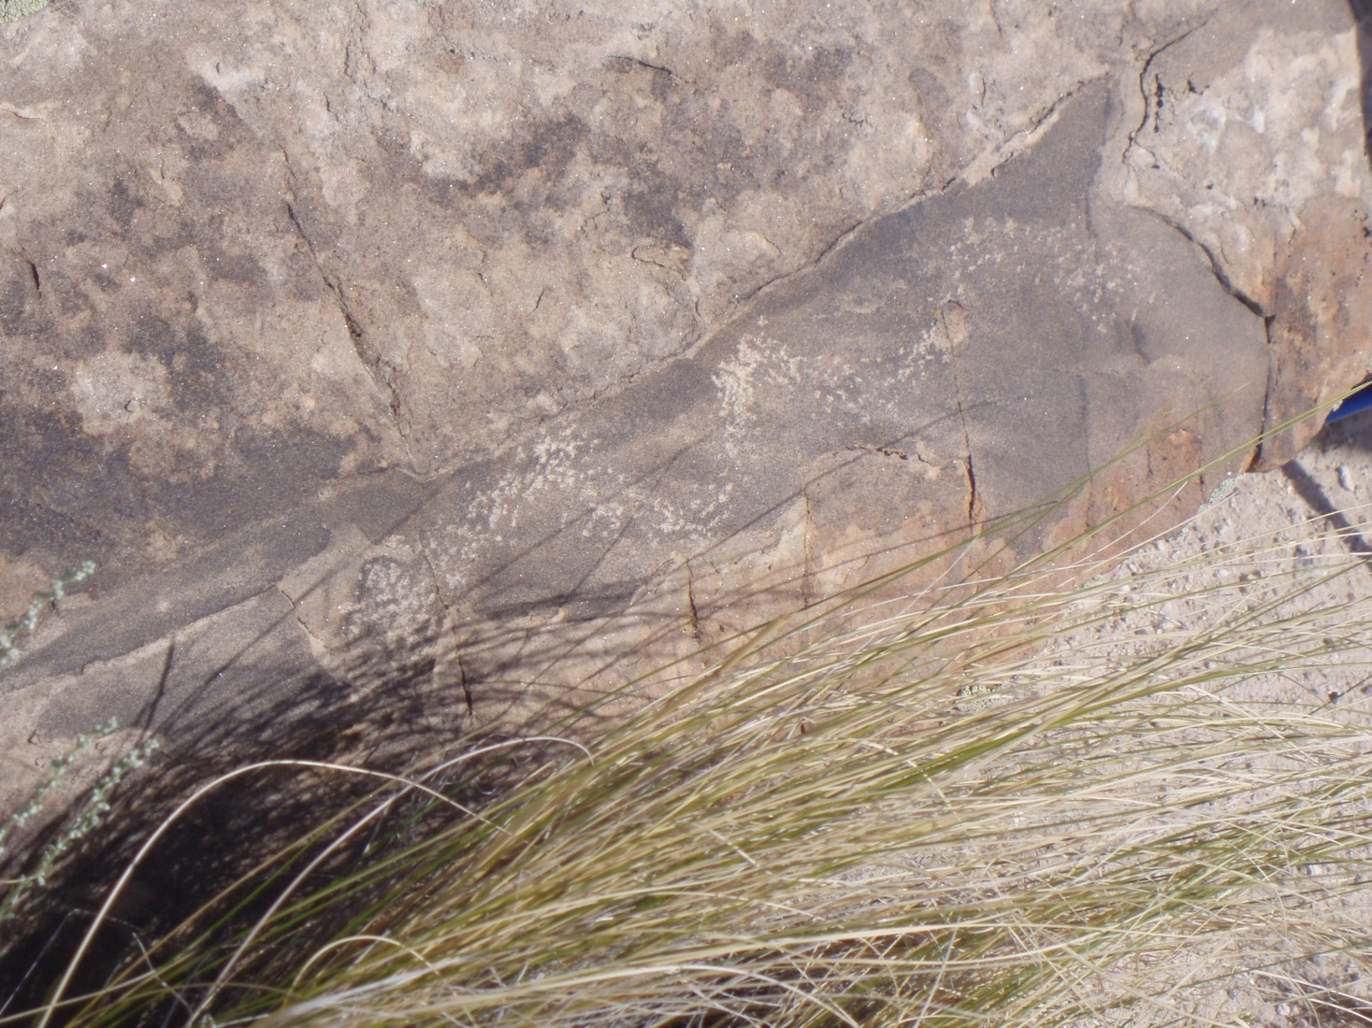
Diffi
Notes:
Difficult to see – at the base of the rock covered over by grass - looks like a snake

Slide 12
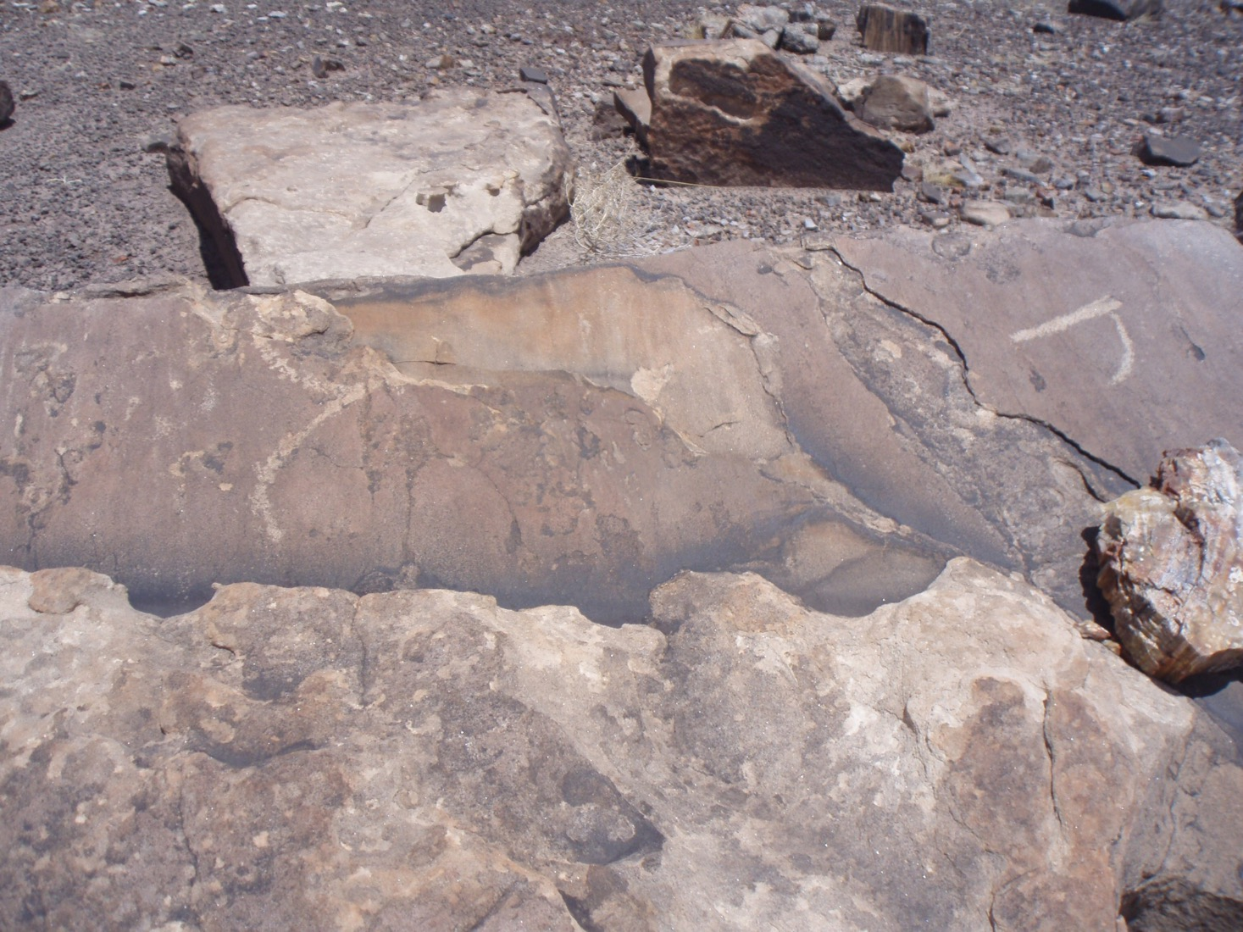
Notes:
Notice how rock is deteriorating

Slide 13
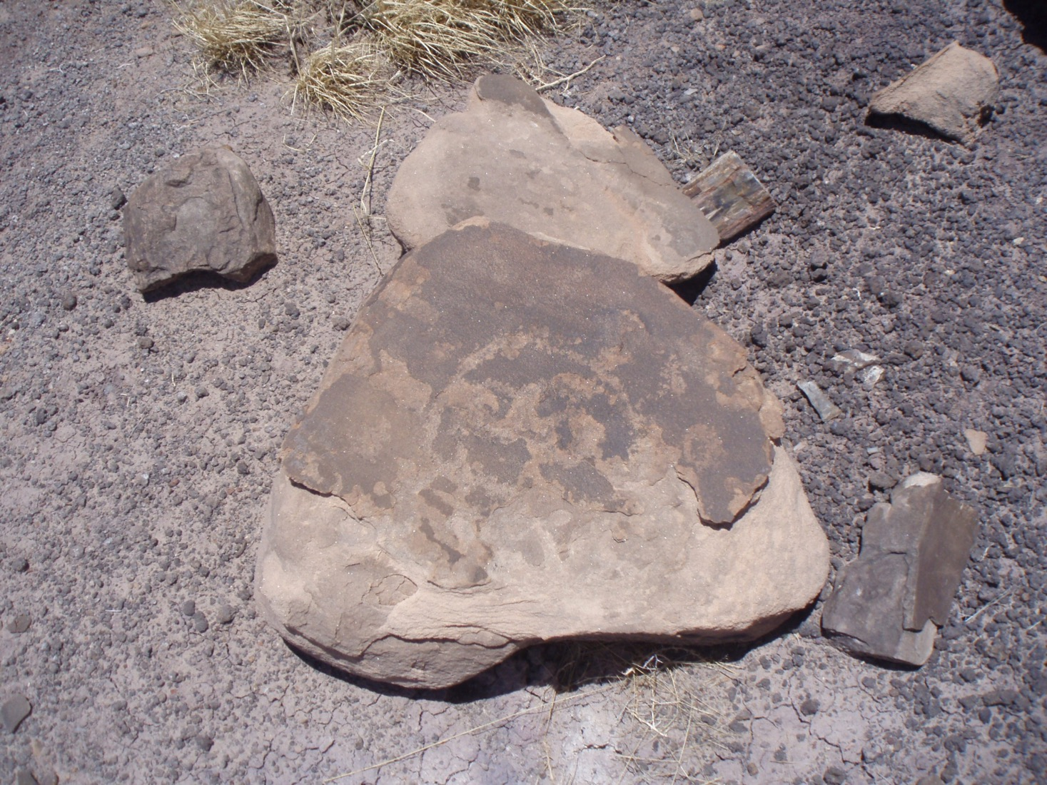
N
Notes:
Not much left of this glyph – rock coating almost gone

Slide 14
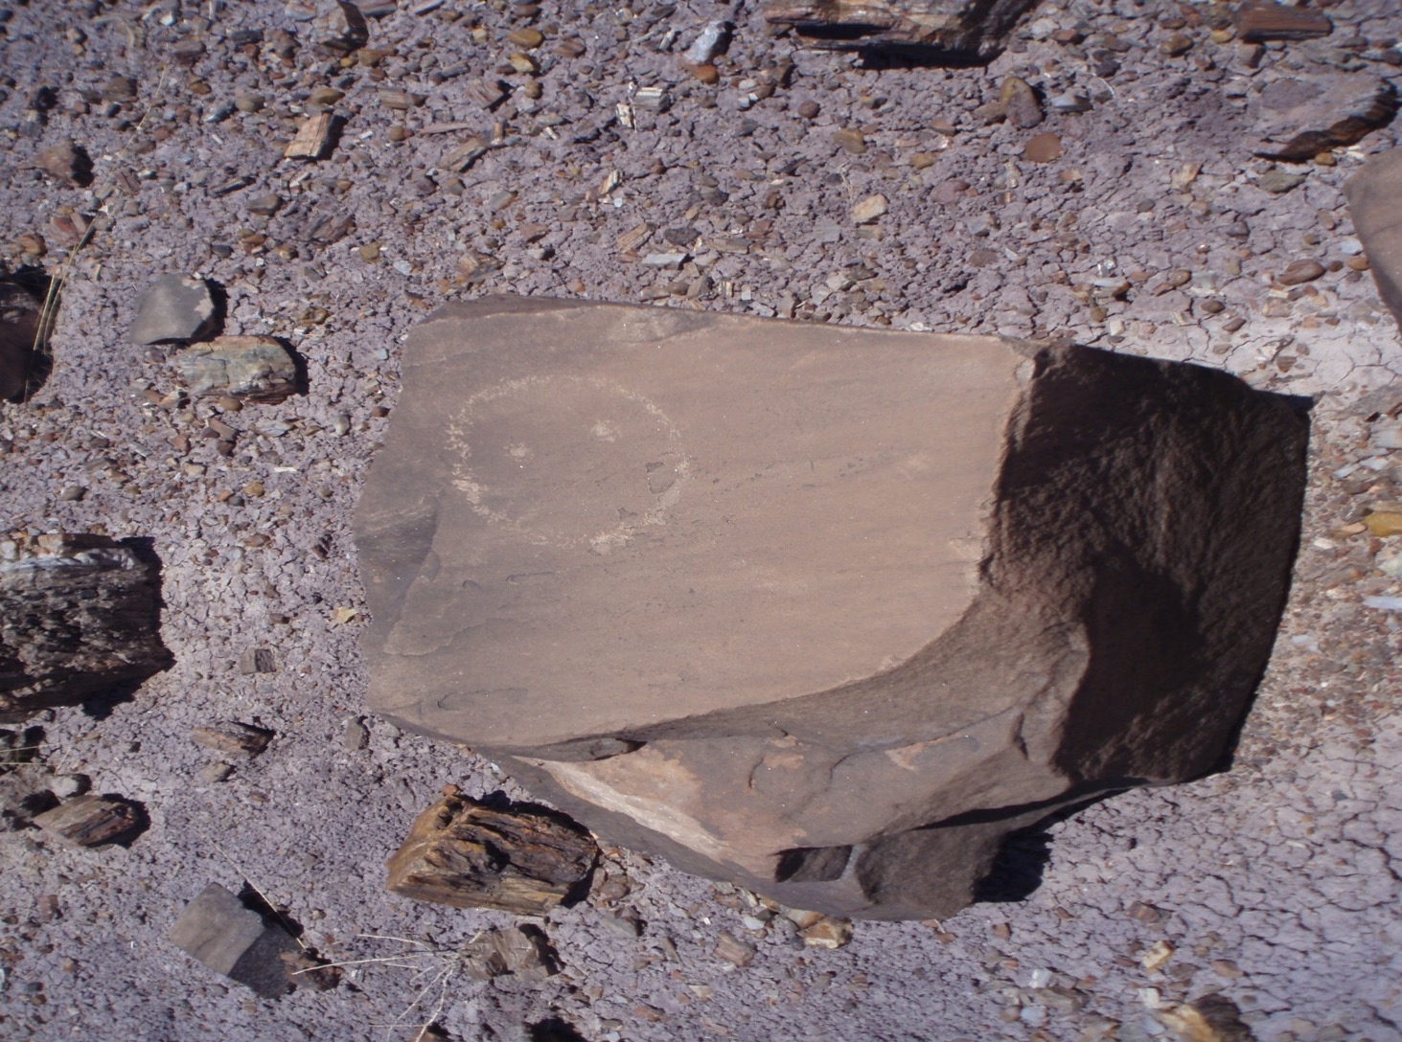
e
Notes:
Happy face? Alien?

Slide 15
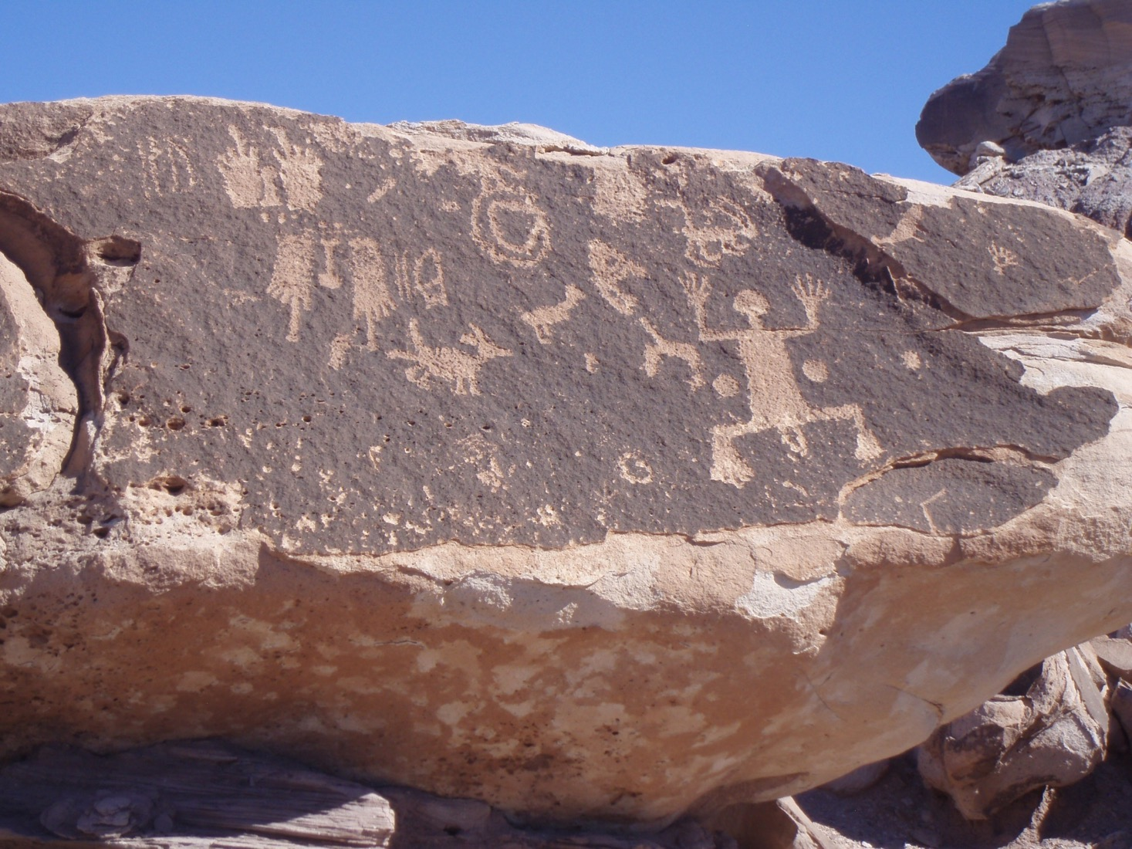
im
Notes:
Animals; drought?

Slide 16
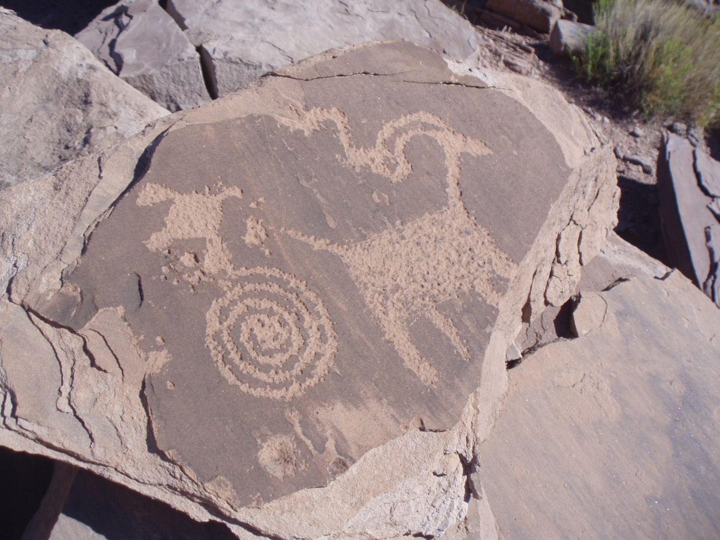
E
Notes:
Excellent examples of etching into rock coating

Slide 17
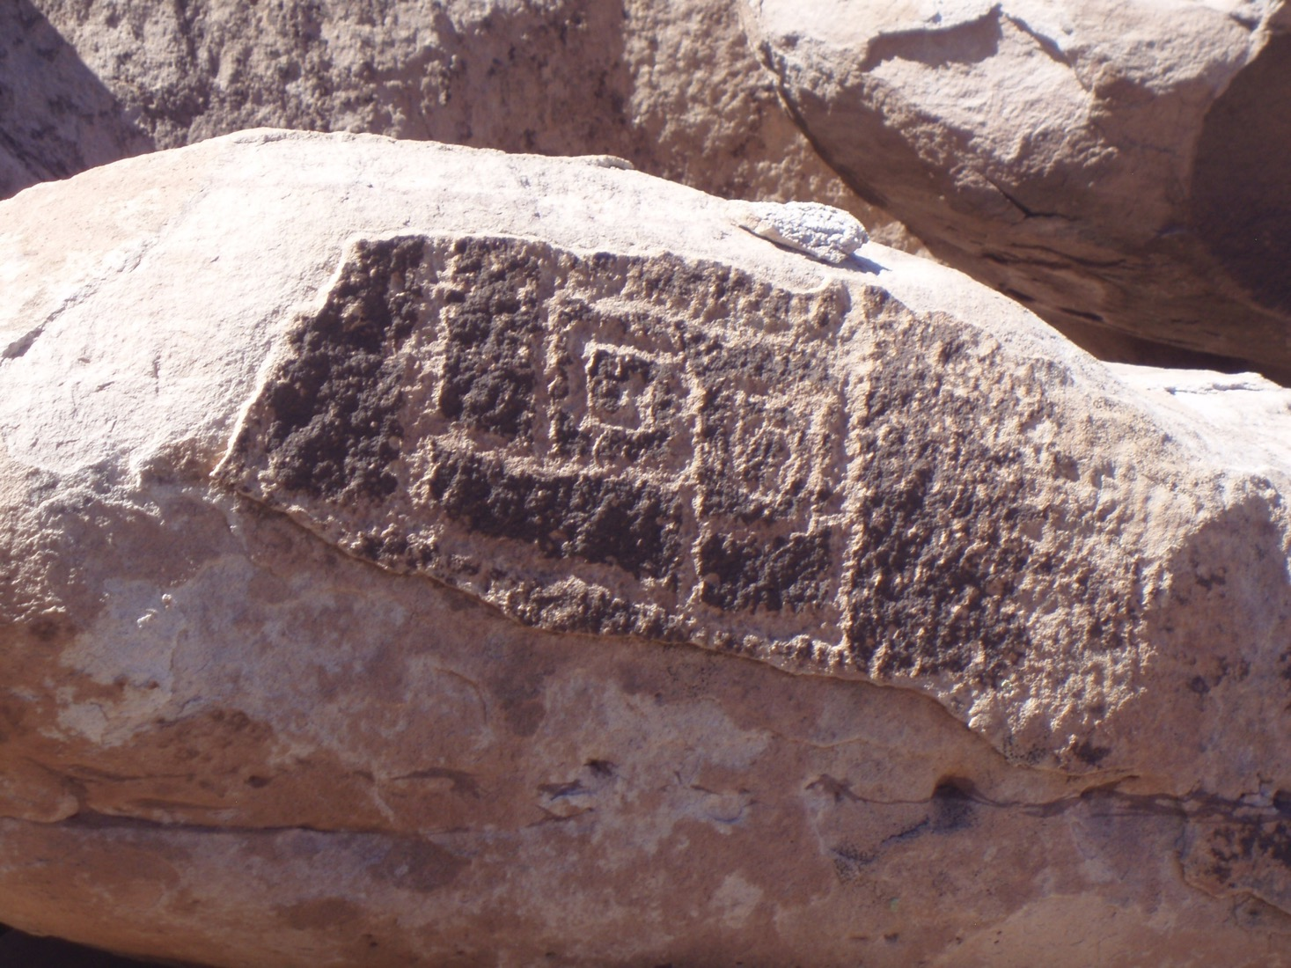
Notes:
More good etching – square edges

Slide 18
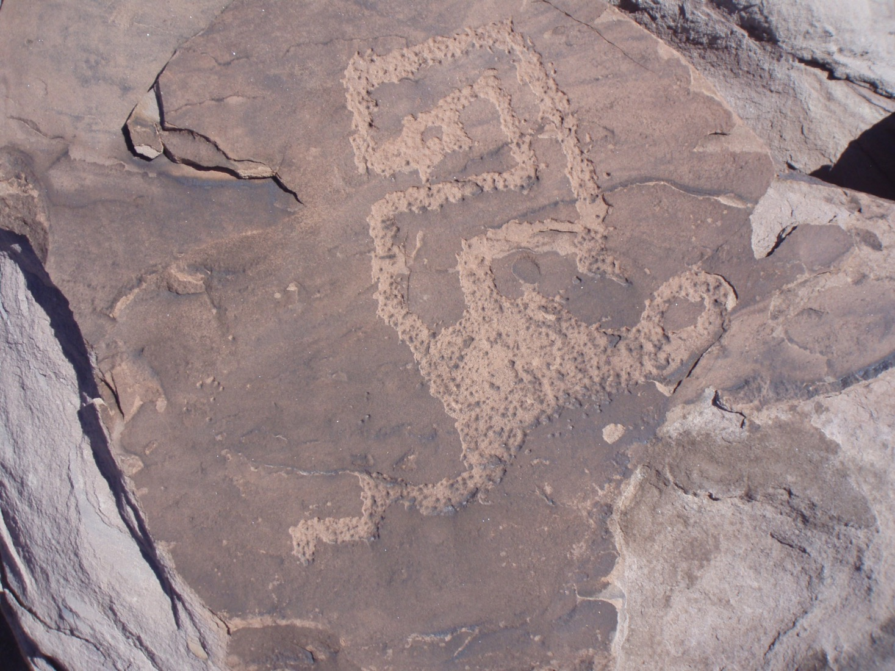
At
Notes:
What could this be?

Slide 19
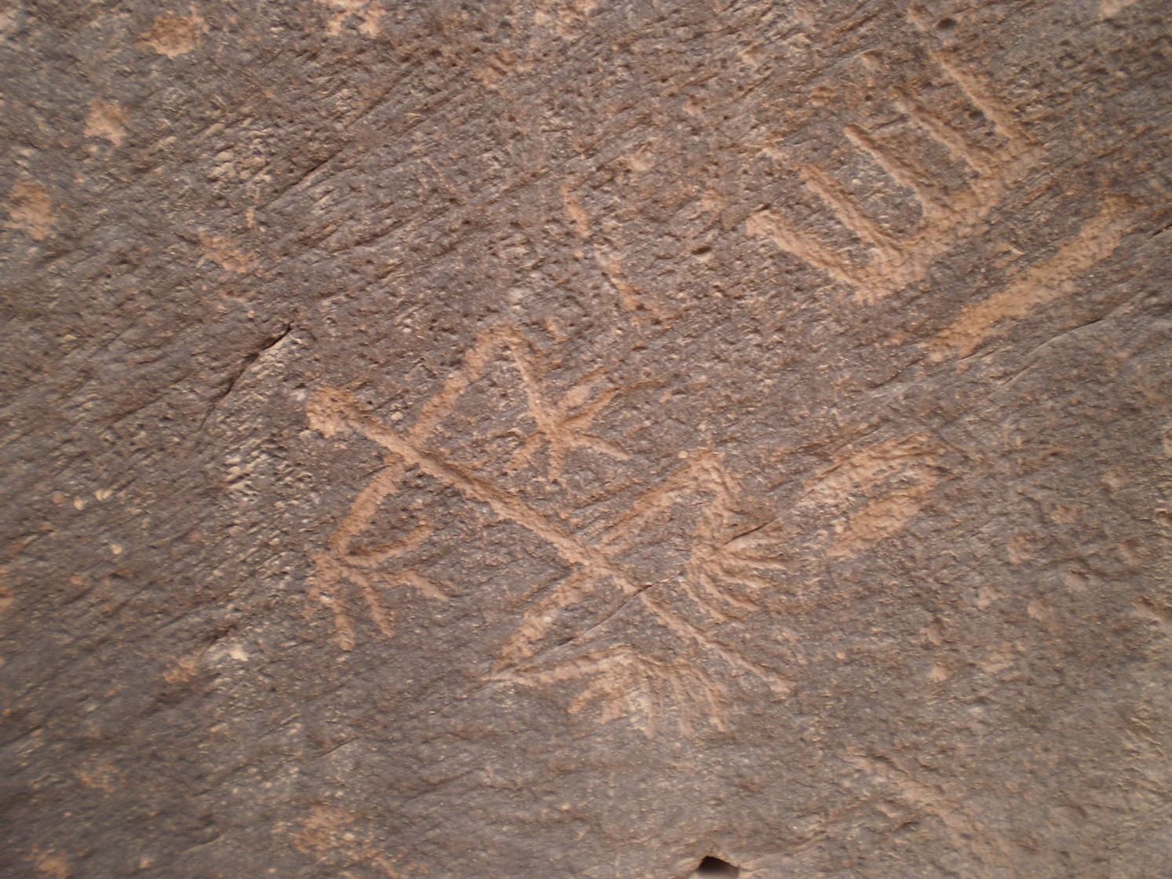
Notes:
Long fingers and toes on the man – drought? A crown – a leader coming?

Slide 20
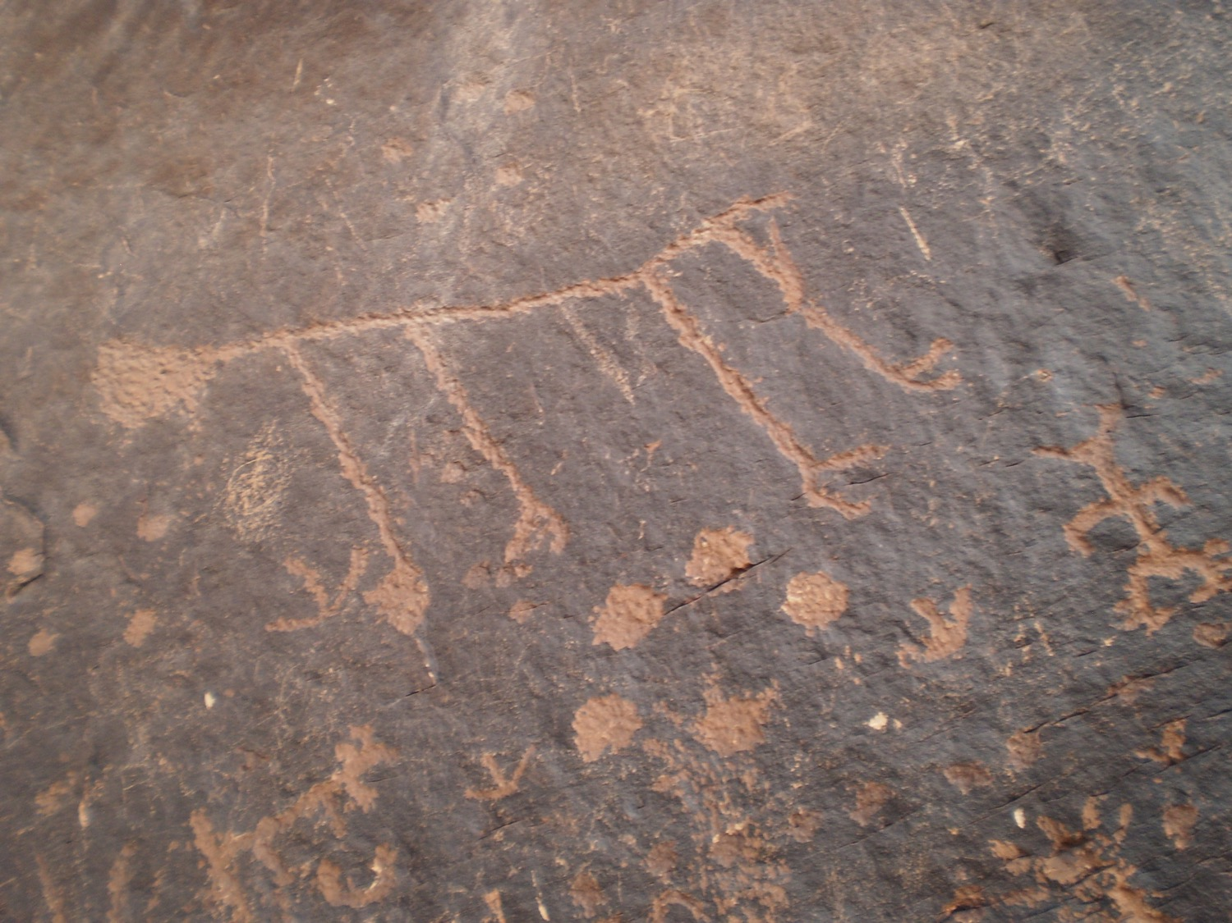
-g
Notes:
Stick-figure giant animal?

Slide 21
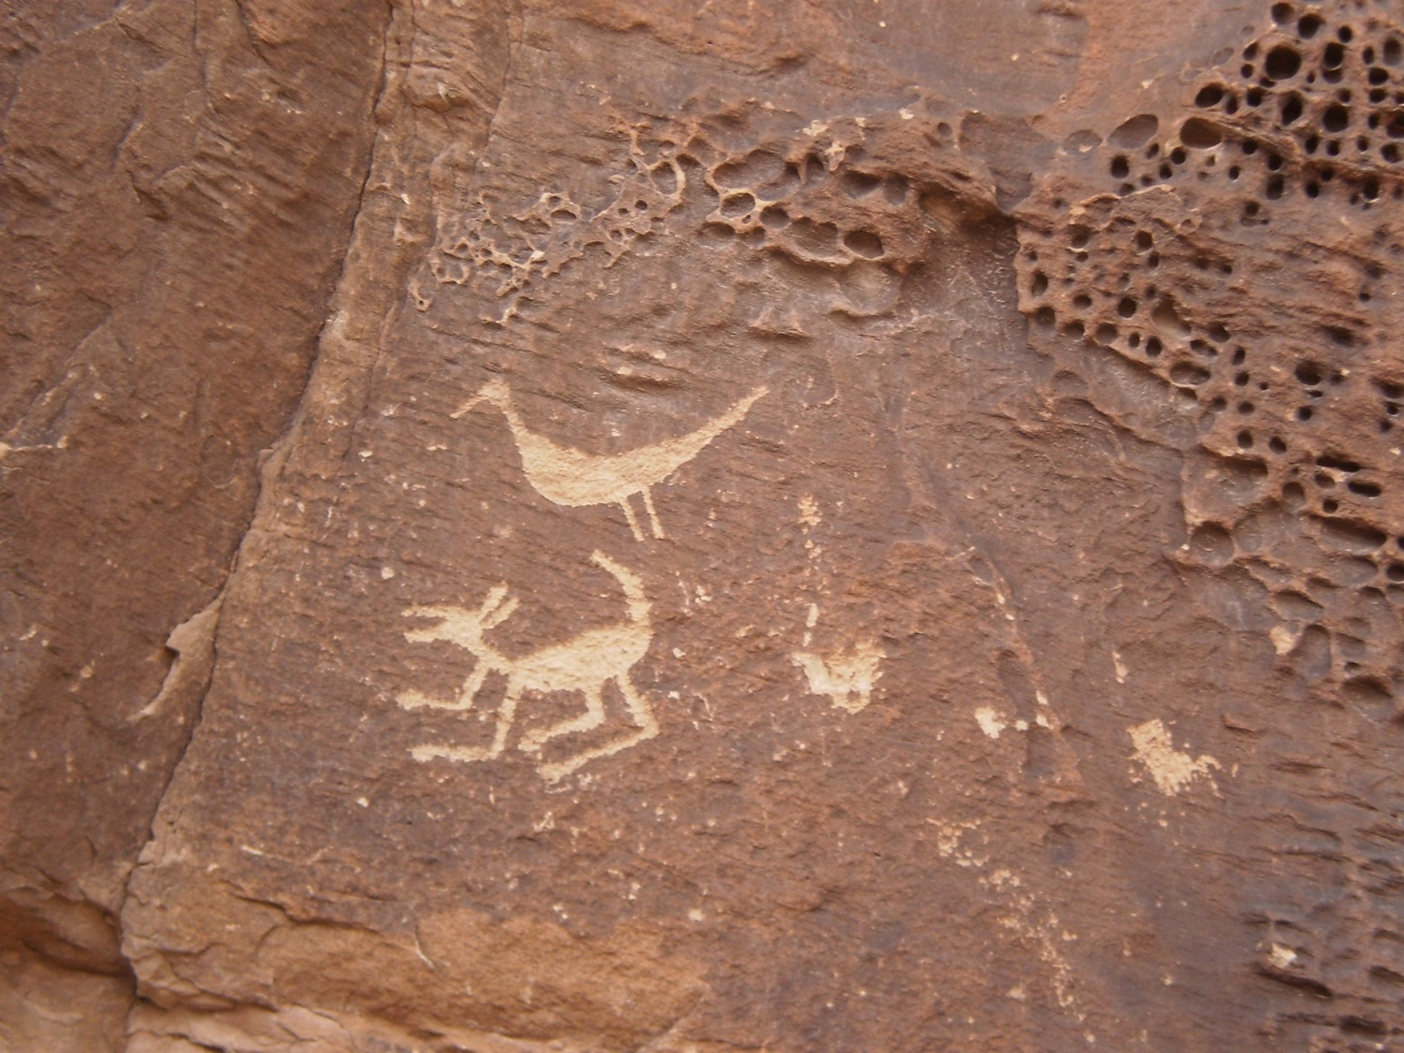
Notes:
Kangaroo and bird?

Slide 22
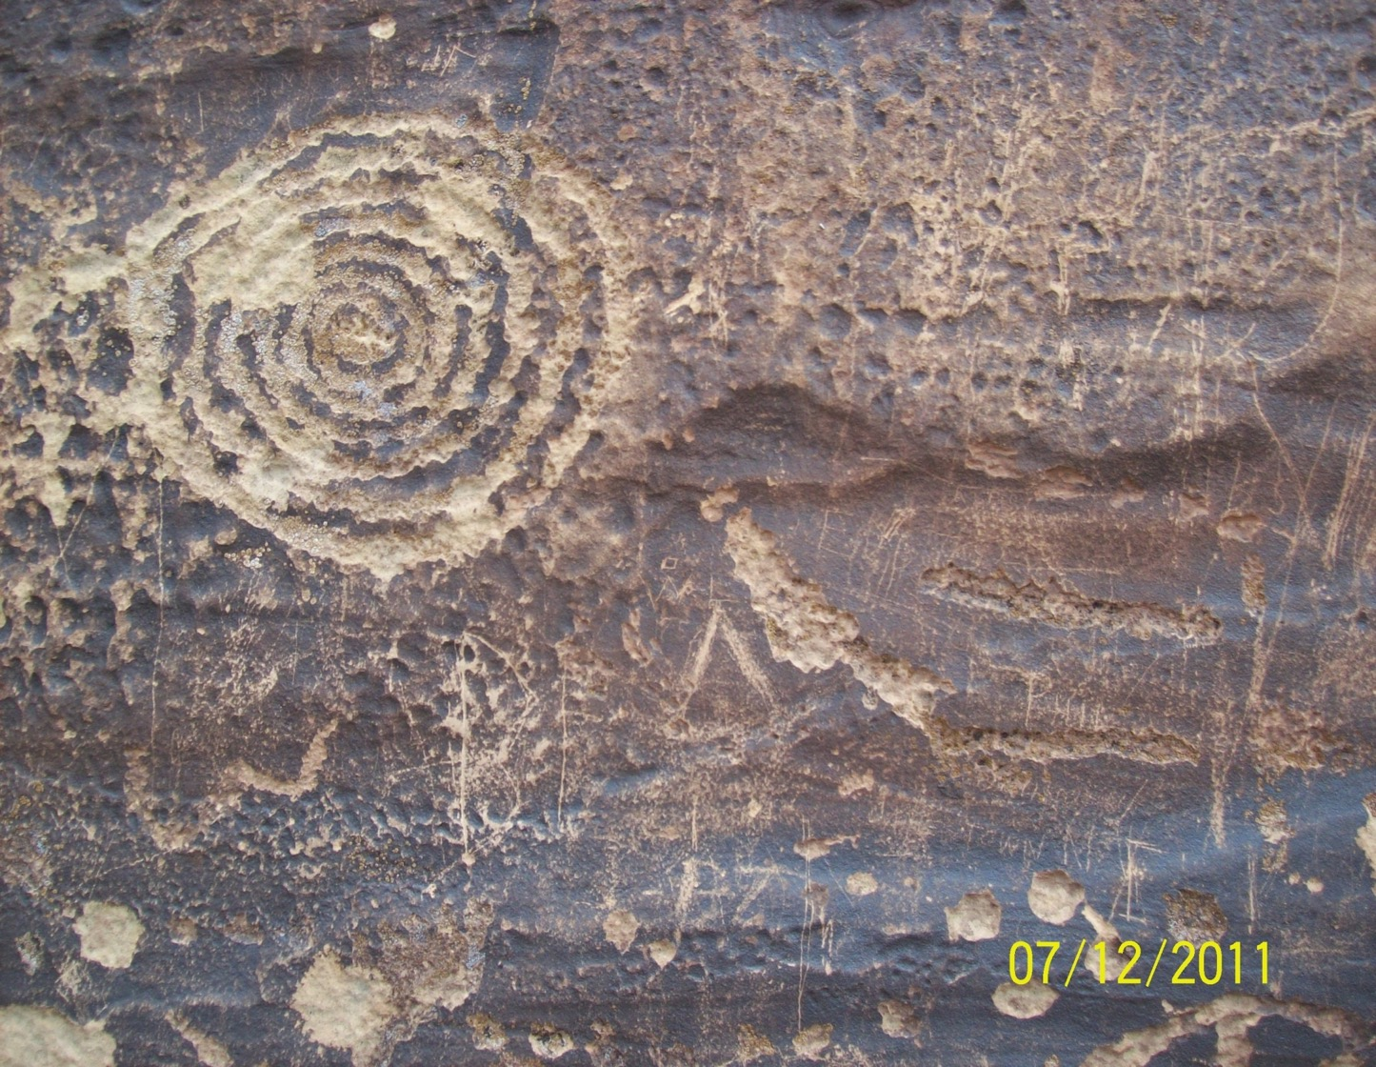
w
Notes:
Great etched swirl with other glyphs

Slide 23
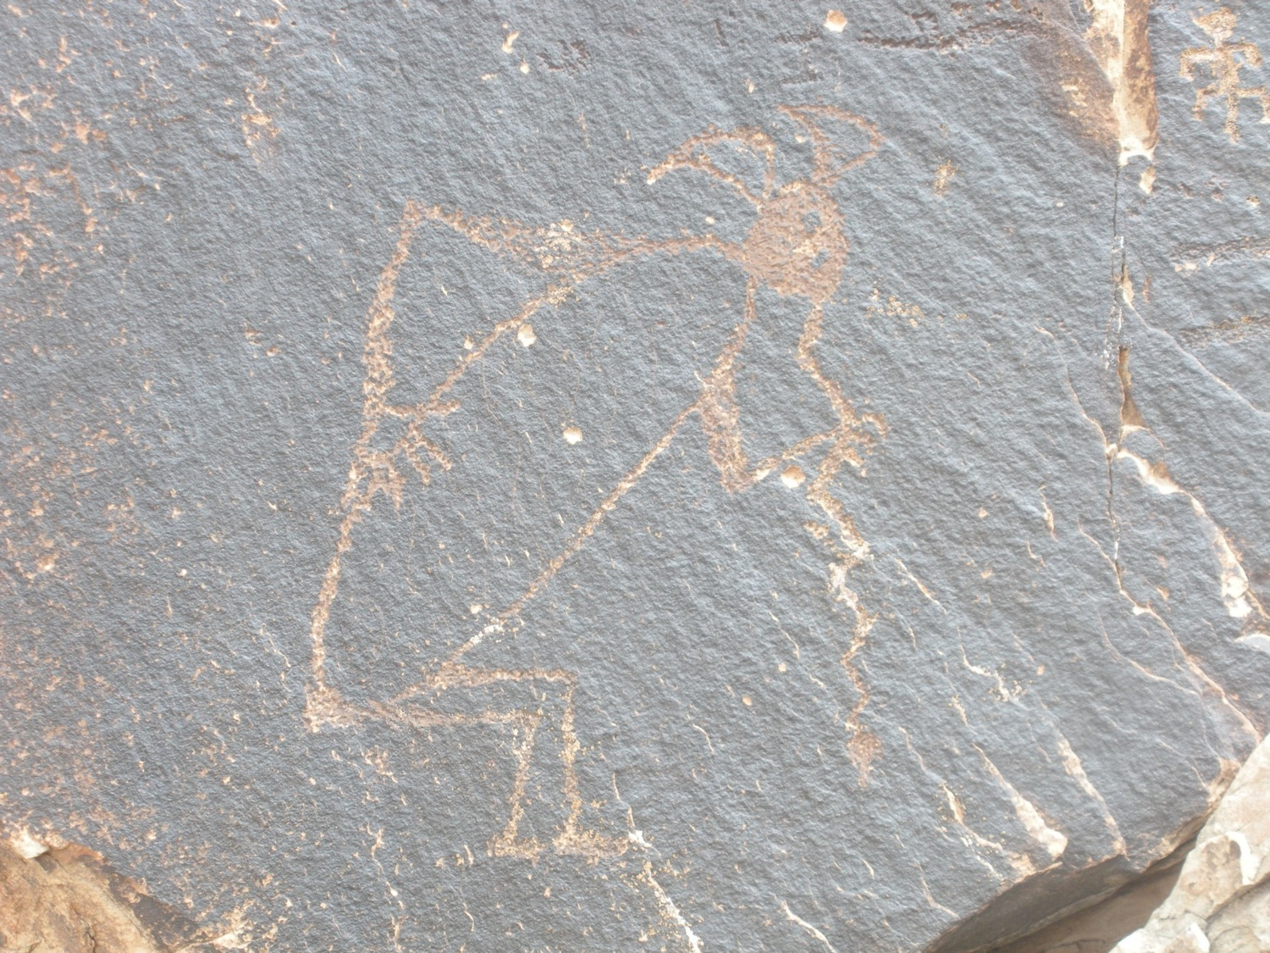
Notes:
Kokopelli

