Slide 1
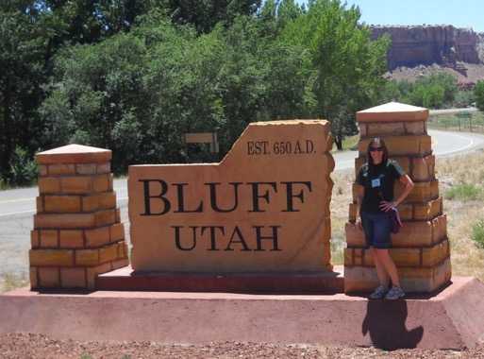
Mormon Pioneers in Arizona
Created by: Dawn Schmidt
Desert Vista High School
**Lesson created from experience in the Four Corners Institute-June 2011

Slide 2
What 2 counties in Arizona have the largest % of LDS?

Slide 3
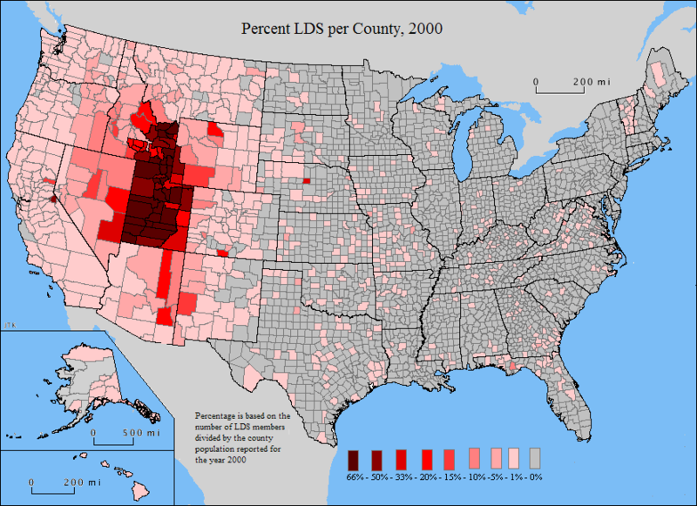

Slide 4
Answer:
Navajo and Graham
Next…Apache and Greenlee
Followed by Coconino, Gila and Maricopa
How is that possible????

Slide 5
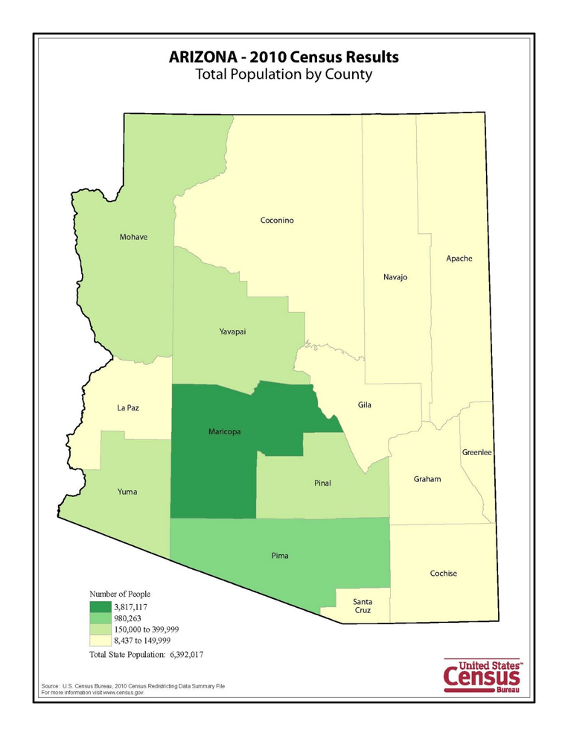

Slide 6
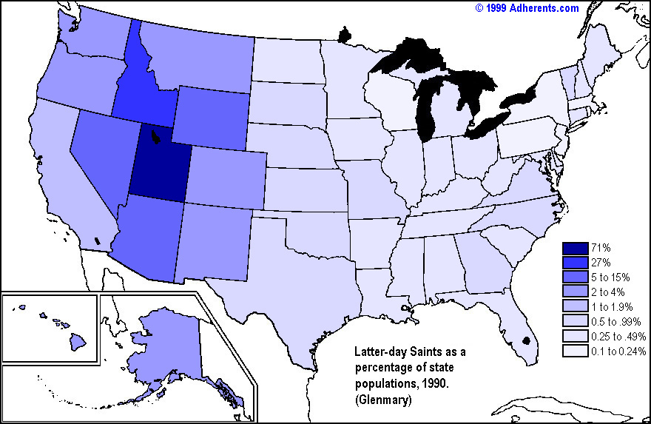
LDS Percentage of State Population Arizona-5.5%

Slide 7
Brief History of Settlement
Saints aka Mormons wanted to settle the area from Salt Lake City to Sonora, Mexico at the request of Brigham Young
Would be referred to as the Deseret Region
Early Mormons began to move into Arizona in the early 1860s as result of exposure to the state through involvement with Mormon Battalion

Slide 8
Characteristics of Mormon Pioneer Settlements
Water Source: Early pioneers were farmers
Streets: Were created wide enough so a wagon could turn around without backing up
Grid Pattern: City planning was established in Salt Lake City, Utah
North-south grid pattern, the center of town is usually at Main and Center with streets extending with avenues and streets labeled 1st, 2nd, etc coupled with the cardinal directions

Slide 9
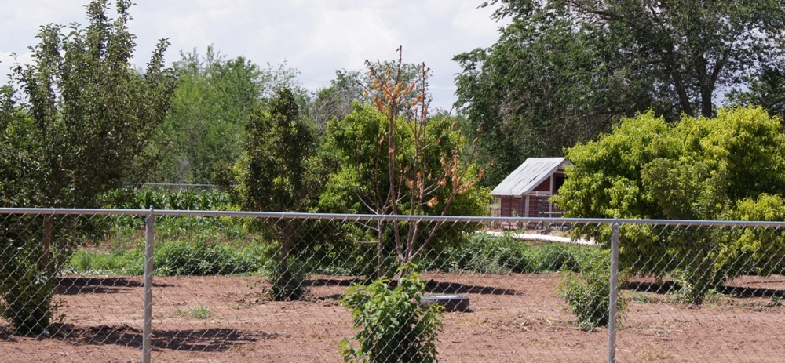
Characteristics-continued
Canals: Water crops sufficiently
Dams or reservoirs were created when necessary
Meeting House: Mormon church
Sustainability: Each house would have a garden plot and fruit trees
Trees: Would usually line the streets or side of town to serve as wind breaks
Fruit trees and garden plot in Woodruff, Arizona

Slide 10
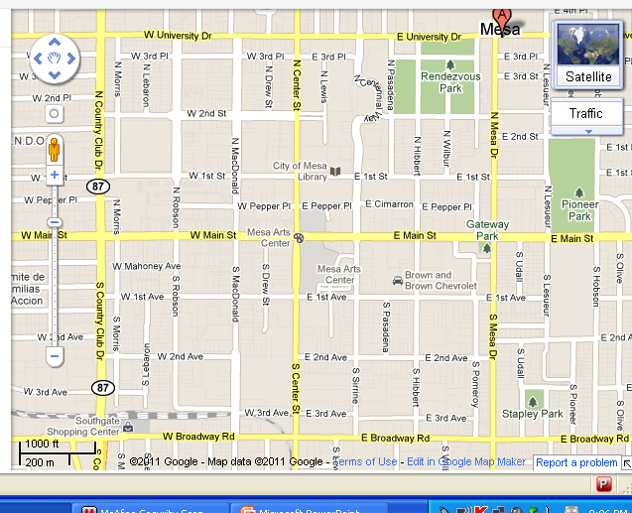
Grid pattern with Main and Center
Does Mesa, Arizona fit this pattern?

Slide 11
Main and Center

Slide 12
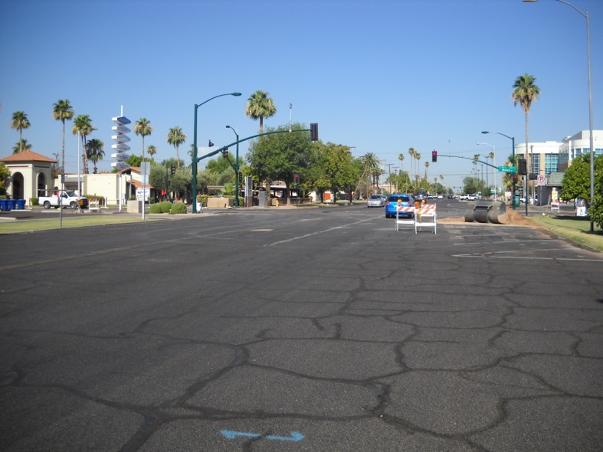
Wide Streets

Slide 13
Water Source

Slide 14
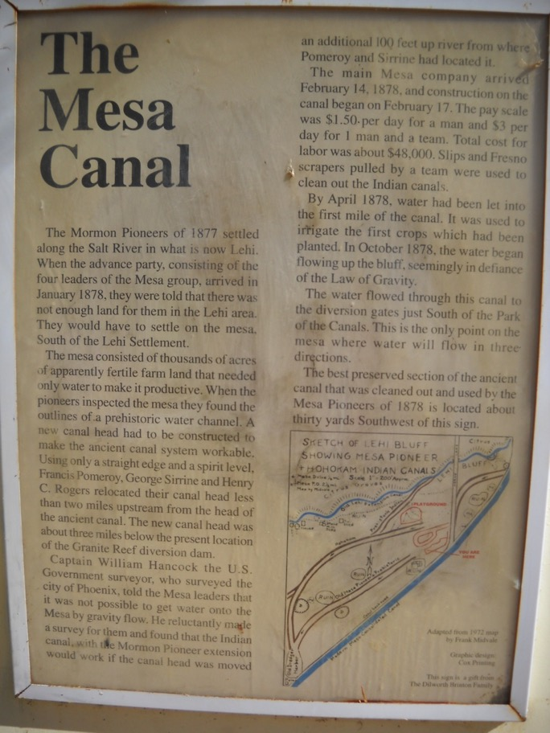
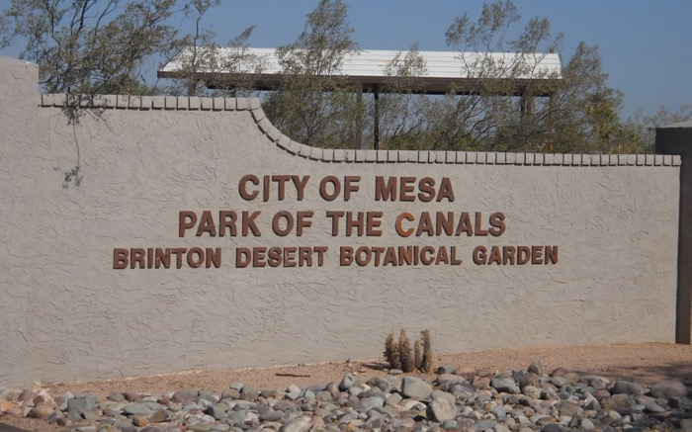
Canal System
Original inhabitants, the Hohokam created the ancient canals and the Mormons discovered and re-used them.
Near the original site of Lehi.

Slide 15
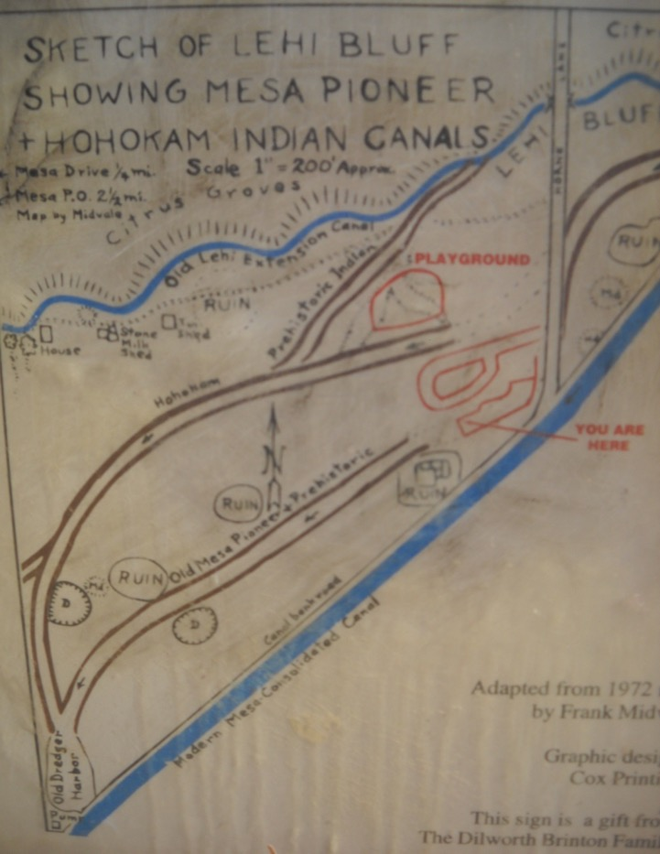
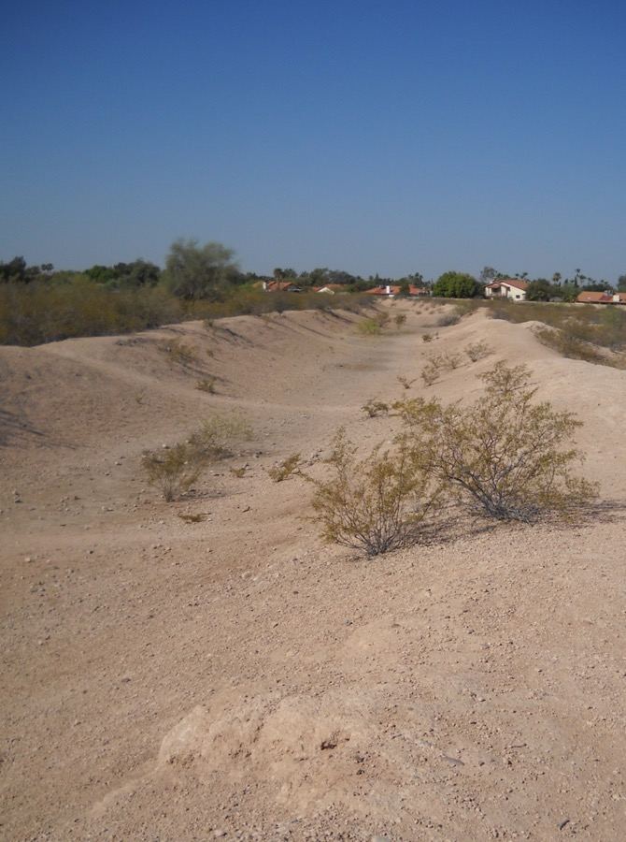
Ancient Canals

Slide 16
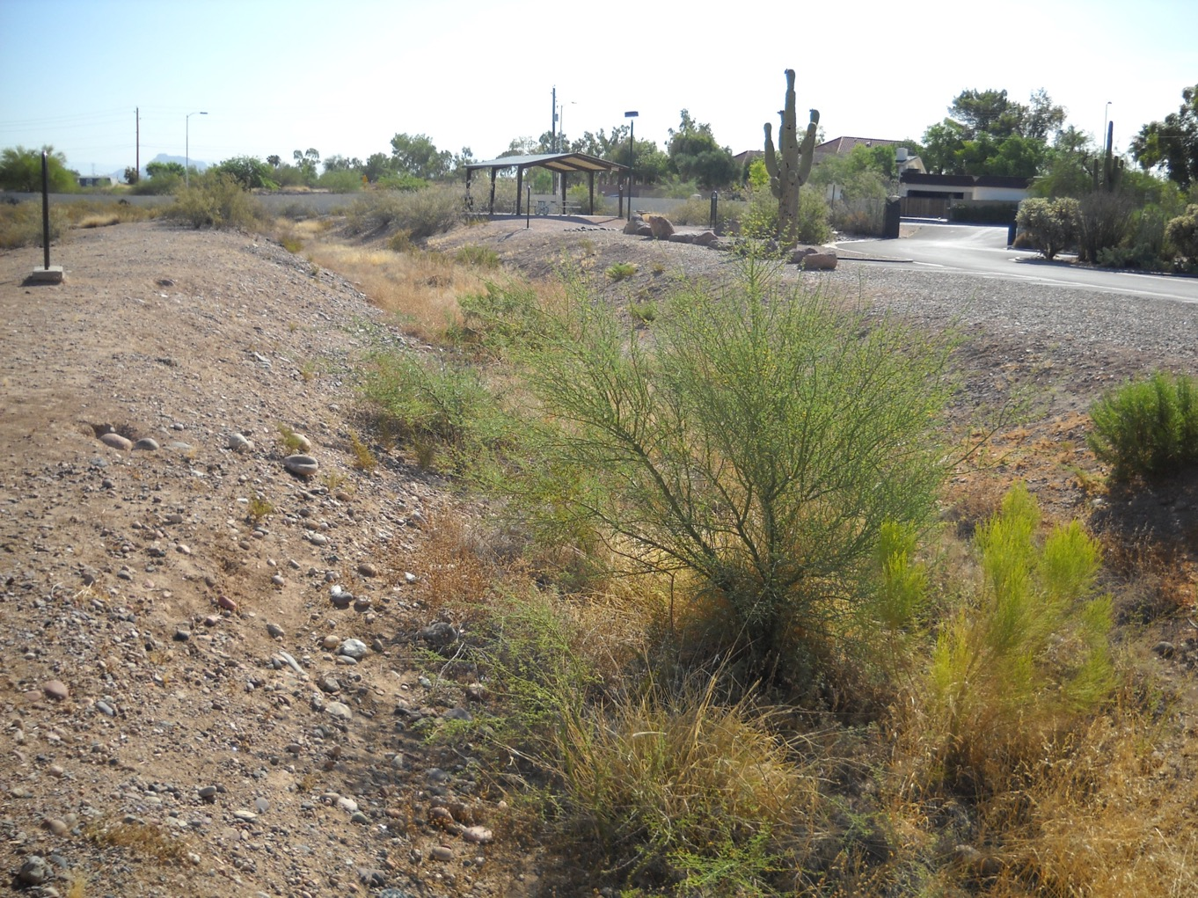

Slide 17
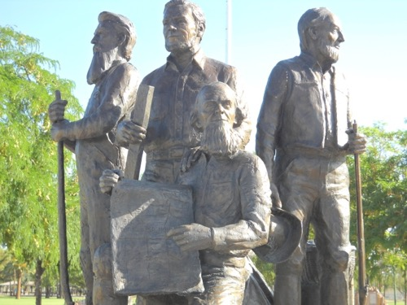
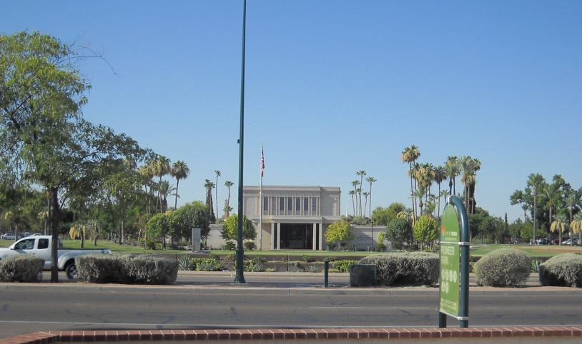
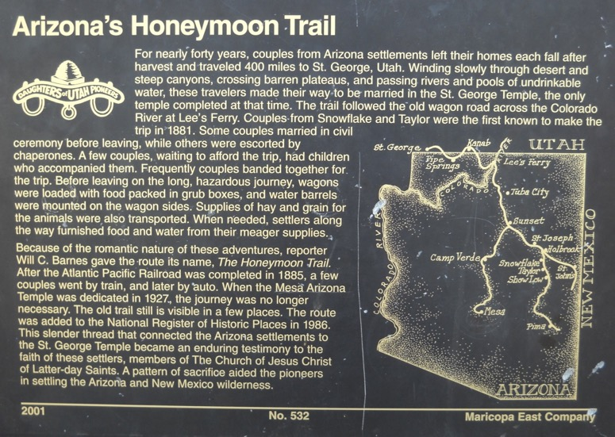
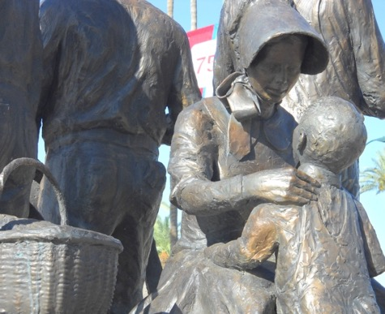
Mesa Temple-Completed 1927

Slide 18
Student Task
Find a partner.
Use ONE AZ Rivers and Topography map per partnership. You will mark on this map.
Examine the 4 maps and choose 4 locations for Mormon pioneer settlements.
Create colorful labels or icons for your locations and create a key for the map.
Write a paragraph justifying your location using at least 3 characteristics of Mormon settlements.
Be sure to 1) include geographic, cultural, or economic reasons for locations; 2) identify the exact locations by latitude and longitude; and 3) any pertinent information that would further explain your choices.
Your partnership will also be graded according to the scoring guide.
Conventions: Spelling, punctuation, and grammar are correctly done. 10 points
Absolute locations (by latitude and Longitude coordinates) are given for the 4 possible settlements. /5 point
Ideas: At least 3 economic, geographical, or cultural characteristics are given for the 4 possible settlements /10 points
TOTAL /25 points

Slide 19
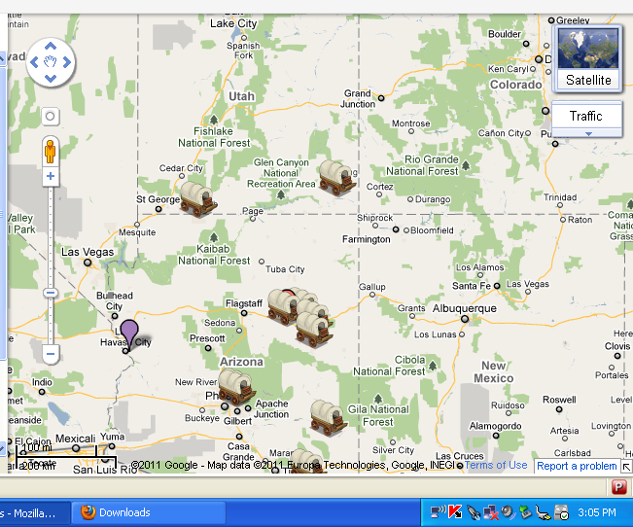
Website Link for Map: http://www.google.com/maps/ms?msid=203928692828628153054.0004a6dfdbbd842eba206&msa=0
*Map created on Google Maps detailing early Mormon pioneer settlements in Arizona and Southern Utah (Bluff).

