Slide 1
Local Resources Holocaust Resources
Arizona Geographic Alliance Website
Arizona & Phoenix Resources
Compiled by Jeannine Kuropatkin 2022

Slide 2
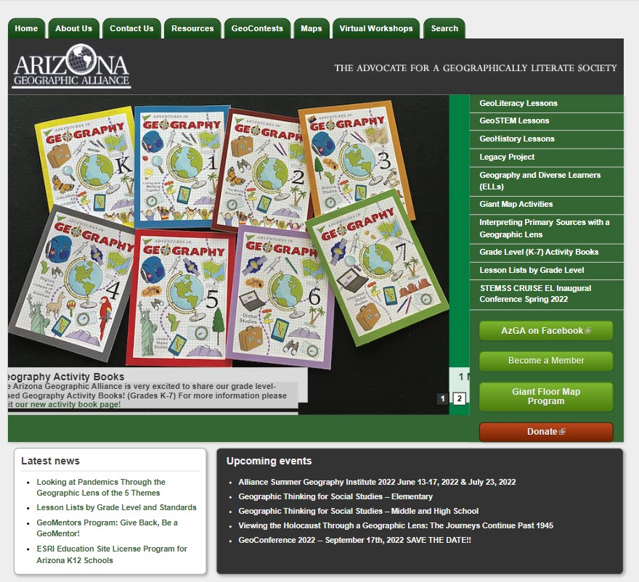
Arizona Geographic Alliance Website
Holocaust Related Lessons
The Voyage of the MS St. Louis: The Refugees No Country Wanted
Where Do We Go Now?
Jewish Population After WWII
Kindertransport: Cultural Comparison
of Urban Areas
The Righteous Gentile: The Story of Irena Sendler and the Holocaust
Jerusalem: A Holy City

Slide 3
Arizona Geographic Alliance Website
Holocaust Related Lessons
Use the SEARCH Tab
If you know the Lesson Title, Key Words, or Author’s Name
<Jewish population>
<Holocaust>
<Kindertransport>
<St Louis>

Slide 4
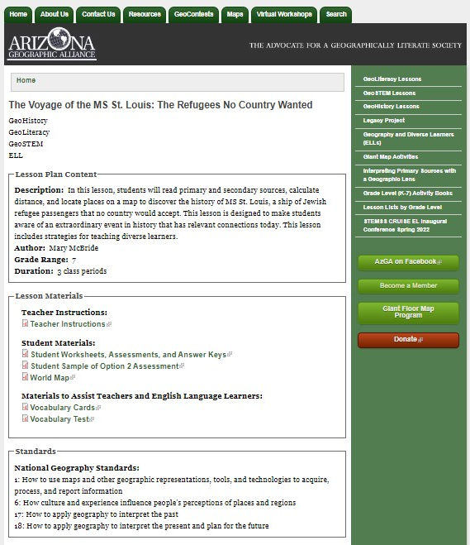
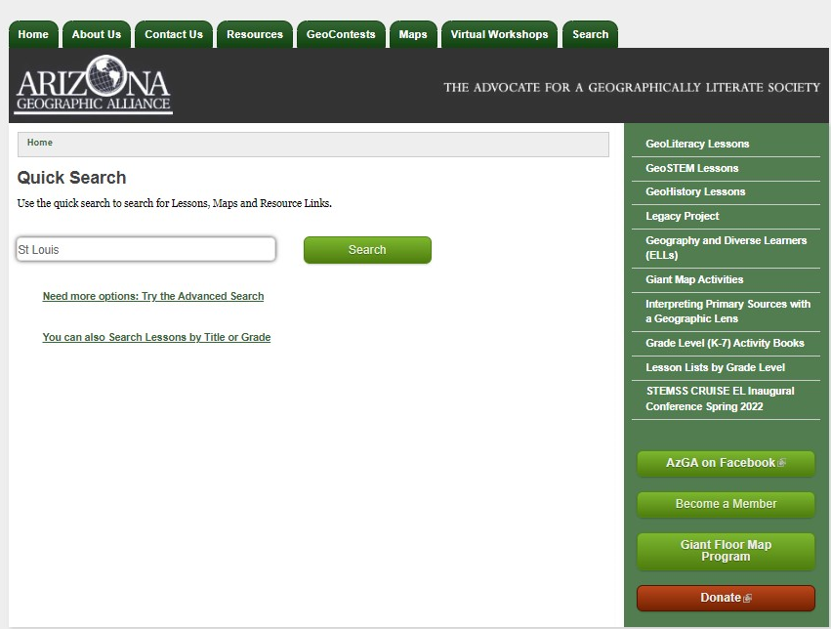
Arizona Geographic Alliance Website
Holocaust Related Lessons
Plugged in St Louis
in the SEARCH Tab

Slide 5
Arizona Geographic Alliance Website
Lesson Format
Overview of Type of Geo Lesson
Lesson Plan Content:
Description | Author
Grade Range | Duration
Lesson Materials:
Teacher Instructions
Student Materials
ELL Materials
National Geography Standards

Slide 6
Phoenix Holocaust Association https://phxha.com/

Slide 7
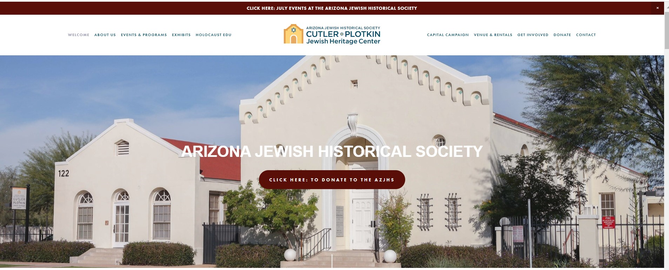
Arizona Jewish Historical Society https://www.azjhs.org/

Slide 8
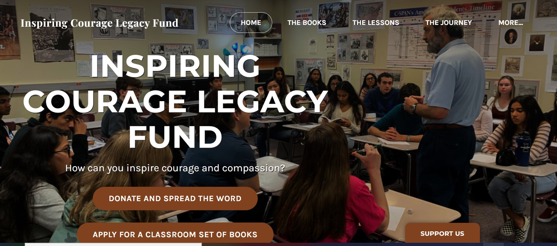
Inspiring Courage Legacy Fund https://www.inspirecourage.org/

