Slide 1
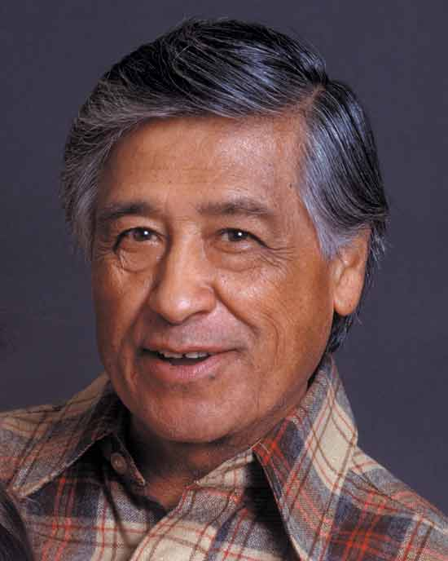
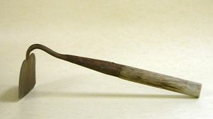
Cesar Chavez: An American Hero
amhistory.si.edu
clubs.palomar.edu

Slide 2
Workers Using Short Handled Hoe
http://www.dailykos.com/story/2010/09/26/905301/-How-regulation-came-to-be-El-Cortito-the-short-hoe

Slide 3
Cesar Chavez Holding a Short Handled Hoe
www.latinamericanstudies.org

Slide 4
Protesting by Marching
chavez.cde.ca.gov

Slide 5
Protesting by Marching
csyndicjournal.us

Slide 6
Protesting by Marching
cinemaguild.com

Slide 7
Boycott Grapes
http://www.britannica.com

Slide 8
Migrant Workers
www.lovingjustwise.com

Slide 9
Families of the Migrant Workers Travel Too
www.wisconsinhistory.org

Slide 10
Civil Rights
www.menendez.senate.gov

Slide 11
Civil Rights
emu.edu

