Slide 1
Tales from the Crypt:
Learning about Geography and History from the Local Cemetery
Gale Olp Ekiss
Arizona Geographic Alliance

Slide 2
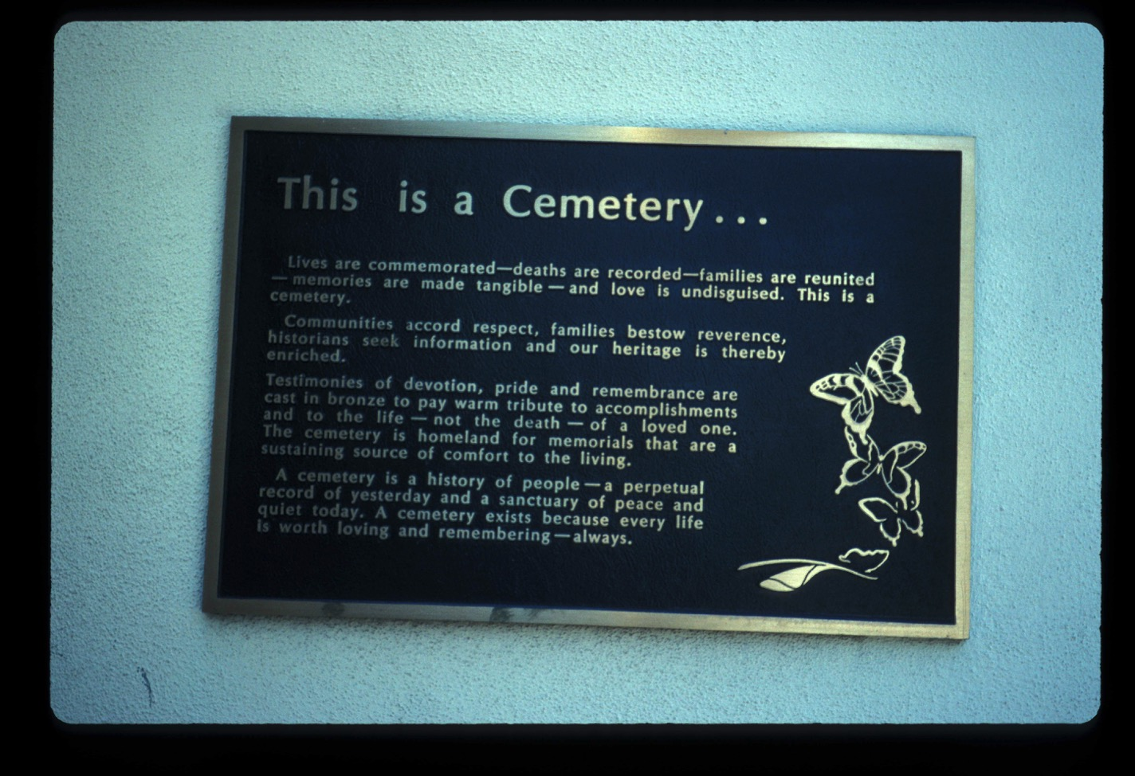

Slide 3
This is a cemetery.
Lives are commemorated—deaths recorded—families are reunited—memories are made tangible—and love is undisguised.
Communities accord respect, families bestow reverence, historians seek information, and our heritage is enriched.
Testimonies of devotion, pride, and remembrance are cast in bronze to pay warm tribute to accomplishments and to the life—not the death—of a loved one.
The cemetery is homeland for memorials that are a sustaining source of comfort to the living.
A cemetery is a history of people—a perpetual record of yesterday and a sanctuary of peace and quiet today. A cemetery exists because every life is worth loving and remembering—always.

Slide 4
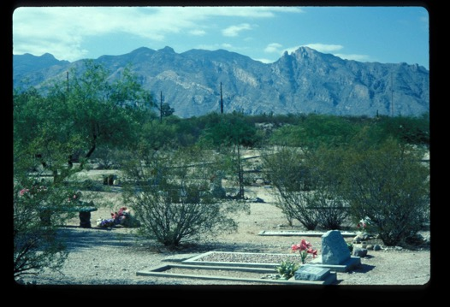
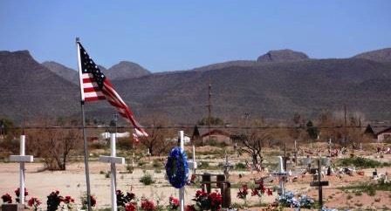
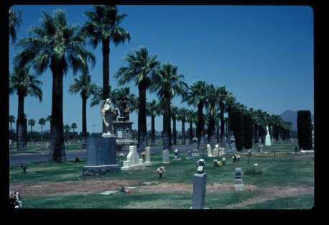
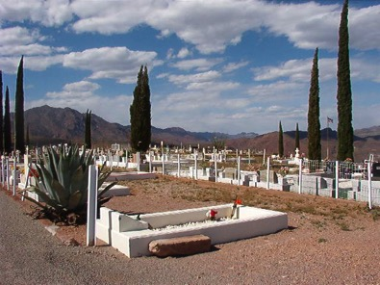
Tales from the Crypt - Kinds
Binghampton--Tucson
Gila River
Holy Hope--Tucson
Morenci

Slide 5
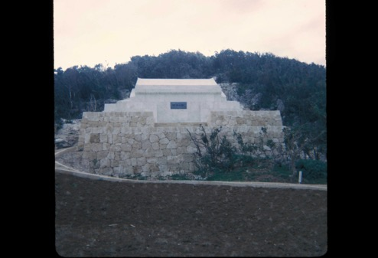
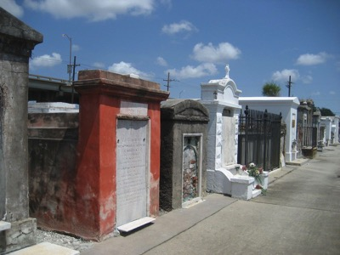
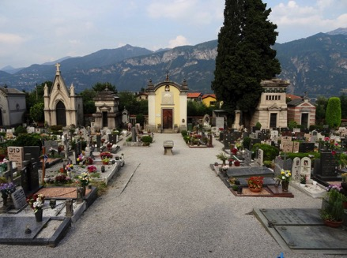
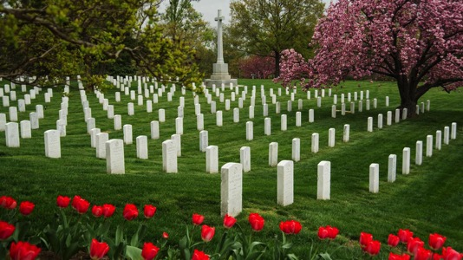
Tales from the Crypt - Kinds
Okinawa
New Orleans
Arlington
Europe

Slide 6
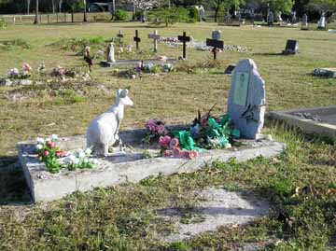
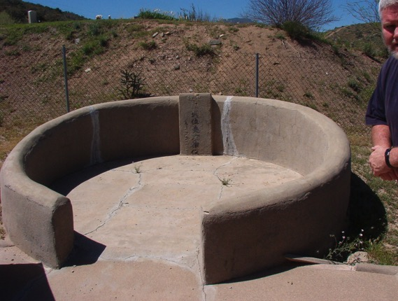
Tales from the Crypt - Kinds
Australia
Chinese

Slide 7
Tales from the Crypt
How are cemeteries private spaces?
How are cemeteries public spaces?

Slide 8
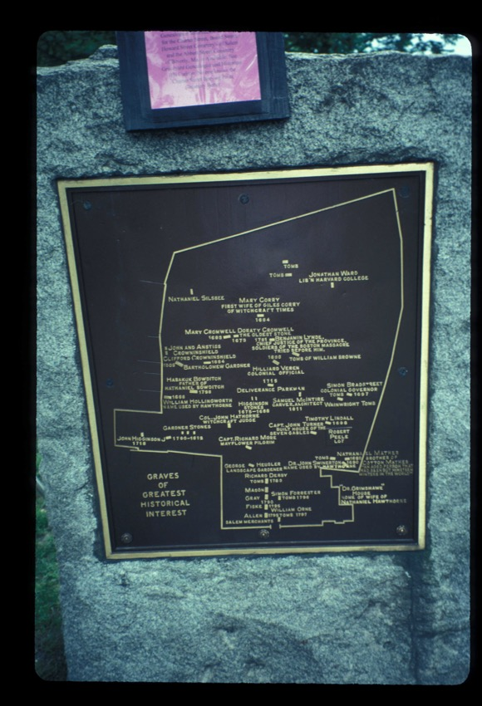
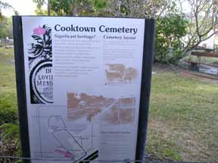
Tales from the Crypt - Maps

Slide 9
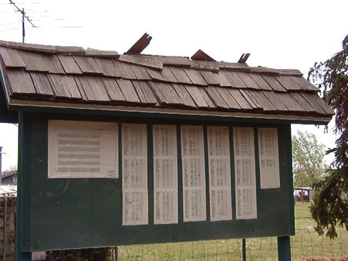
Tales from the Crypt - Maps
Taylor, AZ
Mesa, AZ

Slide 10
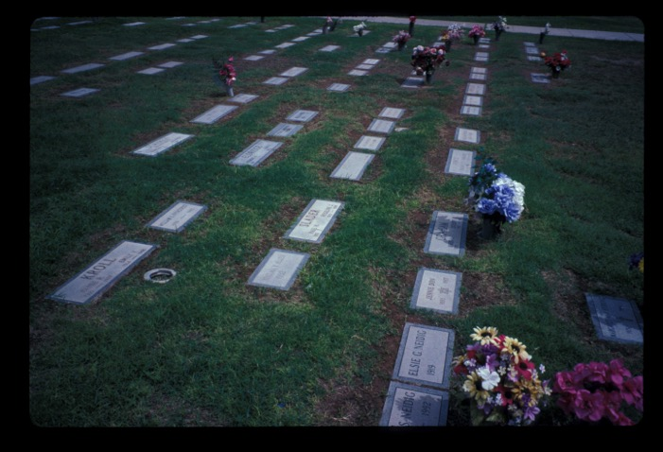
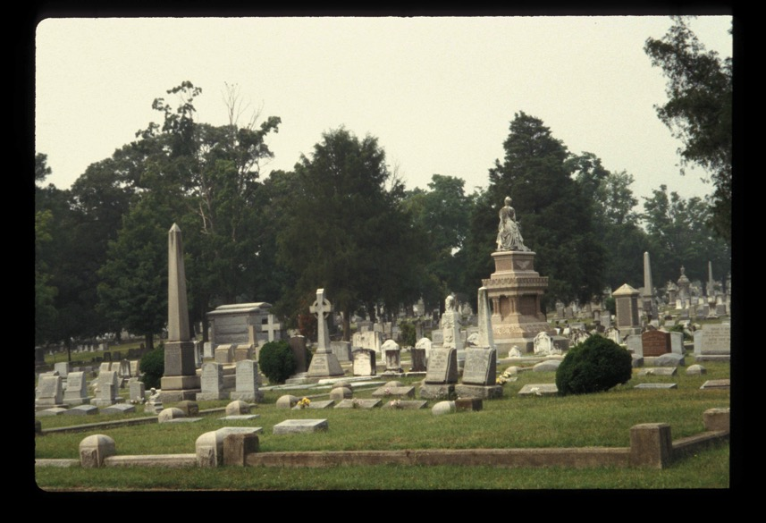
Tales from the Crypt - Landscape
Old or New?

Slide 11
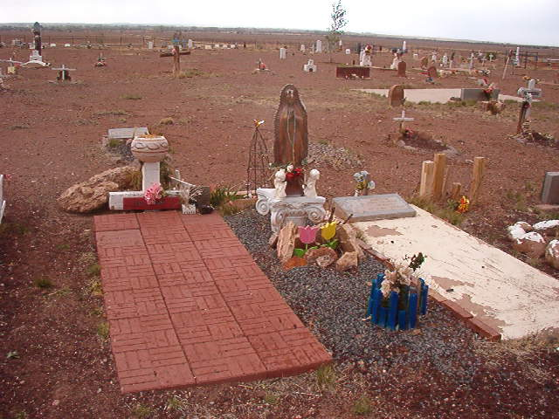
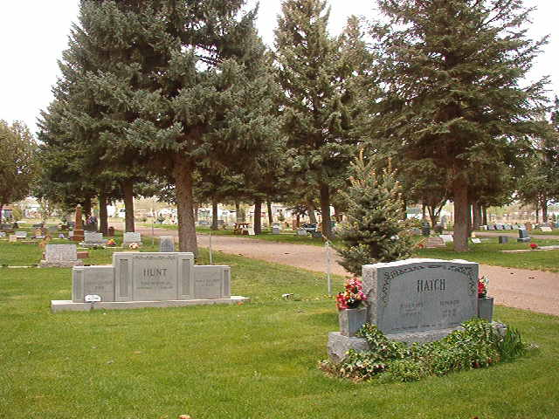
Tales from the Crypt - Landscape
Grass/Trees/Shrubs or Natural?

Slide 12
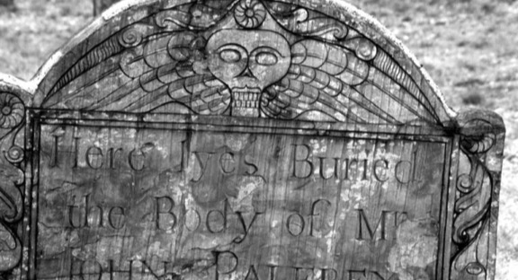
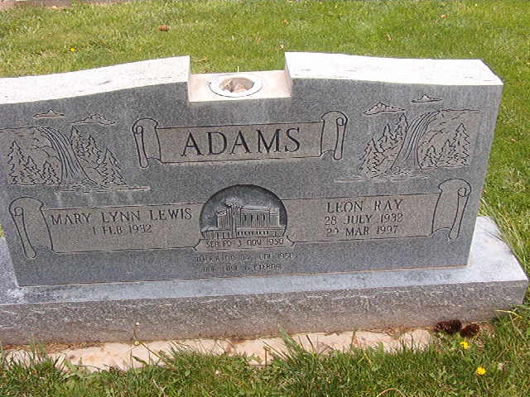
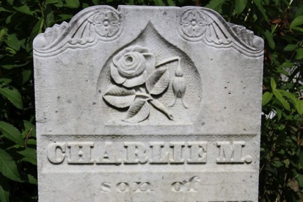
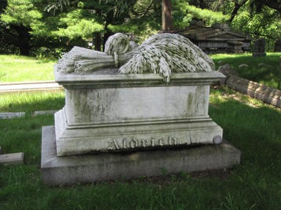
Tales from the Crypt - Symbols
Finality of Death
Religious Symbols
Life Taken Too Soon
Long And Eventful Life

Slide 13
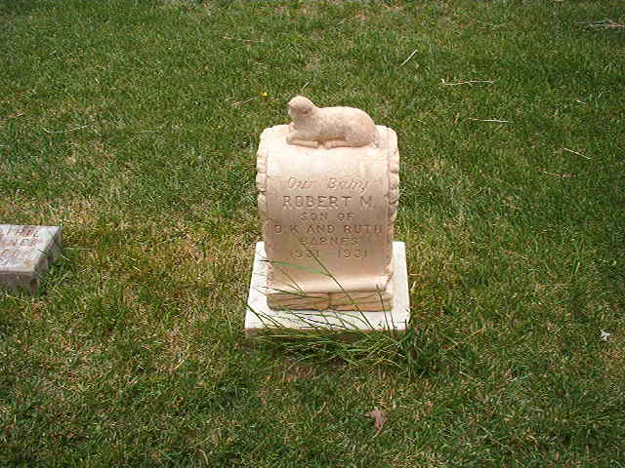
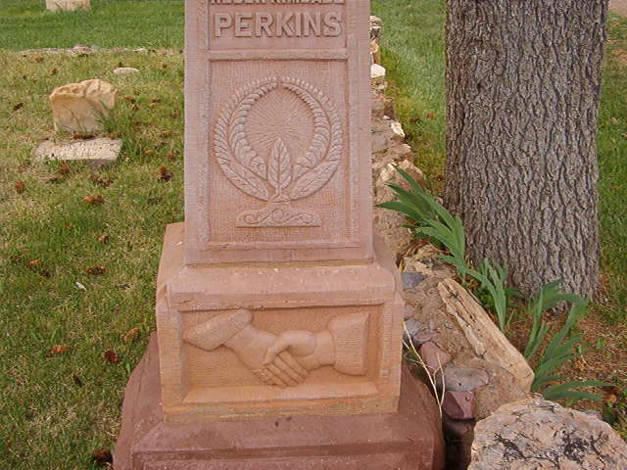
Tales from the Crypt - Symbols
Innocence and Purity
Farewell and Friendship

Slide 14
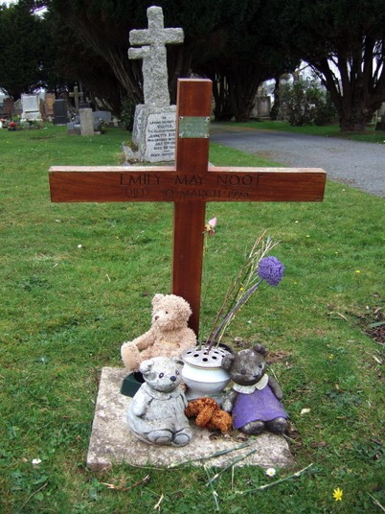
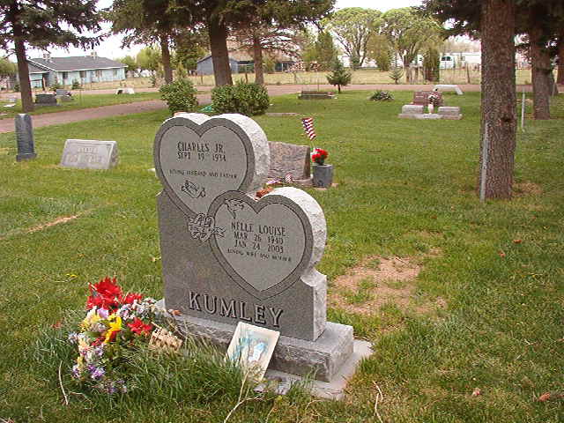
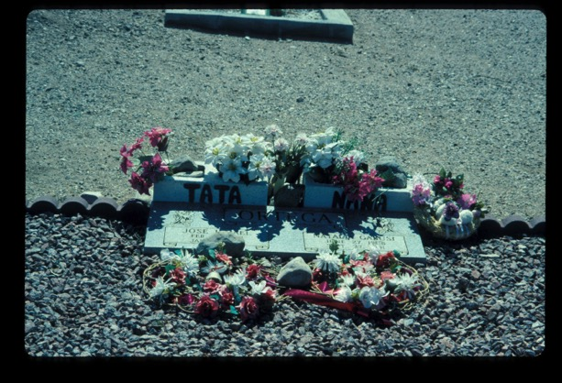
Tales from the Crypt - Symbols
Love

Slide 15
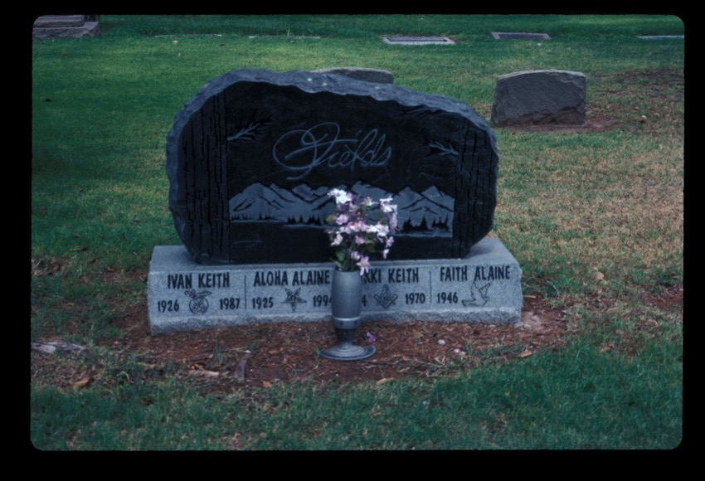
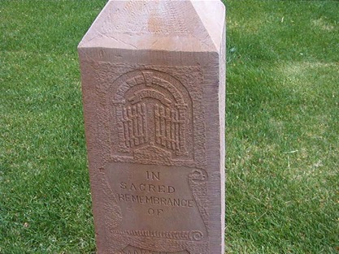
Tales from the Crypt - Symbols
Open Gates to Heaven
What Organizations Are Represented On This Stone?

Slide 16
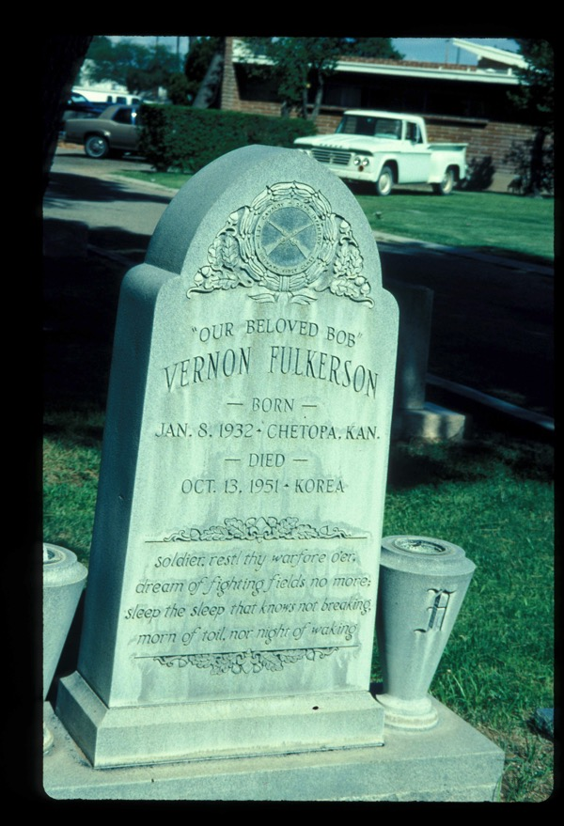
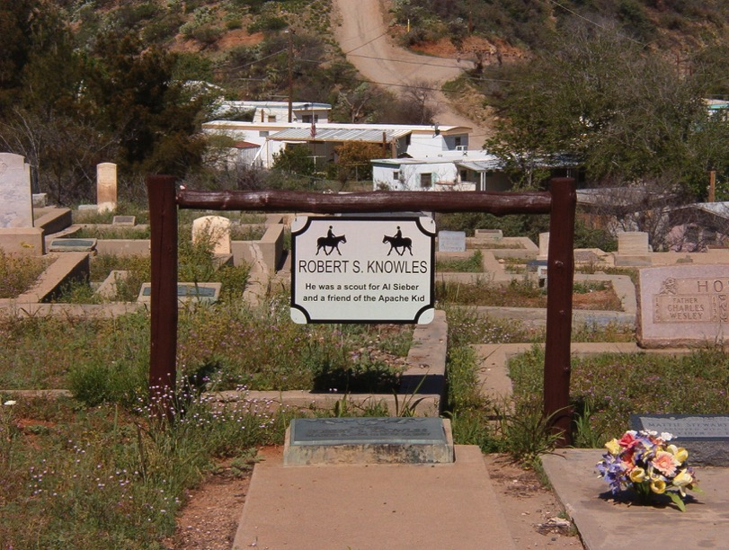
Tales from the Crypt - Symbols
Biographical

Slide 17
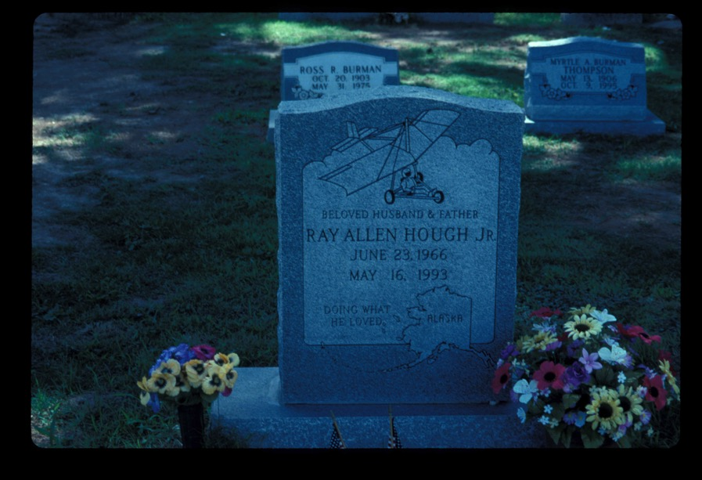
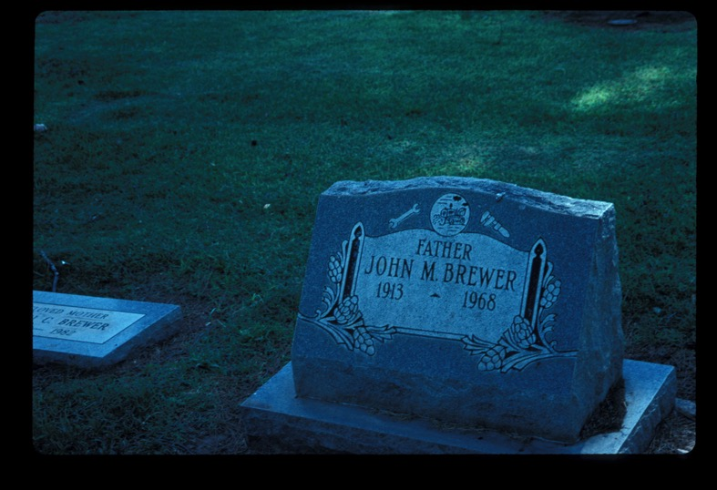
Tales from the Crypt - Symbols
What Do The Symbols Signify?
Biographical

Slide 18
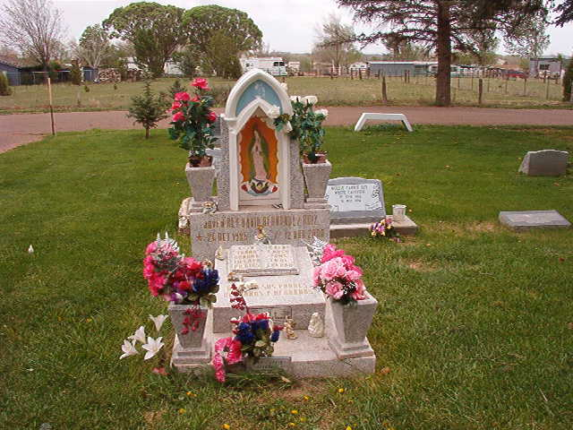
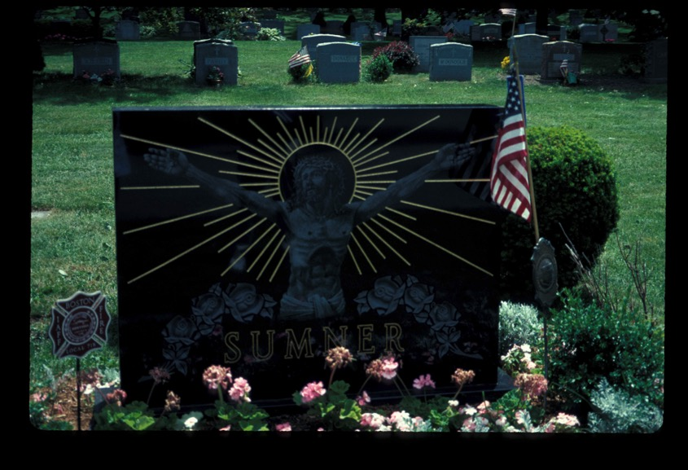
Tales from the Crypt - Symbols
What Religions are Represented?

Slide 19
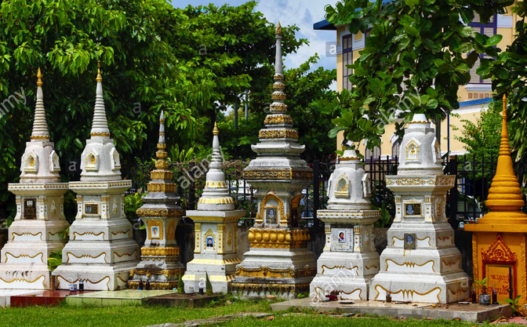
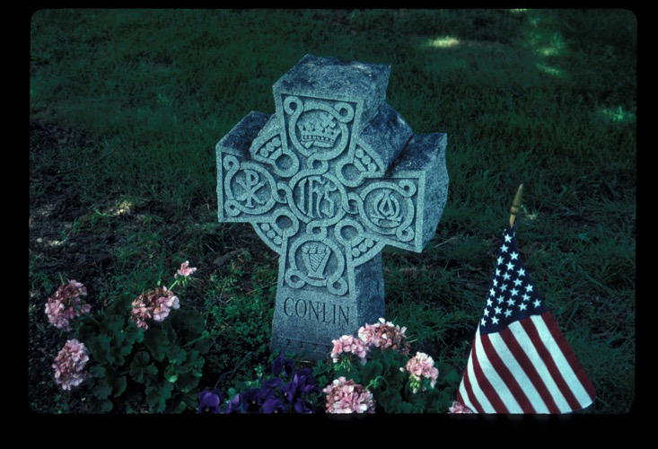
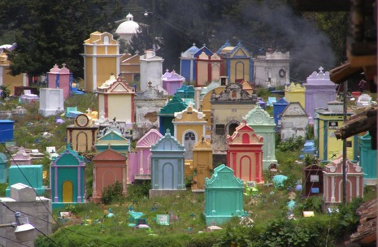
Tales from the Crypt - Symbols
What Religions/Parts of the World are Represented?

Slide 20
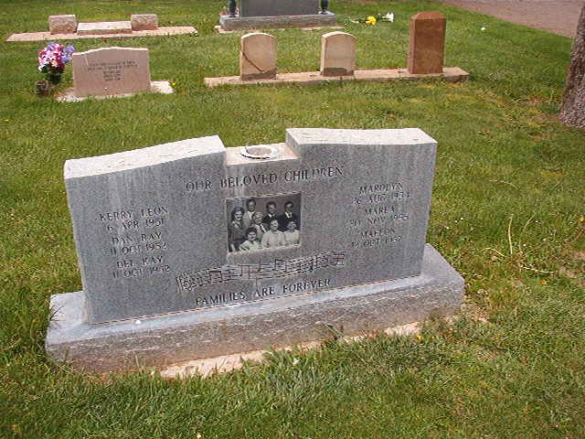
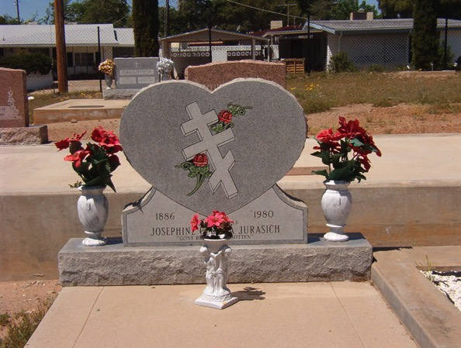
Tales from the Crypt - Symbols
What Religions are Represented?

Slide 21
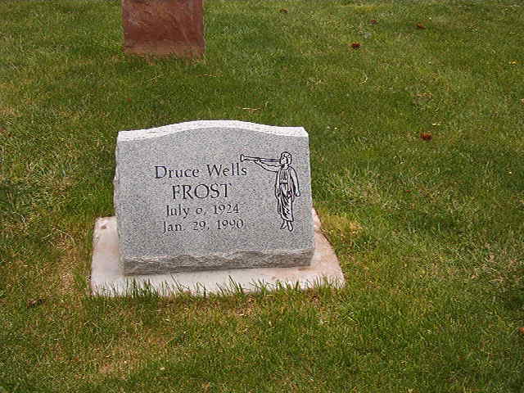
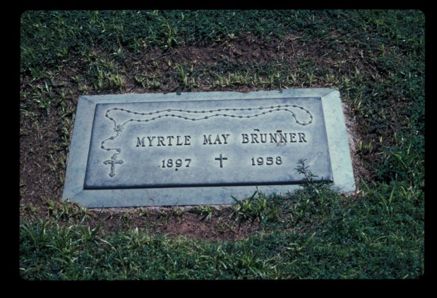
Tales from the Crypt - Symbols
What Religions are Represented?

Slide 22
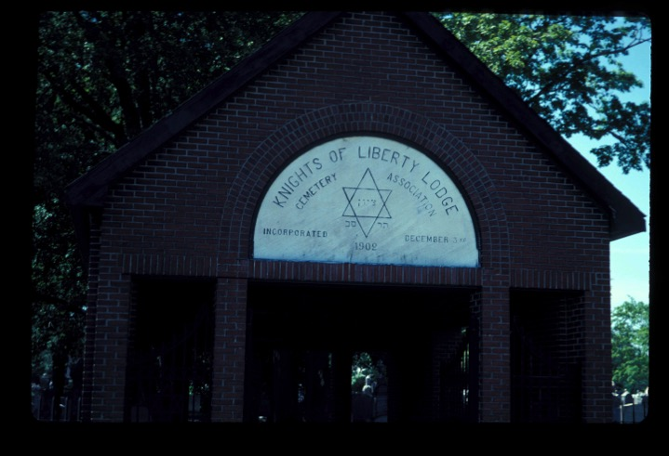
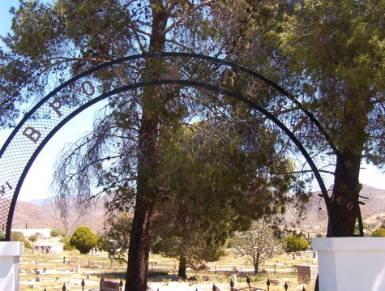
Tales from the Crypt - Regions
What Organizations Have Created These Regions?

Slide 23
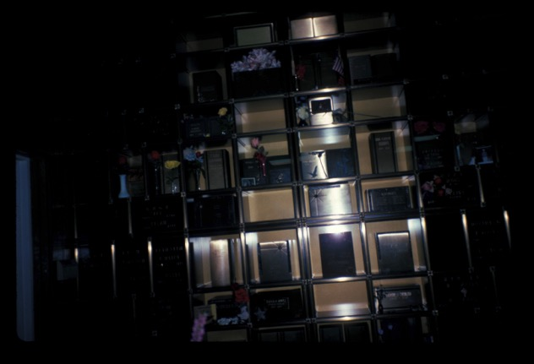
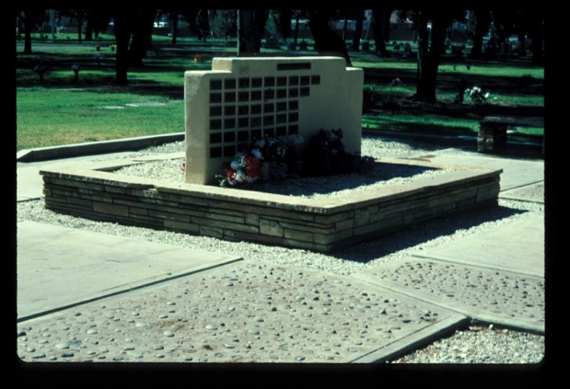
Tales from the Crypt - Regions
New Regions

Slide 24
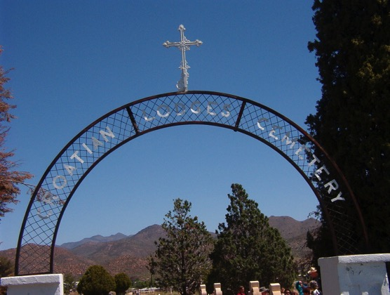
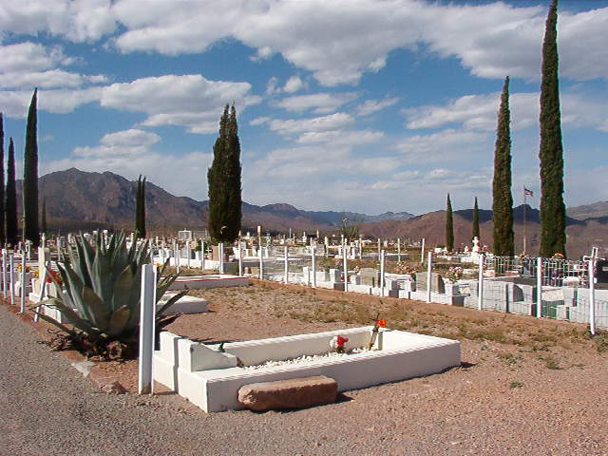
Tales from the Crypt - Regions
Cyprus Trees and Open Gates

Slide 25
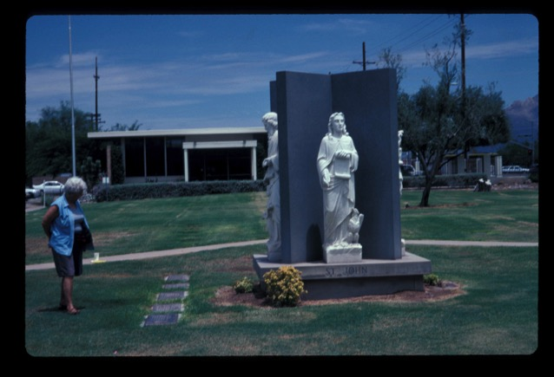
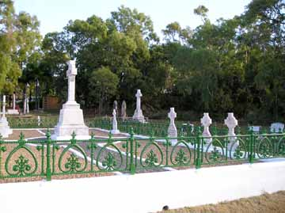
Tales from the Crypt - Regions
Guess What Groups Of People Are Buried In These Regions?

Slide 26

Tales from the Crypt - Regions
Guess What Group Of People Is Buried In This Region?

Slide 27

Tales from the Crypt - Regions
Guess What Group Of People Is Buried In This Region?

Slide 28




Tales from the Crypt - Regions

Slide 29

Tales from the Crypt - Epitaphs

Slide 30

Tales from the Crypt - Epitaphs

Slide 31

Tales from the Crypt - Epitaphs

Slide 32

Tales from the Crypt - Epitaphs

Slide 33

Tales from the Crypt - Epitaphs

Slide 34

Tales from the Crypt - Epitaphs

Slide 35

Tales from the Crypt - Epitaphs

Slide 36

Tales from the Crypt - Epitaphs

Slide 37

Tales from the Crypt - Countries of Origin

Slide 38

Tales from the Crypt - Countries of Origin

Slide 39

Tales from the Crypt - Countries of Origin

Slide 40

Tales from the Crypt - Countries of Origin

Slide 41


Tales from the Crypt - Countries of Origin

Slide 42


Tales from the Crypt - Personalizing

Slide 43


Tales from the Crypt - Personalizing

Slide 44


Tales from the Crypt - Personalizing

Slide 45


Tales from the Crypt - Shapes and Textures

Slide 46




Tales from the Crypt - Shapes and Textures

Slide 47


Tales from the Crypt - Shapes and Textures

Slide 48


Tales from the Crypt - Shapes and Textures
Rich and Poor

Slide 49


Tales from the Crypt - Shapes and Textures
Rich and Poor

Slide 50
Photo Credits
All images were taken by Gale Ekiss except for:
Gila River https://images.findagrave.com
New Orleans https://cdn.vox-cdn.com/thumbor
Arlington https://media.npr.org/assets/img/2012/10/22/arlington_wide
European Cemetery https://c1.staticflickr.com/
Mesa Cemetery map http://www.mesaaz.gov
Finality of Death, Life Taken Too Soon, Long and Eventful Life
http://boredomtherapy.com/secret-cemetery-symbols/
Buddhist graves http://c8.alamy.com/comp
South American graveyard https://i.pinimg.com/
Veteran Cemetery http://cdn.abclocal.go.com

