Slide 1
Urquhart Castle:
Learning about a Castle and Its Workers

Slide 2
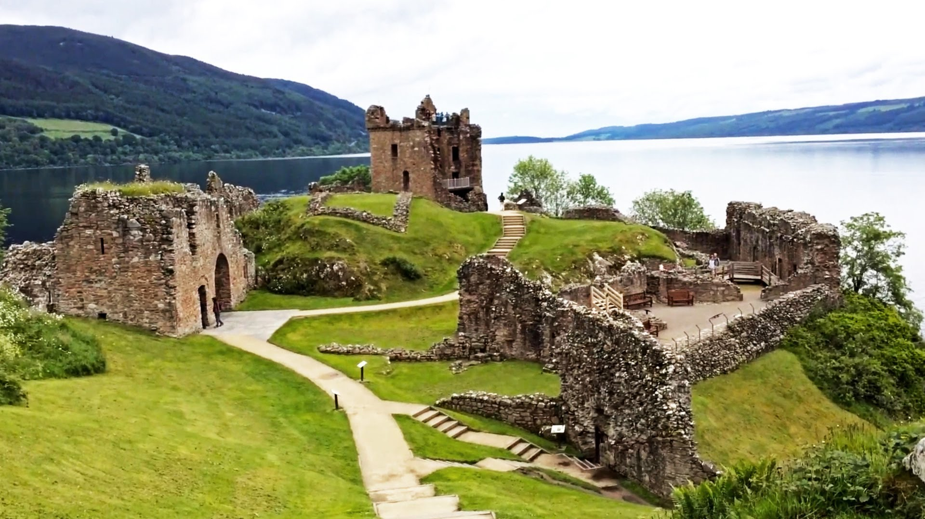
Urquhart Castle
loch ben glen
https://www.youtube.com/watch?v=pAQ3cWtkL6w

Slide 3
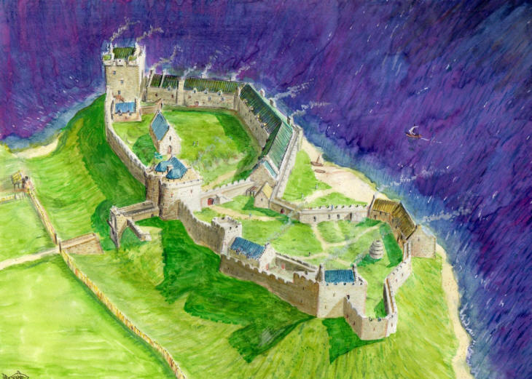
Urquhart Castle
https://s-media-cache-ak0.pinimg.com/originals/47/53/2a/47532a9461a559acb2f1721a79c5431b.jpg
loch ben glen

Slide 4
Urquhart Castle

Slide 5
Roles of Workers

Slide 6
Roles of Workers

Slide 7
Roles of Workers
Rules of the Game
No words.
Use only gestures.
Time limit is one minute to guess the correct role.
If the team doesn’t get the right answer in one minute, the other team can collaborate and make one guess.
Points will be given for right answers.

Slide 8
Urquhart Castle

