Slide 1
How to Make the Foldable
By
Alexis Dopudja

Slide 2
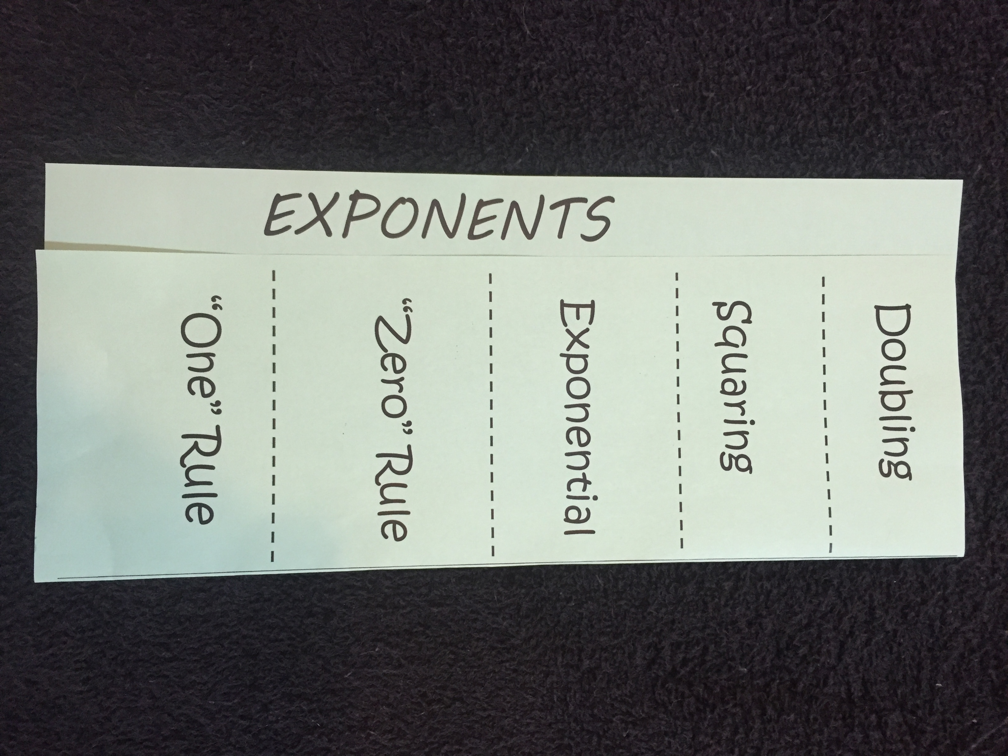
FOLDABLE
Fold on the “y-axis”
Leave about 1 inch on left side and label “EXPONENTS”
Divide right side into 5 sections using dotted lines
Label each section

Slide 3
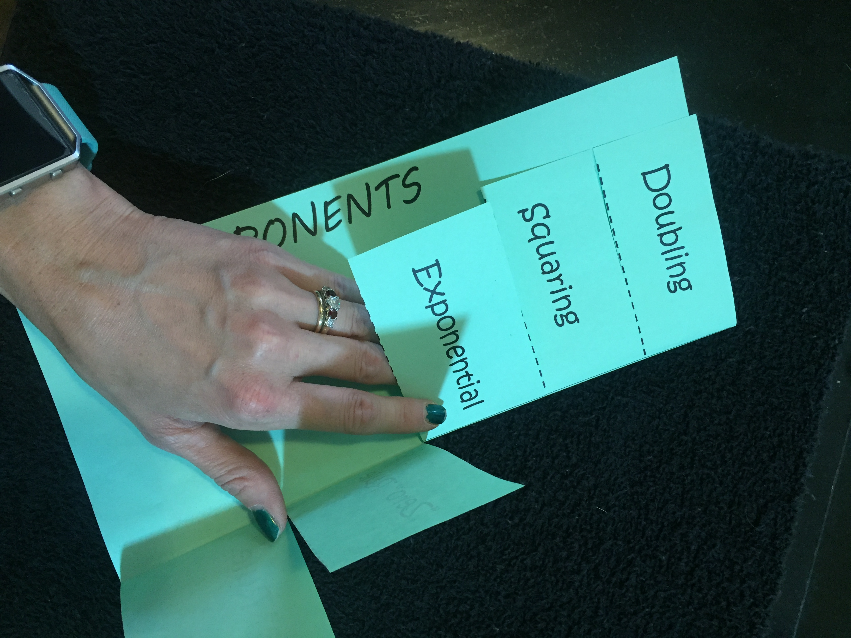
FOLDABLE
Cut on dotted lines

Slide 4
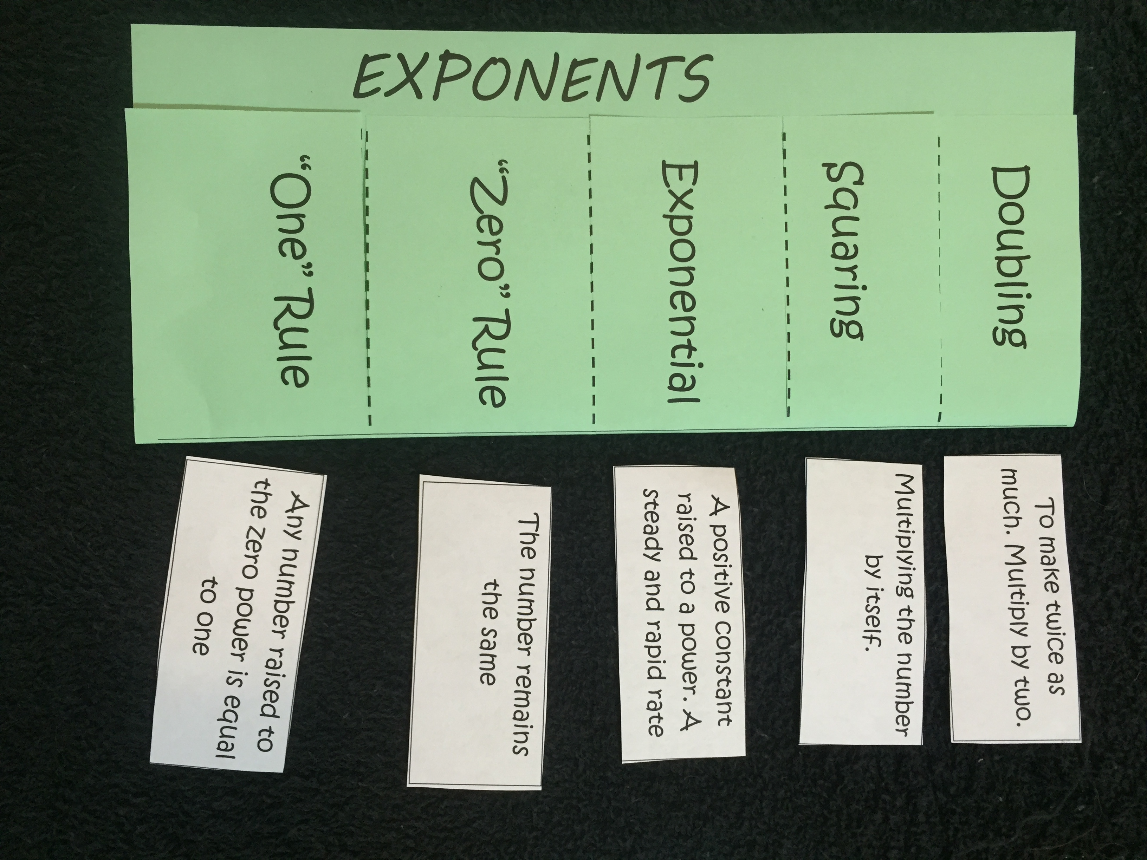
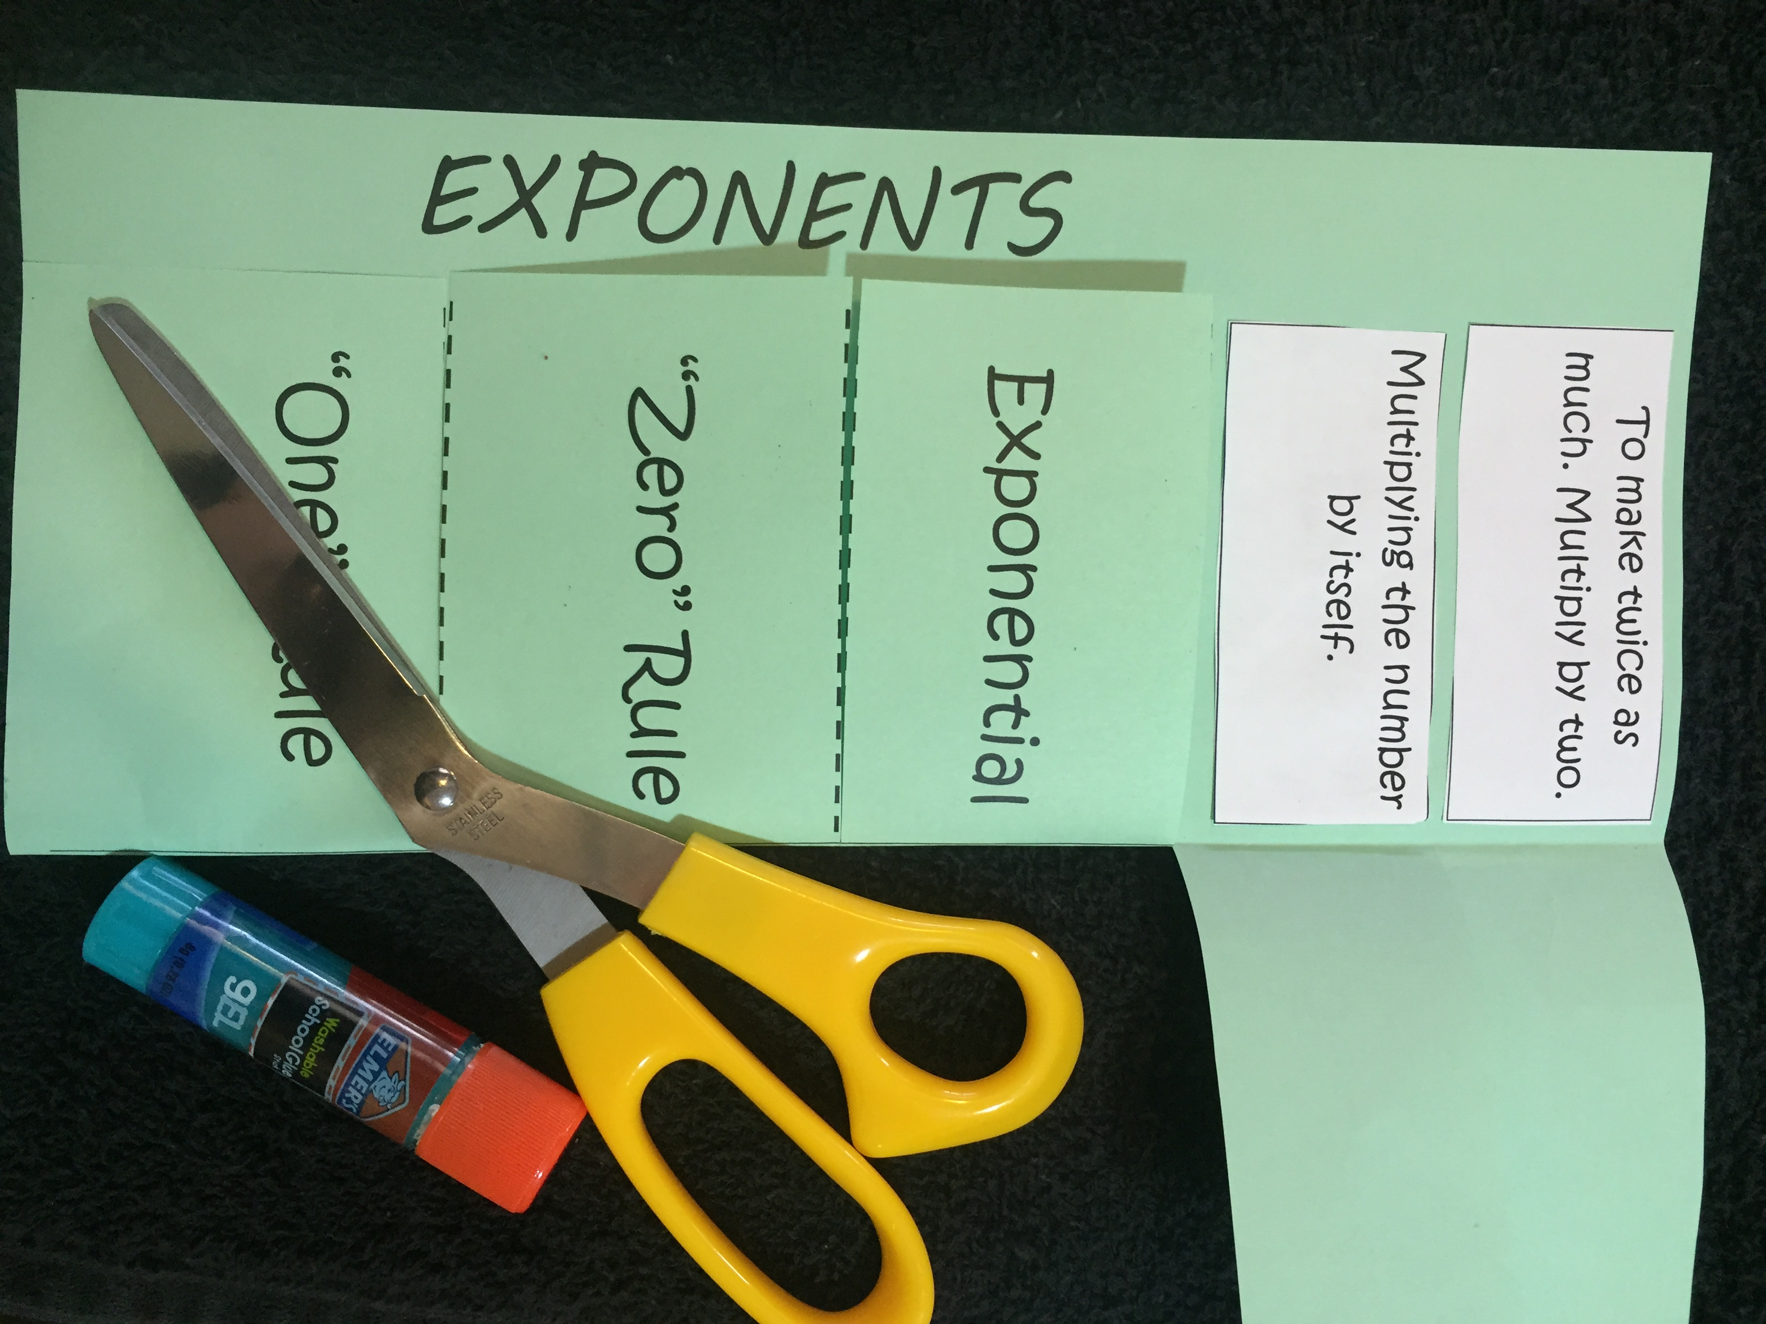
Foldable
Add definitions to inside

