Slide 1
FAST FASHION.

Slide 2
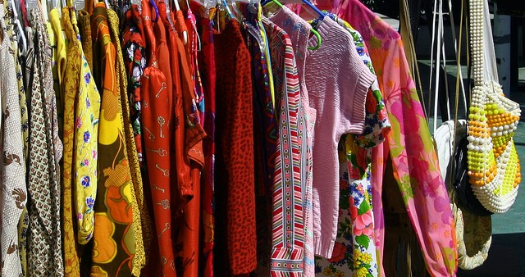
on Notebook paper, answer these questions:
How much each month do you spend on clothing?
How much of your personal spending money does this entail? (10 percent? 20 percent?)
How do your purchases affect others?
https://borgenproject.org/true-costs-fast-fashion/

Slide 3
Why H & M Costs More Than You Think (3.11 min)
https://youtu.be/UOW5jpXnktY

Slide 4
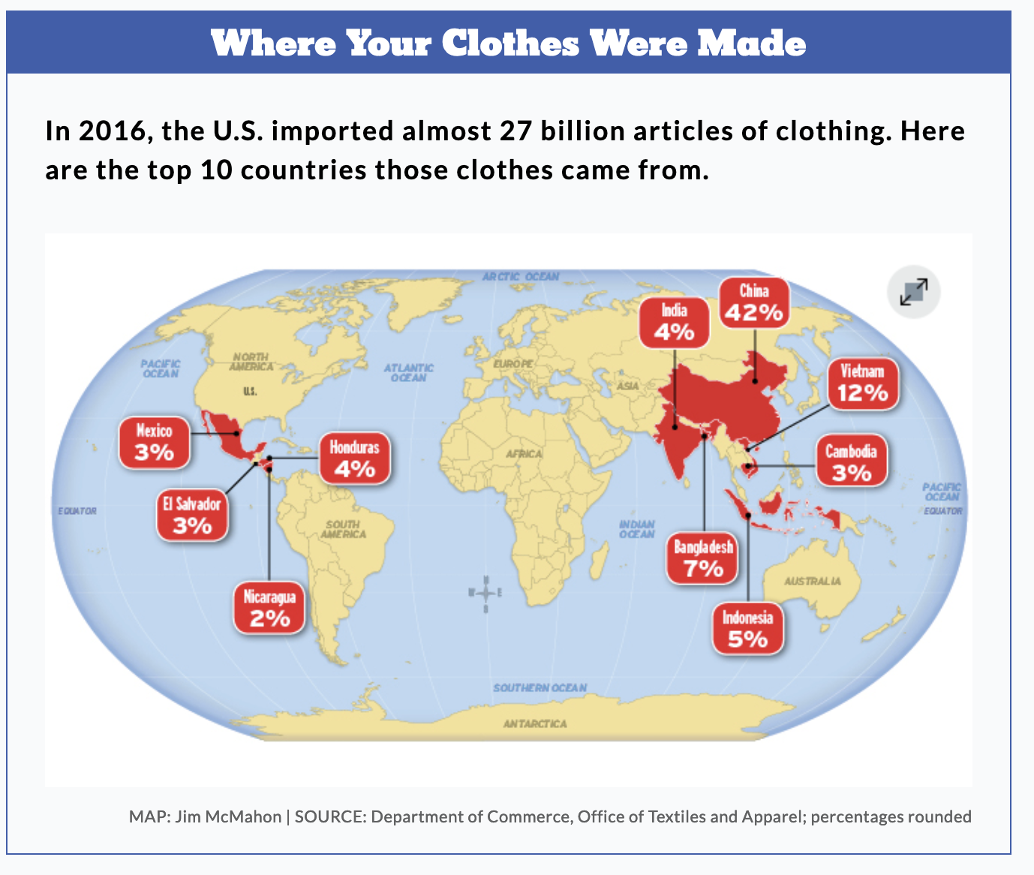

Slide 5
Vocabulary

Slide 6
Vocabulary

Slide 7
Vocabulary

Slide 8
Vocabulary

Slide 9
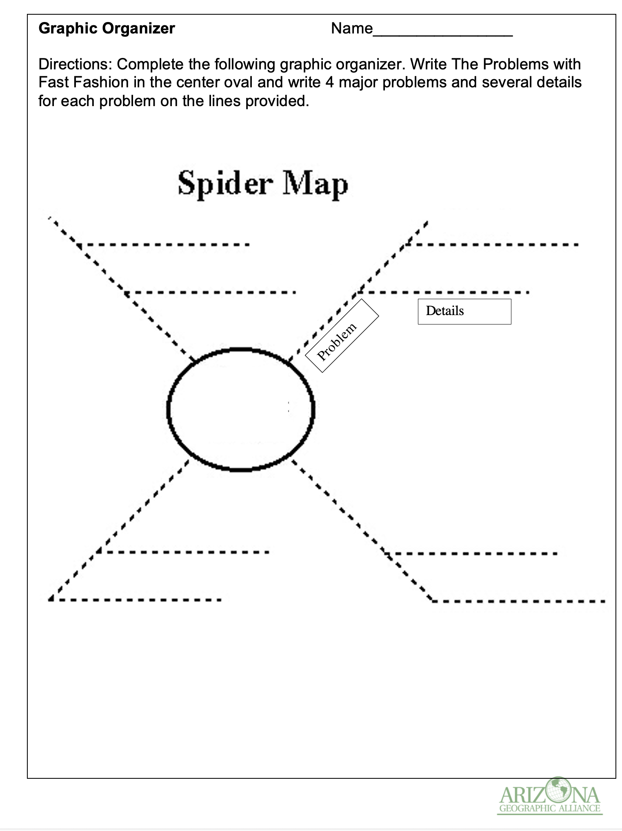
How polluting is the fashion industry? https://www.ekoenergy.org/how-polluting-is-the-fashion-industry/

Slide 10
Your Solutions WITH YOUR TEAM.
Partner 1
Partner 2
Team consensus
Partner 3
Partner 4

Slide 11
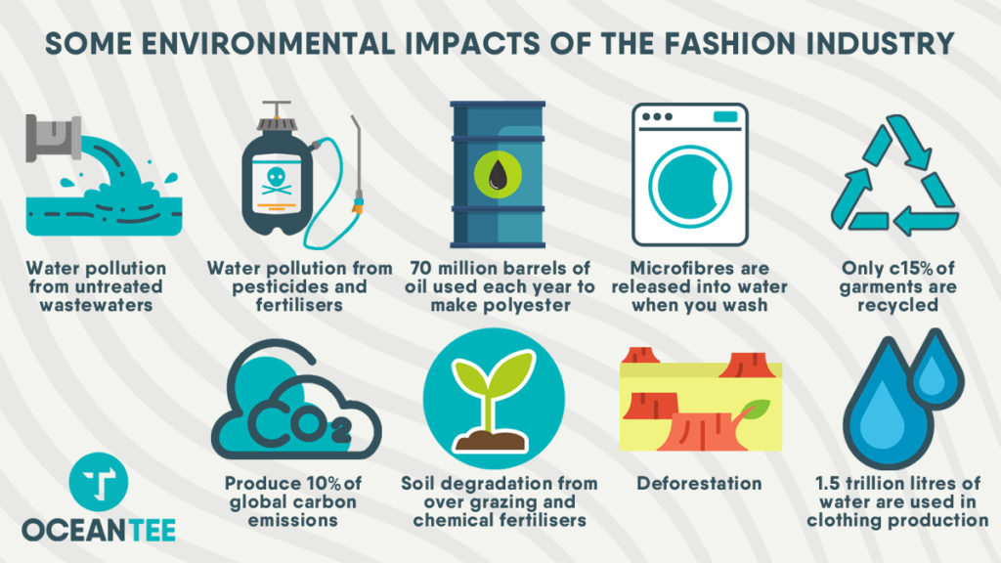
Resources Used for Apparel Production

Slide 12
Possible Solutions
1. BUY LESS
2. BUY CLOTHES FROM SUSTAINABLE BRANDS
More and more fashion brands take into account the environmental and social impact of their production.
3. BUY BETTER QUALITY
Try to repair or repurpose them. Sometimes with a bit of imagination, you can repair or even redesign a torn garment.
Donate your clothes to your friends, family, neighbors, or to charity.
Some clothes shops take back used clothes - from their own brand or even from other brands.
Put them in the textile recycling bin. Textiles can be recycled to make new clothing.

Slide 13
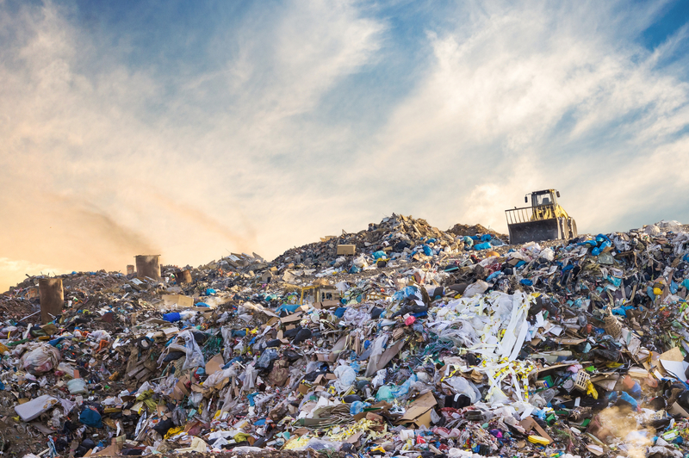
Looking at data to find the PERCENT CHANGE in environmental pollution due to fast fashion over the years.
https://www.openaccessgovernment.org/what-are-the-alternatives-to-landfill/53719/

Slide 14
Vocabulary Percent Change

Slide 15
r
MODEL QUESTION

Slide 16
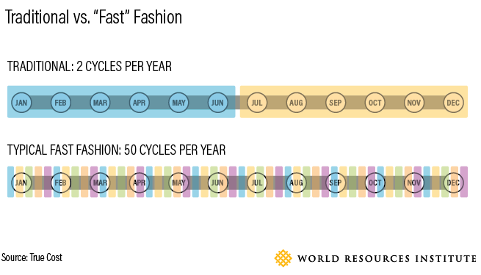
What is the percent increase in cycles per year from traditional to fast fashion?

Slide 17
SOLUTION - What is the percent increase in cycles per year from traditional to fast fashion?
Traditional Fashion - 2 Cycles of Fashion a Year (Initial Value)
Typical Fast Fashion Existing at Present - 50 Cycles of Fashion a Year (New Value)
Change from Past to Present = 50 - 2 = 48
Change Divided by Initial Value = 48/2
Value Is 24 Cycles
To Change It into a Percent - Use Prior Knowledge of Multiplying with 100 to Change into a Percent
24 Times 100 = 2400 % Percent Increase 2400 %

Slide 18
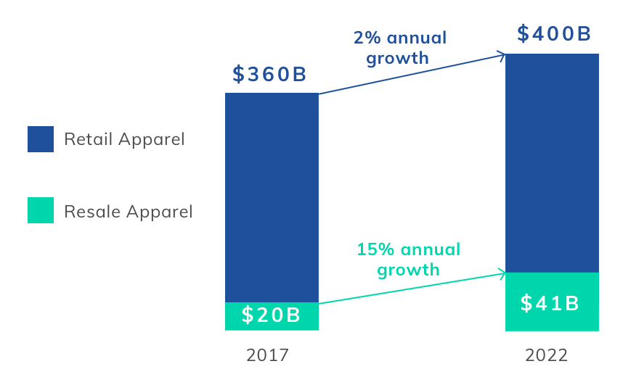
With a partner: What is the annual percent change in retail and resale apparel from 2017 to 2022?

Slide 19
SOLUTION

Slide 20
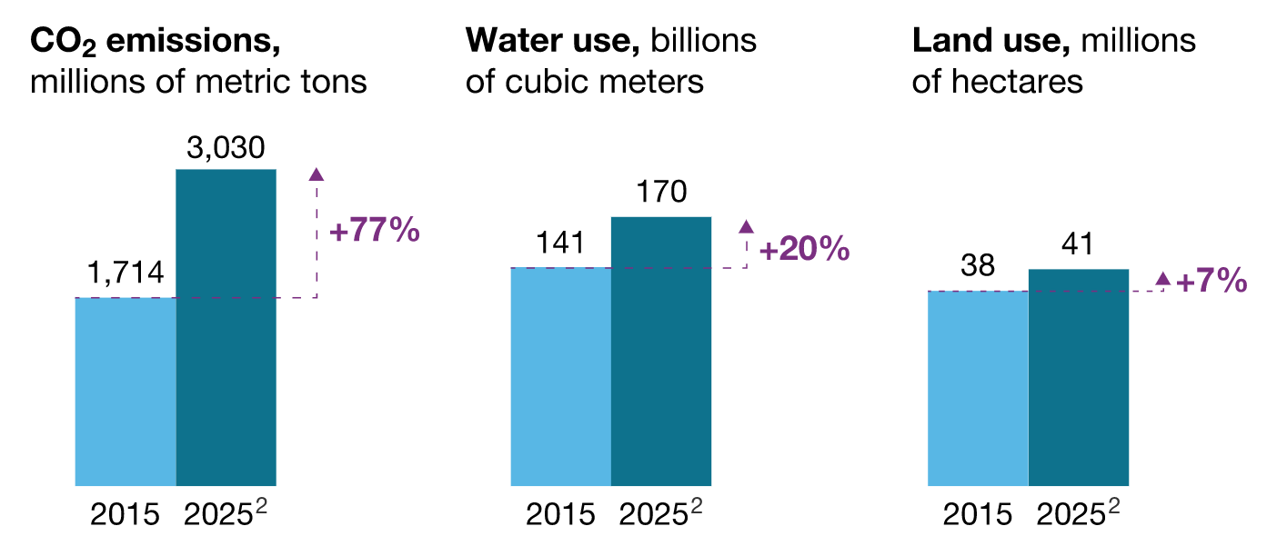
By Yourself: FIND THE PERCENTAGE CHANGE FOR EACH FACTOR IN BAR GRAPHs.
By McKinsey Sustainability

Slide 21
SOLUTION

Slide 22
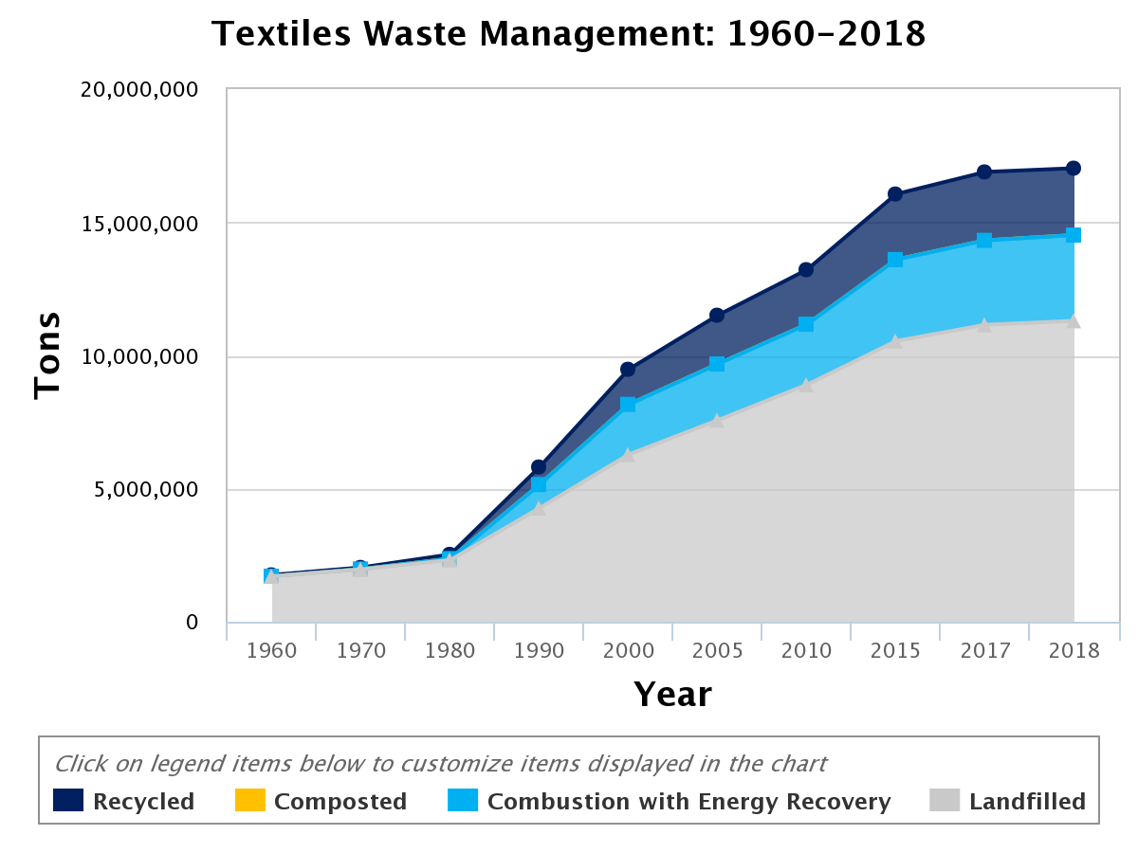
Exit Ticket 1:
Find the percent change in this graph showing the increase of textiles (clothing or fabrics) in landfills.
Recycled = used again in some way
Composted = allowed to naturally decay into the Earth
Combustion with Energy Recovery = converting the materials into usable heat or electricity by burning them
Landfilled = placed in a landfill (thrown away)

Slide 23
Exit Ticket 2:
Explain why fast fashion is a problem not only in your local area but in the world.
Use information that you have gained through this lesson to write your response.
You can include your own personal habits.
Offer solutions to the problem of fast fashion.

Slide 24
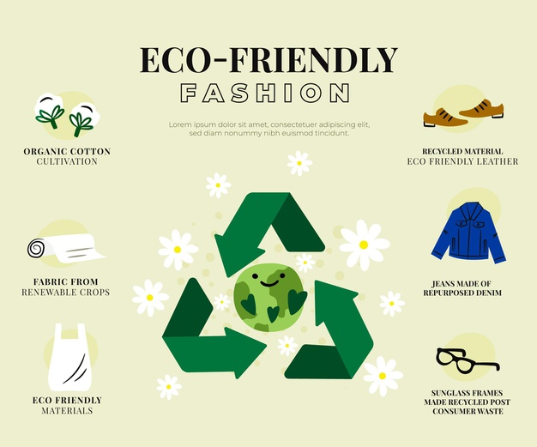
EXTENSION
Read the article: https://motif.org/news/top-sustainable-fashion-designers/
Write a newspaper article on: How the Fashion Industry Can Be More
Sustainable.

Slide 25
Solution
400% - Landfill increased from 1960 to 2015

