Slide 1
Is it Natural Pollution or Human Pollution?

Slide 2
Directions
Look at the pictures of the pollution.
Circle the cause of the pollution. Is it human pollution or is it natural pollution?
Good luck!

Slide 3
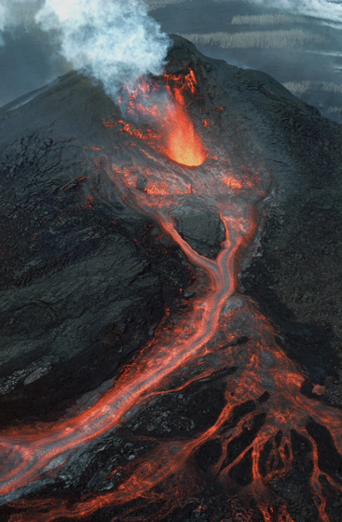
Let’s Practice
Human
volcanic eruptions?
Natural

Slide 4
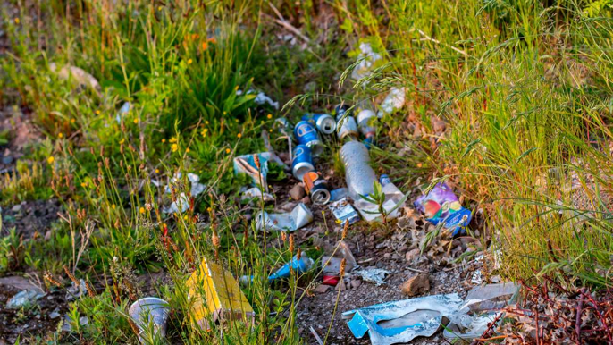
Human
Litter?
Natural

Slide 5
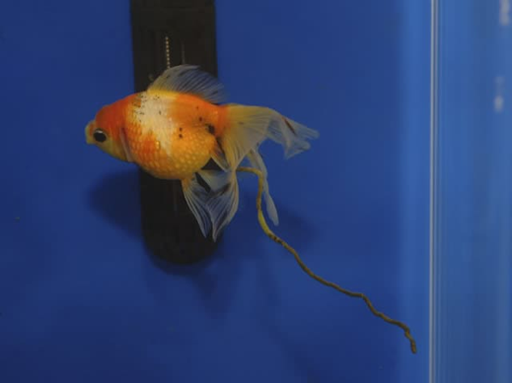
Human
animal waste?
Natural

Slide 6
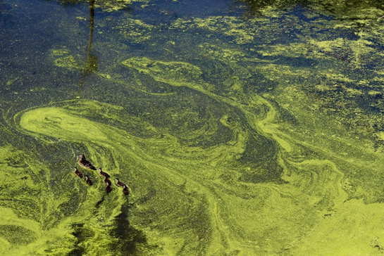
Human
algae ?
Natural

Slide 7
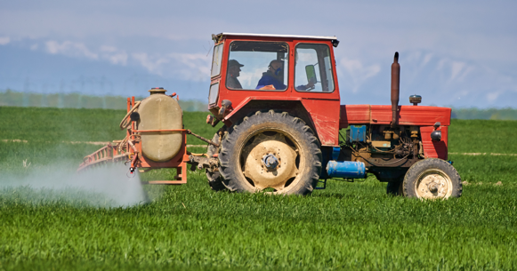
Human
pesticides?
Natural

Slide 8
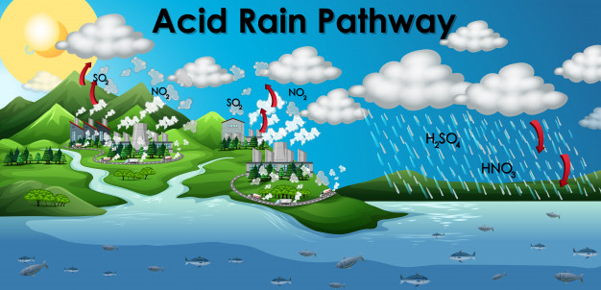
Human
acid rain?
Natural

