Slide 1
Pesky Pollution
The Environment - How Human and Natural Pollution Affects Us

Slide 2
Key Vocabulary Review
Vocab
affect- have an effect on; make a difference to
natural pollution – a pollutant created in nature such as volcanic dust, algae blooms, animal waste, and dirt
human pollution- pollutants created by human activities such as littering, driving cars, operating factories, and dumping chemicals
effect - the result of an action
environment - the water, soil, land, and air that affect living things
Words to know
Key terms
Definitions

Slide 3
What things do you use water for?
Notes:
🍐 This is a Pear Deck Text Slide
🍐 To edit the type of question, go back to the "Ask Students a Question" in the Pear Deck sidebar.

Slide 4
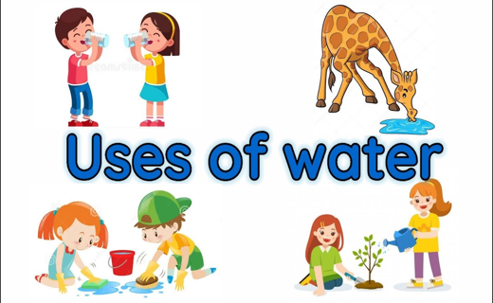

Slide 5
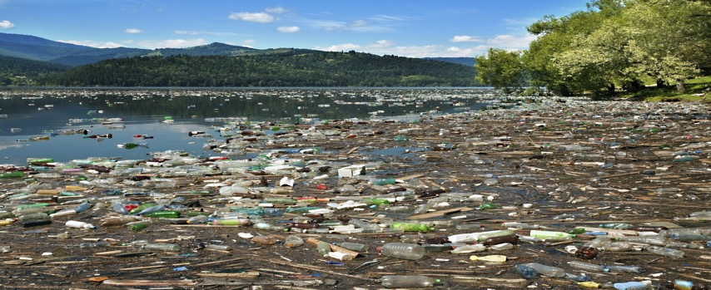
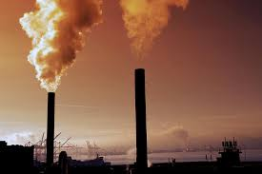
What changes can happen in water?
Water pollution is caused by waste materials, chemicals, or other particles changing a body of water (a river, ocean, or lake) so it becomes harmful to humans and animals that need the water to survive. Water pollution can hurt nature's water cycle as well.

Slide 6
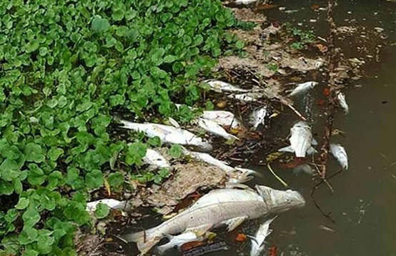
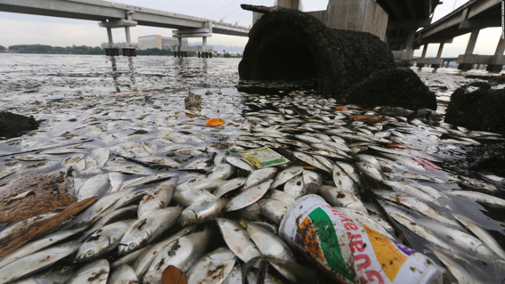
Water pollution can kill.
Water pollution can have harmful effects on the environment. Pollution in the water can reach a point where there isn't enough oxygen in the water for the fish to breathe. The fish can actually suffocate!

Slide 7
What happens if there is water pollution?
Fish can die.
Humans and animals are happy.
Nothing changes

Slide 8
Natural Pollution
Sometimes water pollution can occur through natural causes like volcanoes, algae blooms, animal waste, and dirt from storms and floods.

Slide 9
Human Pollution
Sometimes water pollution can occur through human activity like littering, driving cars, operating factories, and dumping chemicals.

Slide 10
What are other causes of human pollution?
Some human causes of pollution are sewage and waste water from cities, pesticides and fertilizers from farms, chemicals from factories, dirt from construction sites, and trash from people littering.

Slide 11
What is one natural cause of pollution?
litter
volcanoes
cars and trucks

Slide 12
What is one human cause of pollution?
animal waste
algae blooms
littering

Slide 13
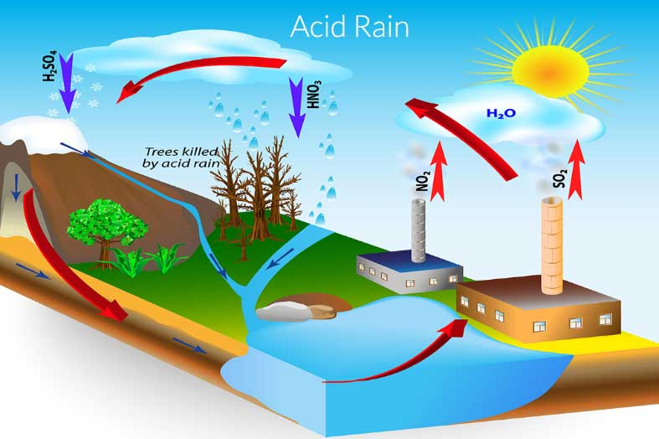
How does pollution affect the environment?
Air pollution can have a direct effect on water in rivers and lakes. When harmful particles get high into the air, they can combine with rain to produce acid rain.

Slide 14
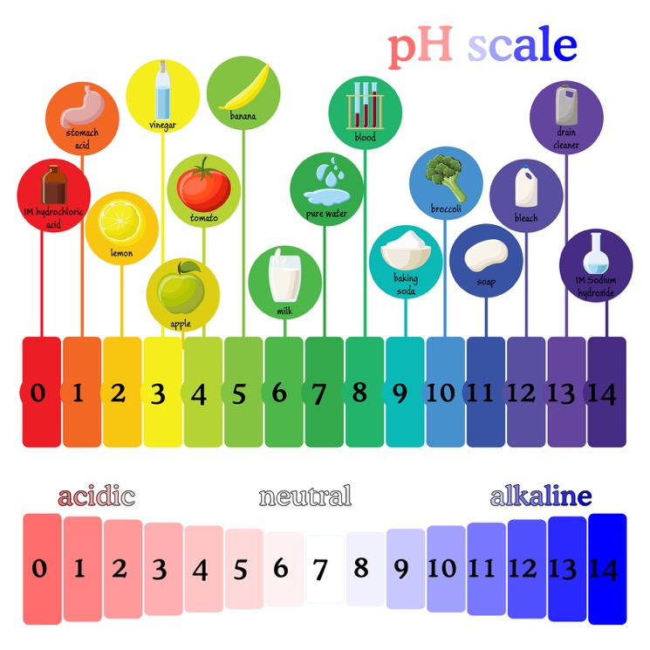
Acid Rain
Acid rain can turn lakes acidic, killing fishes and other animals.

Slide 15
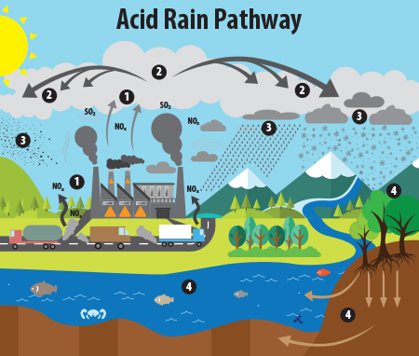
Can you follow the numbers?

Slide 16
What is Acid Rain?
https://www.youtube.com/watch?v=1PDjVDIrFec

Slide 17
What else can pollute the environment? Oil Spills
Some of the most famous incidents of water pollution have been caused by oil spills. Many years ago, an oil spill occurred when an oil tanker, called the Exxon Valdez, hit a reef off the coast of Alaska. Over 11 million gallons of oil spilled into the ocean.
Another bad oil spill happened when an explosion at an oil well, called Deepwater Horizon, caused over 200 million gallons to spill into the Gulf of Mexico.
The Oil Spill https://www.youtube.com/watch?v=M2FwiDINAUQ

Slide 18
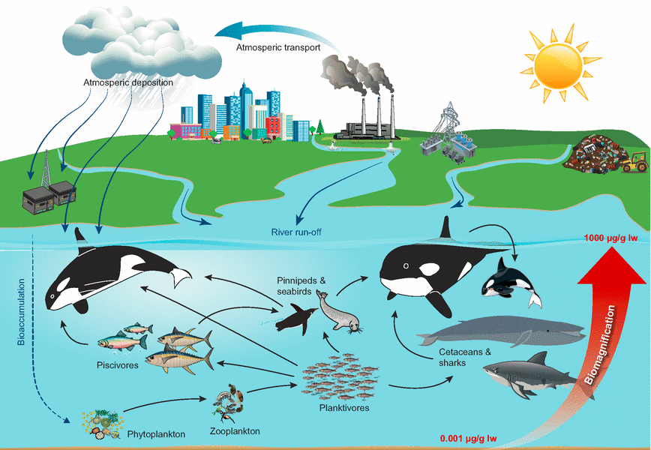
How does pollution affect the food chain?
Sometimes pollution affects the entire food chain. Small fish absorb pollutants, such as chemicals, into their bodies. Then bigger fish eat the smaller fish and get the pollutants too. Birds or other animals may eat the small and big fish and be harmed by the pollutants as well.

Slide 19
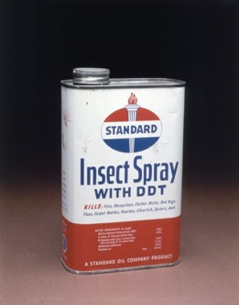
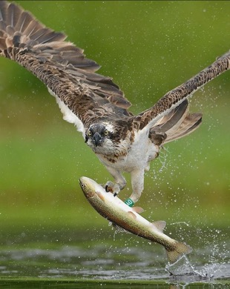
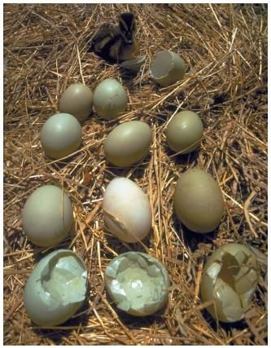
How does pollution affect the food chain?
Many years ago, people used an insecticide (bug killer) called DDT. When birds of prey ate fish that were infected with DDT, they would lay eggs with thin shells. The number of birds of prey began to drop until the use of DDT was ended.

Slide 20
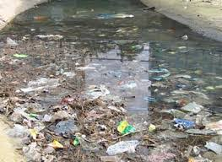
How does sewage affect water?
Sewage can cause major problems in rivers. Bacteria in the river will use oxygen to break down the sewage. If there is too much sewage, the bacteria could use up so much oxygen that there won't be enough left for the fish.

Slide 21
Photo Credits
https://www.youtube.com/watch?v=rUQEm3UYu5M
https://www.youtube.com/watch?v=eV-z9KAqn9k
https://www.watercalculator.org/resource/teach-beyond-the-water-cycle/
https://forestrypedia.com/acid-rain-formation-effects-and-control-measure/
https://www.nrdc.org/stories/air-pollution-everything-you-need-know
https://www.history.com/topics/natural-disasters-and-environment/water-and-air-pollution
https://ticotimes.net/2017/04/11/dead-fish-costa-rica
https://www.theguardian.com/sport/2015/feb/26/thousands-of-dead-fish-found-in-rio-de-janeiros-olympic-sailing-waters
https://www.purgo.co.uk/ph-value-professional-cleaners-in-london/
https://beyondpesticides.org/dailynewsblog/2020/05/ddt-metabolite-dde-and-other-banned-pesticides-found-in-blood-sample-of-african-american-women-in-detroit/
https://sites.google.com/a/owu.edu/endangerment-of-bald-eagles/home/the-science-of-ddt
https://www.pinterest.com/pin/837739968159821857/
https://www.pinterest.com/pin/139893132151706091/

