Slide 1
Hohokam Settlement
Taking Risks and Making Tradeoffs

Slide 2
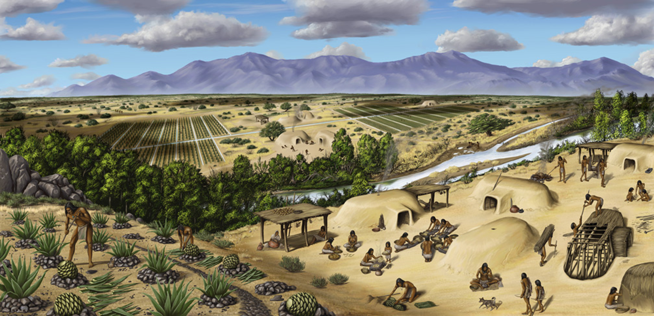
Who were the Hohokam?
Notes:
Teacher Notes:
The Hohokam were a prehistoric group of farmers who lived in the Sonoran Desert around the area we now call Phoenix and Tucson. They built villages and cities along river valleys, grew crops, and made jewelry and pottery. They built complex communities of skilled hunters and gatherers, farmers, builders, traders, and artisans.

Slide 3
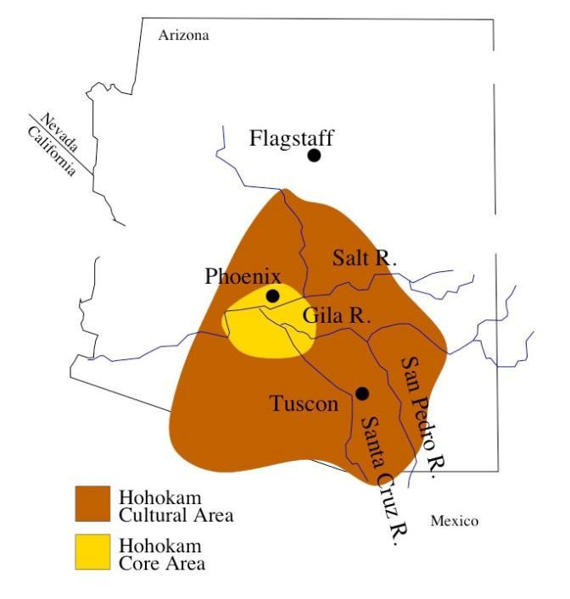
Notes:
This series of maps shows where the Hohokam lived.

Slide 4
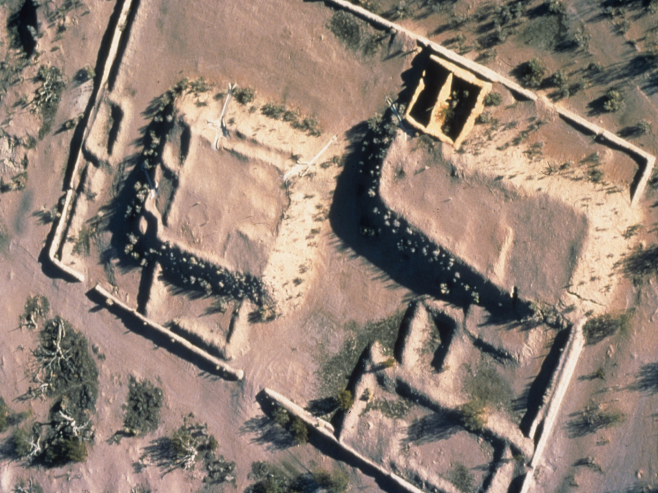
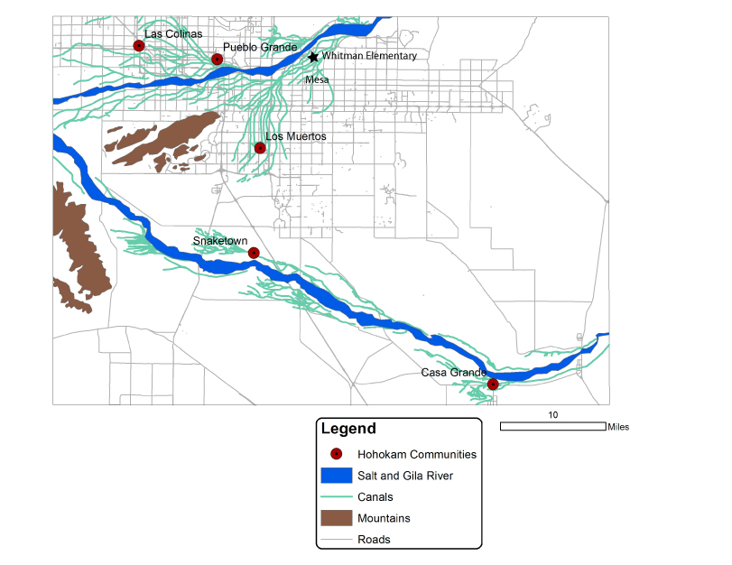
Notes:
The Hohokam lived in Arizona for 1,450 years before leaving – over 560 years ago. We don’t know why they left but evidence of their communities can still be found. Mesa, Arizona was built on top of Hohokam houses and farms.
Image showing maps a mesa and archaeological ruins

Slide 5
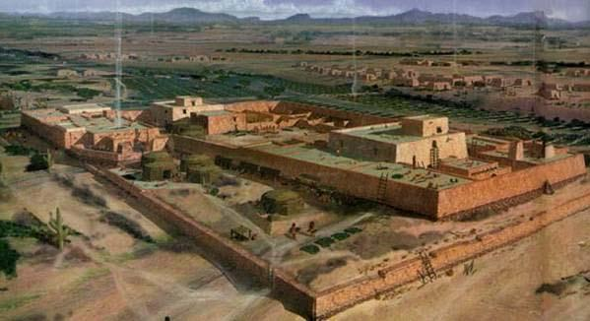
What were Hohokam communities or cities like?
Notes:
Communities built by the Hohokam came in many sizes. Some were very small with just a few houses. Some were large with 500 people living there. These communities would have been like our cities. Larger communities would have had more houses, at least 1 ballcourt, a large plaza or mound for dancing and socializing. People would have traveled there to see events or trade goods. In the center of the community was an open area where public events, activities, and celebrations would happen. Houses were clustered together into neighborhoods. Outside of the neighborhoods trash was thrown into pits or piles.

Slide 6
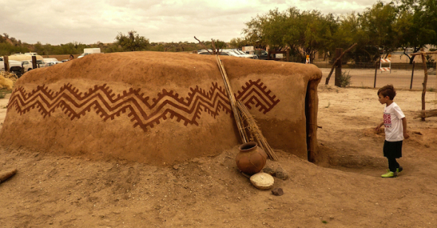
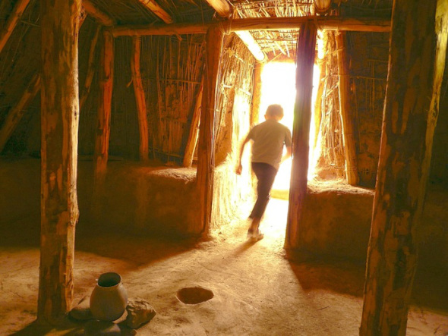
Did they live in houses? What did they look like?
Pithouses
Notes:
There are two types of Hohokam houses, pithouses and adobe houses. A pithouse is a house built into the ground. They dug a shallow hole 3 feet deep and then built the walls of the house. The walls and roof were made of vertical beams. Smaller branches and grass would have filled in the space between the beams. The house would then have been covered in a mixture of sand and mud. This type of house was adapted to the climate of Arizona. Pithouses stayed cooler in the summer and warm in the winter. This type of house is found all over Arizona.

Slide 7
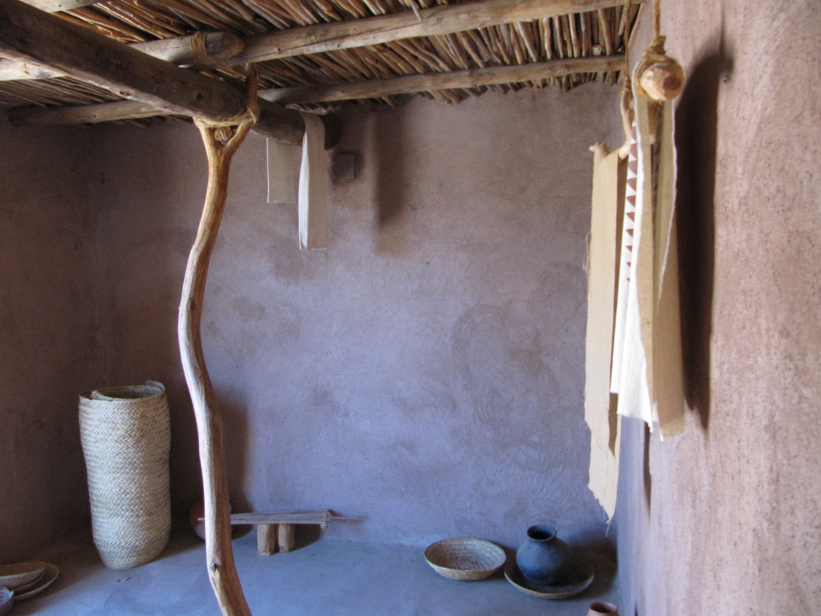
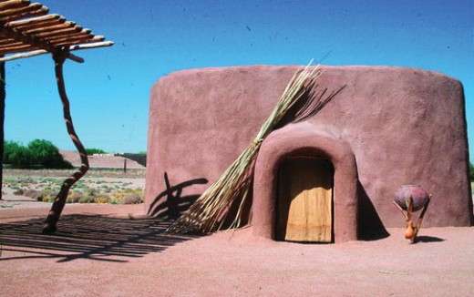
Adobe Houses
Notes:
Adobe houses were square instead of oval and built above ground. The roof was made of wooden beams covered in a layer of grass and branches and then adobe. The roof on an adobe house was flat and would have been used like an extra room. Both types of houses had a fire pit for heat and light. Both pithouse and adobe houses were arranged in small groups with related families living closest together.

Slide 8
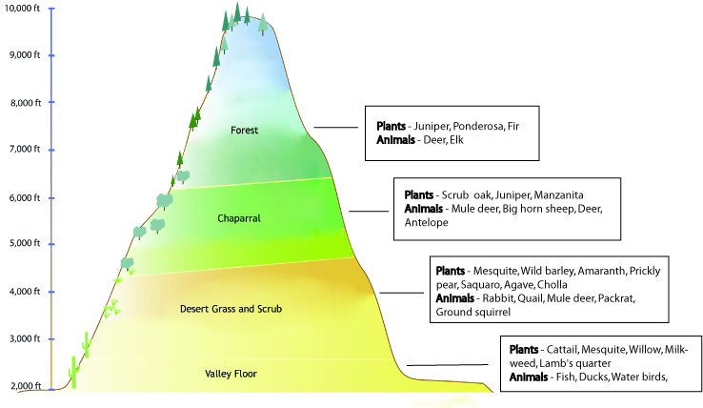
4 Ecological Areas
Notes:
The Hohokam people were experts at using the natural resources of the Sonoran Desert. There are many types of foods and water available in the 4 ecological areas used by the Hohokam. Each ecological area had its own natural resources.
Each of the different environments would have been used by the Hohokam to hunt for wild animals or gather food to eat. The Hohokam would have hunted the foods closest to their community. They sometimes traveled to other areas, like the mountains, to hunt for larger animals or cut down large trees for building. Using many different wild and grown foods helped the Hohokam have a balanced diet and make sure that they would have enough food.

Slide 9
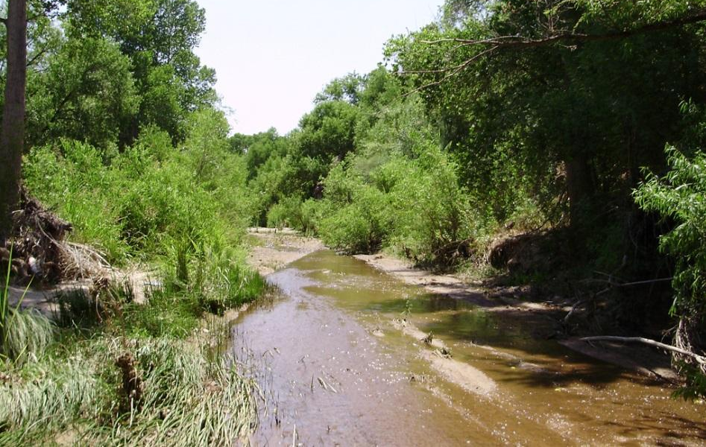
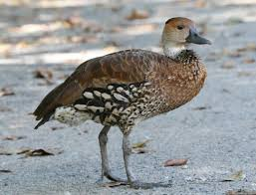
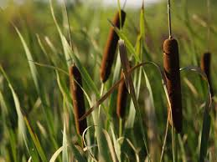
Valley Floor
Notes:
On the valley floor the elevation is very low and the land slopes gently. Major rivers like the Salt and Gila are found here. Flooding happens on the edges of the rivers making the soil richer and more moist.

Slide 10
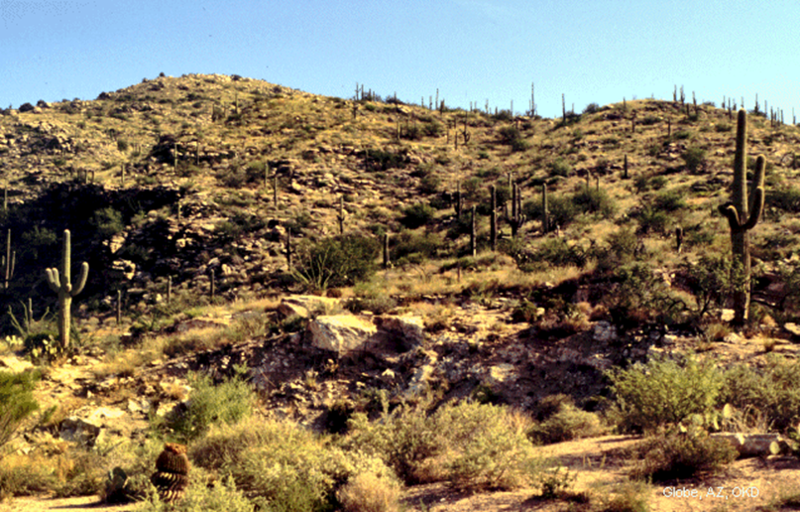
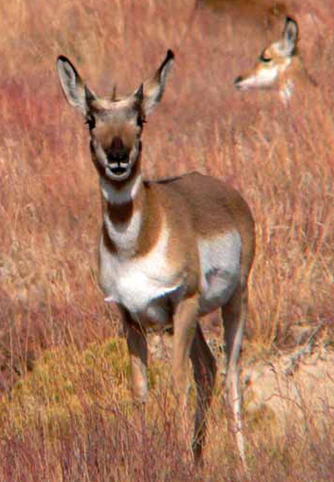
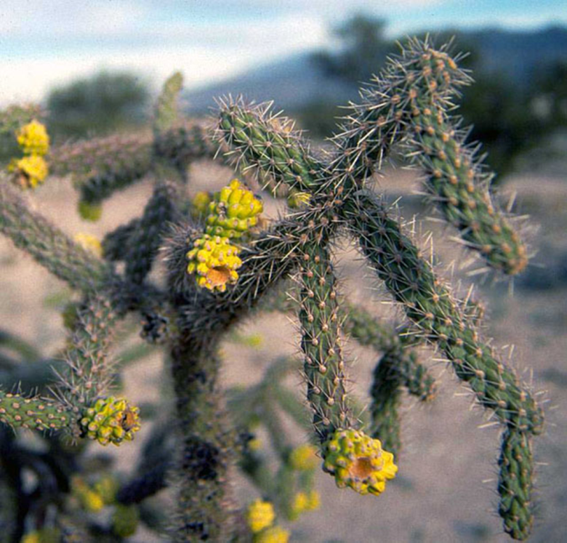
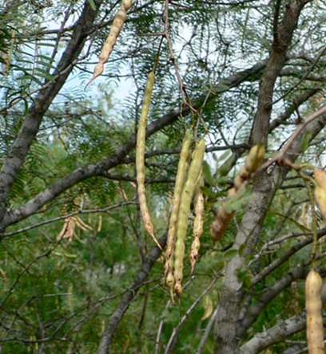
Desert Grass and Scrub Land
Notes:
Desert grass and scrub land has plants adapted to low elevations and dry climates. Areas in the lower desert get precipitation runoff from the mountains and have rich soil that is good for growing crops.

Slide 11
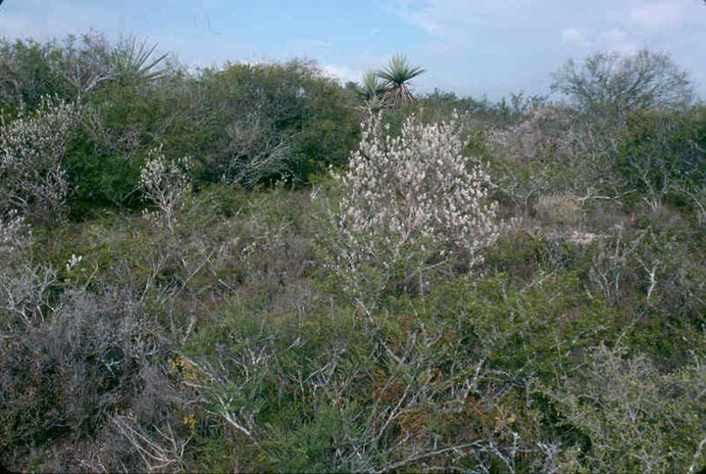
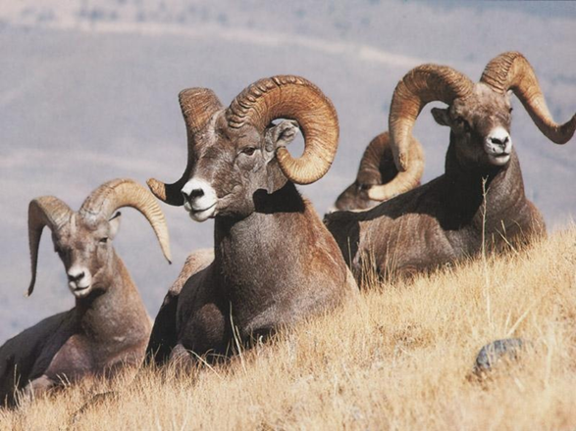
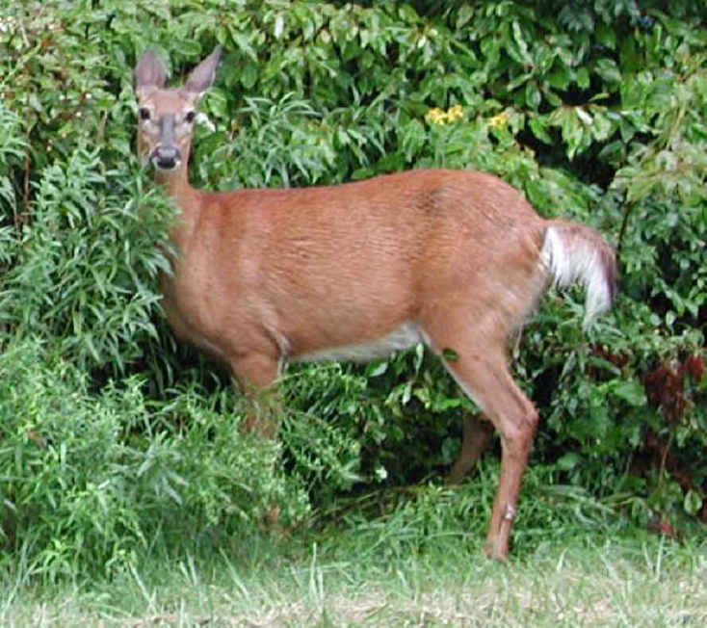
Chaparral
Notes:
Chaparral has steeper slopes, cooler weather and more rain. This means that there is more vegetation and short bushy trees.

Slide 12
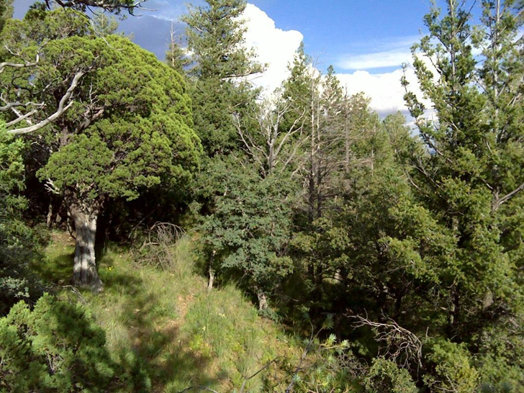
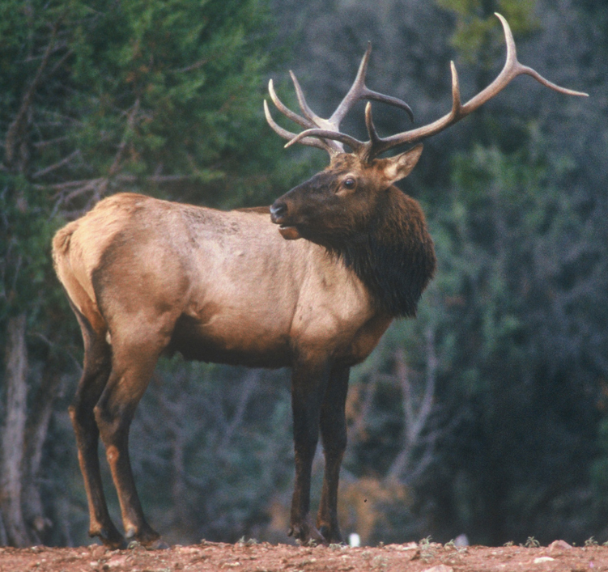
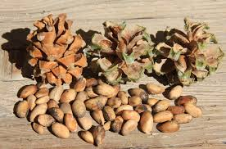
Mountains
Notes:
The highest area of elevation is forests found in the mountains. Mountains are much higher elevation and have cooler temperatures allowing more vegetation and taller trees.

Slide 13
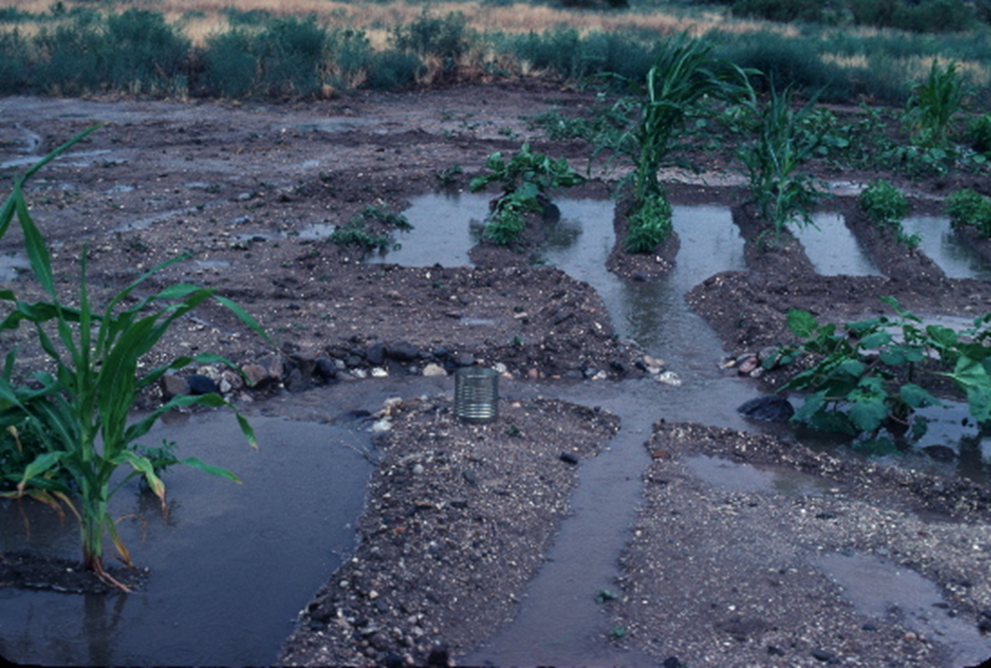
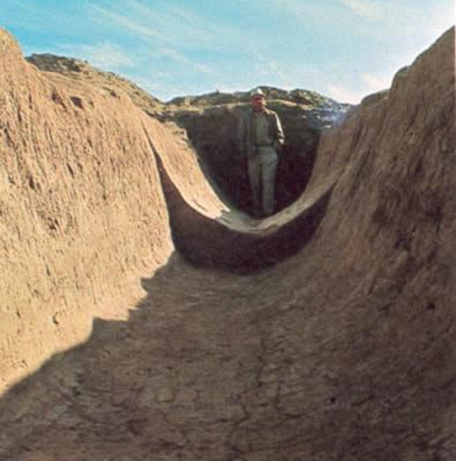
Canals
Notes:
The Hohokam built large canals to move water from rivers to their farm fields. Growing food in a desert is very hard since water is scarce, so Hohokam communities were built near rivers like the Gila and Salt River.
Canal builders dug deep trenches using digging sticks and baskets to carry dirt. These trenches sloped downhill so that water would run from the river to the fields. Canals were widest near the river and got narrower. This helped water flow all the way to the end of the canal. The water was controlled by a system of gates. When a gate opened, the water could move through the canal and reach fields. Farmers opened the gates to let water irrigate their fields.

Slide 14
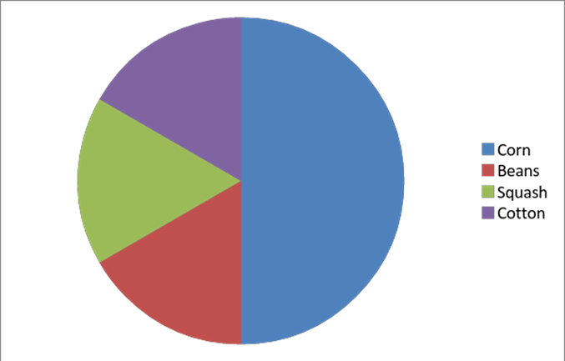
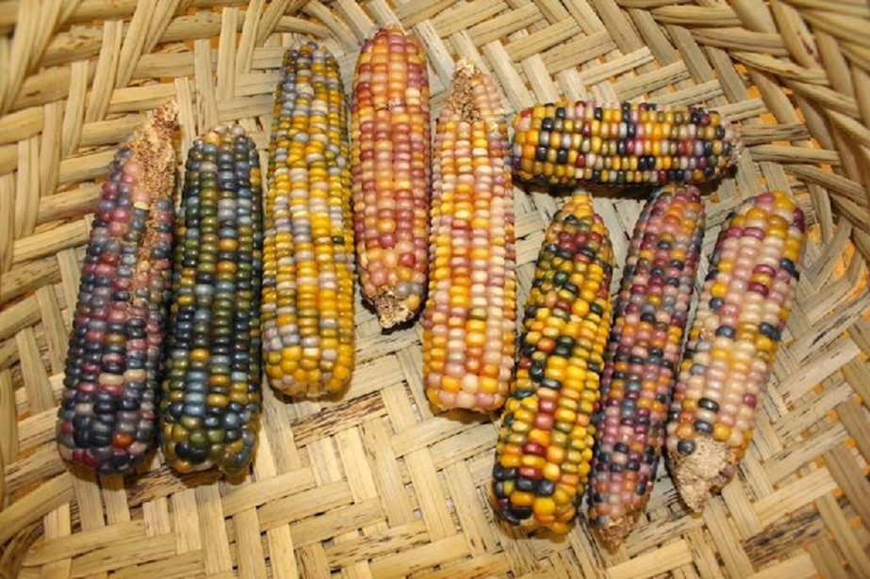
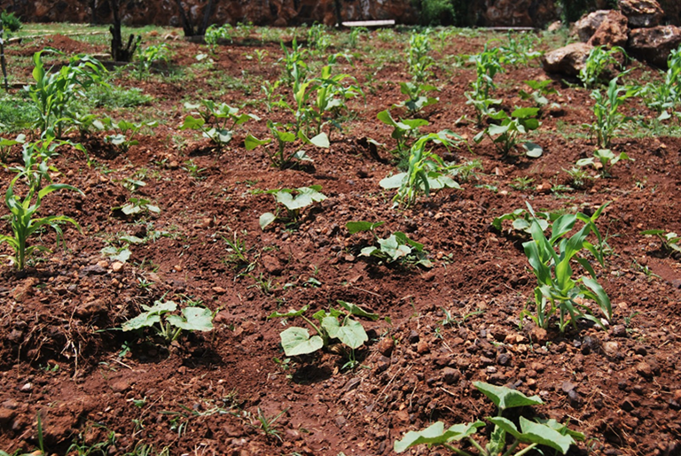
How did they farm in the desert?
Notes:
The most important crops of the Hohokam farmers were corn, beans, squash, agave, and cotton. Corn was the main food of the Hohokam. It was dried and ground between stones called a mano and metate to make corn meal. Beans and squash were also grown and could be eaten fresh or dried in the sun and stored for winter. Cotton was grown to make cloth or to trade with people in other areas of Arizona where it could not grow.
(SWVirtualMuseum)

Slide 15
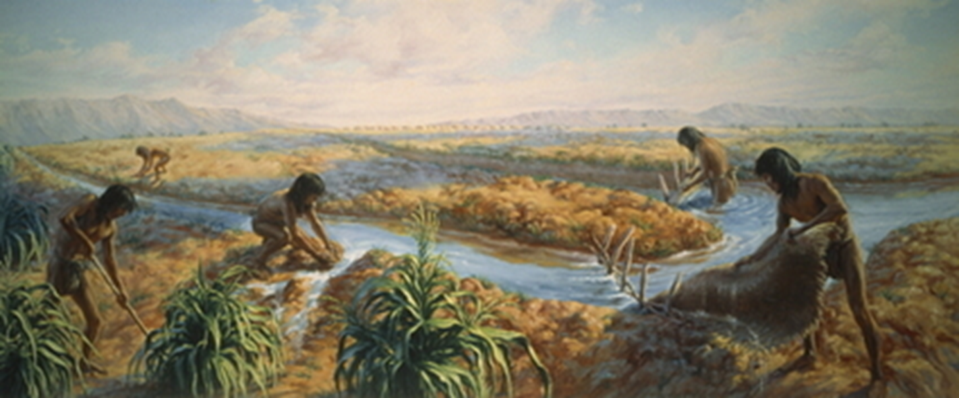
Cooperation Needed
Notes:
The problem with canals was that people at the beginning could use all of the water before it reached farms at the end. Using canals required cooperation to make sure that everyone got enough water. Having canals meant that Hohokam farmers could grow enough food in the desert.

Slide 16
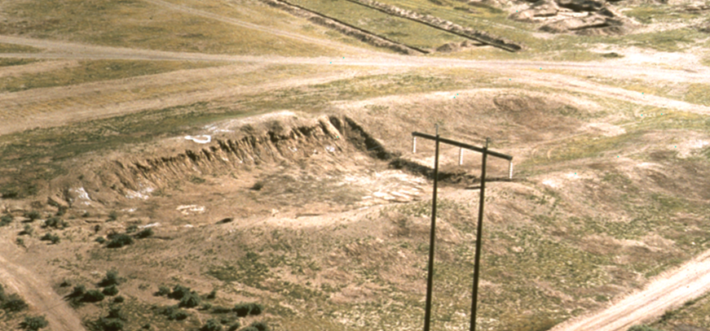
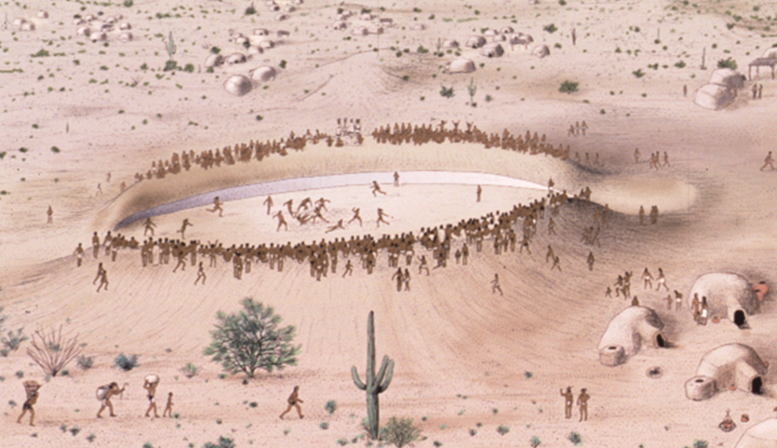
Hohokam Sports!
Notes:
The Hohokam played a ballgame similar to soccer where players tried to score goals by moving a ball with their body to goals at either end of the court. Hohokam ballcourts did not look very much like ours. There was no pavement or metal goal posts. Mounds of dirt were built up in a huge oval shape. People watching the game would stand on top of the mounds so that they could see all the action below. Ballgames were very popular. People would gather from many different communities to watch. Gathering people together from far away helped make new friendships and trade partnerships.

Slide 17
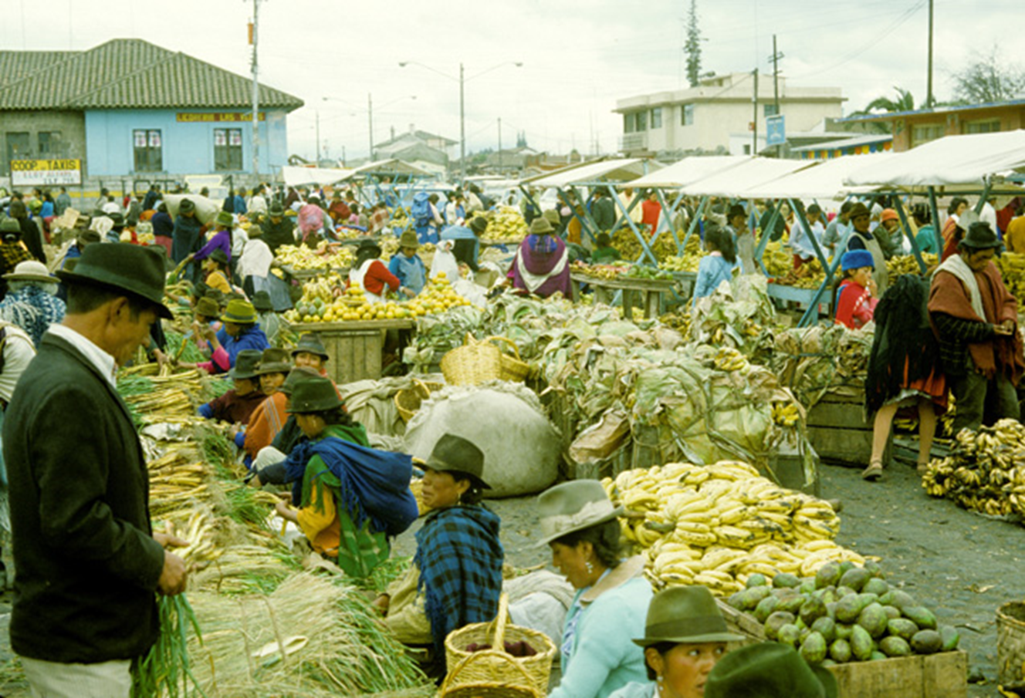
Where did the Hohokam shop?
Notes:
Trading was very important for the Hohokam and helped them get things from other places or other communities. Of course there no grocery stores or malls for shopping so scientists have made inferences about how the Hohokam traded. Communities may have organized markets where people would have brought crafts or food items to trade. Since the Hohokam did not have a money system, people would have exchanged an item they already had for one they needed. Another idea is that people may have just exchanged items with other people they knew.

Slide 18
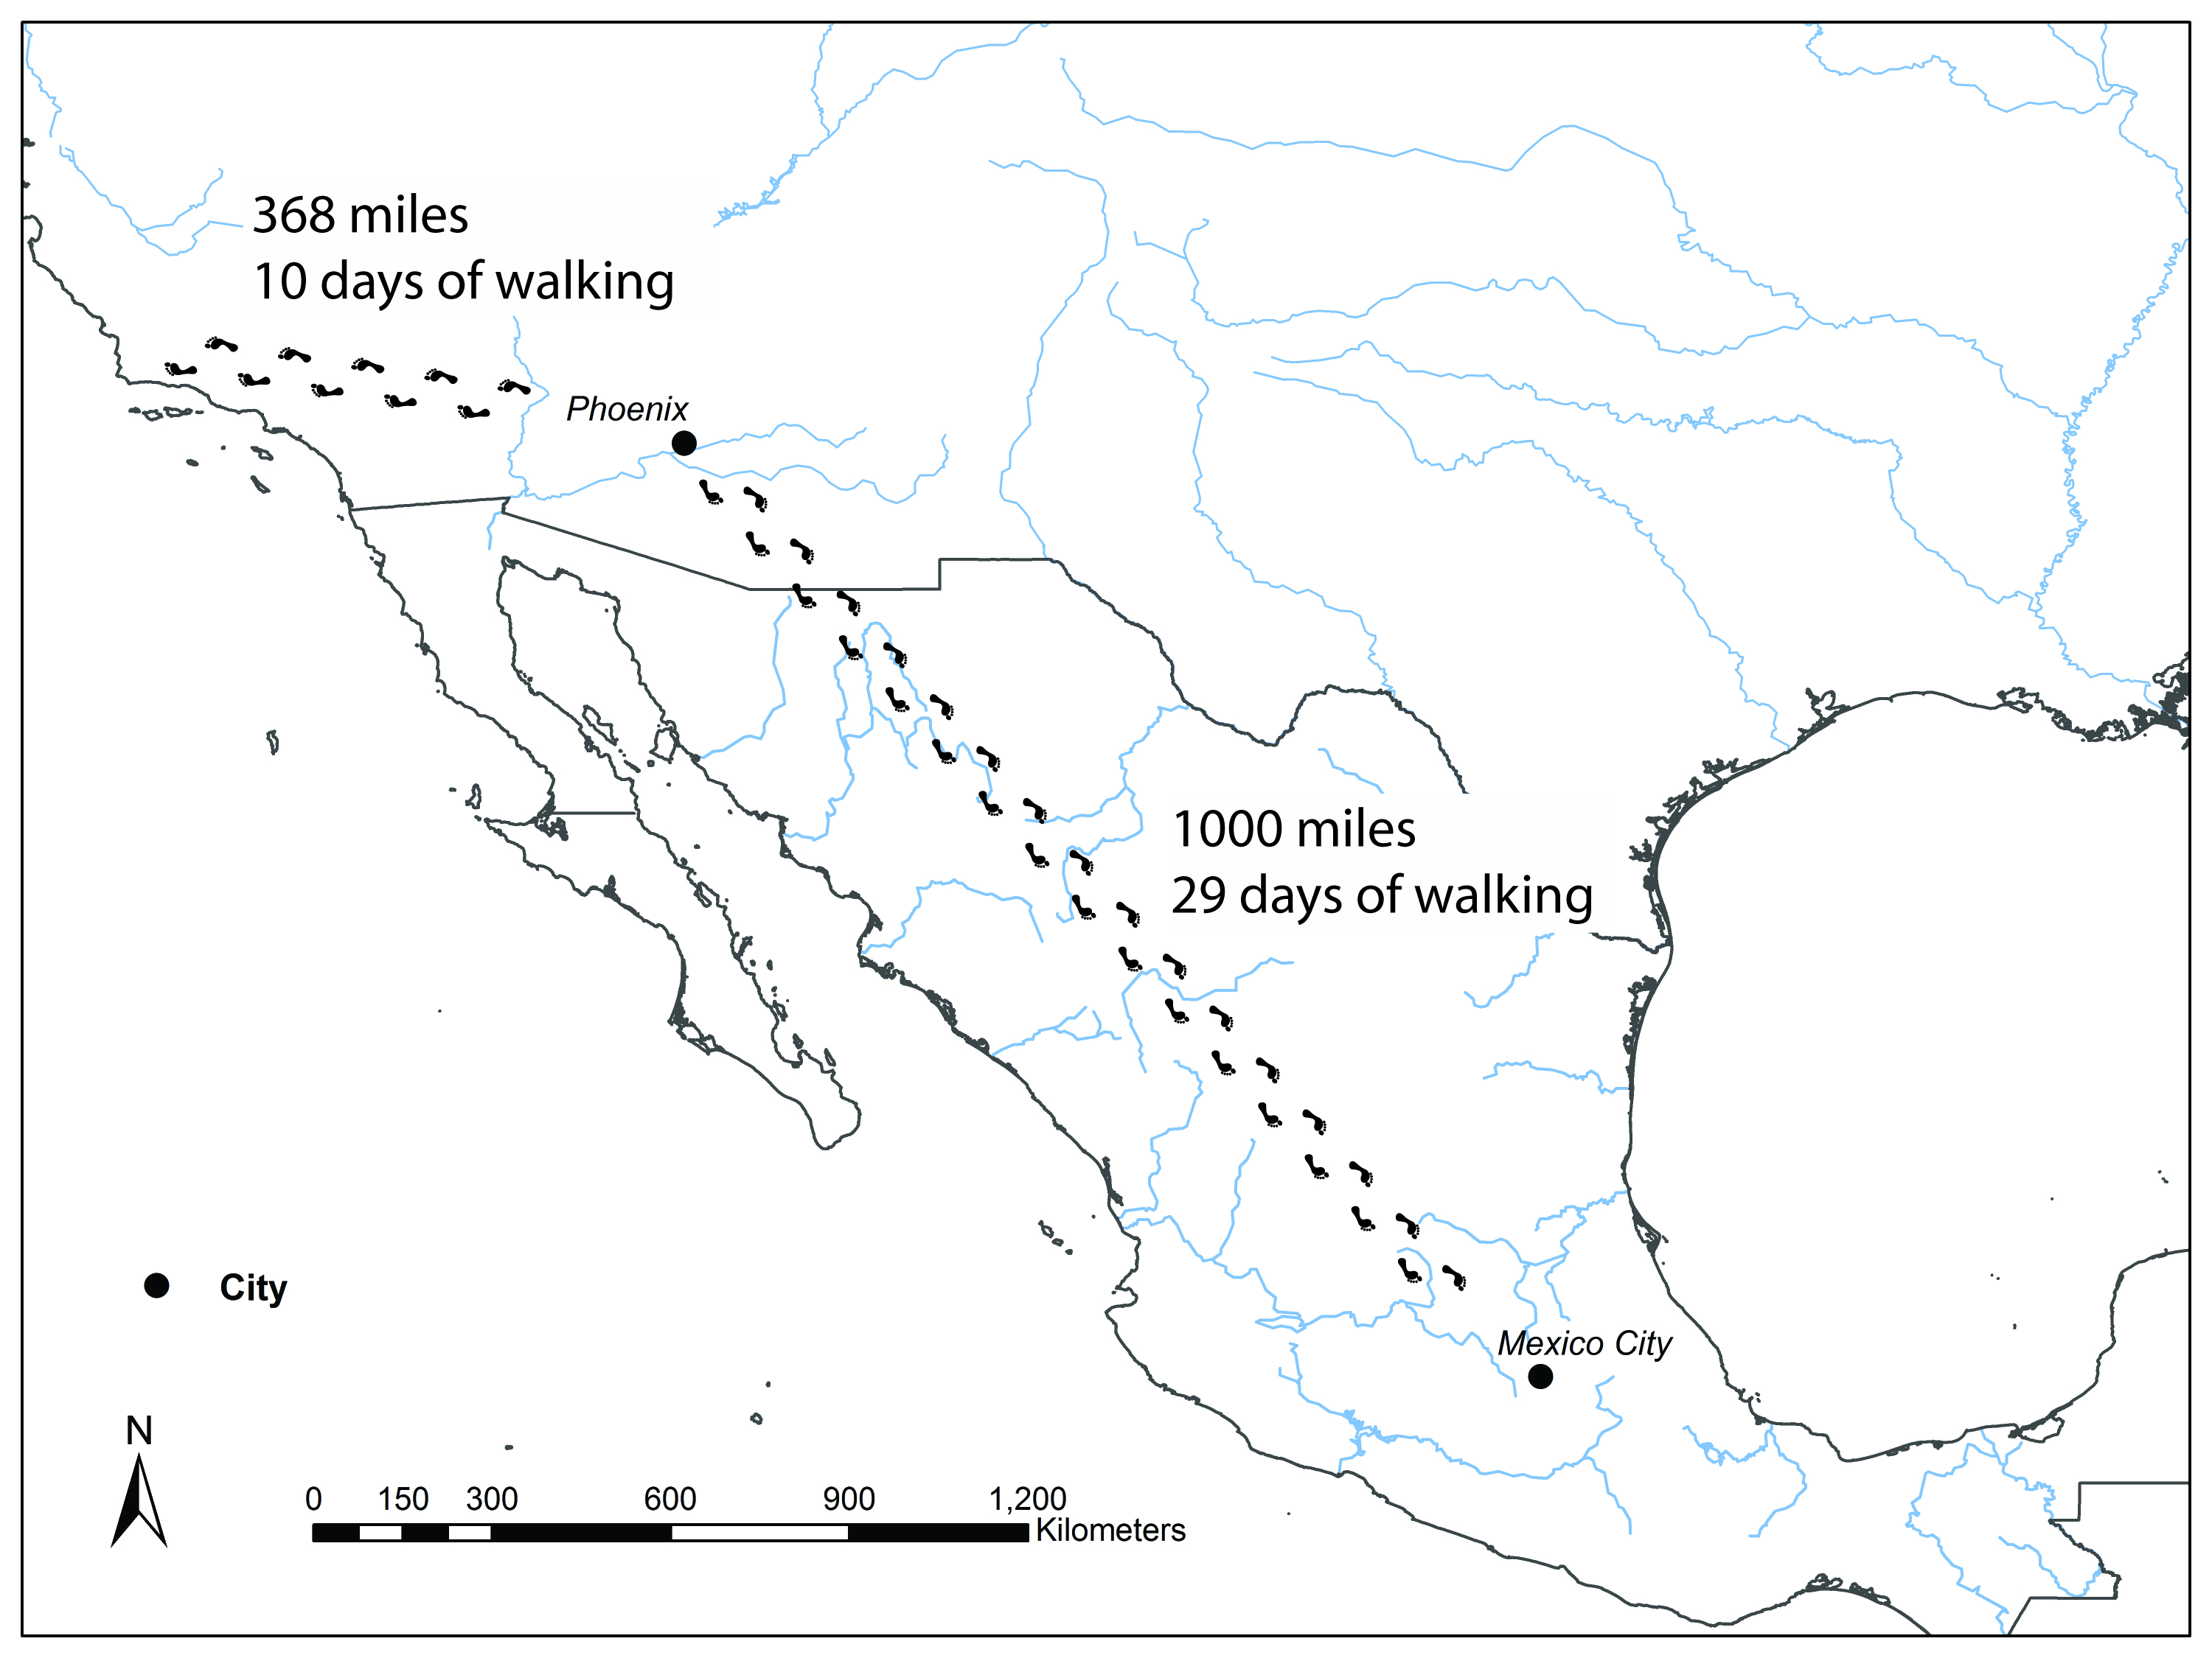
Trade Routes
Notes:
Artifacts like shell or copper bells have been found. These are not native to Arizona and came from Mexico or California. To get many of these items people would have had to trade with each other many times or walk over 1000 miles to get them. The Hohokam also traded with other Native American groups in Arizona. They traded cotton grown in their fields, goods brought from Mexico, and crafts they made.

Slide 19
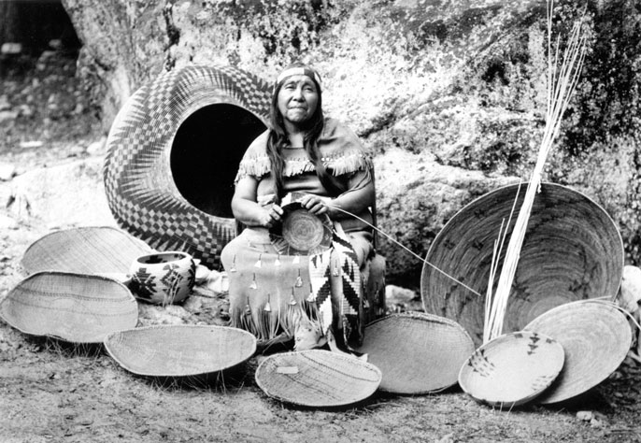
Artisan – an artist who specializes in one type of art or craft
Notes:
Hohokam artifacts made of clay, stone, bone, shell, wood, and fiber are found all over Arizona. They made useful, everyday things like pottery and baskets for cooking and food storage. They also made special things like decorated pottery and jewelry. While many people would have made the objects used for their everyday lives, a few people probably only made one type of object. The people are called artisans and would have worked full time to provide these special objects for their community or to trade

Slide 20
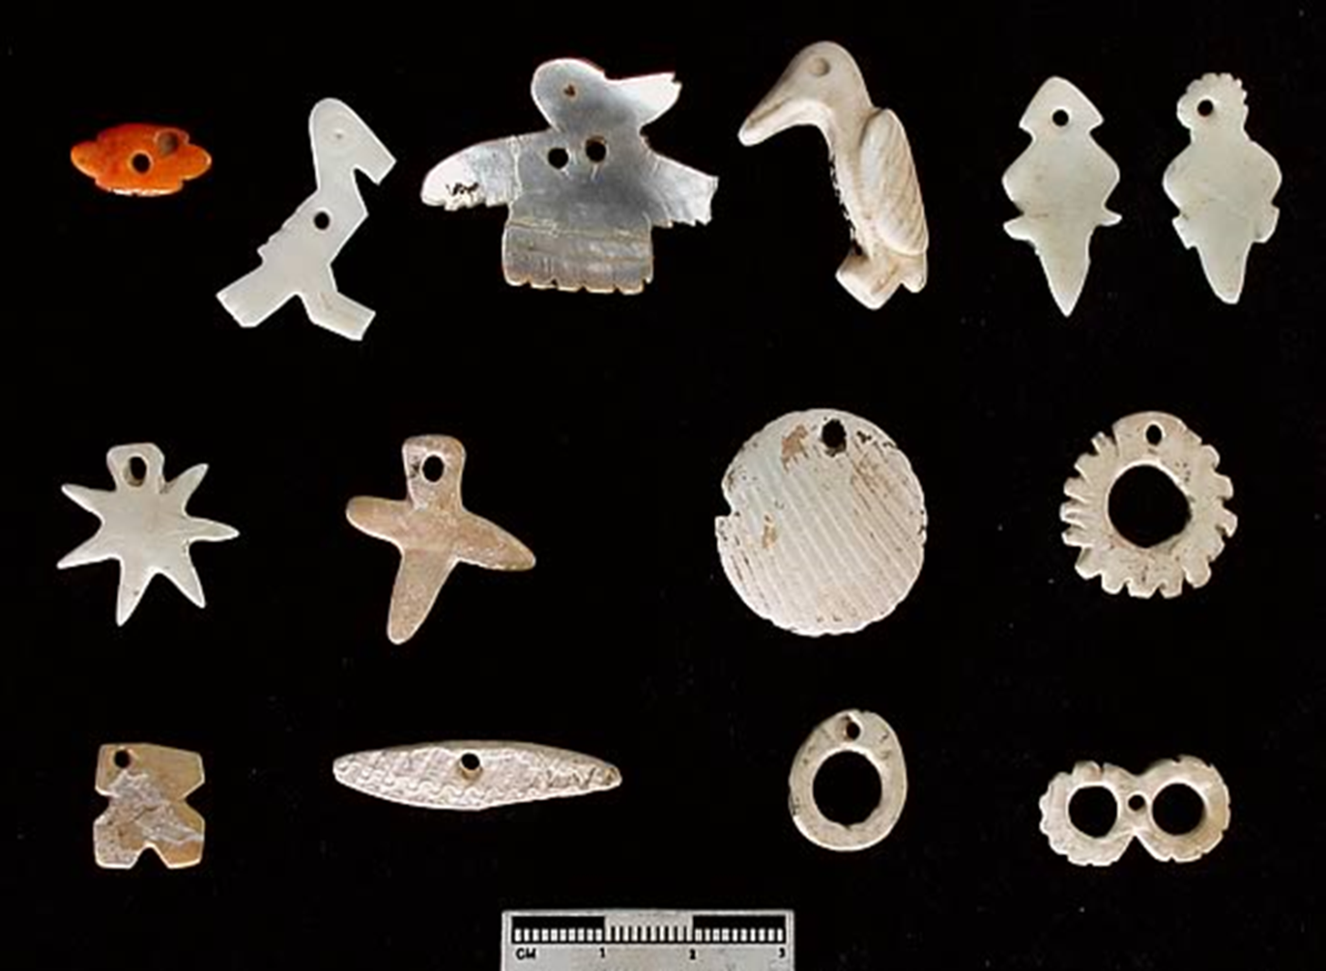
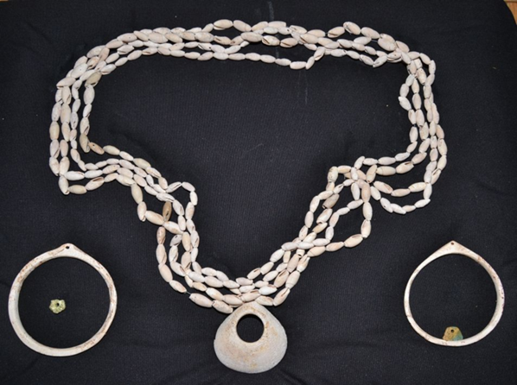
Shell Jewelry
Notes:
One important craft made by the Hohokam was shell jewelry. They made bracelets, rings, and necklaces out of shell brought from Mexico. A piece of shell was drilled or carved using a stone tool. Making a shell bead took time and patience since artisans needed to first carve the bead from the shell and then drill a hole by hand. Jewelry would have been worn by the Hohokam or traded.

Slide 21
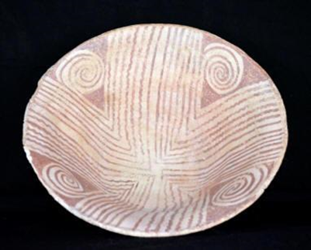
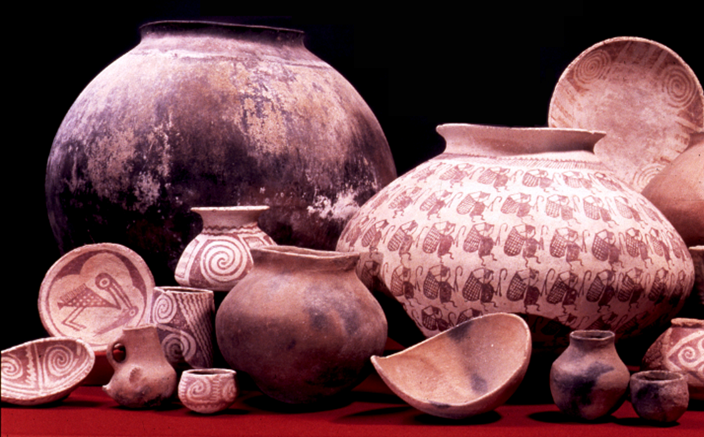
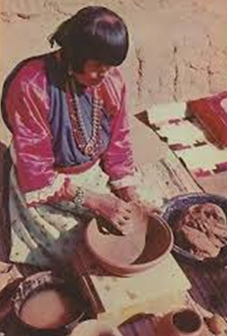
Pottery
Potter
Notes:
The other craft the Hohokam are known for is pottery. Pots were made from tan colored clay. Potters would have traveled to collect the clay and carried it back to their homes. Clay was mixed with sand until it was very smooth and then coiled into a pot. Red paint was used to make designs on the clay. Dried pots were baked in a very hot fire until the sand in them melted making them waterproof. Pots and bowls made of clay were used to store food, carry water, and cook in. Making a pot took a long time and a lot of skill.

Slide 22
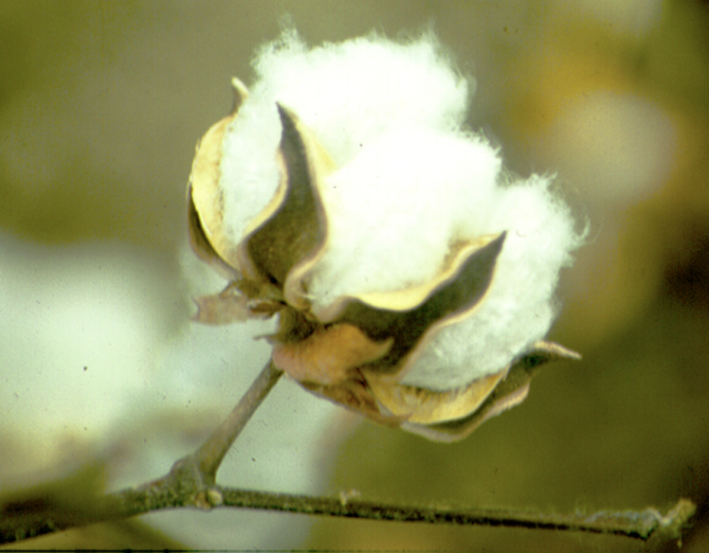
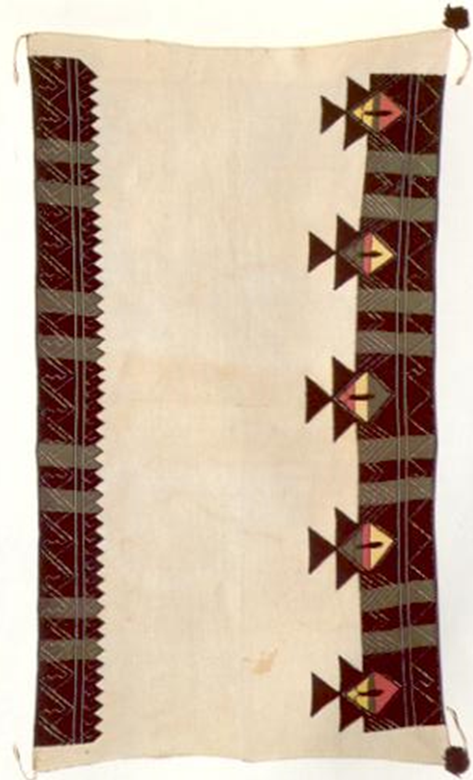
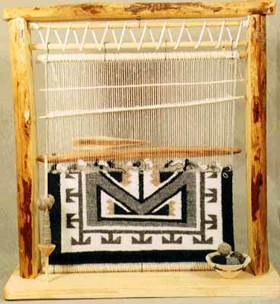
Cotton
Loom
Notes:
The Hohokam were also skilled weavers and used cotton grown in their fields to make cloth. Cotton was harvested from the fields and spun by hand into thread. The cotton could be dyed to make it different colors using plants. Small looms were then used to weave the cotton thread together. Weavers made blankets, kilts, and sleeveless shirts in many colors and with woven designs.

Slide 23

Show the rest of the PowerPoint after
students have completed the lesson activities.

Slide 24
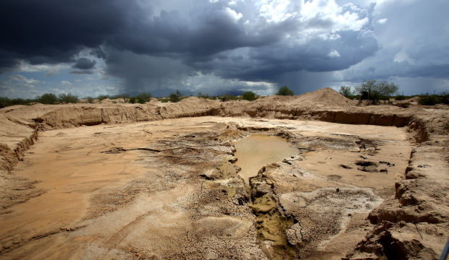
Where are they now?
Notes:
Archaeologist are not sure what happened to the Hohokam or why they left. One idea is that it became too dry or that there were too many people and the canals could not provide enough water to grow food for everyone. A final idea is that the Hohokam never left but that their culture changed over time to become the Tohono O’odham and Akimel O’odham. This idea is supported by traditional stories told by both groups. In these stories, they call the Hohokam their ancestors.

Slide 25
What are these communities like now?

Slide 26
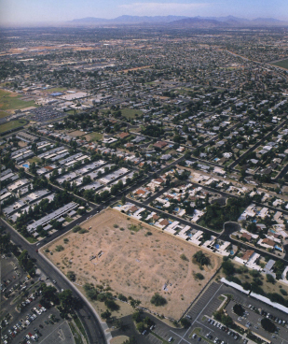
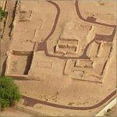
Pueblo Grande Today
Total Population:
250 people
How long people lived there:
750 years

Slide 27
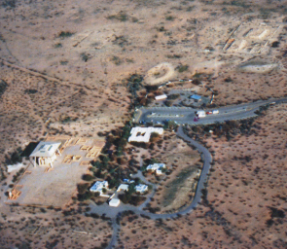
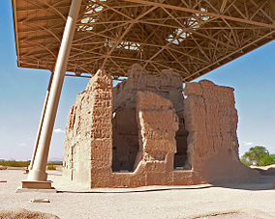
Casa Grande Today
Total Population:
250 people
How long people lived there:
700 years

Slide 28
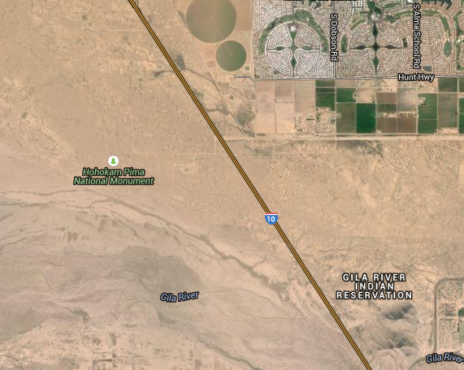
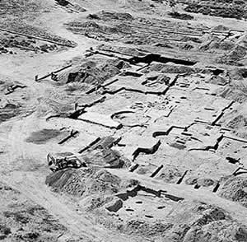
Snaketown Today
Total Population:
350 people
How long people lived there:
675 years

Slide 29
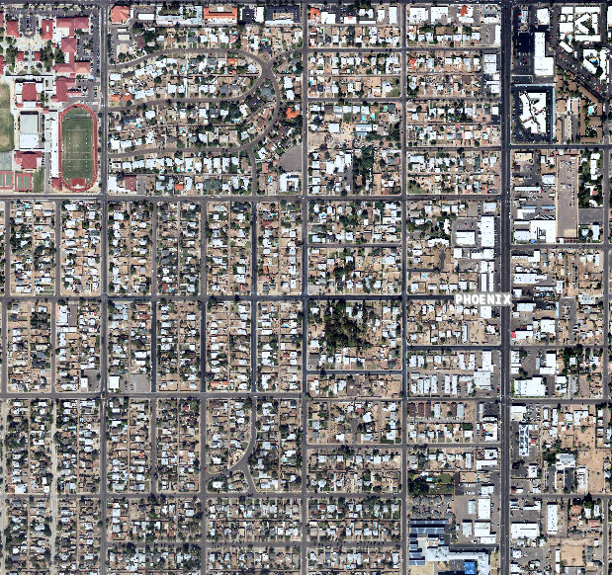

Los Muertos Today
Total Population:
50 people
How long people lived there:
100 years

Slide 30


Las Colinas Today
Total Population:
250 people
How long people lived there:
300 years

