Slide 1
Our Home: Ecosystems
We will learn about ecosystems.

Slide 2
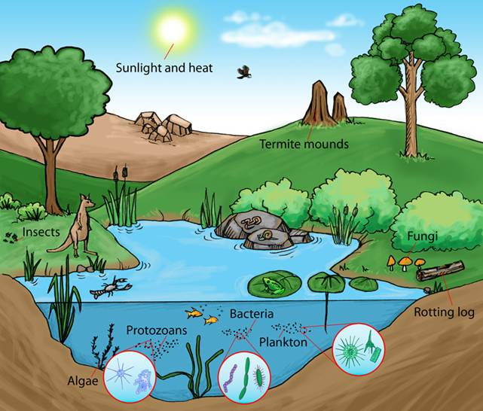
ecosystem
everything that exists in a particular environment
https://www.google.com/search?q=ecosystem&rlz=1C1CHBF_enUS841US854&source=lnms&tbm=isch&sa=X&ved=0ahUKEwjPupjuy4rjAhVTuZ4KHQDoCtoQ_AUIECgB&biw=1280&bih=610#imgrc=NiFxc8hJe7D1qM:

Slide 3
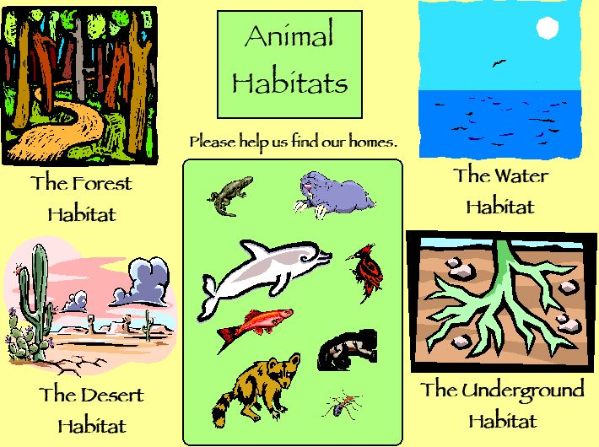
habitat
the place where a plant or animal naturally lives
https://www.google.com/search?q=habitat&rlz=1C1CHBF_enUS841US854&source=lnms&tbm=isch&sa=X&ved=0ahUKEwjuqpqgzIrjAhWlPH0KHXEtBZYQ_AUIECgB&biw=1280&bih=610#imgrc=LBC7QnEerslJhM:

Slide 4
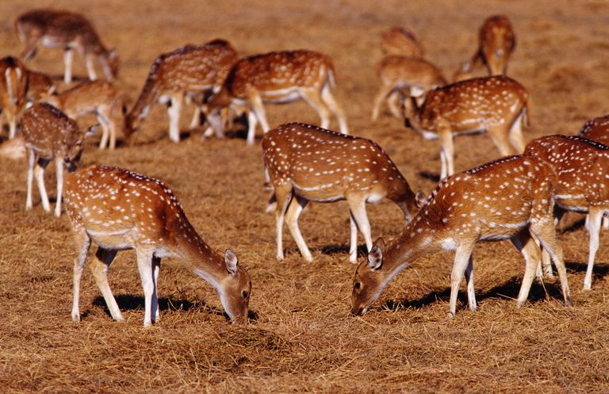
population
a group of people or animals of a particular kind that live in a place
https://www.google.com/search?rlz=1C1CHBF_enUS841US854&biw=1280&bih=610&tbm=isch&sa=1&ei=WjQVXaqxNIaj8AP2iaqABw&q=population+in+terms+of+ecosystem&oq=population+in+terms+of+ecosystem&gs_l=img.3...6520.10540..10763...0.0..0.75.1253.22......0....1..gws-wiz-img.......0i67j0j0i30j0i5i30j0i24.iHYgbDfthPs#imgrc=580Ru0tnCVO1QM:

Slide 5
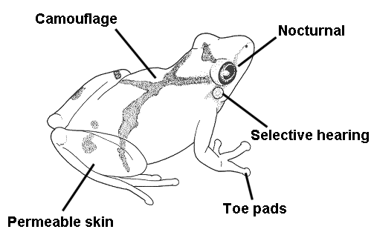
adaptation
a change in a plant or animal that makes it better able to live in a particular place or situation
https://www.google.com/search?rlz=1C1CHBF_enUS841US854&biw=1280&bih=610&tbm=isch&sa=1&ei=ljQVXfaJIuaBk-4Pvvi_0AQ&q=adaptation&oq=adaptation&gs_l=img.3..0i67j0l5j0i67j0l3.27123.29606..29844...2.0..0.63.685.12......0....1..gws-wiz-img.......0i10j0i10i24.Q0fzWi3YfFQ#imgrc=AcP4pzxNu4R_rM:

Slide 6
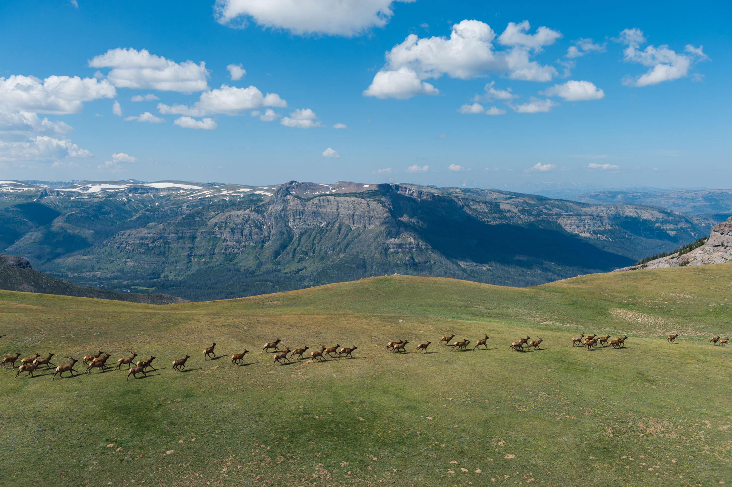
migration
to move from one area to another at different times of the year
https://www.google.com/search?rlz=1C1CHBF_enUS841US854&biw=1280&bih=610&tbm=isch&sa=1&ei=GzUVXYRylv36BIHwg4gO&q=migration+ecosystems&oq=migration+ecosystems&gs_l=img.3...10999.12821..12915...0.0..0.62.605.11......0....1..gws-wiz-img.......0j0i67j0i8i30j0i24.fML48FeFAIg#imgrc=7RiYomSIyyLbEM:

Slide 7
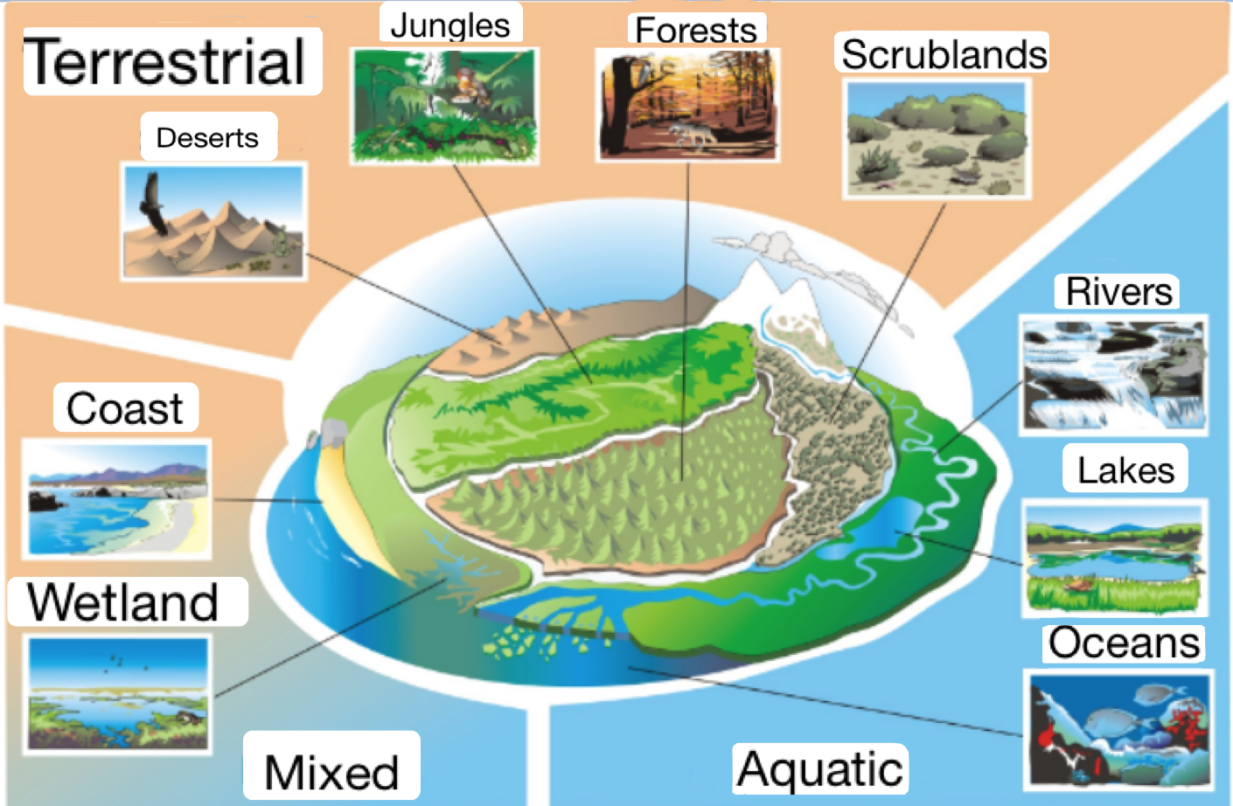
ecosystem
https://www.google.com/search?q=ecosistemas&source=lnms&tbm=isch&sa=X&ved=0ahUKEwiD4b74zZTgAhXQHDQIHRcuCPoQ_AUIDigB&biw=1304&bih=697#imgrc=s2BY7jgPWH6K_M:.

