Slide 1
Look and Learn: Photography Study of Arizona with the Giant Map
Plateau Region
Sheila O’Connor
Isaac Middle School
AZ Geographic Alliance
September 8, 2018

Slide 2
Three Landform Regions of Arizona
Plateau Region
Mountain Region
Desert Region

Slide 3
Plateau Region
A plateau is tall, elevated, flat land. It looks like a table. There are many plateaus in this region that are separated by hills and canyons. The plateau region of Arizona starts in the northern part of the state and goes south to the Mogollon Rim. The cities of Flagstaff and Holbrook are in this region. Some of the landmarks in this region are the Grand Canyon, Meteor Crater, and Humphrey’s Peak. The Navajo and Hopi reservations are also in this region. The plateau region has coyotes, javelina, and sheep. There are sagebrush and many other high desert-type plants. There are also Ponderosa pines in the highest parts of this area. The trees grow in elevations ranging from 5,500 feet to 8,500 feet. This region gets rain and snow. The winters are cold and the summers are warm.
https://geoalliance.asu.edu/sites/default/files/LessonFiles/Wood/WoodStateS.pdf
Notes:
https://geoalliance.asu.edu/sites/default/files/LessonFiles/Wood/WoodStateS.pdf

Slide 4
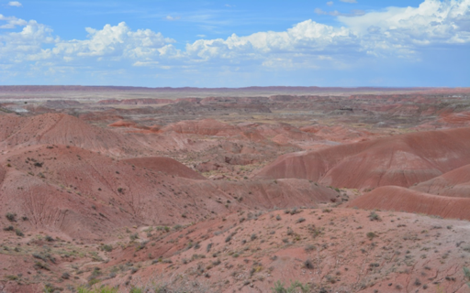
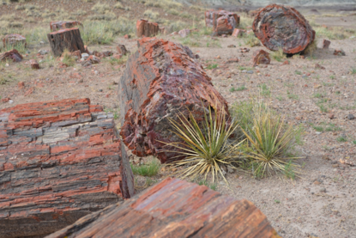
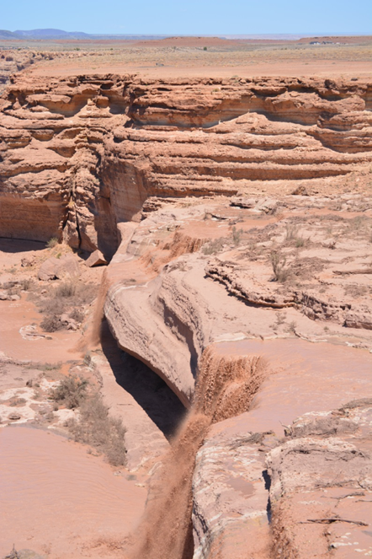
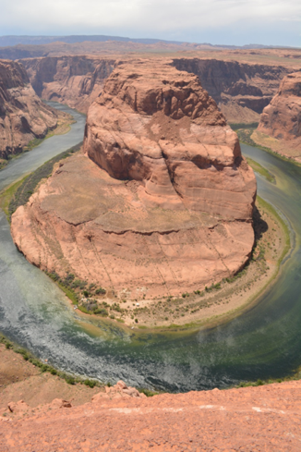
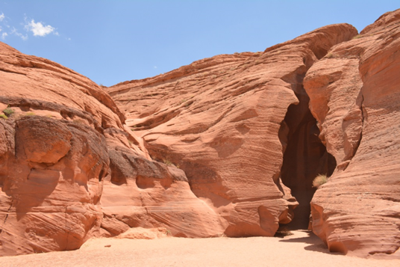
Plateau Region

Slide 5
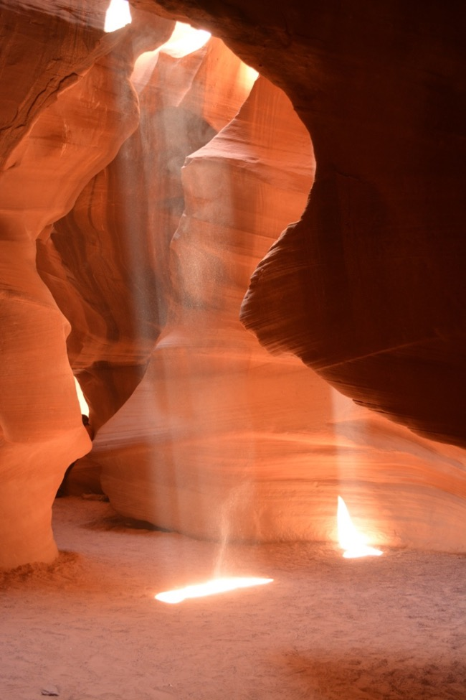
E-10 Antelope Canyon
This is the entrance to this slot canyon. Photographers love to capture the sunlight streaming into the passages. Depending on the time of day, a photographer can spend hours trying to capture the best photo.
Notes:
Plateau Region near Page, AZ

Slide 6
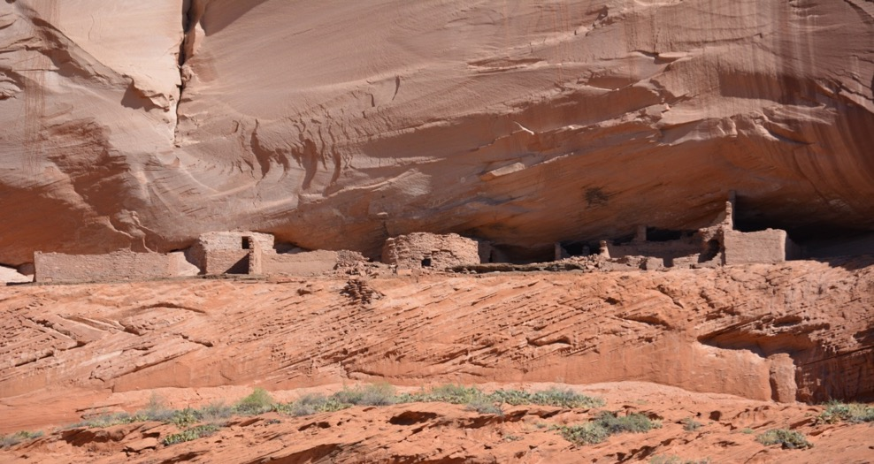
H-9 Canyon de Chelly
This site is famous for the dwellings built high in the cliff walls. There are many theories about why the dwellings are located in these places. There are also some theories about how the ancient people reached their homes. Some theories suggest that erosion has been wearing away the cliffs and the base of soil so that the houses are located high today because of this natural action of the wind.
Notes:
Plateau Region

Slide 7
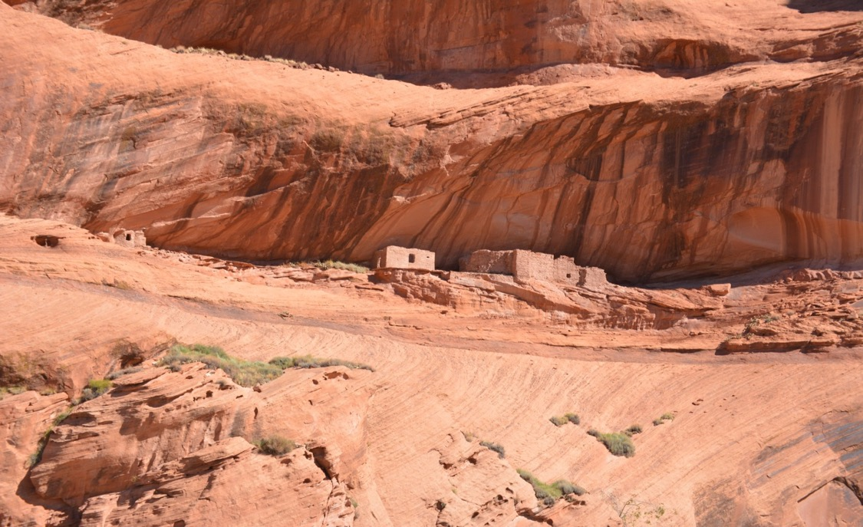
H-9 Canyon de Chelly
These homes were built near the rock walls. Most of the homes are located high in the cliffs.
Notes:
Plateau Region

Slide 8
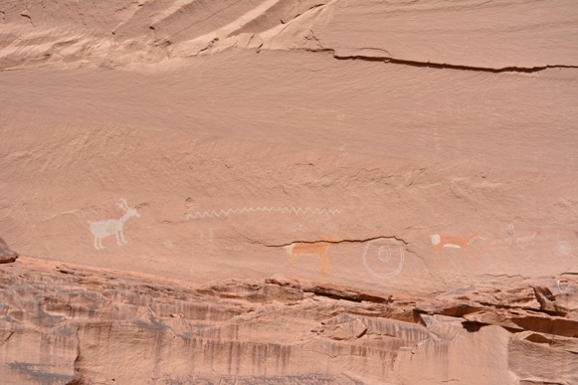
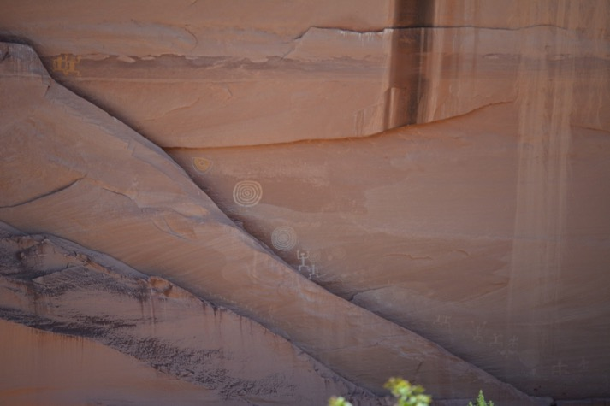
H-9 Canyon de Chelly
Petroglyphs were created by people in the rock walls to leave a message about important events. Can you see any of the people or animals?
Notes:
Plateau Region

Slide 9
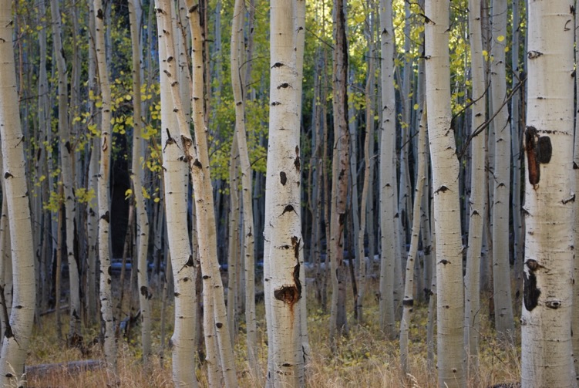
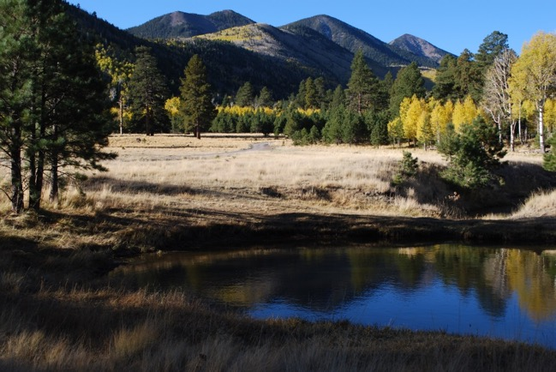
E-7 Flagstaff
If you travel to Flagstaff, you might see some forests like the ones pictured here. This region is known for the large amount of trees and many water sources. If you want to cool off in the summer, you might travel to this region to cool off in the forests.
Notes:
Mountain Region

Slide 10
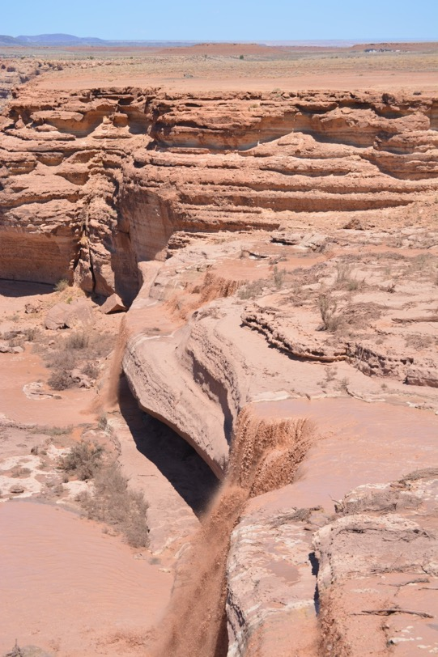
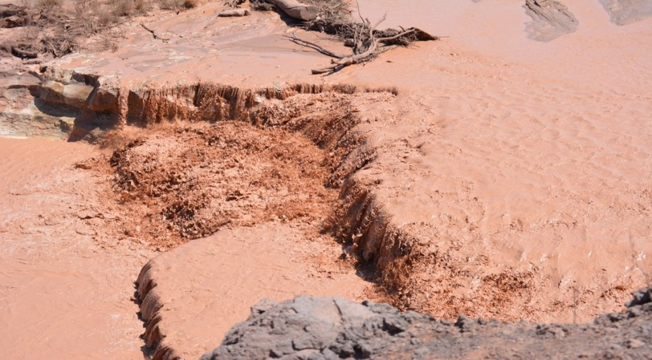
E-7 Grand Falls
Have you ever imagined a chocolate waterfall? However, you would not want to drink it because it has a lot of sediment and mud flowing with the water. It flows best in the spring time after the rains come to Arizona.
Notes:
Mountain Region located in Leupp, AZ (near Flagstaff)

Slide 11
E-10 Horseshoe Bend
This area in northern Arizona really shows off the power of water to shape rocks and the landscape.
Notes:
Plateau Region Southwest of Page, AZ

Slide 12
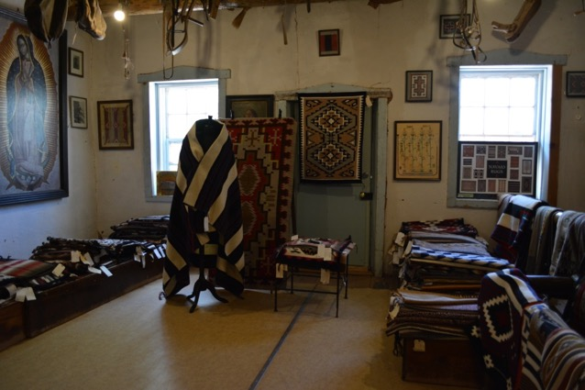
G-8 Hubbell Trading Post
Interior of the Hubbell Trading Post
This trading post has been in operation since 1878. The Hubbell family owned it for ninety years.
Some Navajo weavers still come here to trade hand woven blankets today.
Notes:
Plateau Region Granado, AZ

Slide 13
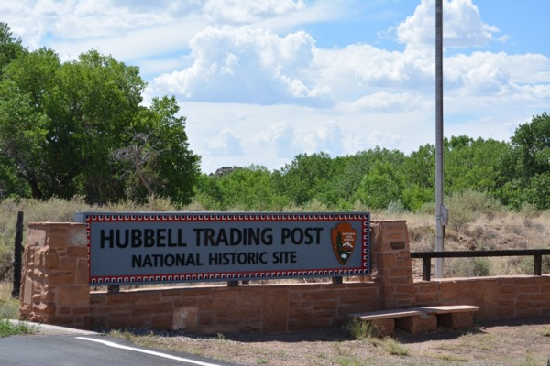
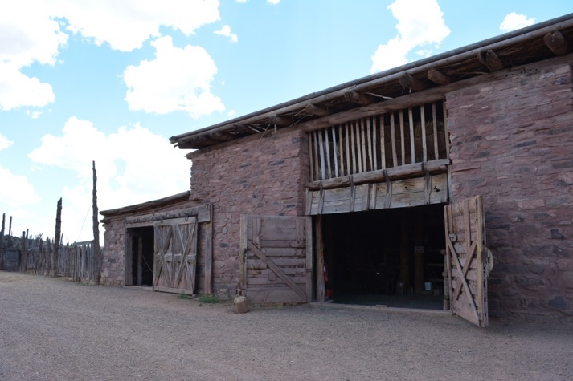
G-8 Hubbell Trading Post
People still come here today to buy goods, and Native Americans also come to trade handmade items with the owners of the trading post.
Horses lived in the stables located on the on the property. What materials were used to make this building?
Notes:
Plateau Region Granado, AZ

Slide 14
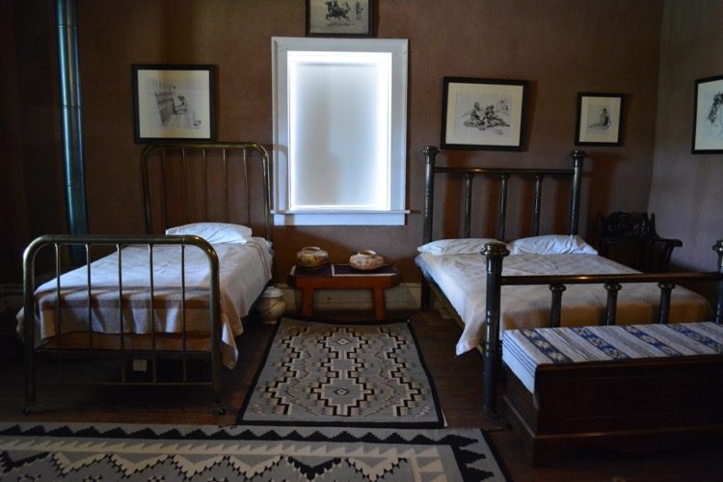
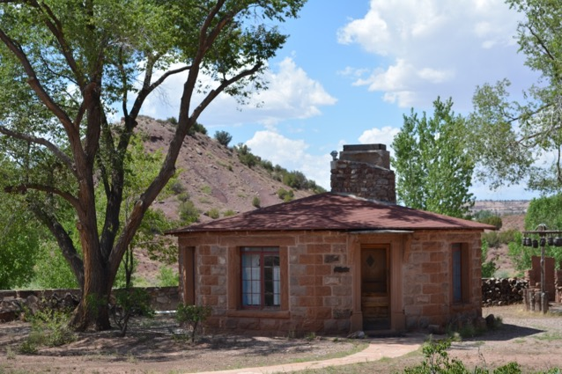
G-8 Hubbell Trading Post
This is one of the bedrooms in the house. Many Native Americans traded handmade rugs for other goods that they needed.
What materials were used to make this house?
Main house-- bedroom and guest house
Notes:
Plateau Region Granado, AZ

Slide 15
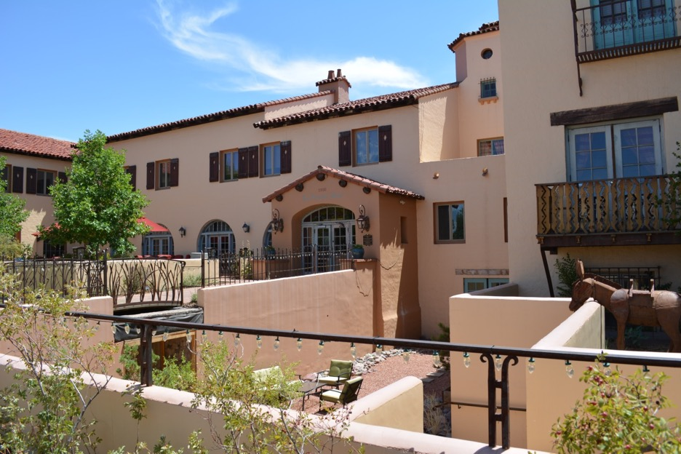
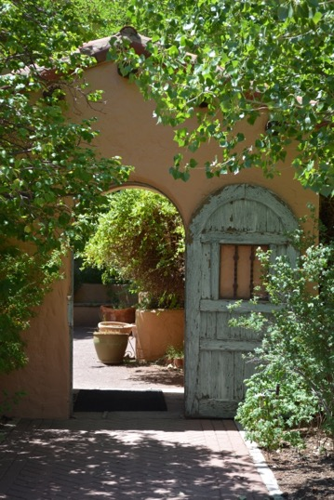
F-7 La Posada
La Posada was designed in 1930 by Mary Jane Colter. It was built for Fred Harvey and served as a Santa Fe Railroad Hotel in Winslow, Arizona.
Notes:
Plateau Region Williams, AZ

Slide 16
G-7 Painted Desert
The desert landscape is vibrant and colorful in this region of the state.
Notes:
Plateau Region east of Holbrook, AZ

Slide 17
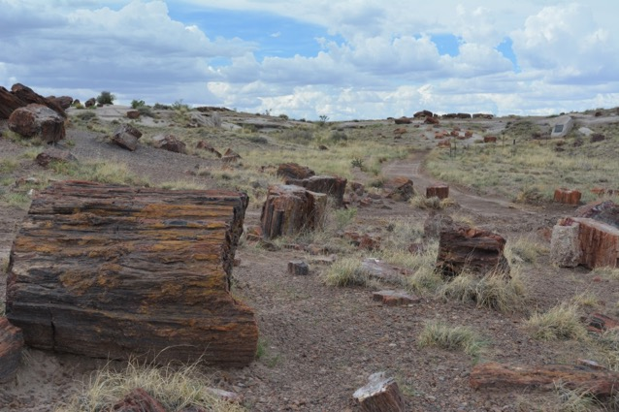
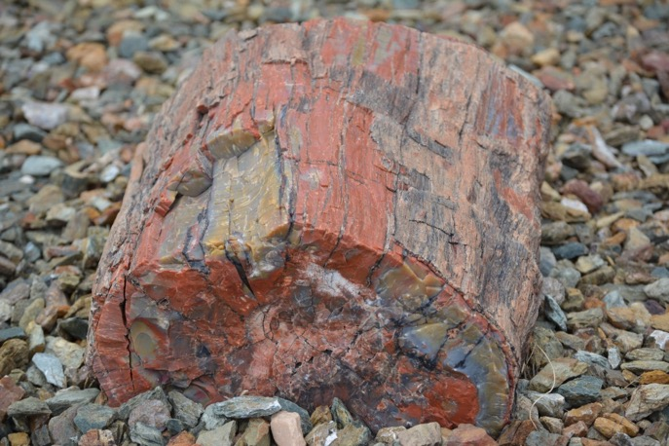
G-7 Petrified Forest
These photos are from a part of the national park called the Jasper Forest. However, you can’t use these trees to build a house. But you can study them to learn about life in Arizona over 225 million years ago!
Notes:
Plateau Region east of Holbrook, AZ

Slide 18
G-7 Petrified Forest
Did you know that you are looking at some pieces of ancient trees?
Notes:
Plateau Region east of Holbrook, AZ
https://geology.com/stories/13/petrified-wood/ This site has a simple explanation about what happens to a tree over time.

Slide 19
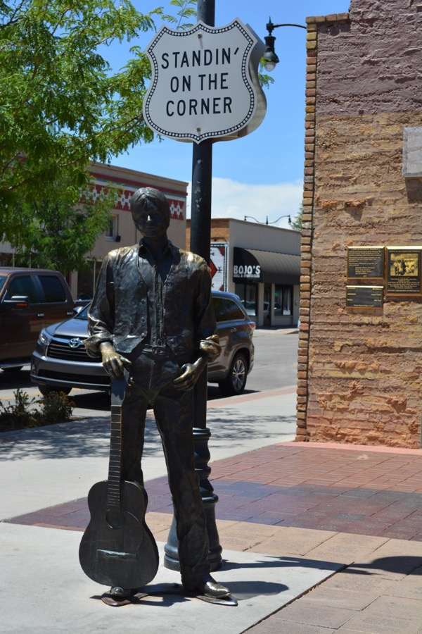
F-7 Winslow
Arizona and Arizona landmarks appear is several famous songs. This particular statue pays tribute to the city of Winslow and to several songwriters. Glenn Frey and Jackson Brown created a hit song called “Take It Easy”. The band called the Eagles recorded it, and Winslow became a hit with tourists. Winslow was already famous in Arizona but now it is famous all over the country because of the song.
Take It Easy (3.50 min)
Notes:
Plateau Region Winslow, AZ

Slide 20
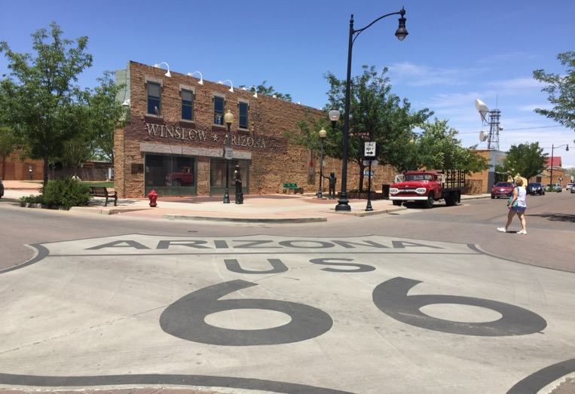
F-7 Route 66 in Winslow
Route 66 runs through northern Arizona and passes through many historic sites and national landmarks. Here is Winslow’s way of acknowledging the route that brought an increase of automobile traffic through the city. Tourists and other travelers still can use this route today. Interstate 40 might be faster but Route 66 still appeals to people who want to “Get Their Kicks on Route 66”.
Notes:
Plateau Region Winslow, AZ

