Slide 1
Look and Learn: Photography Study of Arizona with the Giant Map
Sheila O’Connor
Isaac Middle School
AZ Geographic Alliance
September 8, 2018
Mountain Region

Slide 2
Three Landform Regions of Arizona
Plateau Region
Mountain Region
Desert Region

Slide 3
Mountain Region
The mountain region in Arizona winds across the state from corner to corner. Most of the mountains are 4,000 to 6,000 feet high. One of the highest peaks in the region is Mount Graham near Safford which is 10,713 feet tall.
We get much of our water from dams that store water coming from the mountains. The dams provide water for boating, fishing, and for cities and farms. They also help stop flooding.
Many years ago these mountains were the sites of gold, silver, and copper mines. There are still some copper mines in this region. There are many cattle ranches in the mountain region.
The animals in this region include sheep, mule deer, black bear, and bison. There are also Ponderosa pines and wildflowers in the area. The sides of the mountains are especially beautiful in the spring when these flowers are in bloom. This region gets rain and snow. The winters are cold and the summers are cool with afternoon showers in August.
https://geoalliance.asu.edu/sites/default/files/LessonFiles/Wood/WoodStateS.pdf

Slide 4
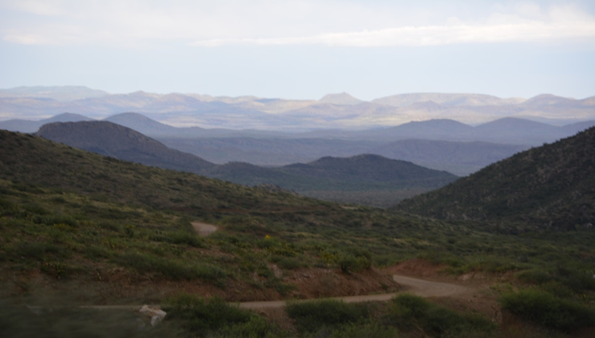
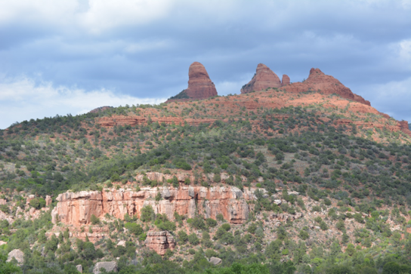
Mountain Region

Slide 5
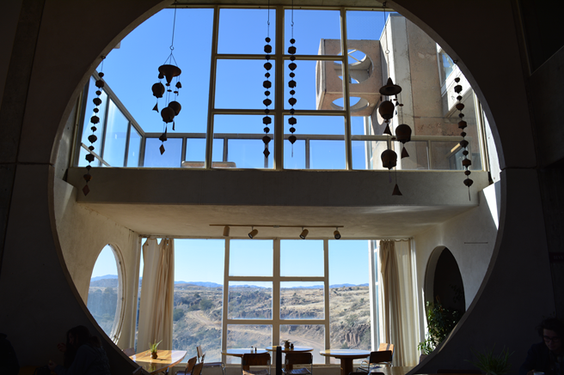
D-6 Arcosanti
© Colleen Miller
Paul Soleri created Arcosanti as a place for artists to work and live. The design of the windows allows someone visiting or living here to see out into the landscape easily.
© Colleen Miller
Notes:
Desert Region

Slide 6
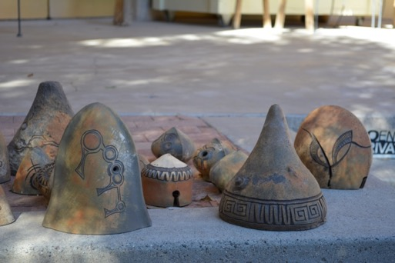
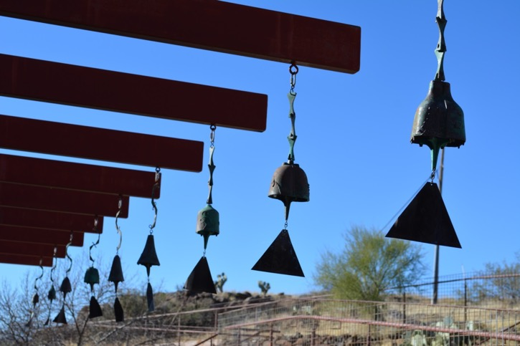
D-6 Arcosanti
The bells made at Arcosanti are easy to recognize. They are handcrafted by the artists who live here. Molds are pictured above along with some of the bells that hang on the property.
Notes:
Desert Region

Slide 7
D-6 Crown King
Pioneers and territorial settlers had to pass through many mountainous regions to reach their destination. This is the road driving towards Crown King. Can you imagine riding this way on horseback or in a wagon?
Notes:
Mountain Region Crown King, AZ

Slide 8
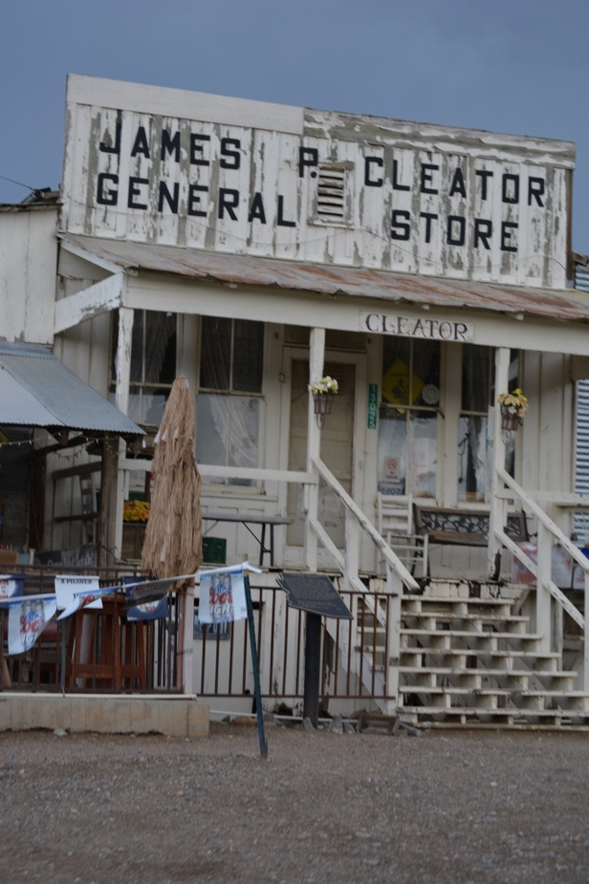
D-6 Crown King
Small towns in Arizona often had a general store to allow people to buy goods in the town.
Notes:
Mountain Region Crown King, AZ

Slide 9
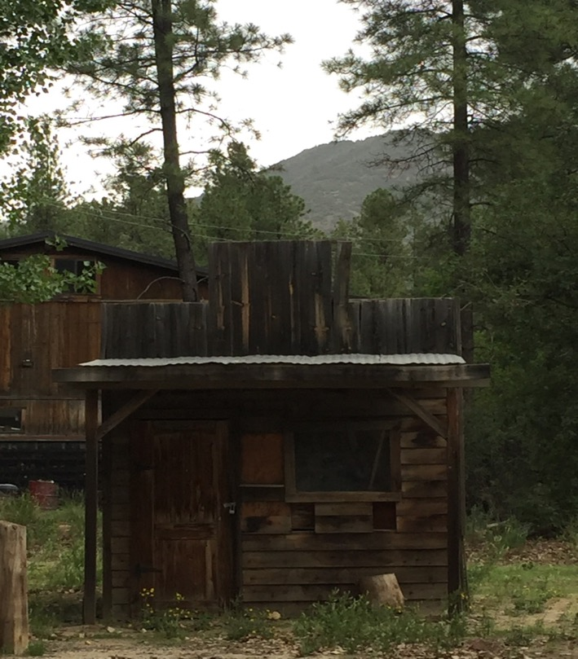
D-6 Crown King
Mining towns and territorial towns left many buildings for us to observe and study today. Here is an example of a small wooden building.
Notes:
Plateau Region

Slide 10
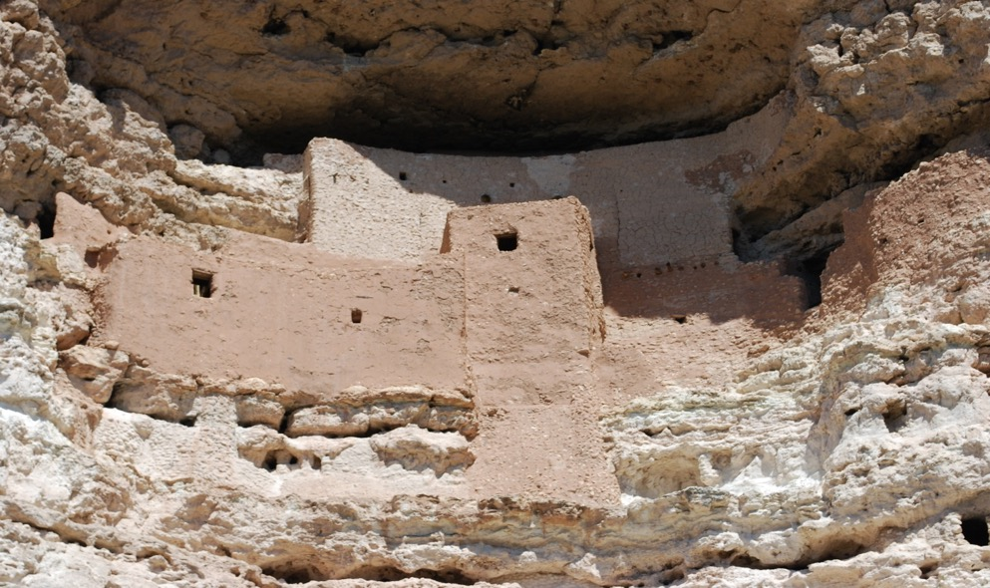
E-6 Montezuma’s Castle
The Sinagua people created these dwellings. They must have had some amazing architects because these homes have lasted for more than 800 years. Can you imagine people visiting your house in the future?
Notes:
Mountain Region Camp Verde, AZ

Slide 11
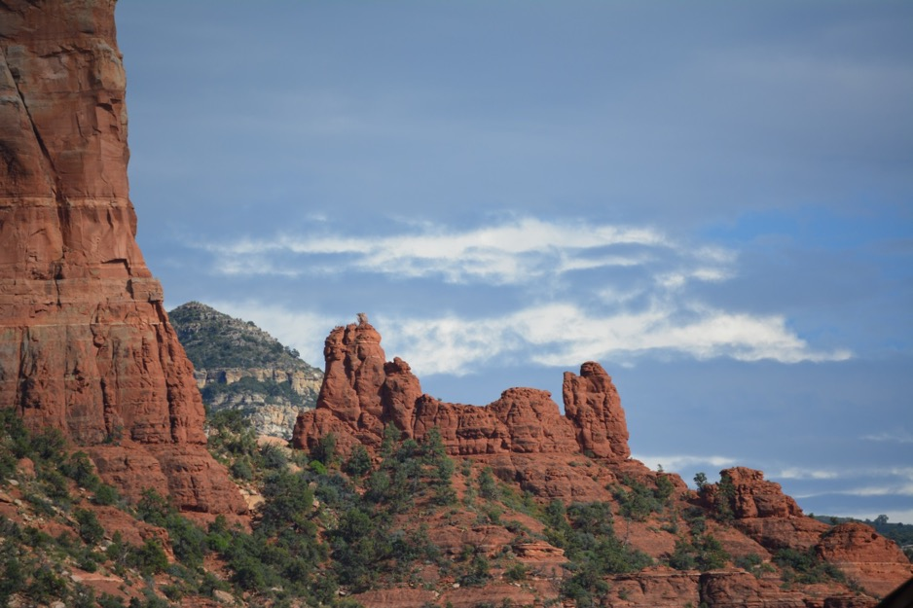
E-7 Sedona
Marvelous mountains and red rocks will amaze and impress you in this region of the Arizona.
Notes:
Mountain Region Sedona, AZ

Slide 12
E-7 Sedona
The rock formations in this region are unique.
Notes:
Mountain Region Sedona, AZ

Slide 13
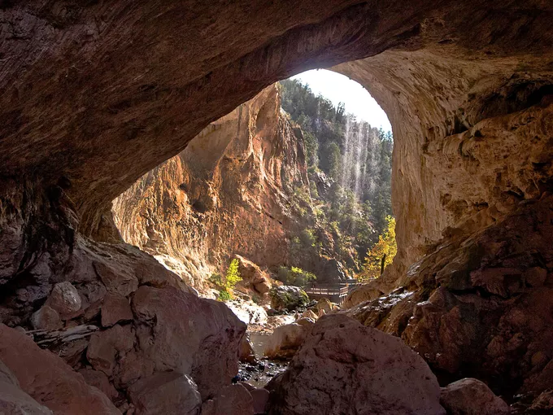
E-9 Tonto Natural Bridge
https://www.azcentral.com/story/travel/arizona/2018/03/12/tonto-natural-bridge-visitors-guide/316584002/
Tonto Natural Bridge is located north of Payson, Arizona. This is a state park that should not be missed if you are looking for an adventure in Arizona.
https://azstateparks.com/tonto

Slide 14
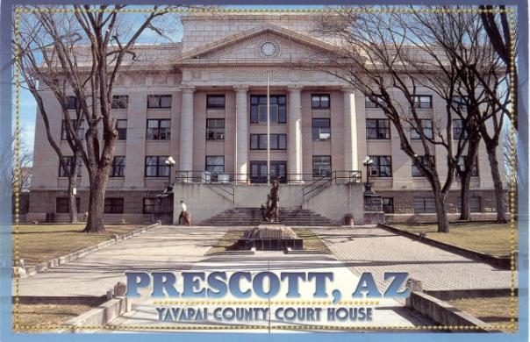
D-6 Yavapai County Courthouse
http://courthousehistory.com/gallery/states/arizona/counties/yavapai
Prescott’s main square is anchored by the Yavapai County Court House. This impressive structure serves as the repository of all legal documents for the county. The courthouse serves as the backdrop on many local festivals and activities in Prescott, Arizona. This building has served the county for more than one hundred years.
http://courthousehistory.com/gallery/states/arizona/counties/yavapai

