Slide 1
Look and Learn: Photography Study of Arizona with the Giant Map
Sheila O’Connor
Isaac Middle School
AZ Geographic Alliance
September 8, 2018
Desert Region

Slide 2
Three Landform Regions of Arizona
Plateau Region
Mountain Region
Desert Region

Slide 3
Desert Region
The desert region is in the southwestern part of Arizona. This region is also called the Sonoran Desert and this desert goes all the way into Mexico. There are many flat valleys bordered by mountains. Some of the valleys in this region are fertile and are used for farming. The problem is there is very little rainfall in this region. The weather is hot and the summers are very long. Most of Arizona's people live in this part of the state. Palo Verde is the state tree. Palo Verde, which means green stick, grows in this region. There are also many cacti in this area. One of the biggest is the saguaro, looking like a giant guarding the desert. There are many animals in this region. Some of them are jackrabbits, coyotes, javelina, and various types of reptiles.
https://geoalliance.asu.edu/sites/default/files/LessonFiles/Wood/WoodStateS.pdf

Slide 4
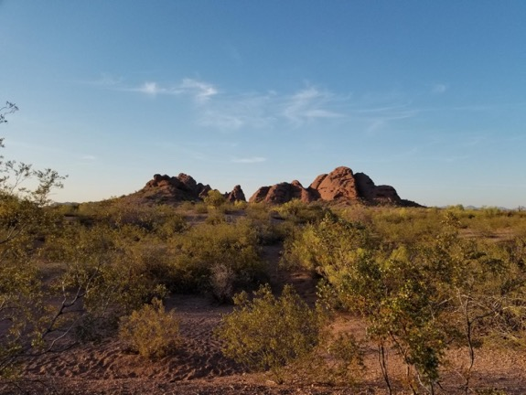
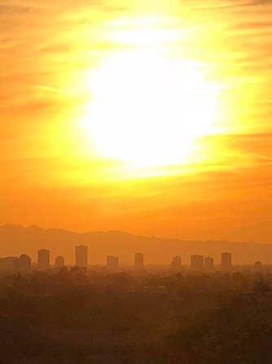
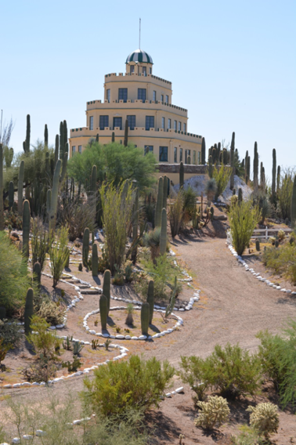
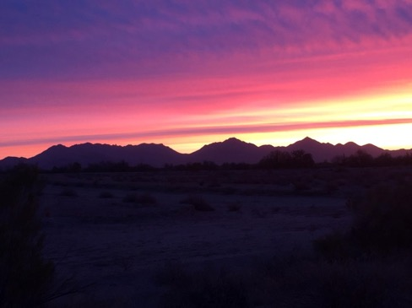
Desert Region

Slide 5
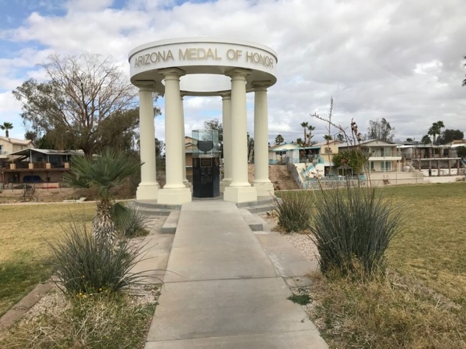
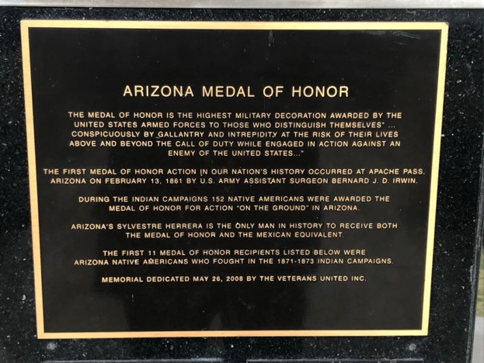
A-7 Arizona Medal of Honor Memorial
This site is located near Bullhead City in the Arizona Veterans Memorial Park. It recognizes Arizonans who have received a medal of honor from the United States military. The medal of honor is the highest military decoration awarded by the United States Armed Forces to those who distinguish themselves” … conspicuously by gallantry and intrepidity at the risk of their lives above and beyond the call of duty while engaged in action against an enemy of the United States…"

Slide 6
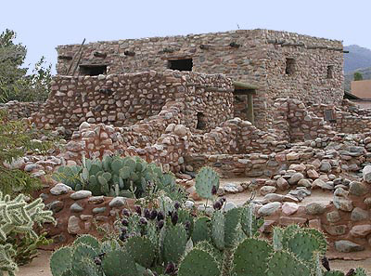
F-5 Besh-Ba-Gowah
http://www.discovergila.com/Besh-Ba-Gowah.php
Besh-Ba-Gowah is located in Globe, Arizona. It represents the architecture of the Salado people. In this structure, there were 200 interconnected rooms with a second story centered around several plazas for markets. This structures were built over a long period of time. Some archaeologists estimate that the Salado people added to the community structures for 200 years. This community was prosperous in the 1300s and the completion of Besh-Ba-Gowah is estimated to be around 1400 AD.
http://www.globeaz.gov/visitors/besh-ba-gowah http://azruins.com/besh-ba-gowah-archaeological-park/

Slide 7
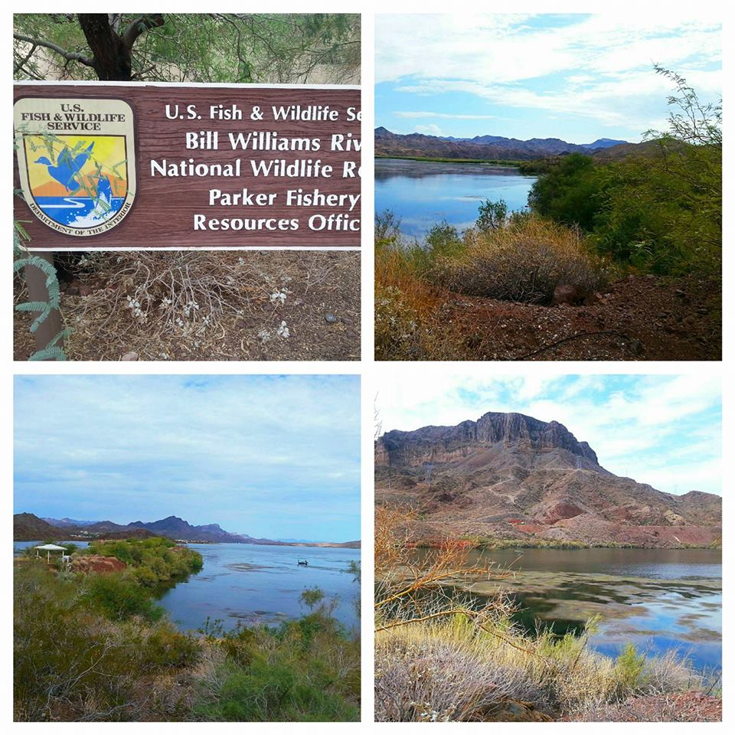
B-6 Bill Williams River
The Bill Williams River near Parker Arizona provides a natural recreation area and wildlife refuge for the western part of the state. The Bill Williams River feeds into the Colorado River. The National Wildlife Refuge protects the wildlife, birds, and fish in this area. Over 400 different species use this area as their home in the desert. It contains one of the largest remaining native cottonwood and willow forests along the Colorado River.
https://www.fws.gov/refuge/bill_williams_river/

Slide 8
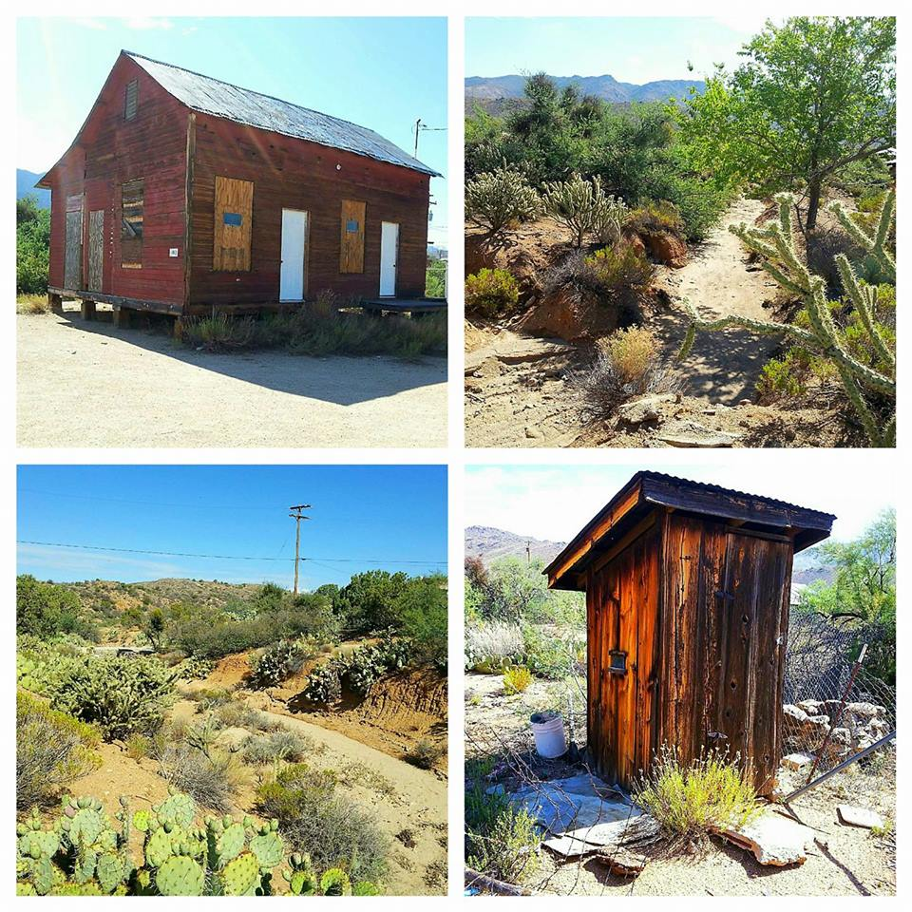
B-8 Chloride, Arizona
Do ghost towns exist in Arizona? Chloride is an example of a mining town that has not seen a lot of mining or visitors in many years. Sometimes, people call it a ghost town. The town’s population is about 150 people today. During the mining boom there were over 5,000 people living there. Here are some photos to show an old school house and some images of the Mohave Desert that miners would have crossed to get to the Cerbat Mountains where the silver, lead, gold, turquoise, and zinc could be found.
https://westernmininghistory.com/towns/arizona/chloride/

Slide 9
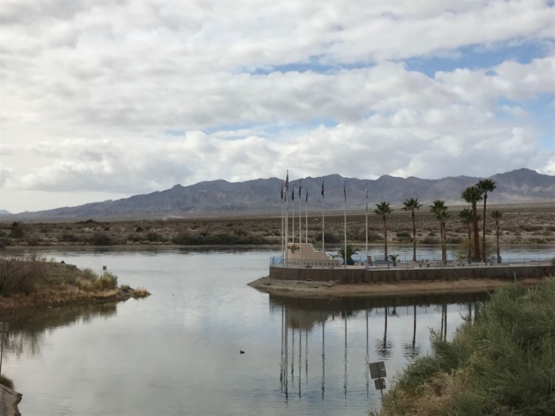
A-7 Colorado River near Bullhead City
Every city that is near the Colorado River has access to water sports and water activities that many in Arizona dream about in the summer time. Perhaps, that is why these towns receive so many tourists throughout the year. The location near the Colorado River is significant for trade, transportation and for recreation.

Slide 10
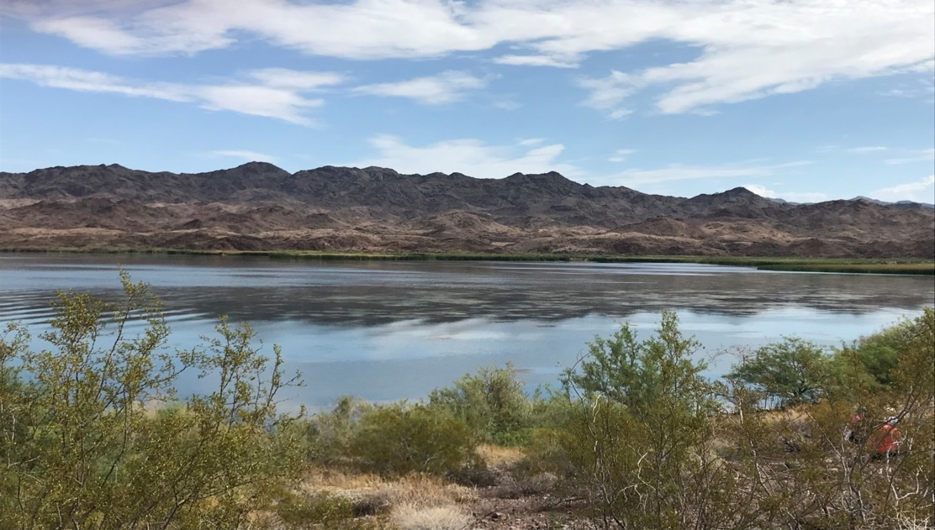
B-6 Colorado River near Lake Havasu
The Colorado River provides fresh water for many places throughout Arizona. It is an important natural resource for people and animals.
Notes:
Desert Region The Colorado River provides water to the majority of the people who live in Arizona. This river provides excellent locations for fishing, swimming, and kayaking in some areas of the state. Lake Havasu is known for its water recreational sports. This photo captures a calm and less disturbed segment of the river that is located north of Lake Havasu.

Slide 11
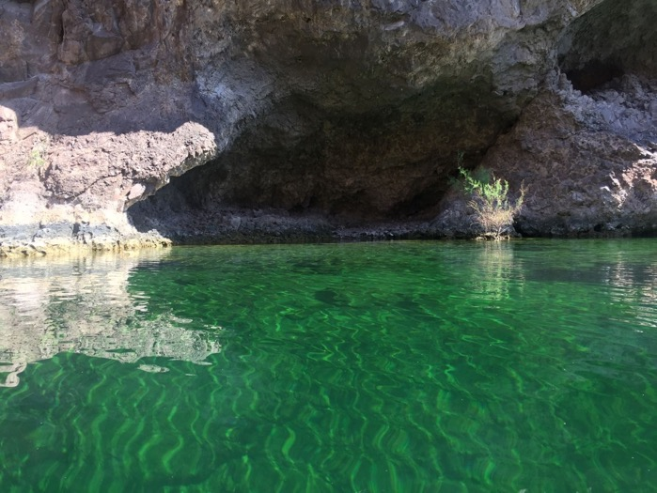
A-8 Emerald Cave on the Colorado River
This is a place along the Colorado River between the Hoover Dam and Willow Beach located north of Kingman, Arizona. This location attracts tourists because the water and the rocks work with the sunshine to reflect an emerald color off of the cave walls. You will need to kayak or take a boat to see this special location along the Colorado River. Also, If you are lucky, you might spot some bighorn sheep climbing the canyon walls.

Slide 12
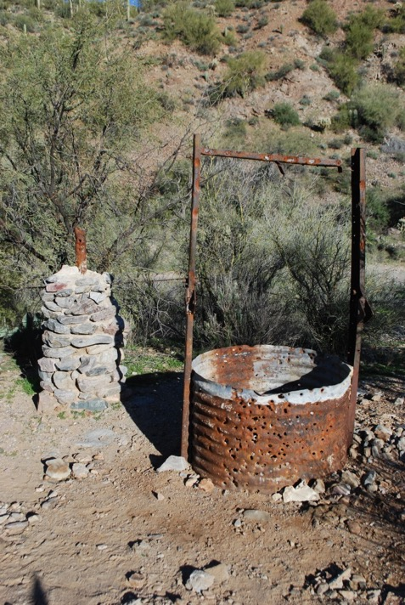
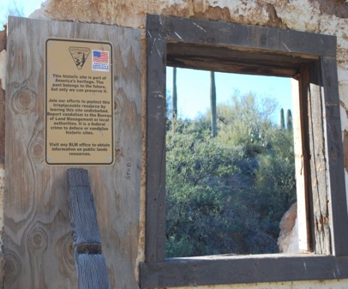
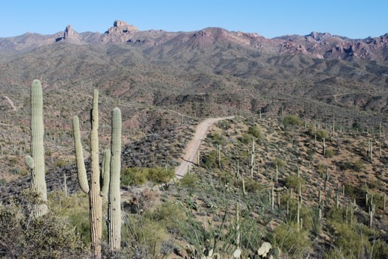
E-4 Florence: Historic Mining Area
Miners and pioneer settlers needed wells to gather water.
This is the road into town.
Notes:
Desert Region

Slide 13
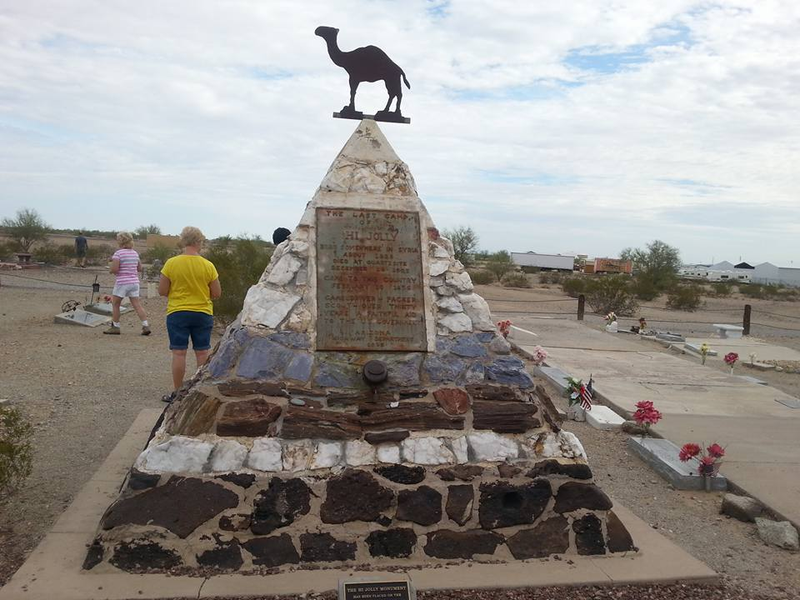
B-5 Hi Jolly Monument
This monument pays tribute to Hi Jolly or . He was a man who worked with camels when some military men thought that camels could be trainable and adaptable to the Sonoran Desert. This monument is located in a cemetery found in Quartzite, Arizona.

Slide 14
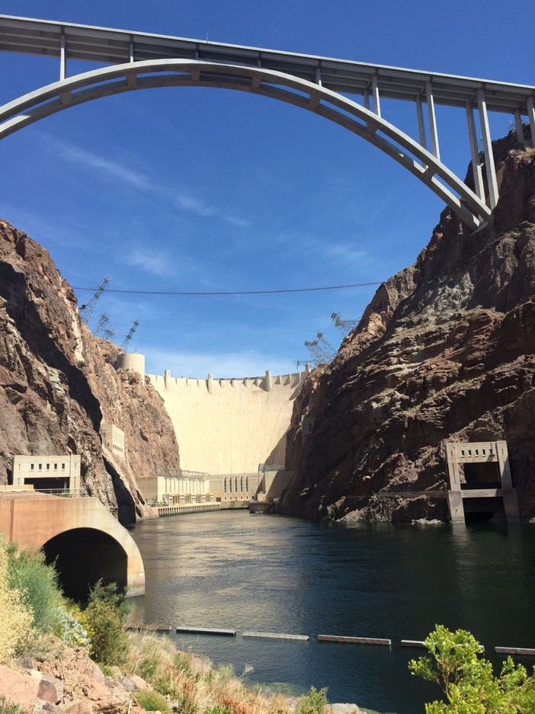
A-9 Hoover Dam
In the past, Arizonans needed a way to control the rivers. This dam was created to control the flow of the mighty Colorado River in western Arizona. Both the Hoover Dam and the bridge were designed by engineers.
Do you like to build items? Do you like to complete puzzles? Have you ever thought about becoming an engineer?
Notes:
Desert Region Northwest of Kingman

Slide 15
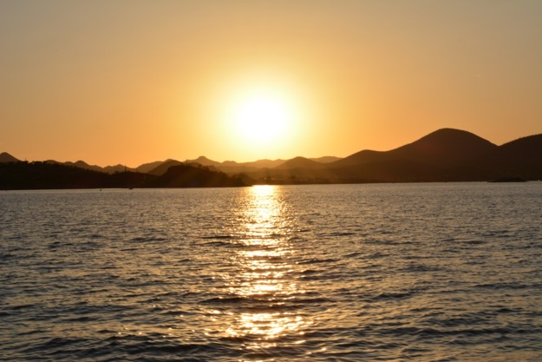
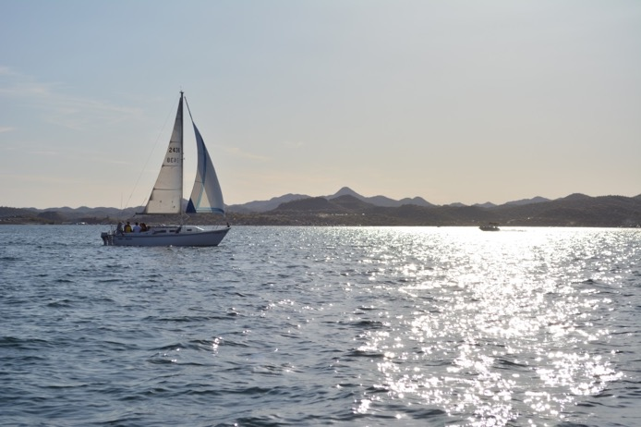
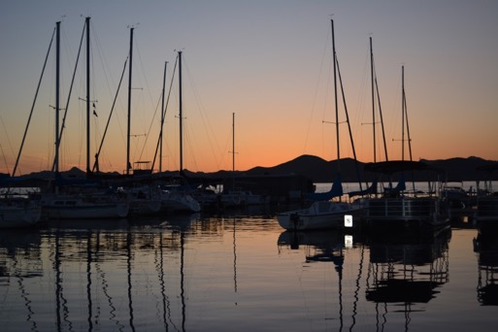
D-5 Lake Pleasant
Arizonans can enjoy several man-made lakes that allow people to enjoy sailing, paddling kayaking, and watching sunsets.
Notes:
Desert Region Peoria, AZ

Slide 16
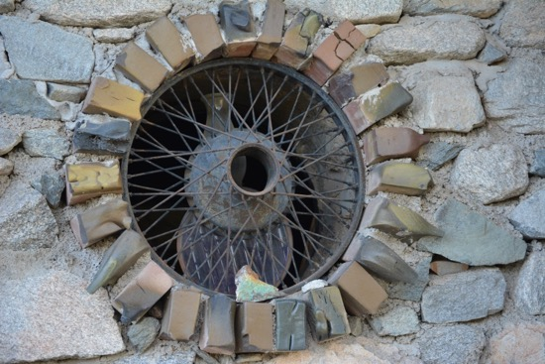
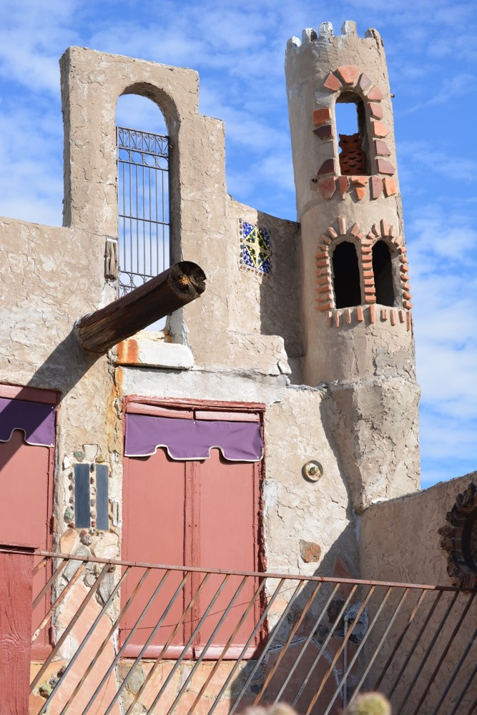
D-5 Mystery Castle
Bruce Gully built the Mystery Castle by hand with objects found in the desert near South Mountain. He built this house for his daughter because she had asked for a castle when she was a young girl. Can you see any objects that you recognize in these photos?
Notes:
Phoenix, AZ

Slide 17
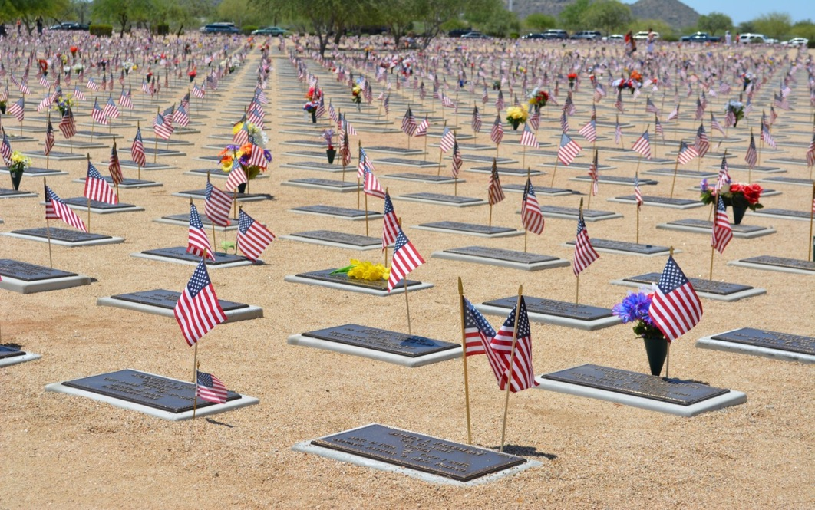
D-5 National Veteran’s Cemetery
Many Arizonans have served in the US military. The National Veteran’s Cemetery honors these people for their service to the country.
Notes:
Desert Region Phoenix, AZ

Slide 18
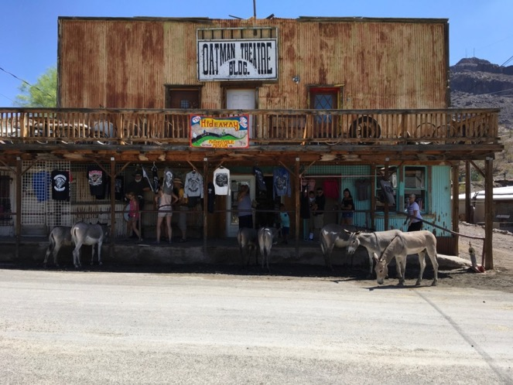
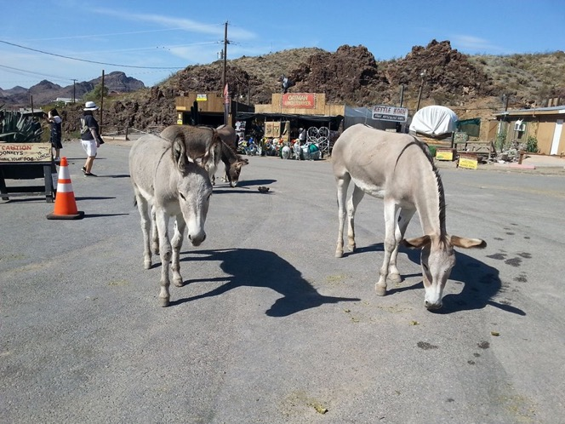
B-7 Oatman
A sense of days gone by still exists in some of the old mining towns. The burros wander and help to bring tourists to this sleepy town in northern Arizona.
Notes:
Desert Region Oatman, AZ

Slide 19
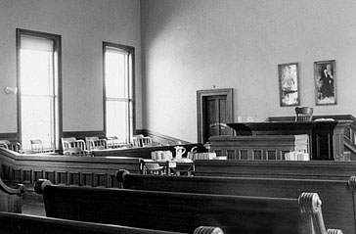
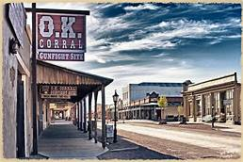
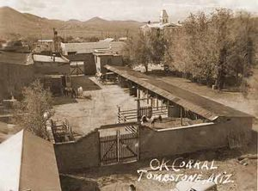
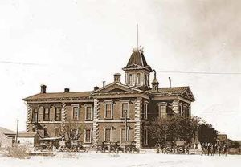
G-2 OK Corral and Courthouse in Tombstone
https://azstateparks.com/tombstone/about-the-courthouse/park-history
https://tombstoneweb.com/history/
https://tombstoneweb.com/history
https://azstateparks.com/tombstone or http://www.tombstoneaz.net/tombstone-court-house.html
This courthouse and the OK Corral location are places to visit in Tombstone if you are interested in a learning about a wilder side of Arizona history from the 1880s when gun fighting was a way to solve conflicts. This courthouse held many historic trials including the trial of Wyatt Earp for the shoot out that took place at the OK Corral. If you were found guilty here, you would be transferred to the Yuma Territorial Prison.

Slide 20
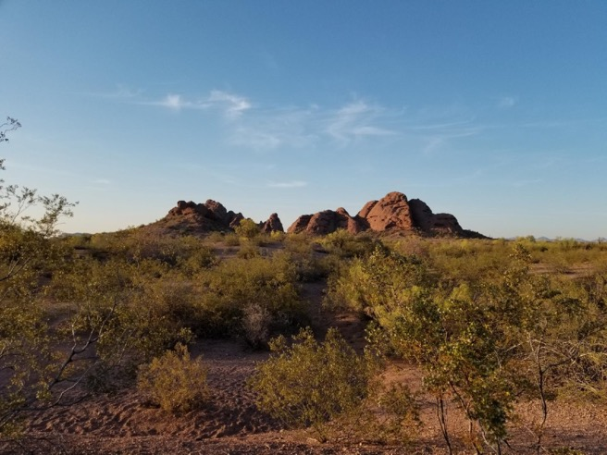
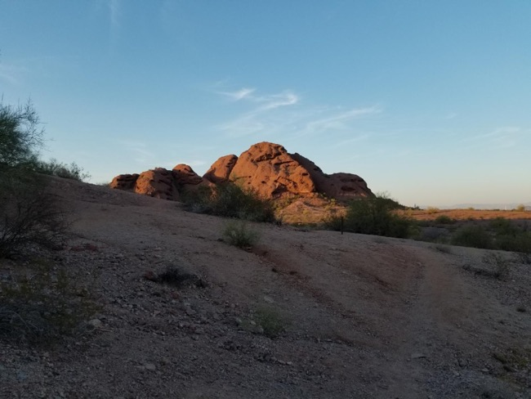
D-5 Papago Park
Papago Park is located between Phoenix and Tempe, Arizona. Today it provides trails and recreation facilities to residents of the two cities. It also hosts a golf course, a sports complex, the Desert Botanical Garden and the Phoenix Zoo. It was the location of a prisoner of war camp during World War I and World War II. A few acres adjacent to the current park are still used by the US military.

Slide 21
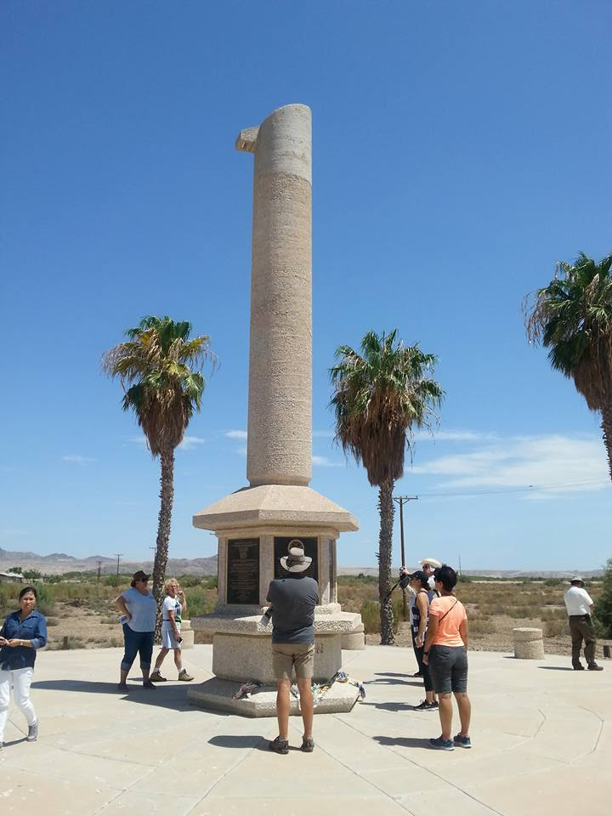
B-6 Poston Memorial
Executive Order 9066 changed the lives of people living in the United States of America with Japanese ancestry during World War II by creating internment camps throughout the Southwest. Arizona was a designated location for internment camps in 1942. The camp located in Poston had a population that reached over 17,000 people during World War II. The internment camp was closed in 1945 when the war ended. The buildings from the camp are in ruins today but the memorial monument was created in 1992 to remind people of the hardships faced by the people Japanese ancestry who faced racial prejudice and wartime indignities.
https://www.azcentral.com/story/travel/local/history/2015/04/24/arizonas-military-history-poston-memorial-monument/26201191/

Slide 22
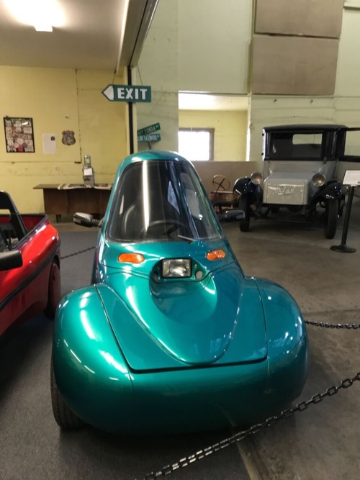
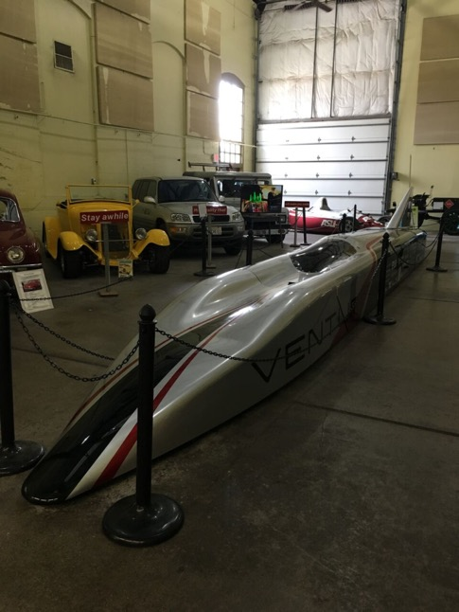
B-7 Powerhouse Route 66 Museum
This museum located in Kingman, Arizona hosts exhibits about the impact of Route 66 and transportation in northern Arizona. The latest exhibit shows electric cars and ideas about cars of the future.

Slide 23
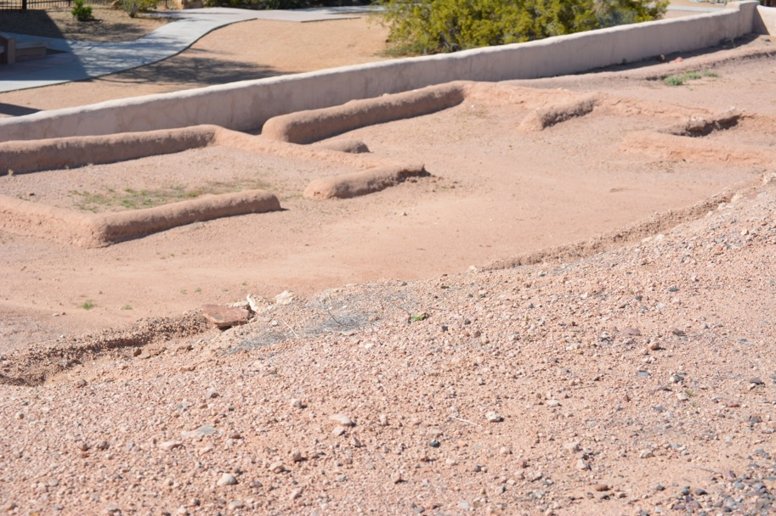
D-5 Pueblo Grande
This site shows the foundations of dwellings in a Hohokam village. The village supported approximately 1000 people . Only a few outlines of buildings can be seen today at the site. This area near the Salt River supported a very active Hohokam community.
Notes:
Desert Region Phoenix, AZ
https://www.phoenix.gov/parkssite/Documents/PKS_Pueblo_Grande_Museum/d_048501.pdf

Slide 24
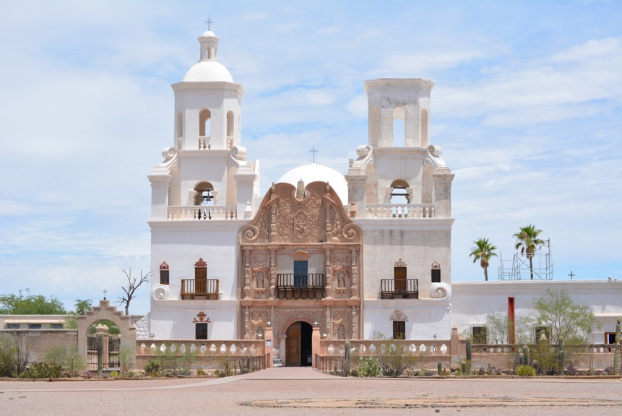
F-3 San Xavier del Bac Mission
https://www.nps.gov/tuma/learn/historyculture/san-xavier-del-bac.htm
This Spanish style mission was completed in 1797. It represents the expansion of missionary work in southern Arizona. Different groups have lived and visited the site including priests from all parts of Europe, American pioneers, Native Americans, and settlers from Mexico. You can visit this historic site today.
https://www.nps.gov/tuma/learn/historyculture/san-xavier-del-bac.htm

Slide 25
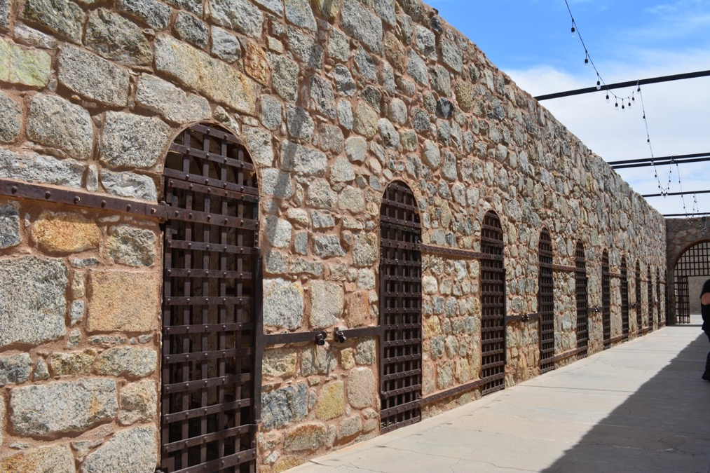
A-4 Territorial Prison in Yuma
If you broke the law about 1900, you could find yourself behind bars in this territorial prison located in Yuma.
Notes:
Desert Region Yuma, AZ

Slide 26
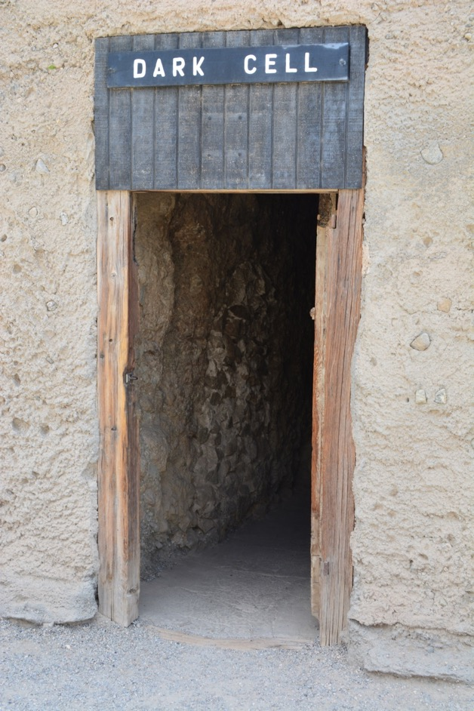
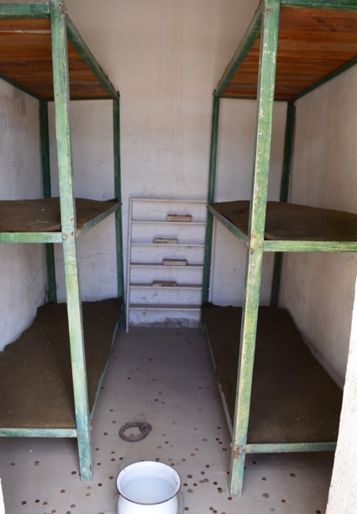
A-4 Territorial Prison in Yuma
Here are some images of the prisoner’s cells. If a prisoner had a serious violation then he or she might be placed in the dark cell. Prison life was very difficult.
Notes:
Desert Region Yuma, AZ

Slide 27
D-5 Tovrea Castle
This house might look like the layers of a birthday cake from a distance but it hides so much more inside. This castle was built in the 1920s as part of a hotel. It also served several families as their home. The city of Phoenix owns the building and the land today.
Notes:
Desert Region Phoenix, AZ
https://tovreacastletours.com/

Slide 28
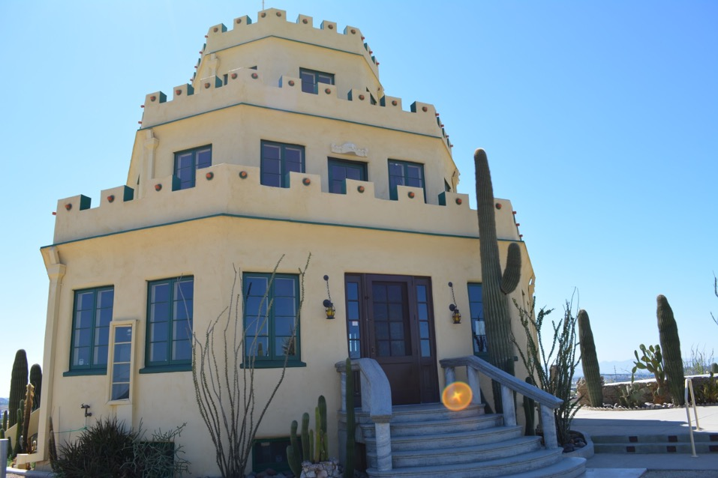
D-5 Tovrea Castle
This building is set on a hilltop in Phoenix. It is surrounded by planned gardens. It can be seen from a distance and it inspires people to think about the opportunities available in Phoenix.
Notes:
Desert Region Phoenix, AZ

Slide 29
Photography Credits
Colleen Miller holds the copyright to most of the photographs used in this presentation.
She and I have travelled to many of these places together. I am always amazed by her creativity and use of her cameras.
Fortunately, she has a large collection of amazing photos for locations throughout the state of Arizona.
She has allowed me to use the photos for educational purposes with this lesson.

Slide 30
Any Questions?

Slide 31
Contact Information
Sheila O’Connor
Isaac Middle School
602-455-6800
saoconnor@isaacschools.org

