Slide 1
Landmarks Part 2
Painted Desert to
Yuma Territorial Prison

Slide 2
Painted Desert

Slide 3
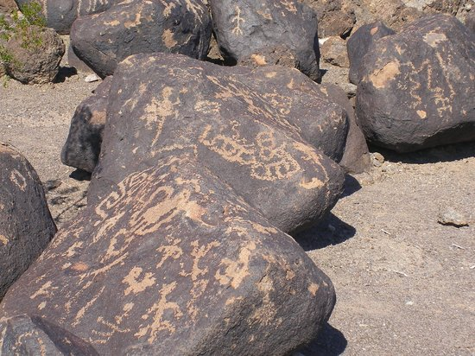
Painted Rock Petroglyphs

Slide 4
Petrified Forest National Park

Slide 5
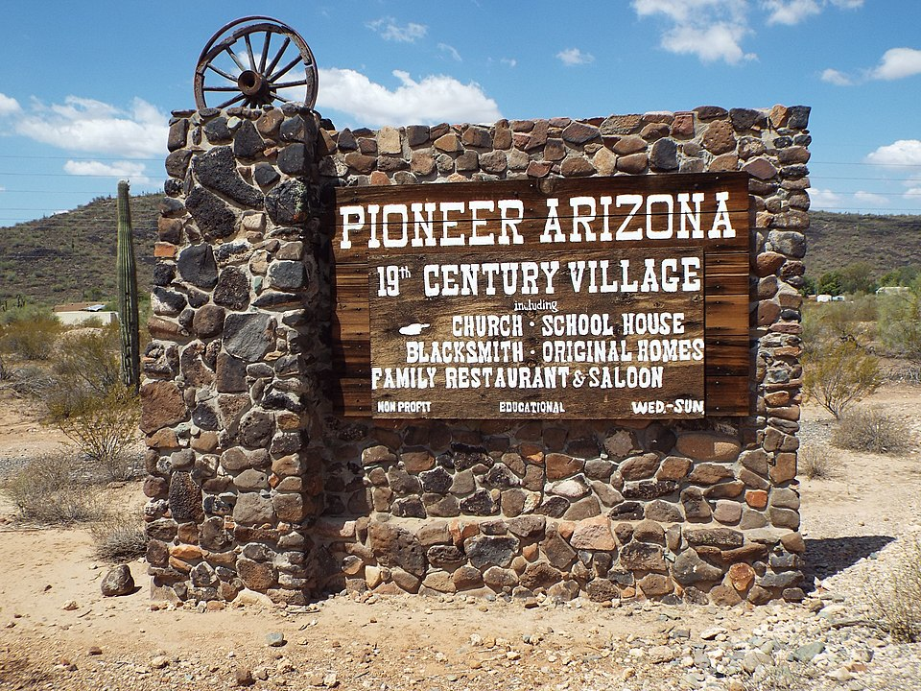
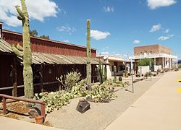
Pioneer AZ Living History Museum

Slide 6
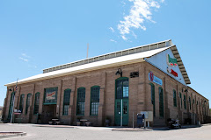
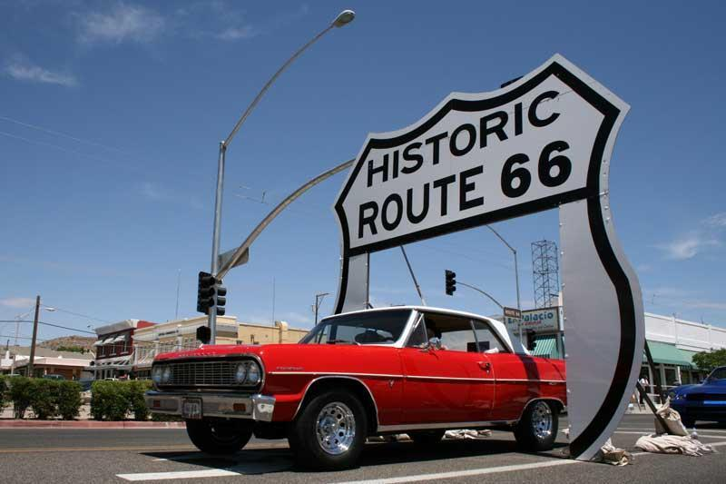
Powerhouse Route 66 Museum

Slide 7
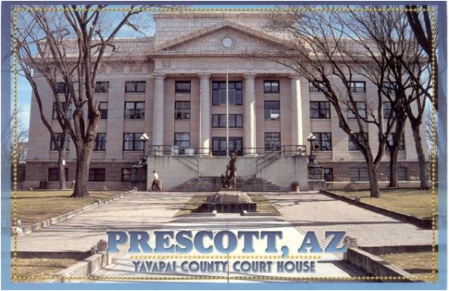
Prescott

Slide 8
Red Rocks of Sedona

Slide 9
Roosevelt Dam

Slide 10
Saguaro National Park

Slide 11
Salt River Rafting

Slide 12
San Xavier Mission

Slide 13
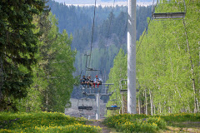
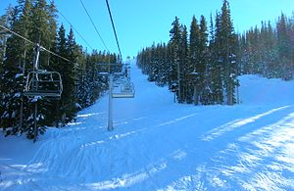
Sunrise Ski Resort

Slide 14
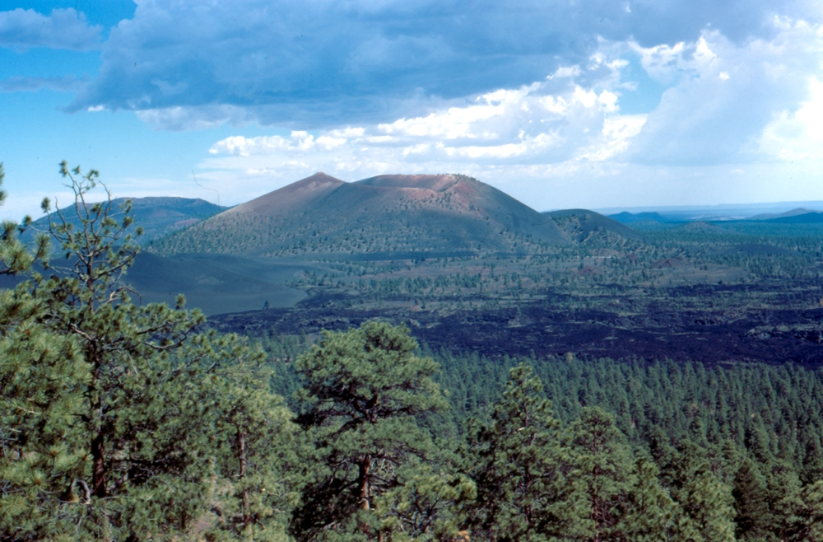
Sunset Crater

Slide 15
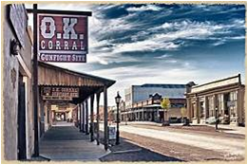
Tombstone

Slide 16
Tonto Natural Bridge State Park

Slide 17
Tumacácori

Slide 18
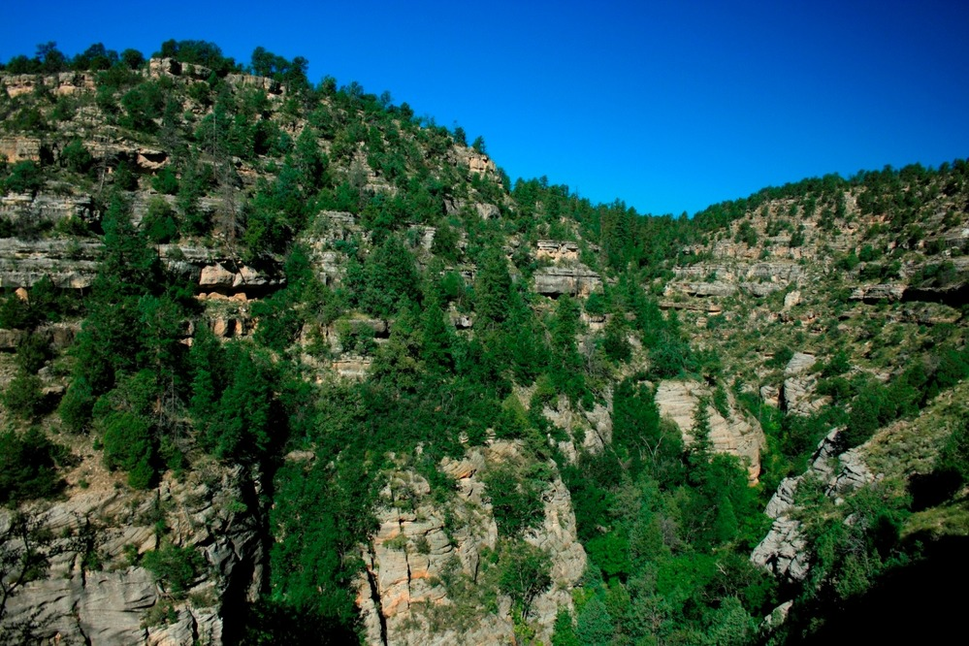
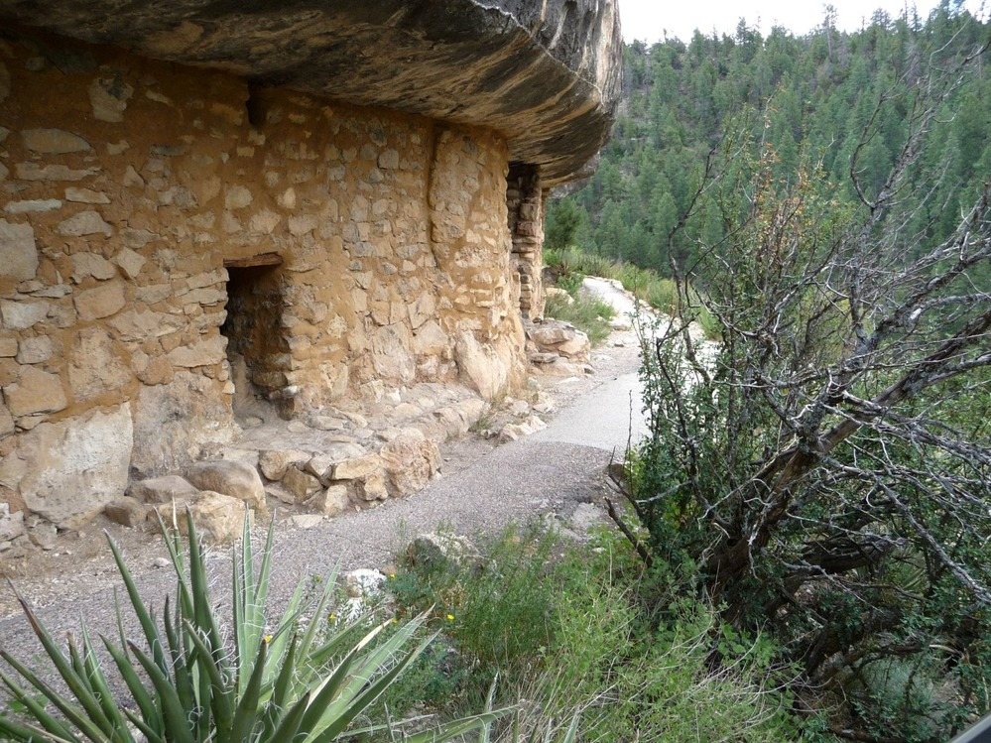
Walnut Canyon National Monument
Walnut Canyon
Walnut Canyon Ruins

Slide 19
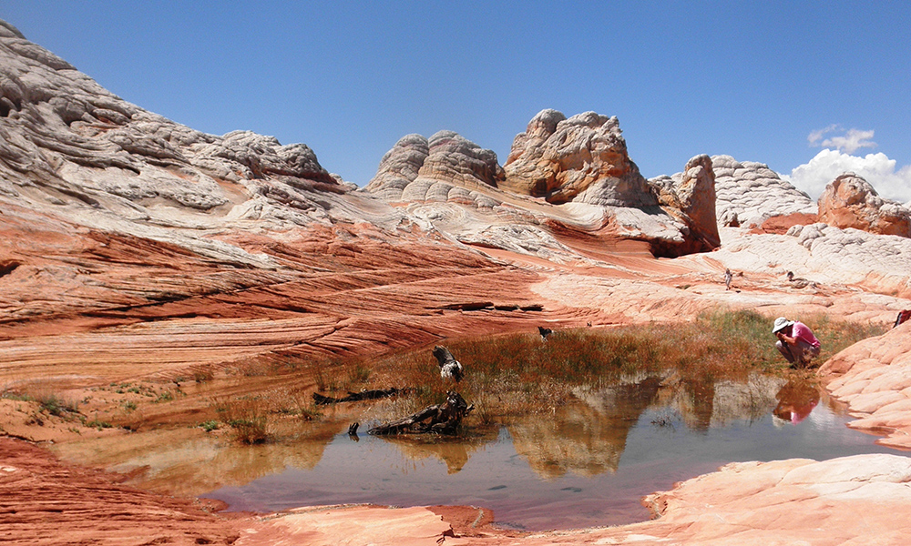
Vermillion Cliffs

Slide 20
Woods Canyon Lake

Slide 21
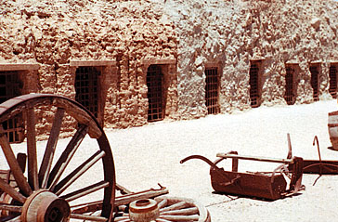
Yuma Territorial Prison

