Slide 1
Arizona Landmarks Part 1
Bagdad Copper Mine to Organ Pipe Cactus National Monument

Slide 2
Bagdad Copper Mine

Slide 3
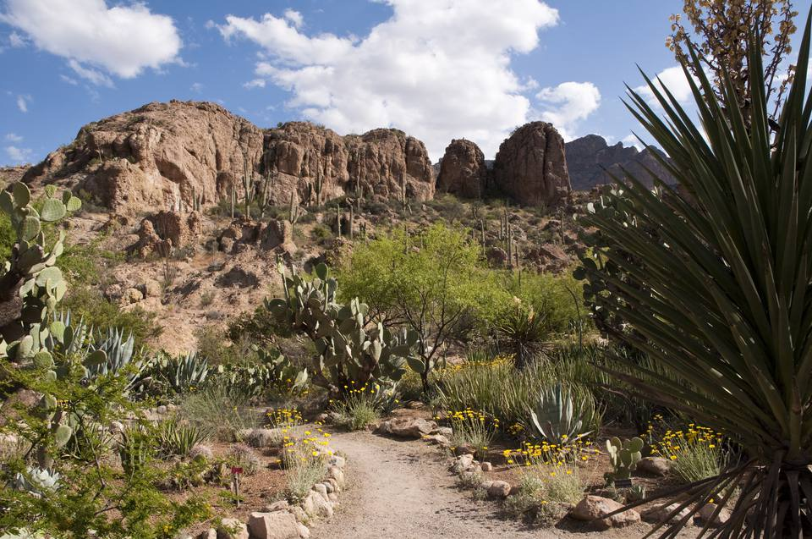
Boyce Thompson Arboretum

Slide 4
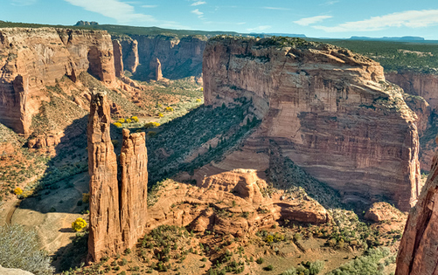
Canyon de Chelly

Slide 5
Casa Grande Ruins

Slide 6
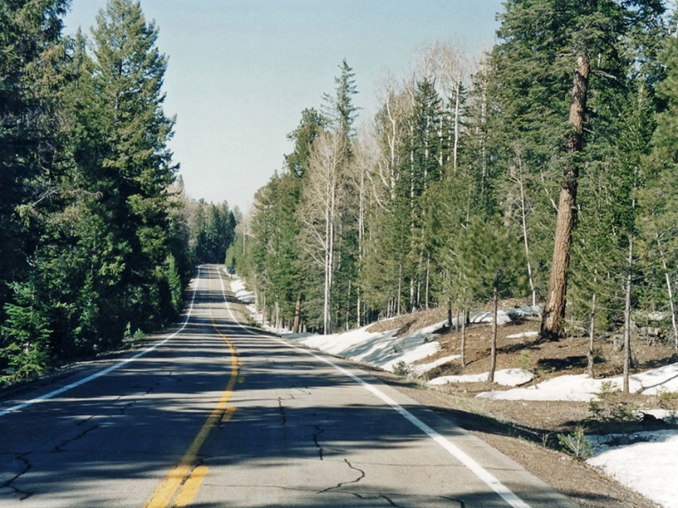
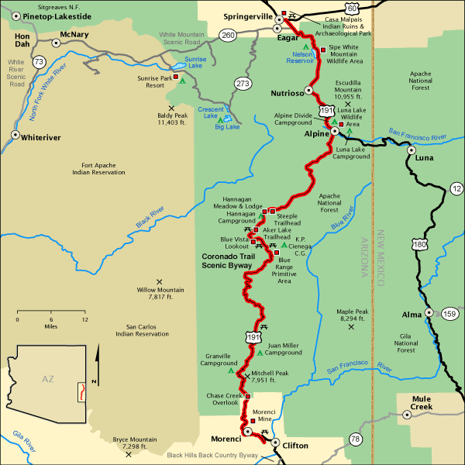
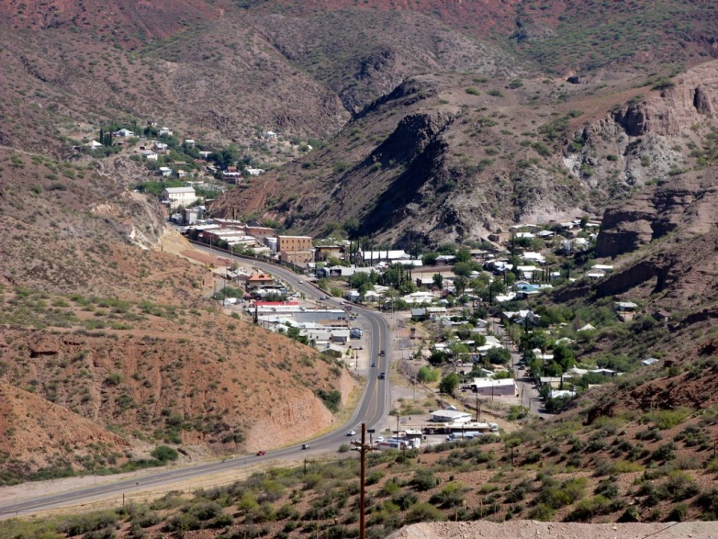
Coronado Trail

Slide 7
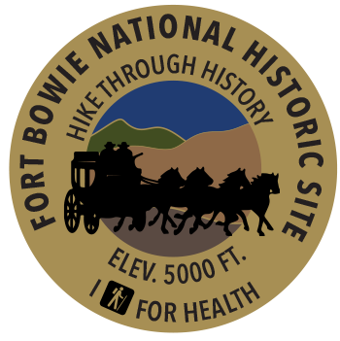
Fort Bowie National Historic Site

Slide 8
Four Corners Navajo Nation Park

Slide 9
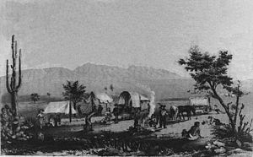
Gila Trail

Slide 10
Glen Canyon Dam

Slide 11
Grand Canyon

Slide 12
Grand Canyon Caverns

Slide 13
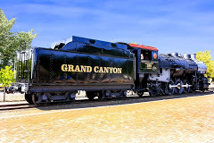
Grand Canyon Railway
Historic Train Depot
Historic Steam Train

Slide 14
Hi Jolly Memorial

Slide 15
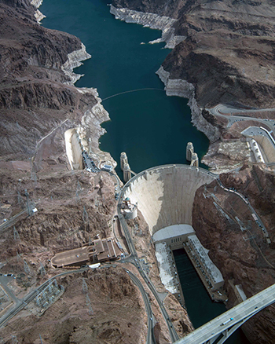
Hoover Dam

Slide 16
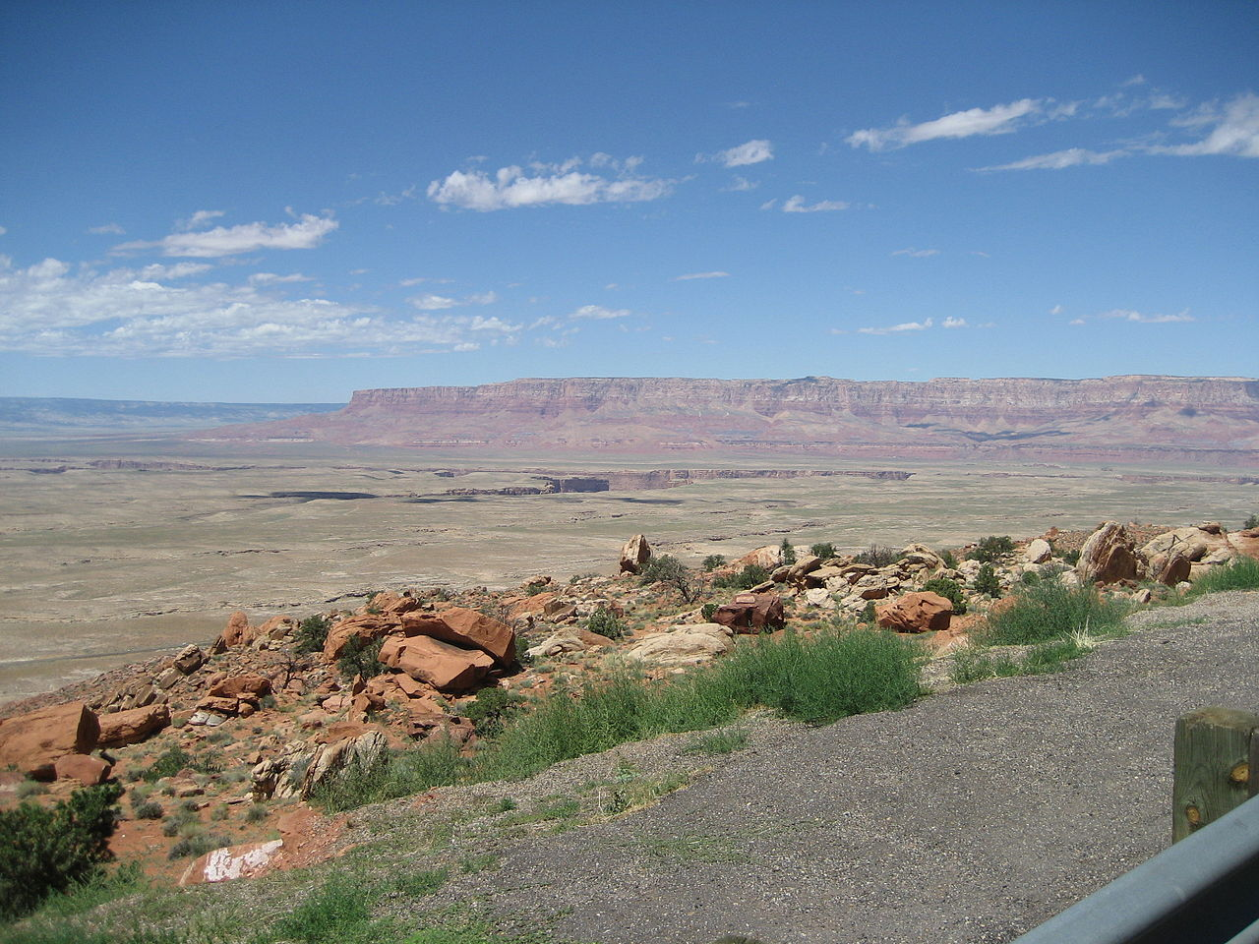
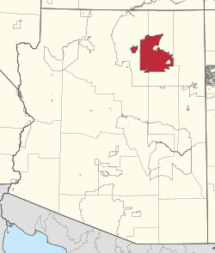
Hopi Reservation

Slide 17
Kitt Peak Observatory

Slide 18
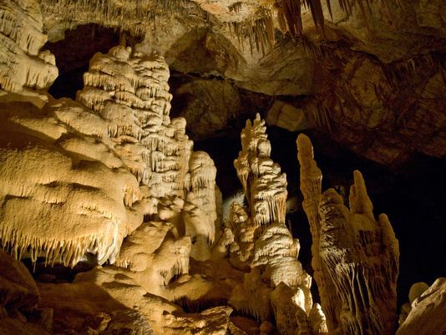
Kartchner Caverns

Slide 19
Lavender Pit Mine

Slide 20
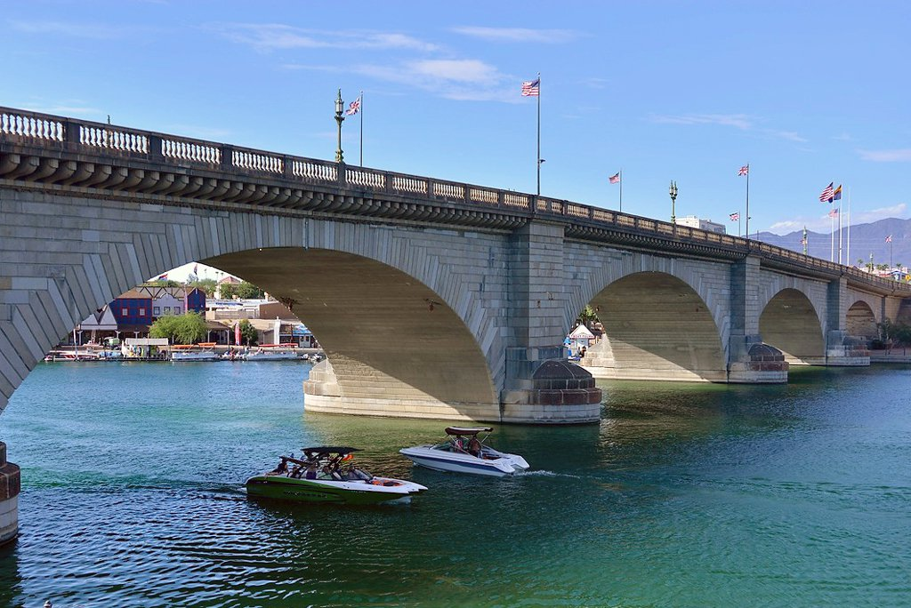
London Bridge

Slide 21
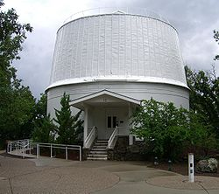
Lowell Observatory

Slide 22
Meteor Crater

Slide 23
Monument Valley

Slide 24
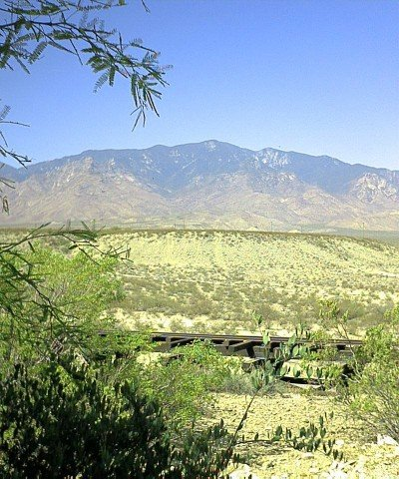
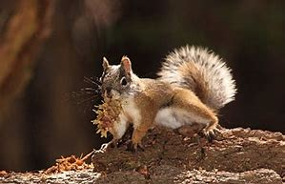
Mount Graham

Slide 25
Mount Lemmon

Slide 26
Mount Trumbull

Slide 27
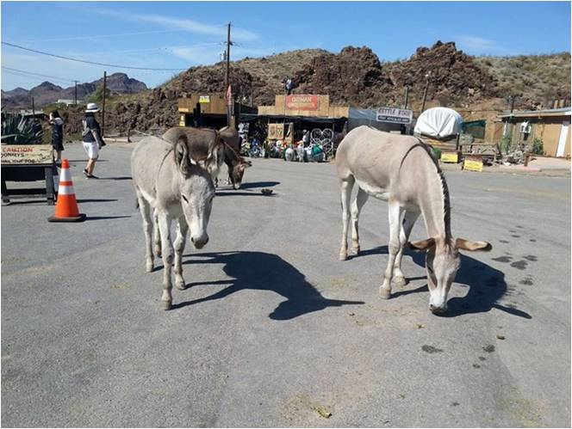
Oatman

Slide 28
Organ Pipe Cactus National Monument

